Slide 2
Office Of Research Marketing And Communications
Lee Ferguson, Director

Slide 3
LEARNING OBJECTIVES
Educate the research community on OR C&M specialized services and how to find them
Answer some of the most common questions we get from researchers
Notes:
Information some of you are already well-versed in, but may be new to others. Even those who have worked with our office of a while will hopefully learn new things. Goal at the end of this presentation is to have answered all the most common questions we get. If you have a question, please hold it till the end of the presentation. I’ll be happy to answer it then.

Slide 4
WHO WE ARE & WHAT WE DO
Marketing & Communications, Office of Research
Office created in 2016 by the Vice Chancellor for Research
Support the goals and mission of the Office of Research by fostering excitement for creativity, innovation, and scholarship
Lee Ferguson
Director
lfergu12@uthsc.edu
Amber Dean
Coordinator
adean21@uthsc.edu
Notes:
We are a small team: myself, director and Amber Dean, Marketing and Communciations, Coordinator

Slide 5
WHO WE ARE & WHAT WE DO
How do we support the goals and mission of the Office of Research?
Share valuable information internally and externally about the UTHSC research enterprise
Increase awareness about OR initiatives, services, and resources
Work in conjunction with UTHSC’s main Marketing & Communications office
One of several satellite M&C teams
Notes:
A word about Sally’s team: a much larger team, with writers, graphic designers, digital and web specialists. We work with them and they work with us, help each other out.

Slide 6
WHO WE ARE & WHAT WE DO
What we do
ONLINE PRESENCE
website (uthsc.edu/research)
blog (rainmaker.uthsc.edu)
social media
COMMUNICATIONS
Internal: news, stories, updates, notifications, messages
External: press releases and media relations
MARKETING
Content (physical & digital) Promotion (achievements, offices, events)
EVENTS
Monthly, annual, special
Notes:
We’ll go through each of these categories in depth, so that you know where to find, how to use, and who to contact if you need service in any of these areas.

Slide 7
ONLINE PRESENCE

Slide 8
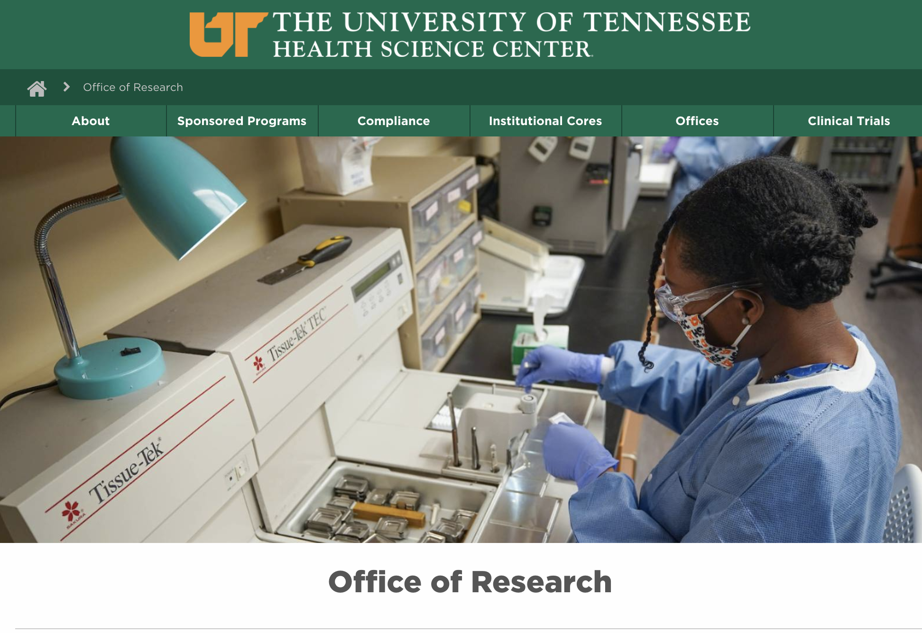
ONLINE PRESENCE
WEBSITE: uthsc.edu/research
Take time to look around the homepage!
Important docs
Link to blog
Link to listserv
OR events calendar
Latest News
CONTINUAL WORK IN PROGRESS

Slide 9
ONLINE PRESENCE
WEBSITE: subpages
38 shown here
Multiple subpages within each

Slide 10
ONLINE PRESENCE
WEBSITE: subpages
Updates, revisions, suggestions?
Lee Ferguson: 448-2494 | lfergu12@uthsc.edu
Amber Dean: 448-3287 | adean21@utshc.edu
Best practices
Include actual URLs | Send screenshots with markups | Long lists: send in one MS Word doc
Workflow
You submit we make edits we submit for publication main M&C publishes
we notify you

Slide 11
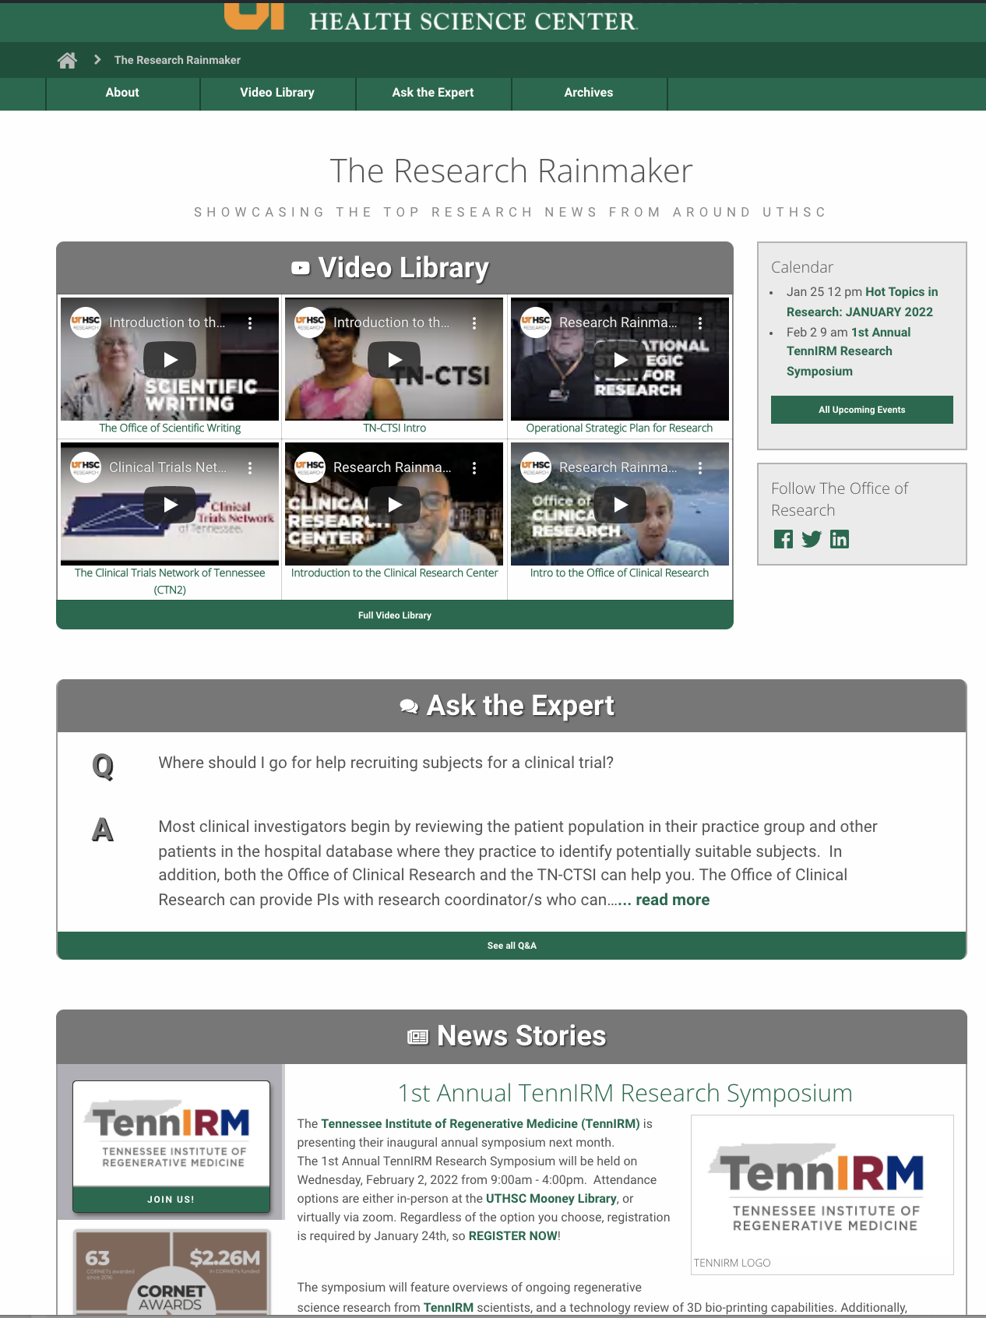
ONLINE PRESENCE
Research Rainmaker
rainmaker.uthsc.edu
Office of Research Blog
Formerly a print newsletter
Multi-media
Interactive features

Slide 12
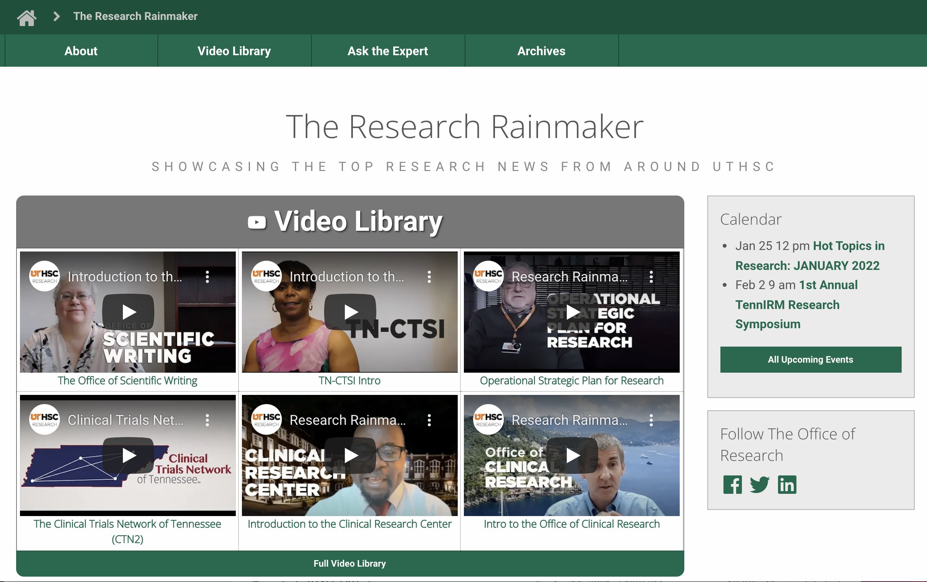
ONLINE PRESENCE
Research Rainmaker
rainmaker.uthsc.edu
Video Library:
Informational videos
Features OR offices/entities
5-7 min ea

Slide 13
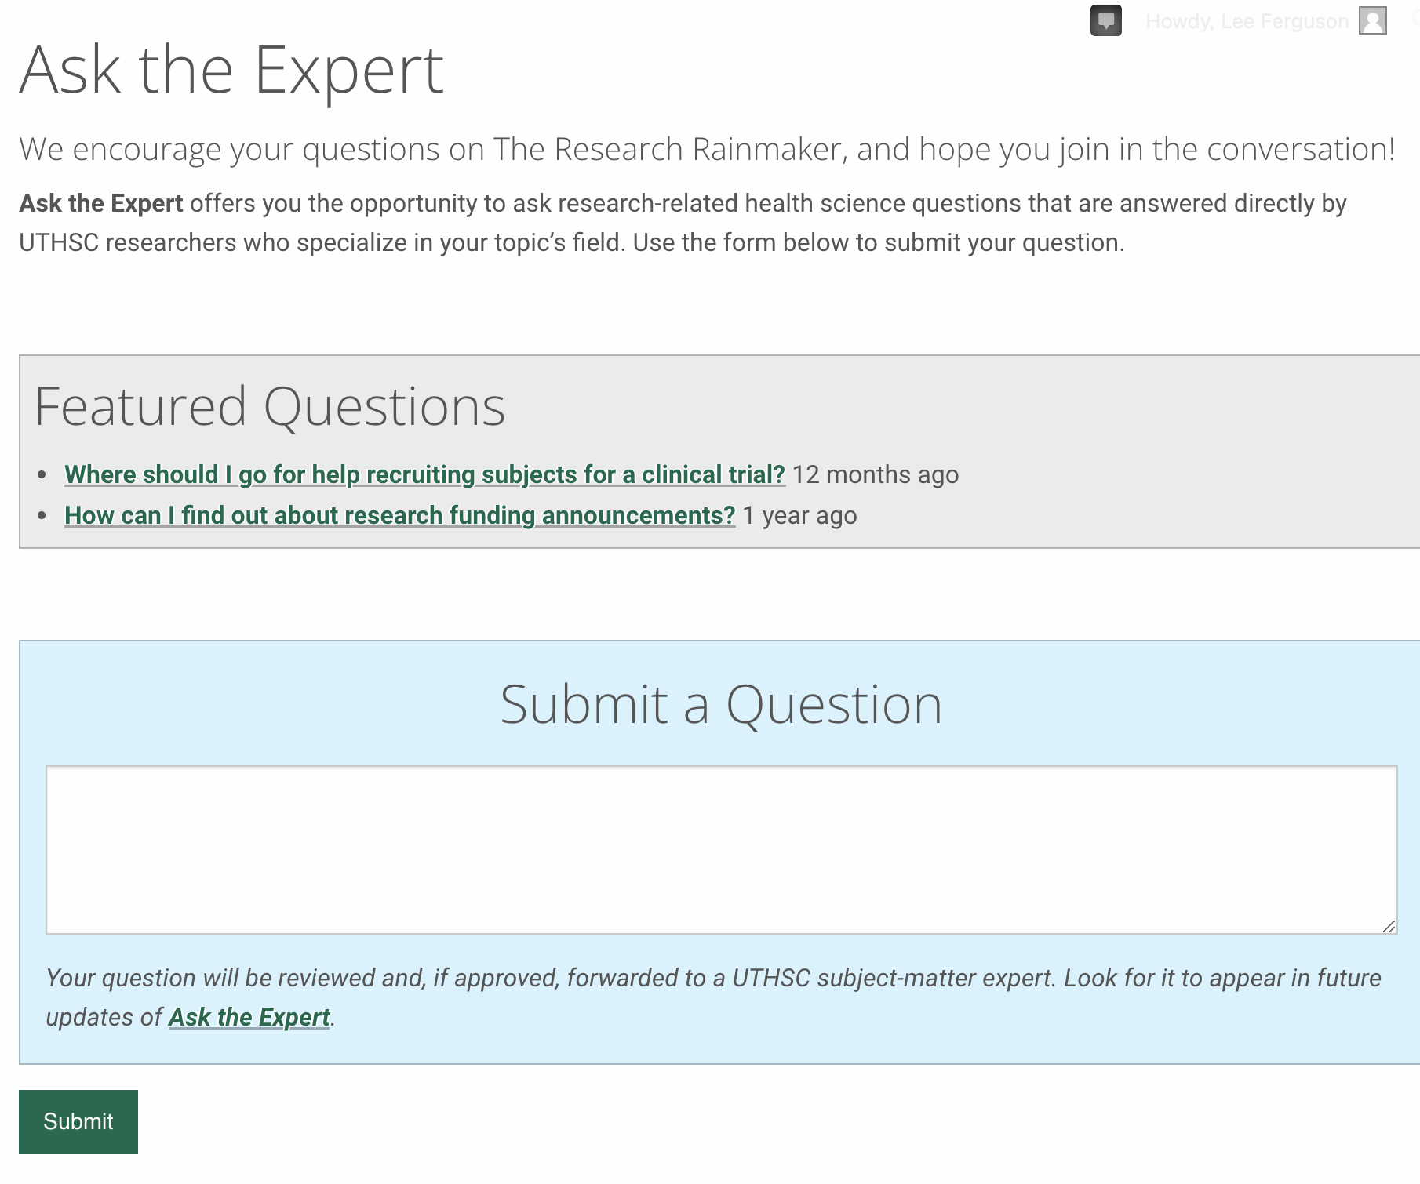
ONLINE PRESENCE
Research Rainmaker
rainmaker.uthsc.edu
Ask the Expert
Any research-related question
Answered by UTHSC expert
Will contact you once your message is received

Slide 14
ONLINE PRESENCE
Research Rainmaker
rainmaker.uthsc.edu

Slide 15
ONLINE PRESENCE
Research Rainmaker
rainmaker.uthsc.edu
News Stories

Slide 16
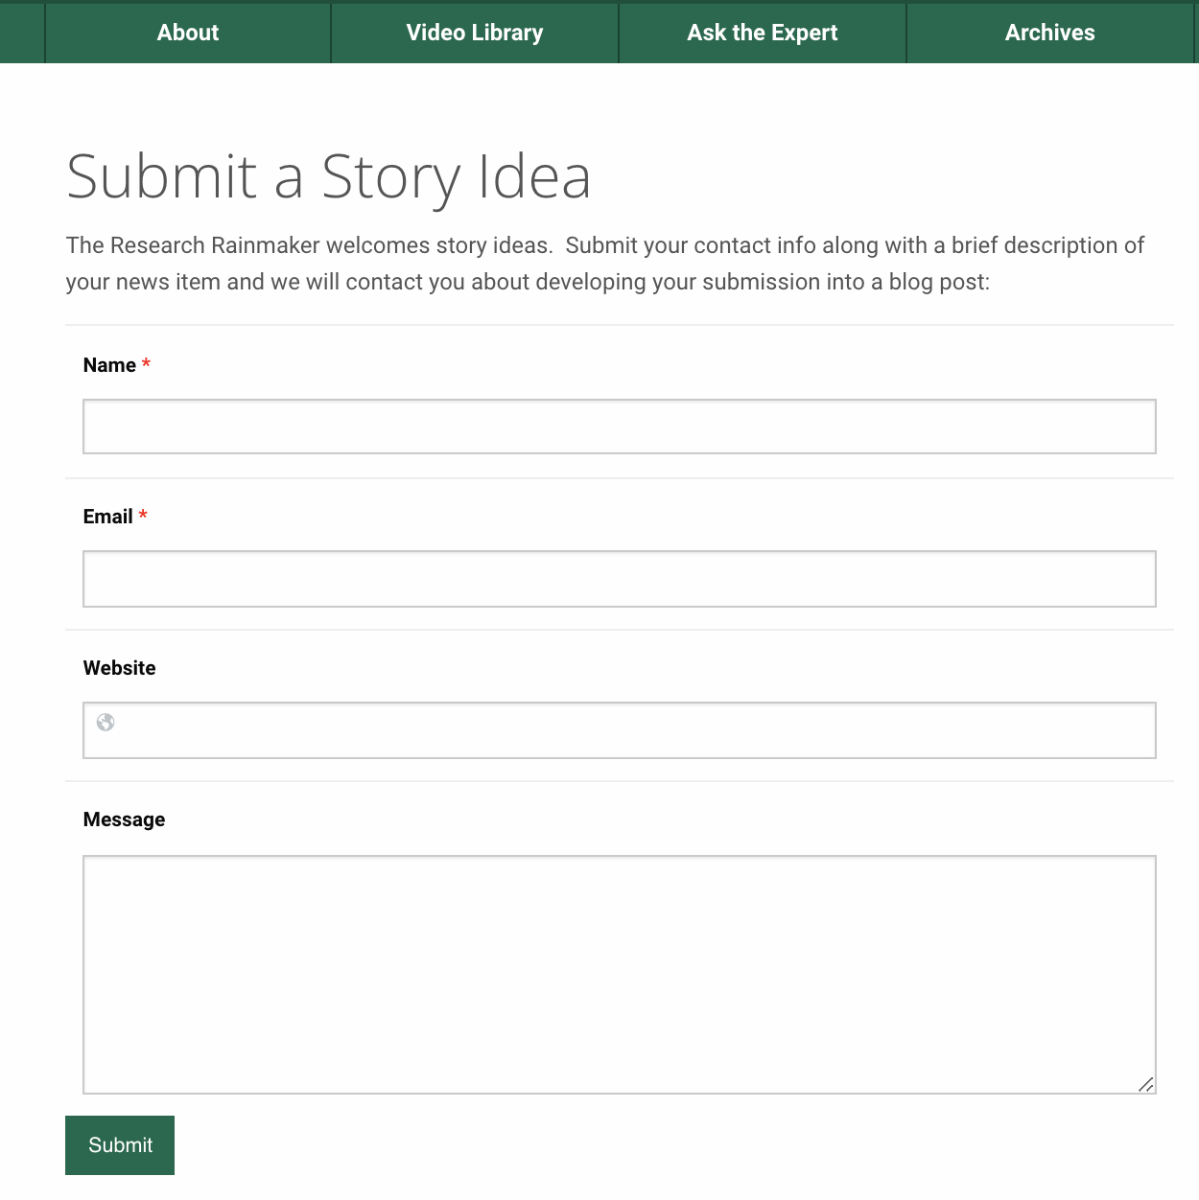
ONLINE PRESENCE
Research Rainmaker
rainmaker.uthsc.edu
Submit a Story Idea

Slide 17
ONLINE PRESENCE
Social Media
3 different channels with different emphasis
Twitter – everything & the kitchen sink. TAG US! @UTHSCResearch
LinkedIn – professional networking, tailored to highlight individual researchers we can tag. TAG US! @UTHSCOfficeofResearch
Facebook - The least amount of interaction, the least number of posts. @UTHSCOfficeofResearch

Slide 18
COMMUNICATIONS

Slide 19
COMMUNICATIONS
INTERNAL and EXTERNAL
Internal: news, stories, updates, notifications, messages
External: press releases and media relations

Slide 20
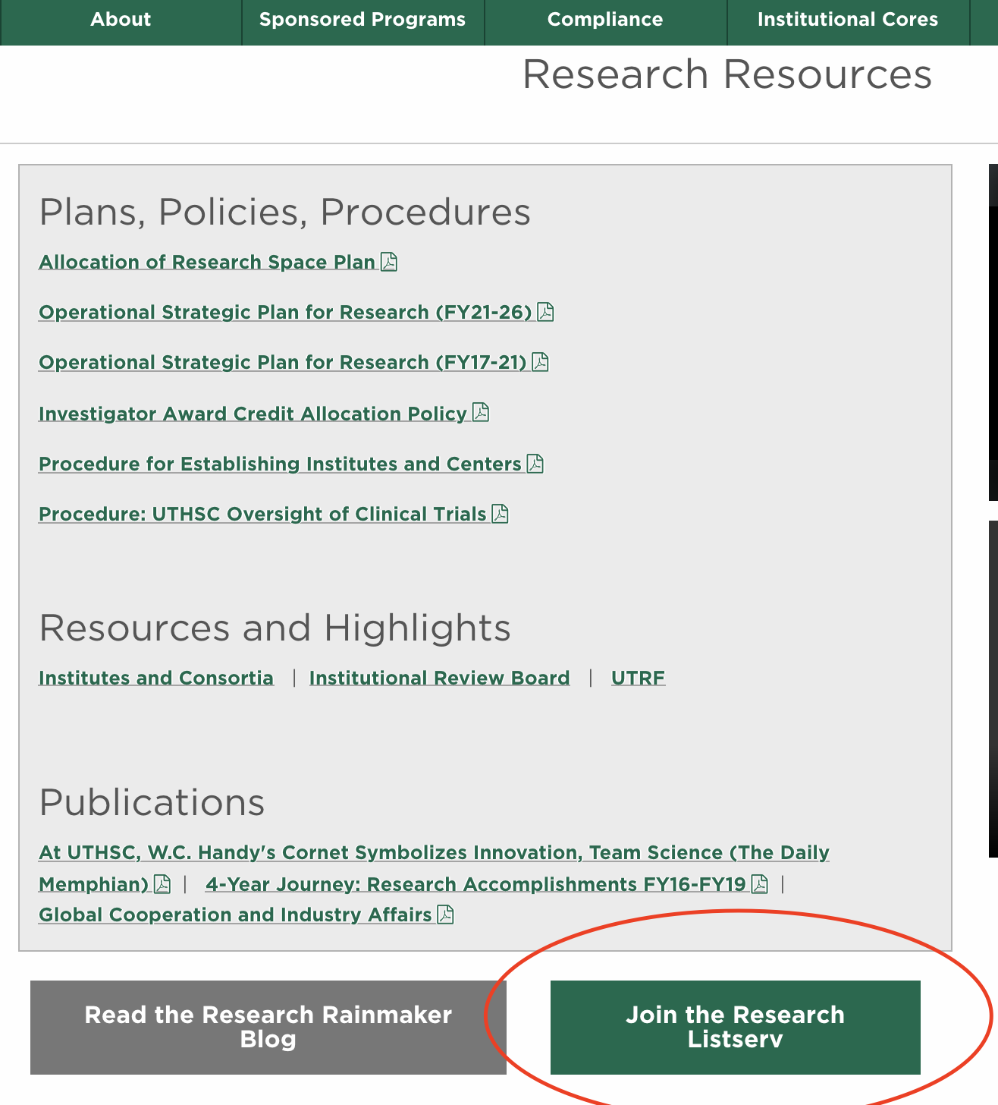
COMMUNICATIONS
Channels: Internal
LISTSERV
Key communications from the VCR and OR departments
Research guidelines and policies affecting all faculty
Events and workshops
News/Updates about research resources and services
Funding Ops from ORD
Need to sign up? listserv.uthsc.edu/mailman/listinfo/researchers

Slide 21
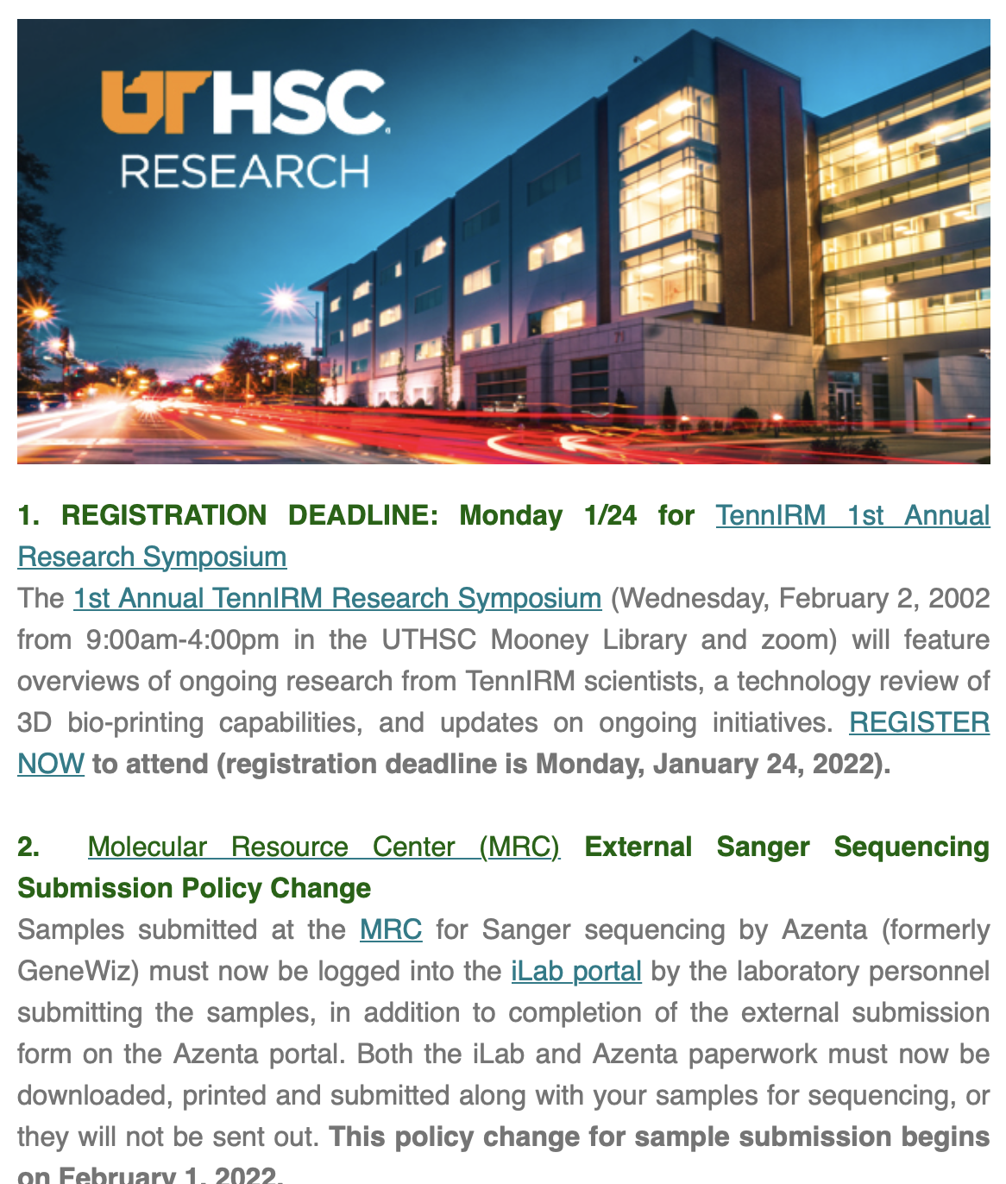
COMMUNICATIONS
Channels: Internal
LISTSERV
**NEW** 5 QUICK THINGS
Concise, weekly highlights
Cuts down on multiple messages per week
Have a message you’d like posted?
Lee Ferguson
901-448-2494 or lfergu12@uthsc.edu

Slide 22
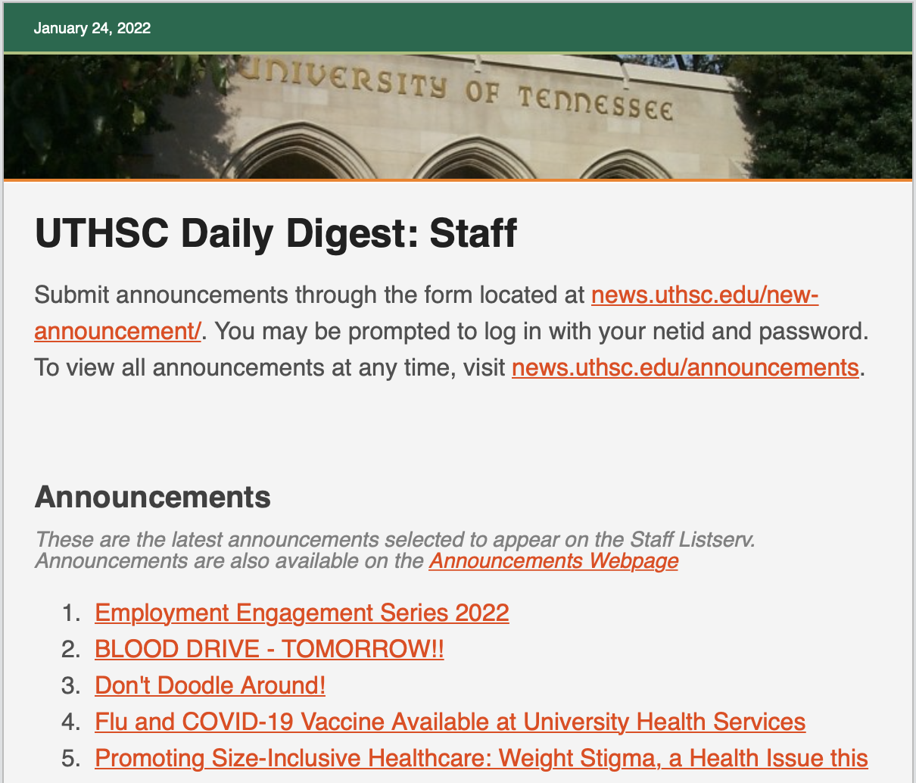
COMMUNICATIONS
Channels: Internal
DAILY DIGEST
Anything you’d like advertised
Can either submit to us, or directly to DD
For upcoming events or notices with a deadline, we usually post 3 times a week
If we can’t send things on listserv, we’ll put them here
All office of Research events also go here
All listserv announcements also go here

Slide 23
COMMUNICATIONS
EXTERNAL
Press releases and media relations . . . . .

Slide 24
PRESS & MEDIA RELATIONS

Slide 25
PRESS & MEDIA RELATIONS
Press Releases
Large grants and other news at VCR discretion
Workflow/timeframe:
passes through many levels
2 week minimum leadtime
Workflow ex:
OSP send NOA with abstract we write 1st draft based on abstract we send to PI for revisions/recs/quotes PI returns to us with revisions/edits we revise, ask any questions, return to PI for approval send PI-approved draft to their Dean for review we send Dean-approved draft to VCR VCR approved draft is sent to Peggy Reisser in main M&C office for release

Slide 26
PRESS & MEDIA RELATIONS
Press Releases
Best practices, from marketer to researcher:
Use easy, everyday language. Press releases target a non-scientific audience
Provide a professional headshot (required by main M&C for publication)
Let us know about co-investigators and other entities we should mention or get clearance from (most people are good about this)
Be open to questions and a bit of back & forth

Slide 27
PRESS & MEDIA RELATIONS
Media Relations
Policy/Procedure: uthsc.edu/communications/media-relations
If contacted directly by the media, you must consult with M&C prior to providing any response (telephone, email, or in-person)
Why M&C representative must be present at all interviews with press
We work with the main M&C team. We are one of several satellite M&C teams on campus. We notifiy main M&C of all interviews and invite them to participate. They often simply defer to us.
Things to remember when giving an interview:
Refer to us as “UTHSC” not “UT”
Assume anything you say will be printed
You are representing the university – speak appropriately, never negatively

Slide 28
MARKETING

Slide 29
MARKETING
Marketing
Promote Office of Research units, cores, and multidisciplinary research institutes and consortia; special events hosted by OR
Develop, create, and distribute content in support of the UTHSC research message and to promote research achievement.
Both digital & physical content

Slide 30
MARKETING
Content Creation
Institutes, Cores, Offices, etc.
You provide the written copy, we’ll make it look good!
Brochures, booklets, flyers
Printed materials
2 week leadtime
We CANNOT revise documents originally created by main M&C!

Slide 31
EVENTS

Slide 32
EVENTS
Monthly / Annual / Special
Hot Topics in Research – usually the 3rd Tuesday of every month
HSE Grand Rounds – usually the 2nd Tuesday of every month
Distinguished Lecture Series – starting again fall 2023!
LEADS - TBD
Research Resource Fair - TBD

Slide 33
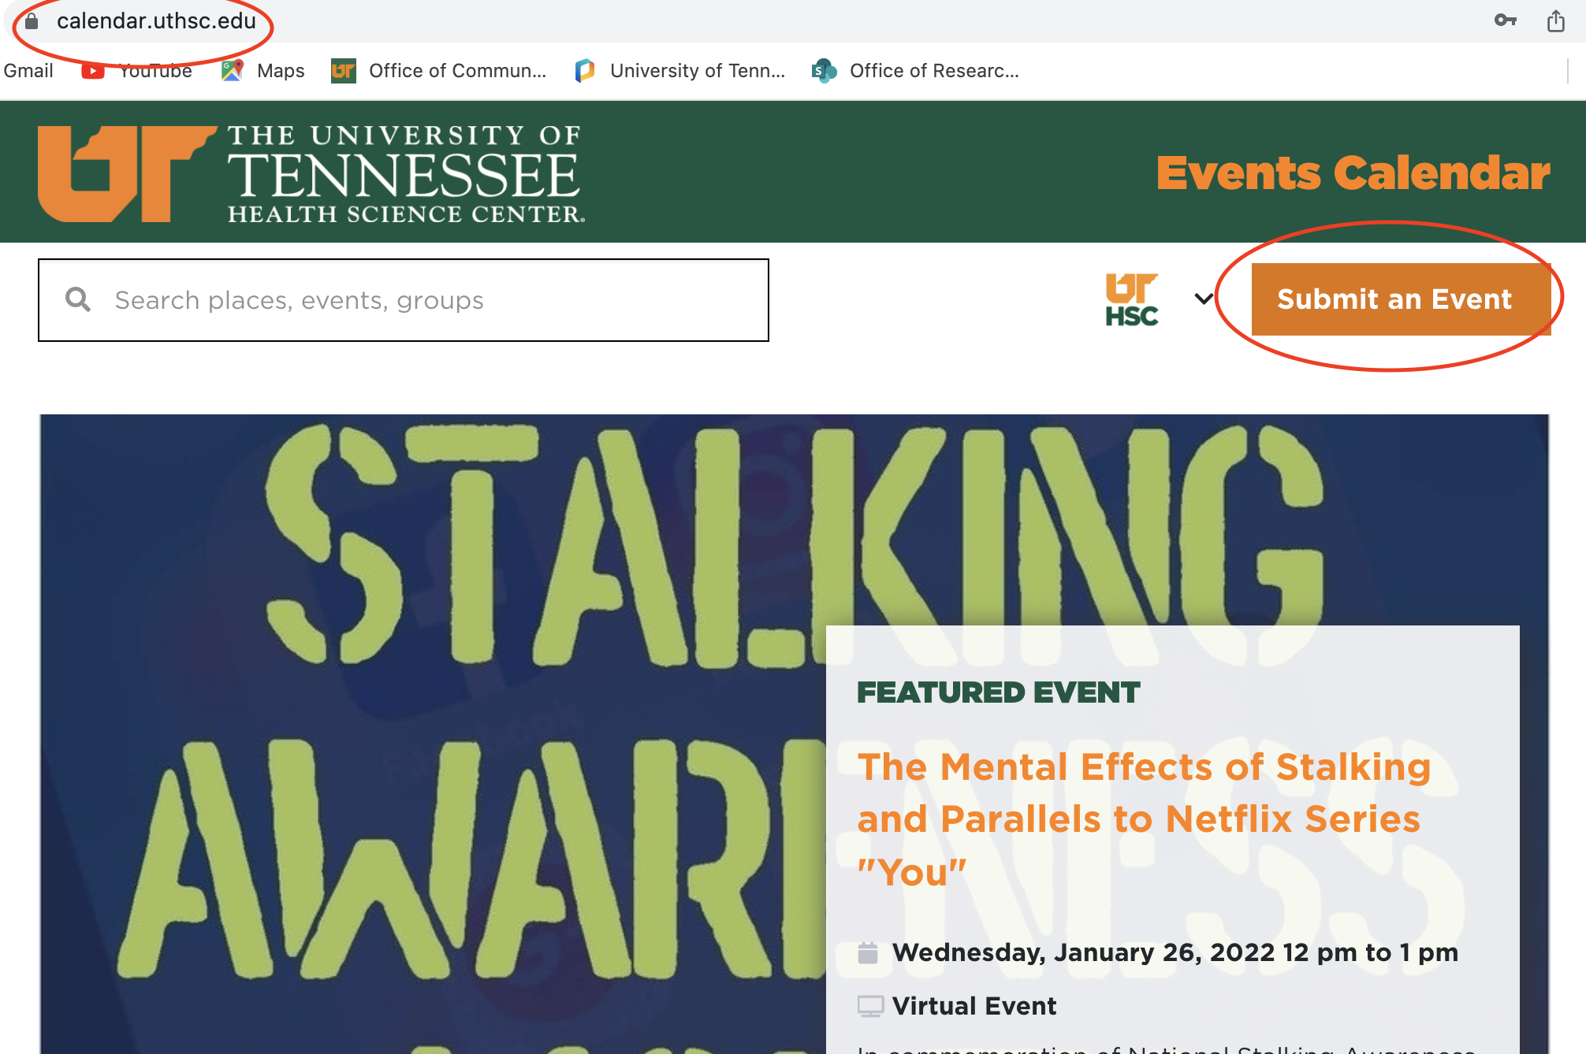
EVENTS
Where to Find
UTHSC calendar
calendar.uthsc.edu
To submit calendar events:

Slide 34
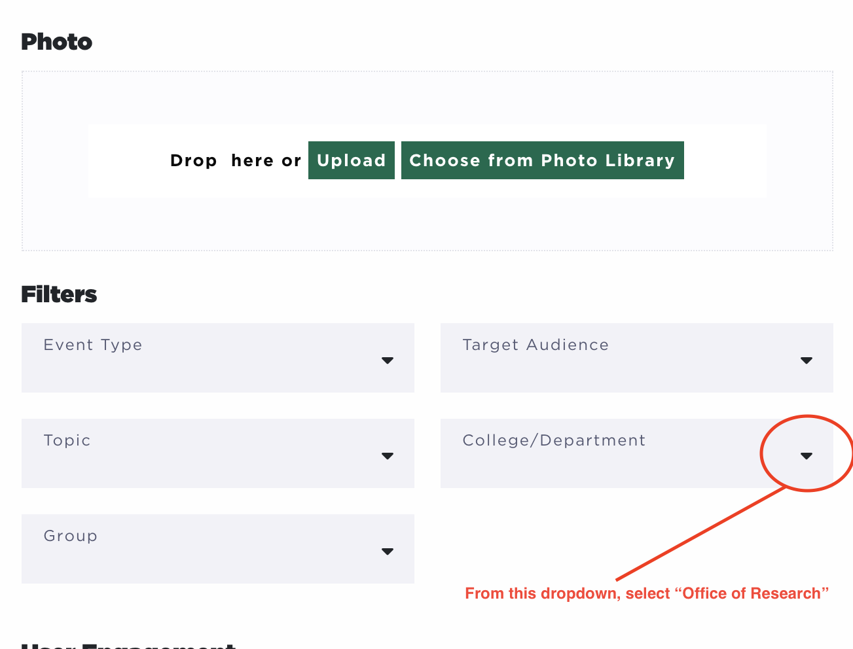
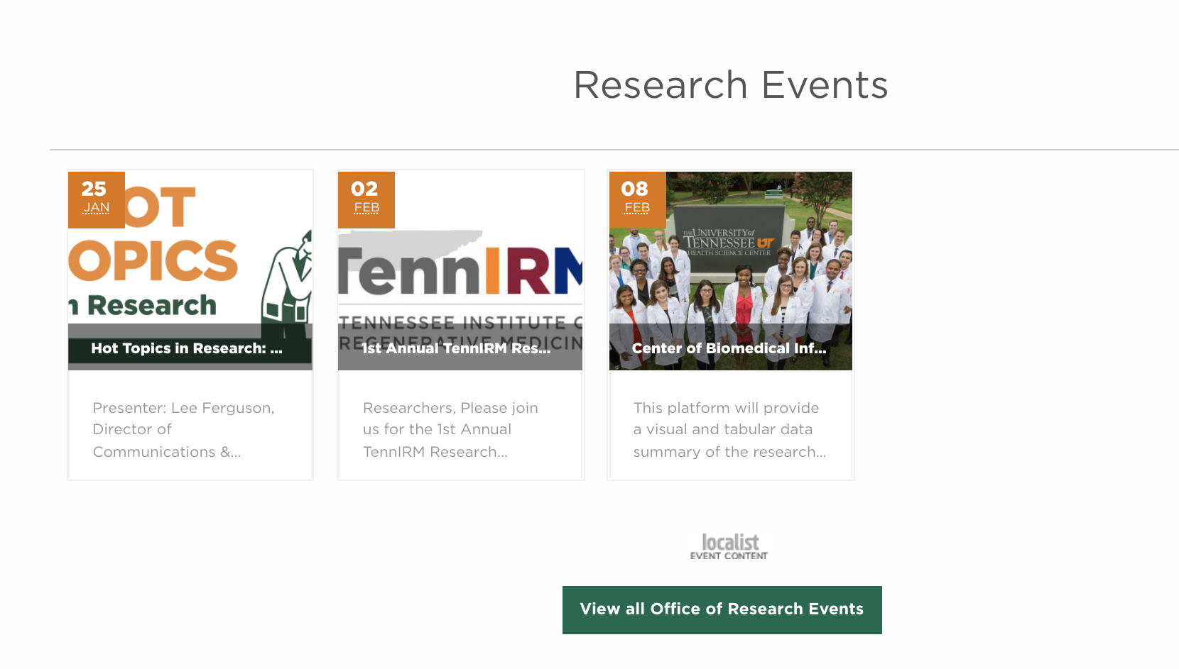
EVENTS
Where to Find
We embed OR events from the UTHSC calendar to our homepage
If you’d like your event shown on the OR homepage, TAG US when submitting your event
Individual pages for each monthly event can be found by clicking “View all OR Events”
Individual pages include recordings and/or slidedecks of presentations

Slide 35
COMMONLY ASKED QUESTIONS

Slide 36
COMMONLY ASKED QUESTIONS
I have a story/news/award/accolade I’d like written about/highlighted. What should I do?
Email Lee and Amber or use the Rainmaker “Submit a Story Idea: rainmaker.uthsc.edu/about/submit-a-story-idea
We’ll contact you to discuss best way to get your news out (press release, blog post, social media)
Can you help me advertise an event?
It depends on the event. Call or email us about it and we’ll help you determine the best way to get the word out.
We will always help via Daily Digest and social media – the Listserv is at our discretion.
You can also submit to the Campus Calendar: calendar.uthsc.edu
If it’s research related – please remember to tag us in the FILTERS section (OFFICE OF RESEARCH) so that it will show up in the events section on the OR homepage

Slide 37
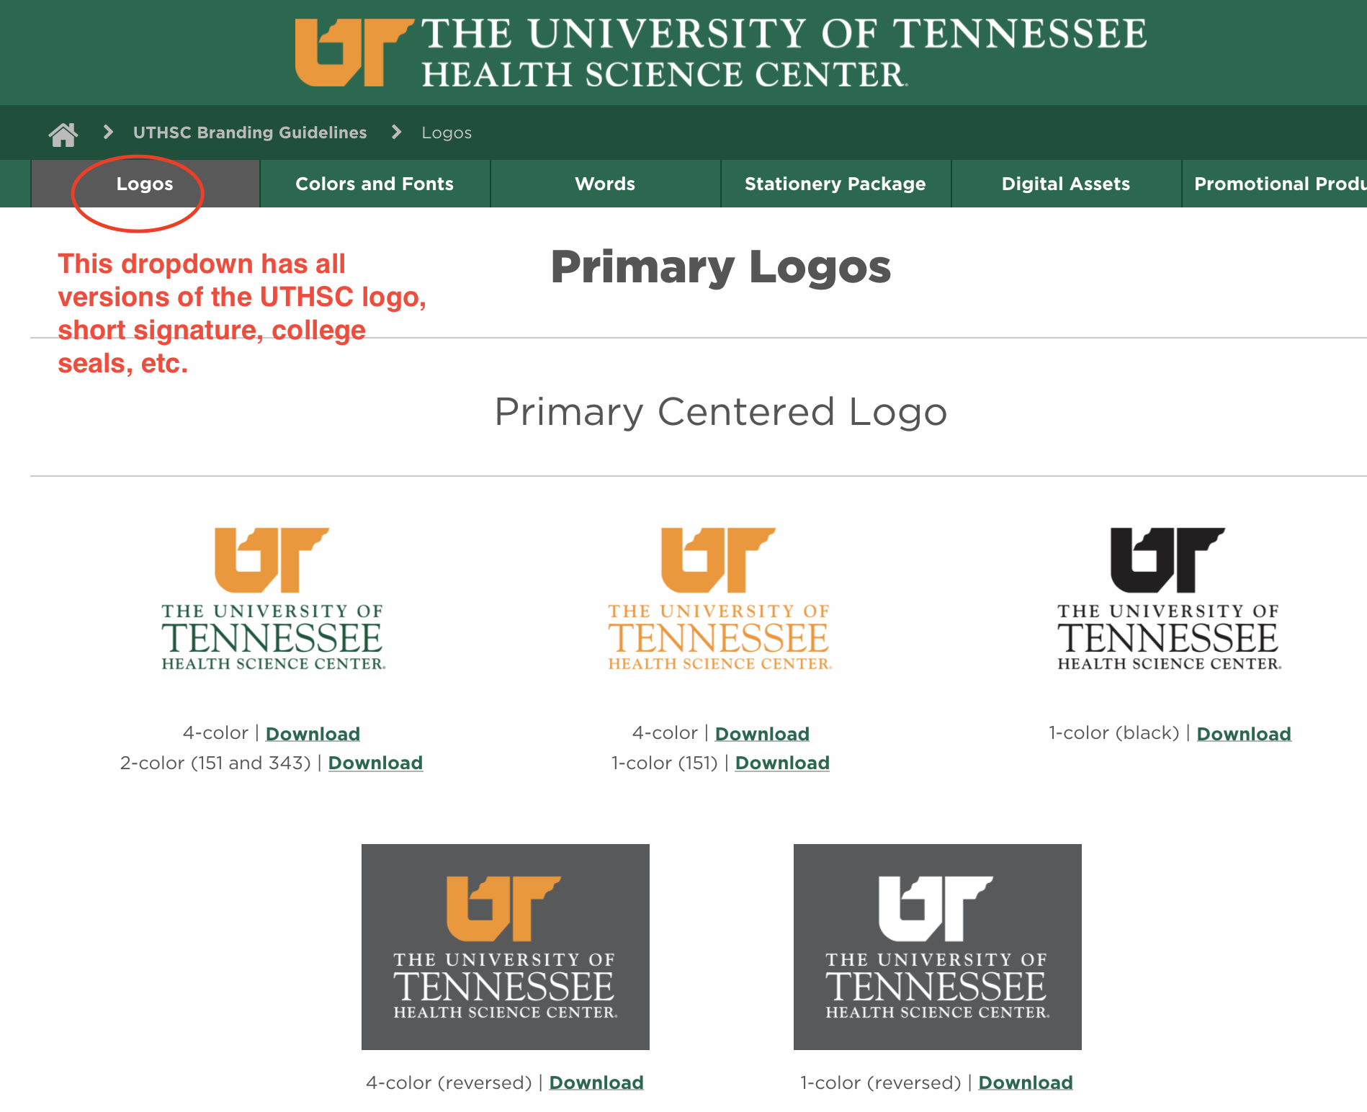
COMMONLY ASKED QUESTIONS
I need letterhead / I need a logo. Can you make this?
No. Only the main M&C office creates letterhead.
Visit uthc.edu/brand/logos for all UTHSC logos
NOTE: If you are using any UTHSC logo that has black text, YOU ARE USING AN OLD, INCORRECT LOGO!
Email brand@uthsc.edu if you need an updated logo for your center, institute,

Slide 38
COMMONLY ASKED QUESTIONS
Can I submit my own message to your Listserv?
Absolutely! Submit the message to researchers@listserv.uthsc.edu for approval.
I want to advertise to recruit subjects for a trial. Can you help?
Our office does not generally work with investigators on clinical trials to help them recruit.
The TN-CTSI is an excellent resource: tnctsi.uthsc.edu/consultation-and-services/recruitment
Ensure all IRB protocols followed: uthsc.edu/research/compliance/irb/researchers/standard-operating-procedures.php
Run publicity spots on any clinical trial by our office to ensure the university is correctly identified.

Slide 39
WHO WE ARE & WHAT WE DO
A final word:
Always working to improve audience reach, increase messaging awareness, and ease discovery of information and news.
Continually developing the Research Rainmaker blog, updating the Office of Research website, and developing the Office of Research’s social media.
WE ARE ALWAYS OPEN TO SUGGESTIONS FOR IMPROVEMENT!

Slide 40
Questions?

