Slide 1
Regulatory Binder: Best Practices
Derita Bran MSN, RN, CCRC

Slide 2
Objectives
By the end of this module, the participant will be able to:
Describe the purpose of the Regulatory Binder
Discuss best practices when maintaining a Regulatory Binder
Identify essential documents maintained within the Regulatory Binder

Slide 3
Disclaimer
The information provided is an example of the Regulatory Binder set-up and the contents to be maintained
Sections discussed may not apply to all studies
This slide presentation is of general information and should not be considered all-inclusive of information regarding the Regulatory Binder
The presenter has no financial or other interest relevant to the subject matter
*This presentation is sponsored by TN-CTSI

Slide 4
What is a Regulatory Binder?
Electronic/paper/combination file that contains:
Study specific information
Study essential documents
Regulatory documents

Slide 5
Regulatory Binder (RB)
Purpose:
Compliance:
Demonstrates compliance with Regulations and Good Clinical Practice (GCP)
Validates adherence to high standards of research practices and human subject protection
Record Keeping:
Provides an organizational framework for study specific essential documents
Organization and Access:
Allows easy access to study documents with minimal effort
Permits evaluation of the conduct of the study and assists to determine the quality of the data

Slide 6
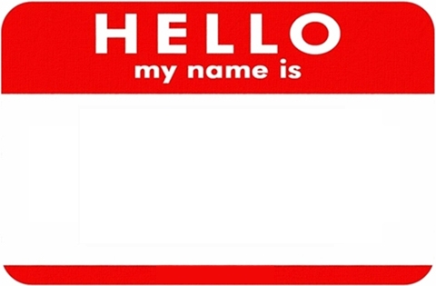
Other Names for Regulatory Binder
WHAT ARE SOME OTHER NAMES FOR THE REGULATORY BINDER?
Derita
Dee
Mom
Grams

Slide 7
Regulatory Binder Names
Regulatory Binder (RB)
Reg Binder
Investigator Binder
Investigational Site File (ISF)
Study Binder
Master Trial File (MTF)
Study Administrative Binder
Regulatory Files
Study File
Trial Master File

Slide 8
Labeling the RB
WHAT INFORMATION SHOULD BE
INCLUDED IN THE
LABELING OF THE RB?

Slide 9
Labeling the RB
Title
Number the binders if more than 1 (ex. 1 of 3)
PI name
Protocol Name/identifier
IRB#
Sponsor

Slide 10
Responsibility
WHOSE RESPONSIBILITY IS IT TO
MAINTAIN THE RB?

Slide 11
Responsibility
It may involve many different research study team members!
Key Study Personnel (KSPs)
Principal Investigator (PI) is ultimately responsible, but most often this task is delegated to other members of the study team, as well
Investigators
Clinical Research Coordinators
Research Associates/Assistants
Clinical Research Associates (Monitors)
Data Managers
Regulatory Affairs staff

Slide 12
Best Practices
What best practices RE: mAINTENance, organization, and storage
do you follow when maintaining the RB?

Slide 13
RB Best Practices
Maintenance:
Establish the RB at the beginning of the study
Keep the binder current, up-to-date, and organized
Subject specific information/documents are usually maintained separately from the Regulatory Binder in subject specific research records
Do not destroy earlier versions of essential documents
Organization:
Store items in reverse chronological order
Customize the binder to the needs of the specific protocol
Order the sections to facilitate easy referencing
File sections that most referenced in the front of the binder
Industry sponsored trials may have template binders to be used

Slide 14
Best Practices cont’d
Storage:
Store the binder in a safe and secure location at the investigator’s site
Documents not stored in the RB should have a note (NTF)/memo indicating the location of where the documents will be maintained outside of the RB
Maintain subject confidentiality
It is suggested the following be maintained outside of the RB:
Signed ICFs
Test results
Completed CRFs
Screening/Enrollment log
Master Log
Contracts/budget/study financial records

Slide 15
Table of Contents
Sections that are included in the RB
Current Protocol
Current Consent Form
IRB Documents
Study Team Credentials
IP Brochure/Manual
DOA/DOR
Case Report Forms
Training
Documents
IP Information and Accountability
Correspondence
Screening/
Enrollment log
Master Log
Laboratory Documents
Specimen Tracking Log
Protocol Deviation log
Note to Files
Monitoring Visits and Reports
AE/SAE Logs/Documents
Source Documents
Legal/Financial Documents

Slide 16
Current Protocol
Most updated, current IRB approved protocol version
PI signature page of the protocol. Why does the PI need to sign the signature page?
Protocol Summary documents of changes if this is an amended version

Slide 17
Current Informed Consent Form (ICF)
HOW DO YOU ENSURE
THE STUDY TEAM HAS
THE MOST UPDATED, IRB APPROVED CONSENT FORM
AVAIALBLE FOR THEIR USE?

Slide 18
Signed ICFs
WHERE DO YOU
MAINTAIN
SIGNED ICFs?

Slide 19
Institutional Review Board (IRB)
Purpose:
This section is maintained to document the trial has obtained IRB/IEC approval and can be conducted
The documents in this section can also help to identify the current version of IRB approved documents

Slide 20
IRB
WHAT DOCUMENTS
SHOULD BE MAINTAINED
IN THIS SECTION?

Slide 21
IRB cont’d
IRB Submissions
Initial/Ongoing/
Continuing/
Revision/
Amendment/
Termination
Including all versions of the following:
Protocol with signature page
ICF
Recruitment materials
Correspondence with the IRB
Including:
Approval letters
Proviso letters
PI responses to IRB
IRB notices of upcoming expiration dates
Request for corrected IRB letter
IRB stamped approved documents
IRB Membership Roster
Maintain from date of first submission to close out of the study (all 4 boards if UTHSC)
IRB FWA
Blank CRFs
Participant educational/study informational materials
Reportable events (protocol deviations/
unanticipated problems/ SAEs/New information)
Data Safety Monitoring Board Reports/Other Sponsor reports

Slide 22
IRB cont’d
WHAT TIPS CAN YOU GIVE
ON HOW YOU MAINTAIN
THIS SECTION OF YOUR RB?

Slide 23
Organizing the IRB Section
Helpful Tips:
Approval letter on top of the “clipped” submission
Each submission may have a title page (colored paper) identifying the specifics of the submission/approval
Type of submission, date submitted
Date approved
Summary of changes, if applicable
Suggested to maintain IRB documents outside of iMedRIS

Slide 24
Study Team Credentials
WHAT DOCUMENTS ARE MAINTAINED
AS PART OF THE
STUDY TEAM’S CREDENTIALS?

Slide 25
Study Team Credentials cont’d
Curriculum vitae (CVs)/resume/bio sketch for the Principal Investigator/ sub-or co-investigator(s) and key study personnel (KSP) for the study
Financial Disclosure Forms and Conflict of interest forms
Clinical professional licensure/certification (dental, medical, nursing, pharmacy, etc.) for all KP
Training documents (HSP, GCP, protocol, specific protocol procedures, etc.)

Slide 26
Study Team Credentials cont’d
(1)WHERE DO YOU MAINTAIN
THESE TYPES OF DOCUMENTS?
(2)IF CREDENTIALS ARE MAINTAINED
IN A CENTRAL/ELECTRONIC LOCATION,
WHAT NEEDS TO OCCUR
AT THE CLOSURE OF A STUDY?

Slide 27
Study Team Credentials Best Practices
Maintain these credentials throughout the KSP’s participation in the study (and some studies require 2 years post study)
The KSPs’ credentials should be maintained at the time (or before) their study participation to the end of their participation in the study (These dates should be in alliance with the DOAL)
CV/Resumes should be current/signed/dated
Industry standard is to update CV/Resume every 2 years WHY???????

Slide 28
Training Documents
NAME TYPES OF
TRAINING REQUIRED
FOR KSPs

Slide 29
Training Documents cont’d
Human Subject Protection
ICH GCP E6 (R2)
FDA regulations
45CFR46
Declaration of Helsinki/Nuremburg Code/Belmont Report
Institution specific training
Protocol/procedures/IP
In-services
Study related meetings
IATA/Biohazard
SOPs/MOPs
Site Initiation Visit

Slide 30
Delegation Log
Additional names:
Delegation of Authority Log (DOAL)
Delegation of Authority (DOA)
Delegation of Responsibility Log
Signature Log

Slide 31
DOA/DOAL/DOR
NAME 4 PURPOSES
OF THE DOAL
PI
PI
KSPs

Slide 32
DOA/DOAL/DOR cont’d
Purpose:
Identifies the KSP involved in the study
Matches KSP’s name to handwriting/initials
Documents the delegated task(s) that have been assigned by the PI to the KSPs, ensure KSP is qualified to perform the delegated task
Documents the timeline of an individual’s participation in the study

Slide 33
DOA/DOAL/DOR cont’d
Best Practices:
This document must remain current at all times
Should be completed before/at the time the study is initiated
The PI must initial and date any changes that are made throughout the life of the study
He/she must also sign this form at the closure of the study

Slide 34
Subject/ Participant Logs
Purpose:
Documentation of the individuals approached/screened and/or enrolled in the study
Screening/Enrollment
Master log
Do you have other names for these Essential documents?

Slide 35
Subject/ Participant Logs cont’d
WHERE DO YOU
USUALLY STORE THESE TYPES
OF DOCUMENTS?

Slide 36
Screening/Enrollment Log
Purpose:
Captures patients that have been approached/screened to determine participation desire and initial eligibility
To record the consent of all subjects wanting to participate and meets eligibility criteria
Documents potential subjects who where approached regarding their participation in the study
Provide a comprehensive list of all subjects who were screened for eligibility
Documents chronological enrollment of subjects
Documents the reason a potential subjects was not enrolled
Maintains the status of the subject’s participation (withdrawal/termination/completed the study)

Slide 37
Subject Logs Best Practices
Record subjects as they are screened/consented to ensure completeness and accuracy of the data, including screen failures
This log should contain no identifying information
Number each page
At the conclusion of the study, identify the final page of the log

Slide 38
Master Log
Purpose:
Subject Identification Code List
Confidential list of subject names/contact information

Slide 39
Case Report Forms (CRFs)
Purpose:
Documentation of protocol required information for each subject
Facilitation of data collection and entry

Slide 40
Blank Case Report Forms (CRFs)
CRFs include:
Data collection sheets
Questionnaires
Worksheets
A copy of blank CRFs should be maintained in the RB

Slide 41
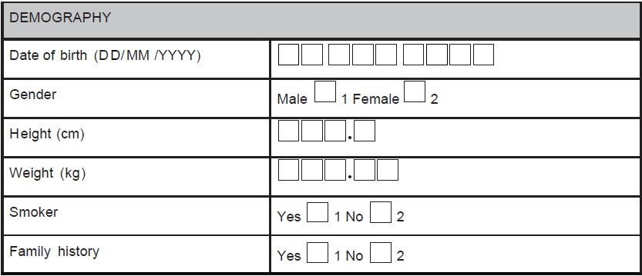
Completed Case Report Forms
WHERE DO YOU
USUALLY STORE
COMPLETED CRFs?

Slide 42
CRFs Best Practices
All completed CRFs should be maintained as essential documents
CRFs should be dated/signed by the study team member completing the form (ALCOA-C)
Data reported on the CRF should be consistent with the source documents
Any change or correction to a CRF should be dated, initialed, and explained (if necessary) and should not obscure the original entry
Usually the PI reviews/signs off on the completed CRFs or documents

Slide 43
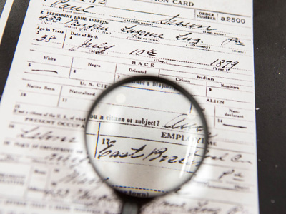
Source Documents
WHERE ARE
SOURCE DOCUMENTS
MAINTAINED?

Slide 44
Source Documents cont’d
Place of storage of source documents:
Patient/Subject’s medical records
Subject’s research record
RB, for a small amount of participants

Slide 45
Investigational Product (IP)
Purpose:
Documentation of the receipt and maintenance of the IP
Documents to be maintained:
Investigational brochure, package insert, or device manual, all versions
Sample of product label
Documentation of study product shipment/receipt/dispensing/return/disposal
Include dates, quantities, batch/serial #, expiration dates
Instructions for IP handling
Randomization instructions, if applicable

Slide 46
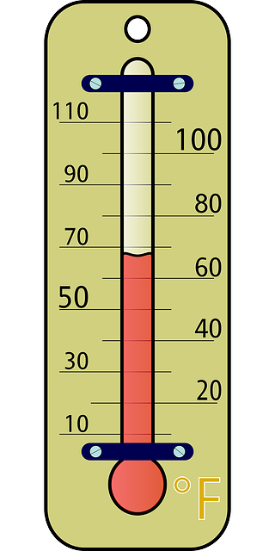
IP cont’d
Documents to be maintained:
Temperature log, when applicable
Storage/maintenance instructions
Unblinding procedures, as applicable

Slide 47
Laboratory/Testing Center Documents
Purpose:
Documentation of the normal ranges for the laboratory tests/procedures/laboratory’s credentials as being a qualified lab to test specimens collected for the study
Documents to be maintained:
Copy of laboratory certification and accreditations
Laboratory normal reference ranges/values for procedures included in the protocol
Certification of analysis/reliability of tests performed, when requested
Copy of Laboratory/Testing Center’s Director’s license and CV (current within 2 years)

Slide 48
Specimen Tracking Log
Purpose:
Provides a means to tracks specimens/samples collected as study procedures
Types of samples to track:
Specimen Tracking Log
Retained tissue log
Documents to maintain
Shipping/Receipt/Maintenance documentation
Storage temperature logs

Slide 49
AEs/SAEs
Purpose:
Documentation of side effects/adverse events (AEs)/serious adverse events (SAEs)/unexpected adverse events experienced by a subject

Slide 50
AEs/SAEs/Unanticipated Events
Maintain the following:
Log for each subject, if applicable
Log for study
Forms/CAPAs
Correspondence, copies and acknowledgement of reports of internal AEs
External reports to IRB, Sponsor, regulatory authorities
IND Safety Reports

Slide 51
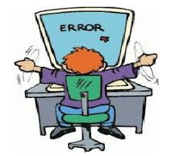
Protocol Deviations
Purpose:
Documentation of non-compliance with the protocol
Best Practices:
Maintain a protocol deviation log
Documentation/memo/Corrective Action Preventive Action (CAPA), as applicable for each deviation
Record events a soon as possible after the event, ALCOA-C

Slide 52
Monitoring Visits
Purpose:
Documentation of the monitoring visit/visit type/ results of visit(s)/findings(s)
Maintain the following in this section:
Monitoring reports/letters/Correspondence
Monitoring Log:
Each Visit should be documented by the monitor and a study team member by dating and signing the log
The reason for each visit should also be document on the log
Pre-study visit, site initiation, routine visits, close-out visit, etc.

Slide 53
Correspondence
Purpose
To record discussions/ correspondence that are significant to the conduct of the study resulting in a complete and accurate audit trail
Types of Correspondence (e-mails/faxes/letters/electronic documents, meeting notes, phone calls) to maintain from:
Sponsor
Contract Research Organization (CROs)
Monitor
IRB (prefer to keep this correspondence with the IRB section)
Study Team
Correspondence regarding individual subjects should/may be maintained with their research records

Slide 54
Legal/Financial Documents
WHERE DO YOU
MAINTAIN
LEGAL/FINANCIAL
DOCUMENTS?

Slide 55
Legal/Financial Documents cont’d
FDA documents
Contracts
Budgets
Subject payments
Letter of Understanding/Confidentiality Agreement
Data Sharing Agreement
Material Transfer Agreement
Signed agreements between parties (i.e., sponsor/CRO/Institution investigators)

Slide 56
Note to Files (NTFs)
WHERE CAN NTFs BE MAINTAINED?

Slide 57
NTFs cont’d
Purpose:
To document the reason for missing/delayed/incorrect information/any discrepancies
To document the corrective action taken/resolution of discrepancies
To document the location of documents stored outside of the RB
To provide additional information or clarification
NTFs should include the following:
Signature of the author and the date created and the PI (when applicable)
Description of the event (who, what, where, when, how, why)
Actions taken to resolve the issue
Any necessary CAPA
Pertinent information to provide clarification of an event

Slide 58
Conclusion
The RB should:
Be maintained in an up-to-date manner at all times
Organized in a logical manner
Located in a central location and accessible to the appropriate study team members
Be maintained in paper / electronic/or combination of both formats

