Slide 1
Research 102 Session 5:
Privacy, Confidentiality,​& HIPAA​
Kim Prachniak, MS, CIP

Slide 2
Privacy vs. Confidentiality
People
Data & Specimens

Slide 3
PRIVACY
“the interest of individuals in controlling the access of others to a personal domain that includes our bodies and physical space, our thoughts and feelings, characteristics of our intimate relationships, sexual orientation, religious preferences and reproductive choices…”
UTHSC IRB Privacy & Confidentiality policy

Slide 4
Right of Privacy
“reflects the obligation of others to not intrude on this domain without our consent and the freedom of each individual to choose the time, place, and manner in which others will have access to it”
UTHSC IRB Privacy & Confidentiality policy

Slide 5
The PreTeen Study 910 Madison Ave.
Memphis, TN 38163
Lena Smith
818 Ranger Ave.
Memphis, TN 38163

Slide 6
Ways to Protect Privacy in Research
Screening and recruitment; conditions under which persons are invited to participate; & interventions or interactions -- not witnessed, overheard, etc.
Disposing of screening records in the absence of consent to retain the information
Collecting the minimum necessary of private information
Restricting # of KSP who have access to private information
Keeping research records separate from other records when possible
UTHSC IRB Privacy & Confidentiality policy

Slide 7
Ways to Protect Privacy, cont.’d
Limiting methods of tracking non-compliant subjects or subjects lost-to-follow-up to assure that their medical condition &/or participation in the research is not disclosed to persons outside the research setting
Prohibiting:
non-consensual research use of existing private information/biospecimens
secondary research use of private information/biospecimens previously collected for research purposes, without additional consent-- except where conditions are met for exemption &/or waiver of consent
UTHSC IRB Privacy & Confidentiality policy

Slide 8
IRB Application – Privacy Question 1
The collection of private information will be limited to the minimum necessary to meet the objectives of the study; AND
The number of key study personnel (KSP) who have access to private
information will be limited to the minimum number necessary to meet the objectives of the study; AND
The research records will be kept separate from other records, such as
medical or educational records, unless the information is useful for the welfare of the subject, or unless the clinic/hospital’s policy is to include research consent forms in the patient’s medical record.
In order to protect the privacy of individuals, you may not conduct this project if you cannot confirm that all of the above statements are true.

Slide 9
IRB Application – Privacy Question 2
Check off all of the following approaches that will assure that prospective subjects are screened, recruited, &/or invited to participate in a way that protects them from being witnessed, overheard, or viewed in a manner that violates their privacy.
Patients will initially be approached for participation by their provider, not a stranger to the patient, unless there is documented permission from the provider to approach the patient.
Recruitment letters will only be sent by the patient’s provider, or they will state that the researcher obtained permission from the patient’s provider.
Recruitment letters will only be addressed to the prospective subject or their legally authorized
representative.
Recruitment will not be conducted in an open area/group setting when medical conditions, sensitive
topics (such as criminal behavior; sexual practices; alcohol & drug use; physical, emotional, or sexual abuse; etc.), or other private matters are being studied.
Screening will not be conducted in an open area/group setting when medical conditions, sensitive
topics (such as criminal behavior; sexual practices; alcohol & drug use; physical, emotional, or sexual abuse; etc.), or other private matters are being studied.
If screening requires the prospective subject to disrobe partially or completely, the prospective subject will do so in a private room & will have a gown or proper cover to put on while he/she waits in the room.
Other
Not applicable

Slide 10
IRB Application – Privacy Question 3
Check off all of the following approaches that will be used to assure that interventions/interactions with subjects provide protections against them being witnessed, overheard, or viewed in a manner that would violate their privacy.
Interventions/interactions with subjects will not be conducted in an open
area/group setting when medical conditions, sensitive topics (such as criminal behavior; sexual practices; alcohol & drug use; physical, emotional, or sexual abuse; etc.), or other private matters are being studied.
If interventions require the subject to disrobe partially or completely, the subject will do so in a private room & will have a gown or proper cover to put on while he/she waits in the room.
If photographs, voice recording, or video recording will be performed, the
subject is aware of this fact and informed about who will be viewing them &/or receiving them, & the subject has given written permission (or verbal permission when a signed consent form is not required by the IRB) for these procedures.
Other

Slide 11
IRB Application – Privacy Question 4
Check off all of the following ways in which tracking non-compliant subjects or subjects lost to follow-up will assure that their medical condition &/or participation in the research is not disclosed to persons outside the research.
Written permission will be secured from subjects regarding all of the methods that may be utilized to track them.
The subject’s phone number(s) will be called, & if the subject is not the person who answers, the researcher will not divulge the title of the study or the fact that the subject is/was participating in a study.
Certified mail will be sent to the subject.
The return address & any markings on the envelope of a letter to the subject will not
identify the title of the study or the fact that the subject is/was participating in a study.
Any letter sent to subjects will not reveal the topic of the study if a medical condition &/or sensitive issue is being studied (such as criminal behavior; sexual practices; alcohol &
drug use; physical, emotional, or sexual abuse; etc.).
The topic of the study or the fact of the subject’s participation will not be disclosed to
any person outside the study who is contacted to determine the whereabouts of subjects.
Other
Not Applicable

Slide 12
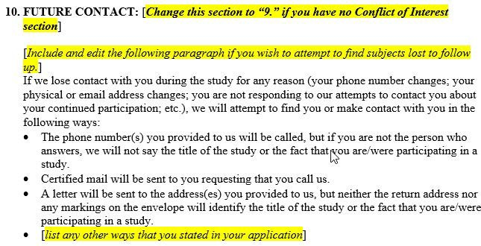
Consent Form – Privacy Text 1

Slide 13
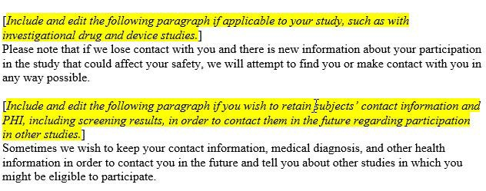
Consent Form – Privacy Text 2

Slide 14
Consent Form – Privacy Text 3
Procedures Section
Describe privacy issues (videotaping, disrobing, etc.) & protections that will be put in place.
Risks Section

Slide 15
CONFIDENTIALITY
“treatment of information that an individual has already disclosed in a relationship of trust and with the expectation that it will not be divulged to others without express permission”
UTHSC IRB Privacy & Confidentiality policy

Slide 16
Ways to Protect
Confidentiality in Research
The identifiable private information is necessary for the research.
All KSP who will have access to identifiable private information/specimens are identified as such in the application.
A plan exists for asking prospective subjects if their identifiable private information obtained for screening purposes can be retained.
Adequate provisions are made to protect the confidentiality of paper & electronically stored research records.
UTHSC IRB Privacy & Confidentiality policy

Slide 17
Ways to Protect Confidentiality, cont.’d
Adequate provisions are made for maintaining the confidentiality of identifiable private information electronically transmitted either locally or externally.
Adequate provisions are made for maintaining the confidentiality of specimens stored at the local site or transmitted externally.
For repositories: subjects are informed how their data &/or specimens will be protected when distributed to investigators who use the repository.
UTHSC IRB Privacy & Confidentiality policy

Slide 18
Ways to Protect Confidentiality, cont.’d
The HIPAA authorization is included in the consent form, unless a HIPAA waiver is approved by the IRB.
Subjects are informed re: whether info about their research participation &/or the results of research procedures will be in their medical record.
For genetic research, subjects are informed re: the Genetic Information Nondiscrimination Act protections.
UTHSC IRB Privacy & Confidentiality policy

Slide 19
Ways to Protect Confidentiality, cont.’d
Subjects won’t be identified in research presentations or publications.
Federal Certificates of Confidentiality are obtained when appropriate.
UTHSC IRB Privacy & Confidentiality policy

Slide 20
IRB Application –
Confidentiality Question 1
Explain what will be done with the individually identifiable, private information (including health information) that you collect about prospective subjects who fail screening or who do not agree to participate (consult the question mark icon for definitions):
The information will be destroyed; e.g., shredded or properly deleted from a computer.
Items of individually identifiable, private information such as names, contact information, and health information will be maintained by the local investigator (either locked and stored if on paper; computer password protected and accessible only to research personnel, or stored in an encrypted fashion on a thumb drive, laptop, or desktop computer).
Information will be forwarded to sponsor/CRO using an encrypted method and then destroyed at the local site.
Other

Slide 21
IRB Application –
Confidentiality Question 2
If you will be retaining individually identifiable, private information (including health information) of prospective subjects who fail screening or who do not agree to participate, HOW will you assure that they agree to this retention AND to sharing this information with other parties, such as the sponsor, if applicable?
The permission document will be attached at the end of this application.
There will be a statement on the questionnaire (or website, mobile app, etc.) such as, "In completing this screening questionnaire and providing your contact information, you are agreeing to allow us to contact you for the study named, to allow us to keep your contact and health information in order to contact you for any future studies for which you may qualify, and to share your information with other parties, such as the sponsor."
We will obtain and document verbal permission provided over the telephone at the end of the telephone screening interview.

Slide 22
IRB Application –
Confidentiality Question 3
Will all paper research records containing identifiable, private information (including the original signed consent form) from individual subjects be locked and stored and be accessible only to research personnel?
Yes
No
Not applicable

Slide 23
IRB Application –
Confidentiality Question 4
Check off all of the following items that apply regarding the electronic storage of identifiable, private information collected in this project:
All electronic research records containing identifiable, private information from individual subjects will be computer password protected and accessible only to research personnel.
All electronic research records containing identifiable, private information from individual subjects will be stored in an encrypted fashion (e.g., on an encrypted, password protected thumb drive; on an encrypted laptop; on an encrypted desktop computer; in an encrypted, password protected file on a laptop/computer; etc.).
Other or additional methods of secure storage (e.g., data will have inter- file linkage, error inoculation, top coding, bracketing, data brokering, etc.)
Not applicable.

Slide 24
IRB Application –
Confidentiality Question 5
Select the following item that applies regarding the electronic transmission (either locally or externally) of identifiable, private information collected in this project (consult the question mark icon for definitions):
All electronic research records containing identifiable, private data from individual subjects will be transmitted electronically via an encrypted method (e.g., UT Vault, Xythos, a federal or industry-sponsor cleared web-based portal, etc.).
All electronic research records containing identifiable, private data from
individual subjects will be coded before transmitted electronically, and the master key will be maintained at the local site.
Other or additional methods of secure electronic transmission
Not applicable.

Slide 25
Electronic Storage/Transmission Methods
Encrypted Computer/Laptop
Encrypted Flash/Thumb Drive
Microsoft 365 OneDrive (cloud) storage
Any outside email can access this
Easiest storage method
UT Vault
Any outside email can access this
Outlook email has encrypt button to click
If you are not a UTHSC employee, ask your Security Officer to be sure it works with your organization’s Outlook licensing/setup.
Typing “encrypt” in the subject line is not the safest way!

Slide 26
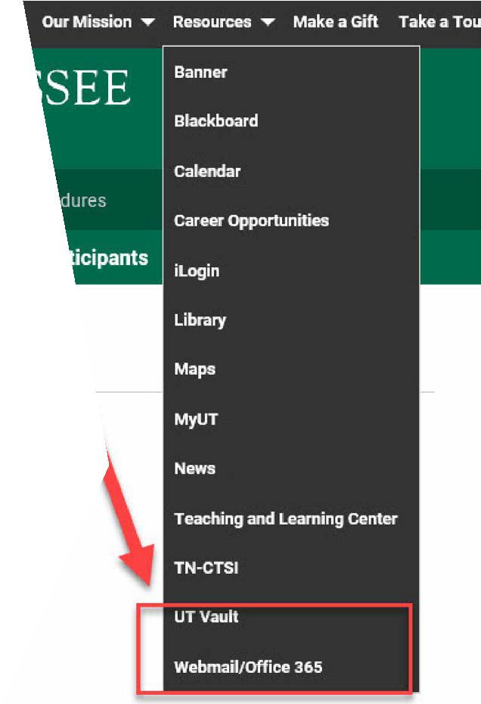
UT Vault
& Microsoft OneDrive

Slide 27
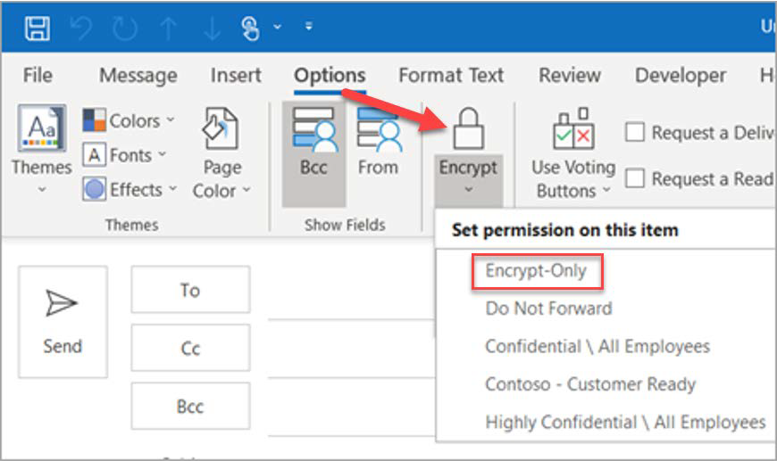
Encrypt button in Outlook email
https://support.microsoft.com/en-us/office/encrypt- email-messages-373339cb-bf1a-4509-b296- 802a39d801dc

Slide 28
IRB Application –
Confidentiality Question 6
Similar specimen questions:
Labeled with code at local site?
Send to external site? If so, coded? If so, master key to code remains at local site?
Identifiers removed and used for future studies
without subject consent?

Slide 29
IRB Application –
Confidentiality Question 7
Will information obtained from procedures performed only for research purposes be placed in the medical record of subjects?
Yes
No
Not applicable

Slide 30
IRB Application –
Confidentiality Question 8
Will documentation of the participation of the subject in the research study, such as a copy of the consent form or other notation, be placed in the medical record of the subject?
Yes
No
Not applicable

Slide 31
IRB Application –
Confidentiality Question 9
Will a federal Certificate of Confidentiality be obtained for this study/project
Yes
No

Slide 32
Consent Form – Confidentiality Text
Main Consent Form Template Section 4, pages 17-23
Repository Consent Form Template Section 4, pages 11-16
https://www.uthsc.edu/research/compliance/irb/ researchers/consent-forms.php

Slide 33
Social Media Privacy & Confidentiality Concerns
Is the social media page advertising your research study public, but some users think it’s private and post private information (e.g., Can I still sign up if my BMI is over 30?)?
Are there instructions for potential subjects to not post any private information on the page?
Do you have settings turned on where you must approve all posts on the page?
Are you answering questions from potential subjects on the main page vs. a phone call?
Are you collecting data on social media for research purposes without subject consent (do you have an IRB waiver of consent & IRB approval to do so)?

Slide 34
Work-from-home Privacy & Confidentiality Considerations
Are you working on your back porch or in a public space (e.g., Starbucks)?
Are there unauthorized people at your house listening to private, sensitive information or PHI?
Are you talking on a headset or via speakers?
Are you using subject names or other PHI when code numbers could be used?
Is your unencrypted laptop with subject PHI lying on the backseat of your car?
Does your home computer have the same protections as your work computer?
Are you locking up paper files containing PHI at home, just as you do at work?
Are you completing subject video-visits virtually with people walking around behind you at your house?
Do subjects have a private room to have a visit over phone/video-call at their house?

Slide 35
Health Insurance Portability and Accountability Act (HIPAA) of 1996
This law required the HHS Secretary to “publicize standards for the electronic exchange, privacy and security of health information.”
Individually identifiable health information was defined as “information, including demographic data, that relates to:
•the individual’s past, present or future physical or mental health or condition,
•the provision of health care to the individual, or
•the past, present, or future payment for the provision of health care to the individual,
and that identifies the individual or for which there is a reasonable basis to believe it can be used to identify the individual.”
https://www.hhs.gov/hipaa/for-professionals/privacy/laws-regulations/index.html

Slide 36
HIPAA Privacy vs. Security Rule
December 2000, HHS published Privacy Rule: “Set national standards for the protection of individually identifiable health information by [these] covered entities: health plans, health care clearinghouses, & health care providers who conduct the standard health care transactions electronically.”
February 2003, HHS published Security Rule: Set “national standards for protecting the confidentiality, integrity, & availability of electronic protected health information.”
https://www.hhs.gov/hipaa/for-professionals/index.html

Slide 37
HIPAA Privacy Rule
Protected Health Information (PHI) is “all ‘individually identifiable health information’ held or transmitted by a covered entity or its business associate, in any form or media, whether electronic, paper, or oral.”
https://www.hhs.gov/hipaa/for-professionals/privacy/laws-regulations/index.html
18 Individual Identifiers:
names;
all geographic subdivisions smaller than a state, including street address, city, county, precinct, & their equivalent geocodes, except for the initial three digits of a zip code if the geographic unit represented by these three initial digits contains more than 20,000 people;
all elements of dates (except year) for dates directly related to an
individual, including birth date, admission date, discharge date, date of death, & all ages over 89, & all elements of dates indicative of age over 89, except that such ages & elements may be aggregated into a single category of age 90 or older;
telephone numbers;
fax numbers;

Slide 38
HIPAA Privacy Rule, cont.’d
18 Individual Identifiers cont.’d:
electronic mail addresses;
social security numbers;
medical record numbers;
health plan beneficiary numbers;
account numbers;
certificate/license numbers;
vehicle identifiers & serial numbers, including license plate numbers;
device identifiers & serial numbers;
web universal resource locators (URLs);
internet protocol (IP) address numbers;
biometric identifiers, including finger & voice prints;
full face photographic images & any comparable images; &
any other unique identifying number, characteristic, or code
UTHSC IRB Use of PHI without Subject Authorization policy

Slide 39
16 Direct HIPAA Identifiers
names;
postal address information, other than town or city, state and zip code;
telephone numbers;
fax numbers;
electronic mail addresses;
social security numbers;
medical record numbers;
health plan beneficiary numbers;
account numbers;
certificate/license numbers;
vehicle identifiers and serial numbers, including license plate numbers;
device identifiers and serial numbers;
web universal resource locaters (URLs);
internet protocol (IP) address numbers;
biometric identifiers, including finger and voice prints; &
full face photographic images and any comparable images
UTHSC IRB Use of PHI without Subject Authorization policy

Slide 40
HIPAA Privacy Rule- Authorization
“[HIPAA] requires that persons provide authorization for the use of [Protected Health Information] for specific purposes other than treatment, payment or health care operations.”
Must be signed by signed & dated by the subject or the subject’s legally authorized representative (LAR);
If LAR signs, the relationship of the LAR must be provided;
Because the authorization is in the consent form, a copy of the consent form must be provided to the subject/LAR; &
Signed authorizations (i.e., consent forms) must be kept for 6 years.
UTHSC IRB HIPAA Authorization for the Use of PHI in Research policy

Slide 41
HIPAA Authorization Elements
the information to be used/disclosed;
the name or class of persons authorized to make the requested use/disclosure;
the name or class of persons to whom the covered entity is permitted to make the requested use/disclosure;
each purpose for the requested use/disclosure;
an expiration date/event relating to the purpose of the use or disclosure; it can be “end of the research study”, or “none” if PHI will be used indefinitely for a research database/repository;
the individual’s right to revoke the authorization in writing, including limitations & how it can be revoked; must indicate that
the Privacy Rule permits the continued research use/disclosure of PHI obtained from the subject prior to the time when the
authorization is revoked;

Slide 42
HIPAA Authorization Elements, cont.’d
the investigator may require the authorization for participation in the study & subjects who revoke the authorization may be withdrawn from the study;
the potential that information disclosed to those parties specified in the authorization could be re-disclosed by the recipient & no longer protected by the Privacy Rule; &
when the research includes evaluation of a treatment, state that the subject’s access to PHI will be temporarily suspended as long as
the research is in progress, but will be reinstated upon completion of the research.
UTHSC IRB HIPAA Authorization for the Use of PHI in Research policy

Slide 43
IRB Application –
HIPAA Question
Please identify the regulatory category under which the request is being made to view, record, and/or retain Protected Health Information (PHI) without subject authorization.
Waiver of subject authorization is being requested because some or all of the PHI is being viewed, recorded, and/or retained without the subject (or potential subject) signing a HIPAA authorization.
Some or all PHI is from individuals who were deceased prior to the date this research proposal was submitted.
Some or all PHI is a limited data set (does NOT contain 16 of the 18 HIPAA-specified identifiers)
Some or all PHI is de-identified data (does NOT contain ANY of the 18 HIPAA-specified identifiers)

Slide 44
HIPAA Waiver Requirements
The use/disclosure of PHI involves no more than a minimal risk to the privacy of individuals based on:
adequate plan to protect the identifiers from improper use/disclosure;
adequate plan to destroy the identifiers at the earliest opportunity consistent with conduct of the research, unless there is a health/research justification for retaining the identifiers or it’s otherwise required by law; &
adequate written assurances that the PHI will not be reused/disclosed to any other person/entity (except as required by law, for authorized oversight of the research project, or for other research for which the use/disclosure of PHI would be permitted by this subpart); AND
The research could not practicably be conducted without the waiver, & without access to/use of the PHI.
https://www.hhs.gov/hipaa/for-professionals/privacy/guidance/research/index.html

Slide 45
Consent Form – HIPAA Text
Main Consent Form Template Section 4, pages 20-22
Repository Consent Form Template Section 4, pages 13-15
https://www.uthsc.edu/research/compliance/irb
/researchers/consent-forms.php

Slide 46
HIPAA Security
iMedRIS is not HIPAA-compliant because UTHSC’s network is not.
Do not upload screening/consent/subject logs that have subject PHI in them.
Do not include any subject PHI when submitting a local adverse event report, unanticipated problem report, emergency use request, etc.
Do not email PHI unless the email is properly encrypted.
Do not forward or reply to any email containing PHI that was not encrypted; report this violation.
If your study is sponsored, the study sponsor will likely let you know
what storage/transmission system is safe to use.
If you have any questions about secure storage/transmission, contact the IRB or the UTHSC HIPAA Security Officer.

Slide 47
HIPAA Violation?
Contact the IRB right away; you will be instructed to submit an unanticipated problem form (Form 4) in iMedRIS.
Contact the UTHSC HIPAA Privacy Officer
Melanie Burlison Assistant Vice Chancellor
mburlison@uthsc.edu ~ 901.448.8030 OR the UTHSC HIPAA Security Officer
Chris Madeksho, CISA CRISC
IT Security Officer itsecurity@uthsc.edu
Contact the HIPAA Privacy or Security Officer at the clinic/hospital.
May need to contact the study sponsor; consult contracting office.

Slide 48
HIPAA & Revised
Common Rule Exemption
(not for FDA-regulated or DOJ-supported studies)
Secondary research uses of identifiable private information, for which consent is NOT required, if the following criterion is met:
The research involves only information collection & analysis involving the investigator's use of identifiable health information when that use is regulated under 45 CFR parts 160 and 164, subparts A & E, for the purposes of “health care operations” or “research” as those terms are defined at 45 CFR 164.501…
45 CFR 46.104(d)(4)(iii.)
UTHSC IRB new study application (Form 1):
Section (485) ➔ Exempt, & then in Section (790) ➔ Option #6

Slide 49
Questions?

