Slide 1
Creating an Effective Advertisement
Recruitment & Retention
SESSION 4:
Ashley G. Evans, BA, MS

Slide 2
Overview
Preparing Advertisement Content
Creating an Advertisement
What Not to Do
Notes:
In today’s presentation we will cover:
Preparing Advertisement Content
Creating an Advertisement
and What not to do when creating an Advertisement

Slide 3
Preparing Advertisement Content
Notes:
Let’s get started by discussing the content of your advertising materials.

Slide 4
Remember the 6 P’s
Product
People
Place
Price
Presentation
Promotion
Notes:
The 6 P’s is a helpful marketing formula to follow and analyze your social marketing materials. Your advertisements should be able to address these aspects such as:
Product
What is your study about? And what is your objective?
People
This is about your/target audience or potential participants. In what ways are you appealing to them?
Place
Where will this study be held? When will it be held? For how long will it be happening?
Price
What is the cost of participation? Think about this not only financially but in the aspect of time and effort as well. What will participants possibly gain?
Promotion
What is a good place and what are the best strategies to get your audience’s attention?
And last but not least, Presentation
How does you audience see your advertisement? How can you visually get their attention?

Slide 5
Preparing Advertisement Content
What is this study about? (Product)
Name
Purpose
Short Description
What is expected of participation? (Price)
Participant expectations
Potential benefits
Be mindful of FDA & IRB guidelines
Notes:
It is imperative that you concisely and accurately tell participants what the study is about.
Include the name of the study, purpose of the study, and a short description of what the study is about.
It is best that the condition being studied is stated.
Make sure to do this in concise and easily understood terms.
Individuals will often perform a cost/benefit analysis when considering research participation.
Express the expectations required of a study participant, which may include the time commitment required for participants.
Clearly state the benefits of participation to your target audience.
Be mindful of FDA & IRB guidelines. Incentives can be included in an AD as long as they are not emphasized and as long as they are not viewed as coercion.

Slide 6
Preparing Advertisement Content
Who is invited to participate? (People)
Age
Gender
Ethnicity
Health History
More
Notes:
Next, you need to identify who your target audience is.
Clearly state the eligibility requirements of being a participant study such as age, gender, ethnicity, or health history/targeted health condition.
Depending on the age of participants targeted, you may also want to target your advertisement towards caregivers

Slide 7
Preparing Advertisement Content
Where will this study take place? (Place)
In person
Virtual
When will this study take place?
After work/school
Weekends
Monthly
Notes:
If known, state the location of the study.
If in person, study sessions should be held at an accessible location.
This could include clinics, community centers, libraries, churches, and more
One thing that has come out of our COVID era is our ability to adapt and connect. It may be possible for study sessions to be conducted through avenues such as zoom meetings, telehealth calls
The time commitment required of participants is important to address. People lead busy lives and are usually interested in, How much time will this take?
Depending on how much time is needed from participants, you may decide to do this after work/school hours, on weekends, or at another time that fits the schedule of your participants.

Slide 8
Preparing Advertisement Content
How do interested participants contact the study team?
Name of study administrator
Phone number
Email address
Website (and/or social media handles)
Notes:
Make sure to include how participants can get in contact with you.
Include information such as the Name of study administrator or study team name (instead of giving a specific person’s name), a phone number, email address, or website and/or social media handles.

Slide 9
Preparing Advertisement Content
Where will be a good place to market your advertisement? (Promotion)
Local businesses
Nonprofits/charities
Religious institutions
TV
Radio
Print/Newspaper
Social Media
Notes:
Lastly, consider where will be a good place to market your AD.
I suggest more than one approach to promoting your study. Here are a list of a few places you can advertise your study. This can include posting your advertisement in local business and community organizations or through socially media contexts such as TV, radio, and social media platforms.

Slide 10
Creating an Advertisement (Presentation)
Notes:
So far, we have addressed the information that needs to be included on an effective study advertisement. Now let’s focus on how to include this information in the best layout to appeal and present to our potential patient population we are seeking to recruit.

Slide 11
Creating an Advertisement
A good advertisement should include:
Appealing headline
What is it like living with this condition?
Organization logo
Photo/Graphic
Call to action
Notes:
The content is important, but you must also catch your audience’s attention by properly presenting your study and making a visually appealing advertisement
When creating an advertisement keep your target audience in mind. Utilize an attractive headline, design, and photos that will appeal to your prospective participants.
A tip for creating an appealing headline is to capture and appeal to what it may be like for a participant living with a specific condition.
For example, an example for people who suffer with migraines may be, “Are you seeking relief from migraines?” or an appeal for a study on insomnia may be “Are you ready for a good night’s rest?” Something simple, relatable, and inquisitive.
And adding graphics/photos also assist in getting their initial attention.
A good advertisement should always include a call to action. An simple example is “If interested in participation, contact us at this email or call us at this number.”
Remember, your objective is to engage with your audience and get them to engage with you.

Slide 12
Creating an Advertisement
A good advertisement should include:
Bullet points
Everyday language
Hemingway Editor
Multiple drafts
IRB Approval
Notes:
Along with the important information content drafted, these aspects may help your advertisement be more visually appealing
When creating an advertisement, utilize bullet points to make things easy to read for your audience.
Use everyday language. Your target audience likely does not have a medical background. Websites like Hemingway Editor can help you measure the readability of your content and reading level and provide you with tips on adjustments you can make to improve the accessibility of your content.
Make multiple drafts and edits to ensure that information is correct and patient centered.
And always get IRB approval before publishing any advertising material for recruitment.

Slide 13
Advertisement Example
Inquisitive Headline
General description and eligibility requirements
Location
Photo
Contact Information
University logo
Call to action
Notes:
Here’s examples from the University of Florida
It has an attractive headline
A short description of the study
Eligibility requirements
The location of the study
A photo
Contact information
A University logo that helps provide legitimacy
And finally a call to action “if you’re unsure if you meet the requirements, call or email a member of the team”

Slide 14
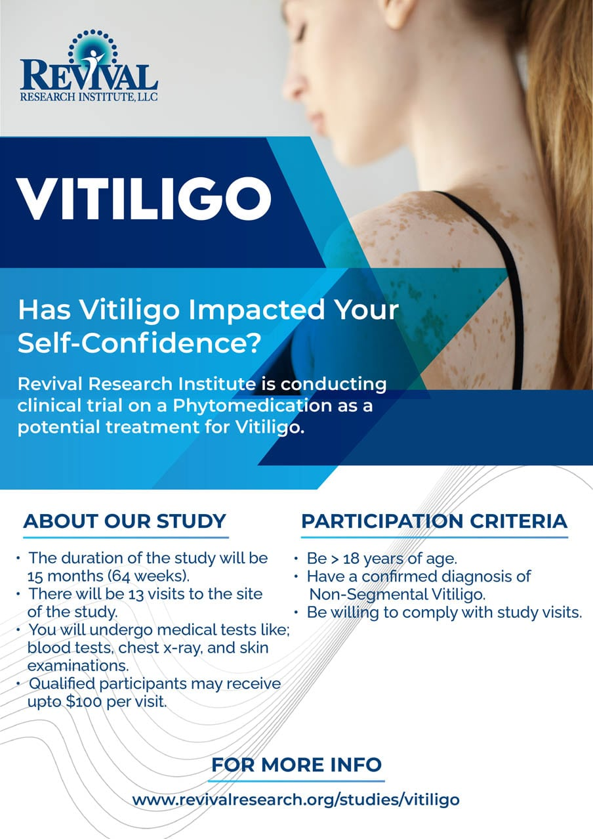
Advertisement Example
Study topic
Organization logo
Emotional appeal
General description and eligibility requirements
Photo
Contact Information
Notes:
Here is another example from the Revival Research Institute on Vitiligo
The health concern being studied is front and center and the organization logo is present
There is a simple emotional appeal to the audience encouraging them to think about how vitiligo has impacted their life, particularly their confidence
There is a general description of the study including expectations and eligibility criteria
There is a supporting photo that is an example of what vitiligo looks like that blends in well with the advertisement
And of course contact information where more information can be found
There is a call to action here as well but I would suggest something else like “If you meet the following criteria, or are unsure, contact us today” followed by your teams contact information

Slide 15
Advertising Examples (Social Media)
Visual is emphasized
More concise text
Link to page/website
Notes:
Let’s look at an AD optimized for social media.
On the screen is an example of a Facebook advertisement from Trialfacts focused on clinical research on migraines within pediatric populations.
Social media is much more focused on catching individuals attention and there is usually A LOT of things competing for individuals attention on social media. If you are a Facebook, TikTok, or Instagram user then you understand how easy it is to end up on social media way longer than you expected because on the many things posts, pictures, and videos that catch your attention.
On social sites, your advertisement has to stand out so visuals, graphics, and videos should be emphasized with the description being more concise than a traditional AD.
The bulleted points include a short description, the purpose of the study, the target audience, potential benefits, a photo, and a link to learn more about the study.
A major benefit to using social media advertisements to promote your study are the access metrics. Likes, comments, and shares give you simple measurements of how much engagement your AD is receiving and if people comment or share, it provides you an opportunity to interact with your audience.

Slide 16
Graphic Design Resource
Canva
Free
Various templates
Create logos, flyers, invitations & more
Notes:
If you’re wondering where you can create advertisements like these, Canva is a great resource that you may want to look.
Canva is a free website that also has premium options. It provides free templates that can be used to create logos, flyers, advertisements and more that could possibly assist you when creating your advertising materials. I often use it myself and I know marketing professionals who also use it. Canva is easy to use and has many visually appealing graphics and designs.

Slide 17
Measuring Effectiveness
Study inquires & enrollment
“How did you hear about us?”
Social media engagement
Likes
Comments
Followers
Shares
Manage & track metrics
Notes:
Effectiveness is related to your objective and purpose of doing the study. In this case, it is to engage and get people to enroll in your study.
A helpful way to measure advertisement effectiveness is to ask, how do you hear about us? When engaging with a potential participant.
Through social media this also can be measure by how many people engage through aspects such as likes, comments, shares, followers, and direct messages. As I mentioned earlier, a benefit to social media usage is the analytics provided to organizational pages.
Measuring effectiveness helps you determine what is working well for your approach, what should continue doing, stray away from doing, and your potential next steps for community engagement.
These metrics can be managed and track through an Excel file or even a Word document

Slide 18
Other Pathways for Advertisement
Radio/Podcasts
More conversational delivery
TV
Outdoor (Billboards)
Newspaper
Black & white or color?
Notes:
Radio/Podcasts
Advertisements on radio spots and podcasts should be more conversational in delivery
TV
Outdoor (Billboards)
Newspaper
When preparing an AD for the newspaper you should decide whether the AD will be in color or in black & white. This of course will impact cost and possibly who is drawn to the AD
The Research study recruitment resource reference sheet can be found on the TN-CTSI website that provides additional information on TV, radio, newspaper venues and the patient population that each of these target. This resource may be helpful to you when targeting specific populations.

Slide 19
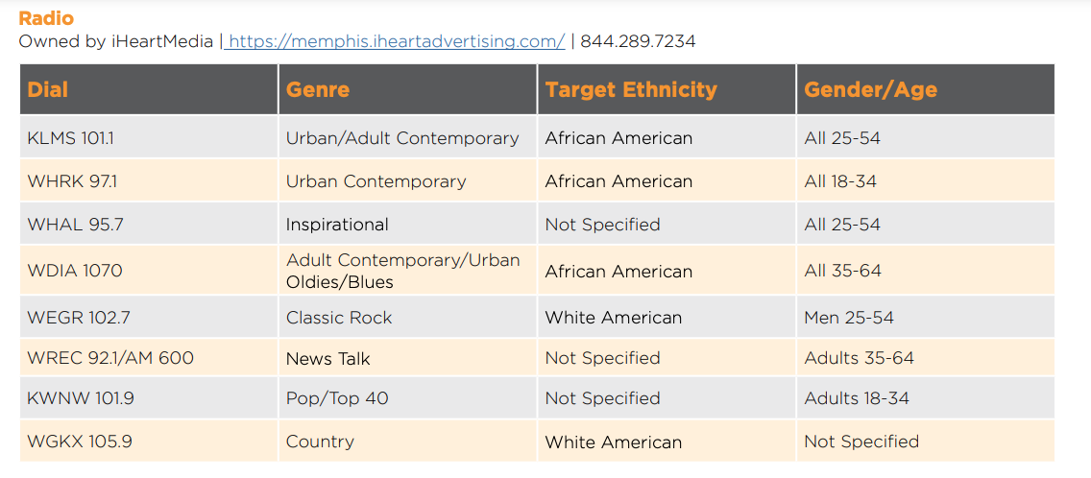
Notes:
Here are a few examples of the information we provide about local TV and radio stations in our Research Study Recruitment Resources.
This document is found on our website. You can find it by going to our consultation and services tab and then clicking on recruitment
Research Study Recruitment Resources

Slide 20
What Not to Do
Notes:
We have discussed so far things to include in your advertising materials. Now let’s turn our focus on what not to do when creating an effective advertisement

Slide 21
What Not to Do
Do not make promissory claims
Do not use language such as "new treatment," "new medication," or "new drug" without explaining that the treatment is investigational
Do not promote your study as "free medical treatment”
Do not emphasize compensation with larger or bold type
Notes:
No claims should be made that the investigational treatment is safe or effective, or that it is equivalent or superior to existing treatments. This includes both explicit and implicit claims. The IRB will review content, as well as the font size and type, and other visual effects, in determining whether materials are too promissory. Advertisements should not coercive.
Do not use language such as "new treatment," "new medication," or "new drug" without explaining that the treatment is investigational. In other words, "new investigational medication" may be approved, but "new medication" would not be approved. Such phrases may lead patients to believe that they will be receiving a treatment that has already been approved by the FDA or has already been proven effective.
Do not promote your study as "free medical treatment" to refer to study-related care patients will receive
If the trial is paid, compensation may be mentioned, but not emphasized through larger or bold type

Slide 22
Remember!
Mandatory information for advertisements and recruitment materials provided by the UTHSC IRB Review Board can be found here.
ALL advertisements must be approved by the UTHSC IRB Review Board.
Notes:
This slide provides the link to the UTHSC SOP for study advertisements and subject recruitment materials that you will submit to University of Tennessee Health Science Institutional Review Board for approval if UTHSC is your IRB of record

