Slide 1
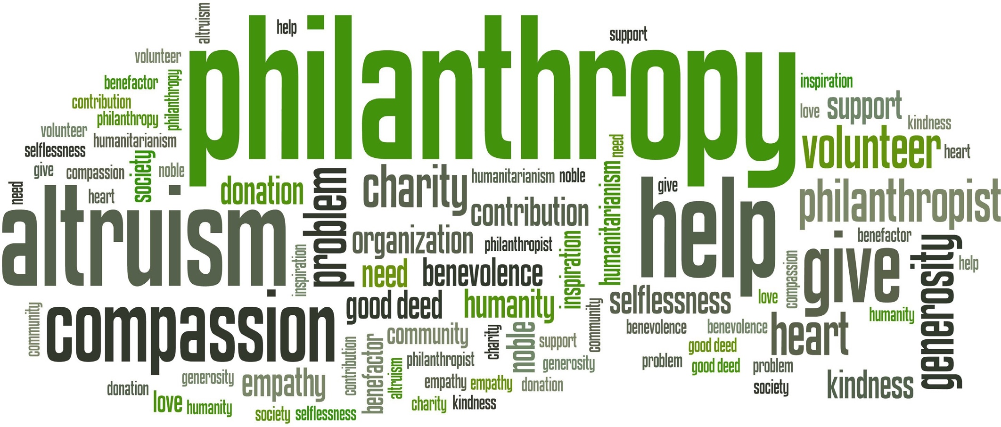

Slide 2
Philanthropy
No expectation for a tangible return on financial contributions
No ROI
No partnership or ownership
No tangible benefits personally or through company/foundation
No influence over program or project
Gifts are eligible for an IRS tax deduction
Charitable in nature, recognized by IRS
Signed/accepted by UT Foundation
In 2021, a person may deduct a maximum of up to 50% of adjusted gross income; excess may be carried forward up to five years

Slide 3
Philanthropy
Sponsorships allow
Sponsors receive tangible benefits of perceived value equal to their investment
Examples of sponsor benefits are: ability to market to non- profit’s constituents, sell products/services on-site of non- profit, receive tickets or use of facilities
Sponsorships are generally considered a contract upheld by law, but provide no tax deduction
Not a sponsorship
Gifts do not accompany a legal contract or work-for-hire agreement
Gifts are secured through a non- legal agreement
Contributions cannot induce tangible benefits other than name recognition and token valued under $75; tangible benefits (ex: food cost) are not tax-deductible

Slide 4
UT Foundation vs ORD, OSP
Philanthropy
Individuals
Private Foundations
Corporations
Groups, associations, or any entity that requires grantee to be a 501c3
Contracts/work-for-hire
Awards for researchers
Operating Foundations
Specific research
Government, or any entity that does not require 501c3 proposal origination

Slide 6
Constituents
Foundations
Foundations must distribute 5% of invested earnings annually to 501c3 nonprofits
Foundation contributions are usually referred to as grants
Most foundations have narrowed their grants focus to a few specific causes or categories (children, health, housing)
Many foundations only give to “pre-selected”

Slide 7
Constituents
Corporations
Corporations make “contributions” through their business
Large corporations also contribute through their corporate foundation
Corporate sponsorships come through marketing or research
Many companies tie their giving focus to their core business (HD with building products) or through employee community involvement (WalMart matches employee gifts and volunteer hours)
Individuals
Individuals give personally or through family foundations
Some family foundations are managed by banks, investment groups or community foundations
Individuals give more than foundations and corporations
National average of public university alumni giving to their alma mater is 11-12%

Slide 8
The Road of Contact to Donor
Identification of contacts
Who do you know that is interested in your work?
Do they have the financial capacity ($25,000+) to make a gift?
Are they approachable and who can approach them?
If yes to all = prospect

Slide 9
The Road
Exploration of prospects Cultivation of prospects
Initial phone call to seek level of interest and set meeting
Initial meeting to inform, potentially engage
Follow up discussions/meetings as needed to get prospect ready for solicitation
Cultivation period can be as short as one additional meeting to one year

Slide 10
The Road
Solicitation of prospects
Write proposal and get approvals
Deliver proposal (preferably in person)
Follow up and close gift or receive decline
Stewardship of donors
Period of time between end of solicitation period/last gift and the next solicitation
Includes touch base contact, sending info, event invitations, etc

Slide 11
culture of philanthropy
YOGURT
GOOD FOR YOU
GOOD FO R THE CO M MU NITY

Slide 12
Fund Raising Partnership with Development
Role of the development officer
Responsible for the constituent relationship on behalf of UT
Acts as the relationship QB
The connector between prospect/donor and YOU
Is the solicitor or co-solicitor with YOU

Slide 13
UTHSC Development Contacts
62 South Dunlap Suite 500 Hyman Bldg.
Greg Harris, Senior Director of Development gharris@utfi.org
(901)448-4975 (office) (404) 358-5283 (cell)

