Slide 1
Library Training Series SESSION 3:
Getting Articles for Research
Kay Strahan, MSLIS

Slide 2
Objectives
Learn about tools (e.g., BrowZine, LibKey, and Discovery Search) to facilitate quick access to full text articles
Determine which tool to use based on information needs
Discuss tips to access full text articles from the Library’s licensed resources

Slide 3
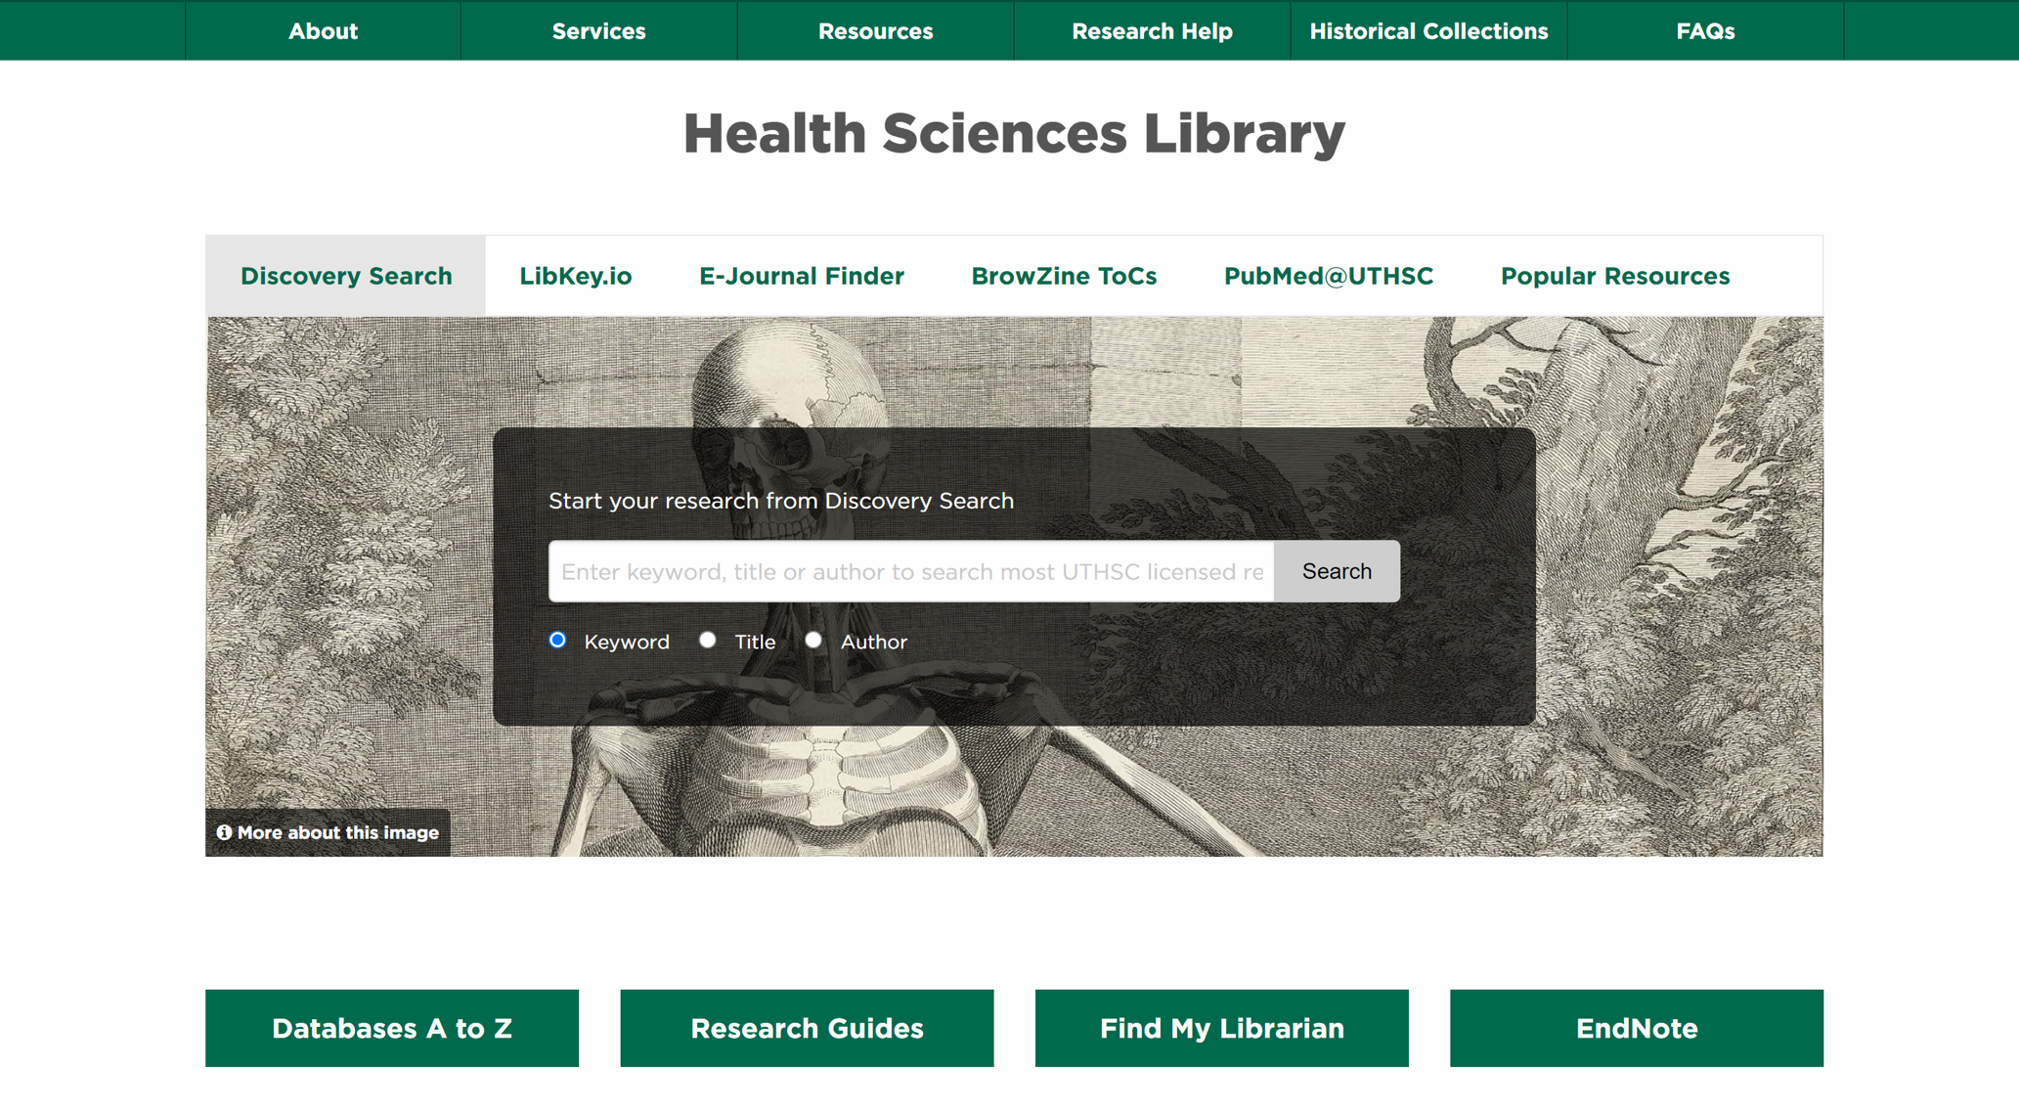
Library Homepage

Slide 4
PubMed
Leading database in biomedical literature with over 32 million citations
Free citation database
Full-text available from PubMed Central
https://pubmed.ncbi.nlm.nih.gov/

Slide 5
Google Scholar
Search engine for scholarly work
Sometimes full text is attached
Can find articles, books, citations to look for in other freely accessible places
https://www.scholar.google.com

Slide 6
TRIP
Formerly Turning Research Into Practice
High-quality evidence-based medicine resource
Searches secondary evidence, key primary research, Clinical Q & A’s, and other resources.
https://www.tripdatabase.com/

Slide 7
medRxiv
Preprint server for health sciences
Preprints are preliminary reports of work that have not been certified by peer review
https://www.medrxiv.org/

Slide 8
Academic Social Networking
Email the author
Academia.edu
ResearchGate
#ICanHazPDF
R/Scholar
The Health Sciences Library does not officially endorse usage of these social networking sites

Slide 9
Unpaywall
Searches for full-text of open access articles
Has browser plug-in
https://unpaywall.org/articles

Slide 10
Save Relevant Information
Within Databases (MyNCBI, Folders, etc)
EndNote (or other citation manager)
Google Docs
OneNote

Slide 11
InterLibrary Loan (UTHSC only)
Get access to an article or a book not available through the library
https://libguides.uthsc.edu/ill
Must register the first time
1-10 business days for requests to be filled
FREE!

Slide 12
InterLibrary Loan @ MPL
Get access to an article or a book not available through your library
https://www.memphislibrary.org/about/inter-library-loan-request-form/
Policies/more information can be found on MPL’s website

Slide 13
Non-Affiliate Resources
https://libguides.uthsc.edu/alumni
Online guide to assist you in finding free full text information
https://libguides.uthsc.edu/c.php?g=856666&p=6327276

Slide 14
Clinical Researchers Resources
https://libguides.uthsc.edu/distance
Online guide to assist you in accessing virtual Library resources

Slide 15
Clinical Researchers Resources
https://libguides.uthsc.edu/clinicalresearchers
Online resource guide to accompany this lecture series

Slide 16
The Library Has…
Databases
Ebooks
Apps
Librarians

Slide 17
Questions? library@uthsc.edu 901-448-5634

