Slide 1
Understanding Research Impact
Library Training Series
SESSION 11:
Jess Newman, MSIS

Slide 2
Learning Objectives
Identify examples, purposes, and limitations of both common and alternative metrics, and sources for those metrics
Understand journal vs article vs author level metrics
Choose and compile the correct metrics
Track and enhance researchers’ visibility with online profiles and scholarly IDs

Slide 3
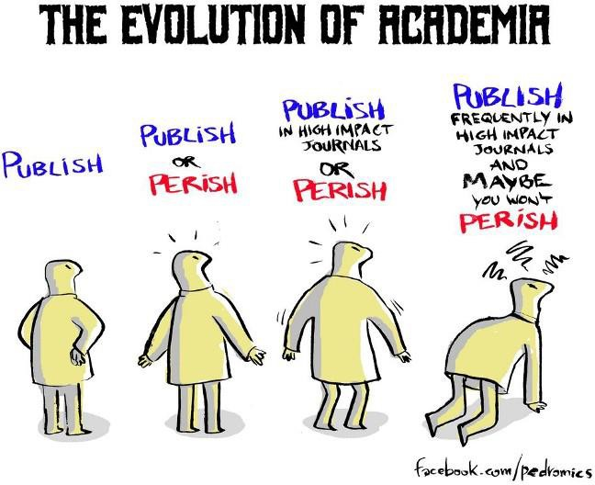
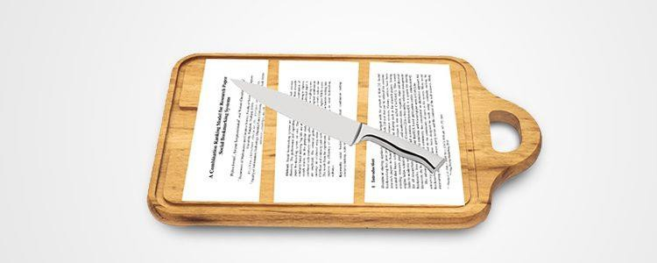
Publishing Pressures

Slide 4
Getting started
What is your goal?
Assessing a journal's quality or choosing a publication venue
Evaluating an author or group or works
Measuring the impact of a publication or other scholarly work

Slide 5
Metric Building Blocks:
Citations & Online Engagement

Slide 6
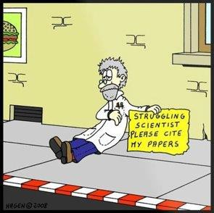
Most metrics start with citations.

Slide 7
Article Level Metrics
Common metrics to assess article level impact

Slide 8
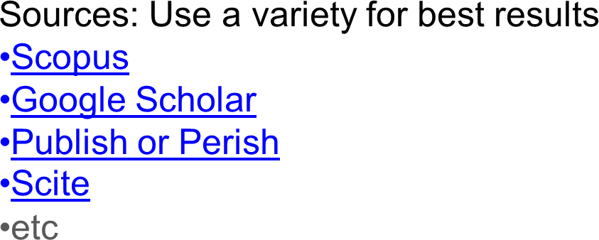
Citation Counts
A measure of the number of citations made to a work by other works.
Simple
Well recognized
Counts will likely vary slightly between sources
Often a significantly delay between
publication and citations (lag)

Slide 9
Citation Counts
A measure of the number of citations made to a work by other works.
Advantages
Established
Well understood
Easily quantifiable
Demonstrates academic engagement
with your work*
*This engagement might not always be positive, see The Citation Typing Ontology & Scite
Disadvantages
Slow to occur and thus disadvantage
early career researchers
Highly dependent on discipline
Do not demonstrate public or
commercial impact
Typically vary depending on source

Slide 10
Altmetrics are an *alternative* to traditional measures.

Slide 11
Altmetrics
Typically online engagement with a work, including downloads, shares, Tweets,
mentions, etc
Sources:
Altmetric (plugin and standalone
explorer)
PlumX (plugin as seen on Scopus & our Institutional Repository)
ImpactStory
Can track wider variety of works, e.g. videos, learning materials, patents, data sets
Demonstrates engagement outside of academia, e.g. media, general public, working professionals
May occur more rapidly

Slide 12
Altmetrics
Online engagement with a work, including downloads, shares, Tweets, mentions, etc
Advantages
Can begin to be measured immediately
Not limited to traditional scholarly
output, may include other types of works
May demonstrate impact outside of
academia
Compiles data from multiple sources
Disadvantages
Potentially “gameable” (e.g. bulk
downloads from bots)
Not all interaction is meaningful or
equally weighted (e.g. a click
vs mention in policy documents)
Sentiment is unknown

Slide 13
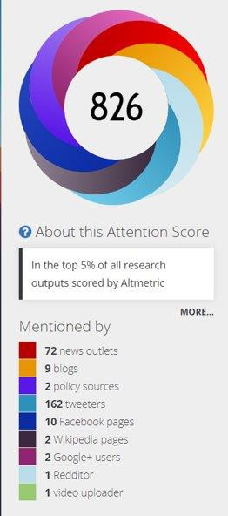
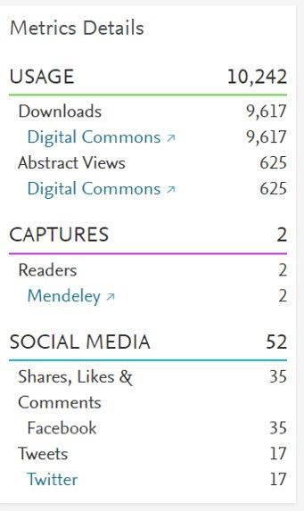
Altmetric and PlumX
Compiled measures of online attention surrounding your work

Slide 14
All following metrics are calculated from citations.

Slide 15
FCR (Field Citation Ratio)
indicates the relative citation performance of a publication when compared to
similarly-aged articles in its subject area
Article level measure
Benchmarking makes it easier to understand what your score means, and to compare across disciplines
Uses FoR (fields of research) subject codes
Source: Dimensions

Slide 16
FWCI (Field Weighted Citation Index)
ratio of the total citations actually received by the denominator’s output, and the total
citations that would be expected based on the average of the subject field
Article level measure (also calculated for authors in SciVal)
Benchmarked
A score higher than 1 indicates higher than average citation behavior
Source: Scopus

Slide 17
Author Level Metrics
Common metrics to assess an author or group of works

Slide 18
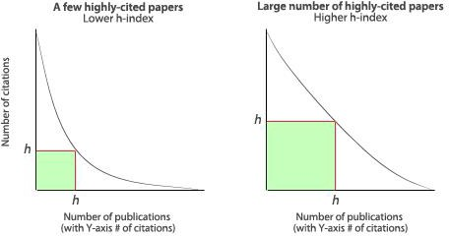
H-Index
number of papers (h) that have received at least h citations
An h of 15 means that an author has at least 15 publications that have
been cited at least 15 times each.
May vary depending on the source
(coverage of journal titles, time span, etc.)
Source: Scopus author search,
Google Scholar, Publons, Publish or Perish

Slide 19
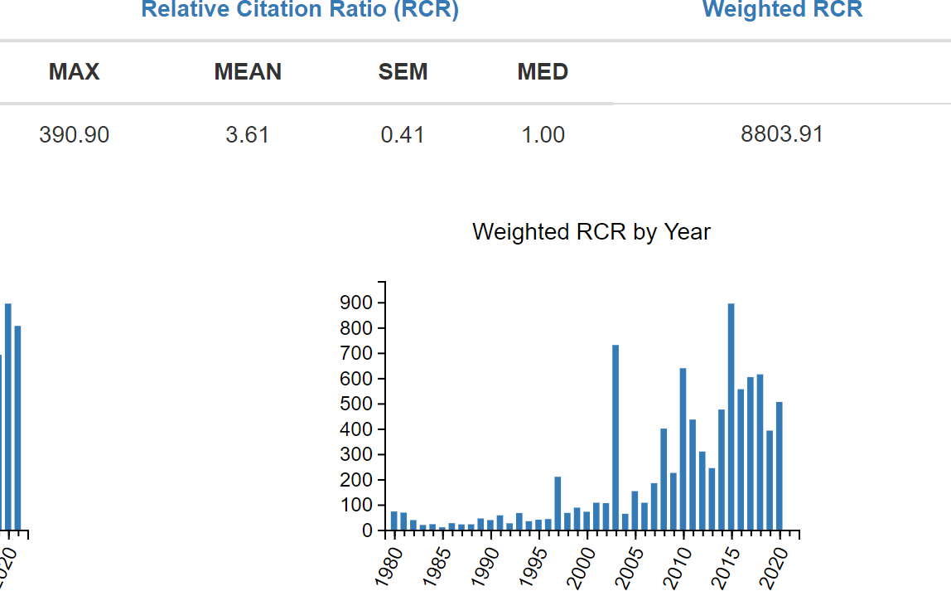
RCR (Relative Citation Ratio)
A field- and time-normalized citation measure from the NIH
Can be used for either article or author level
impact.
Normalization makes it easier to compare across domains.
Benchmarked to 1.0.
Only includes NIH publications (PubMed or PMC).
Source: iCite

Slide 20
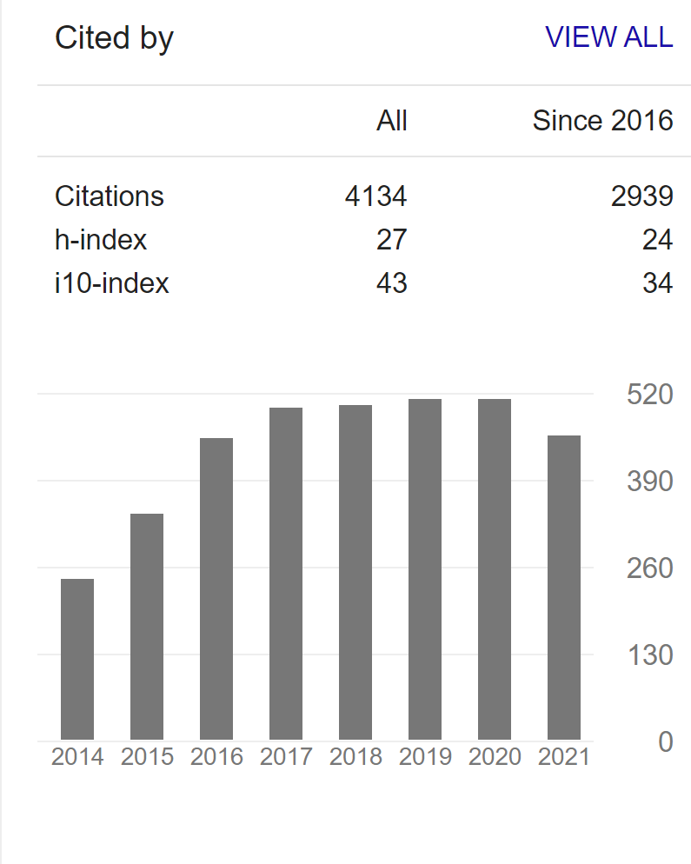
i10-Index
Number of publications the researcher has authored that have at least 10 citations
Created by Google Scholar, freely available
Very simple measure
Does not give extra credit to highly cited works
Source: Google Scholar

Slide 21
Journal Level Metrics
Common metrics to assess the quality or impact of a journal (formal body of
published works)

Slide 22
JIF (Journal Impact Factor)
Average of citation behavior over a 2 year period
Widely recognized measure provided exclusively by the Web of Science Journal Citation Reports
Created in 1955 by Eugene Garfield as a proxy for the importance or quality of a
journal
Has been criticized for being overly relied upon, misleading, and gameable
Source: Web of Science (not available through UTHSC), but often located on
journal webpages

Slide 23
CiteScore
average of citation behavior over a 4 year period
Scopus’ version of a JIF
Highly comparable but longer evaluation period (2 year vs 4 year)
Not normalized and should not be used to compare journals from different fields

Slide 24
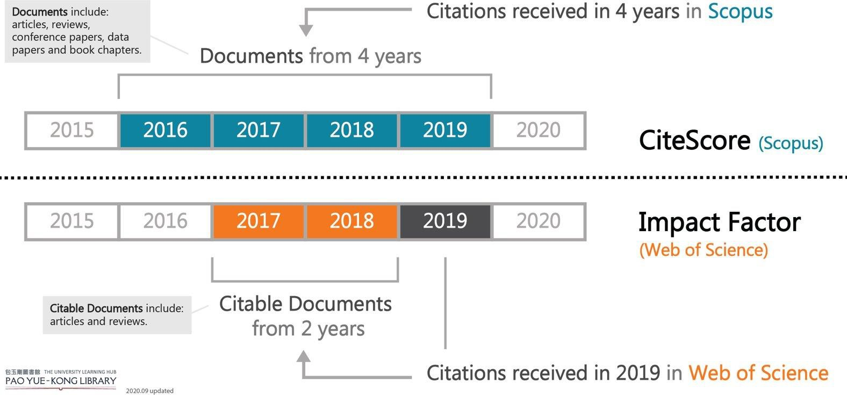
CiteScore is similar to JIF

Slide 25
SJR
Average number of weighted citations received in a year / number of documents in
previous 3 years.
Doesn't consider all citations of equal weight; the prestige of the citing journal is taken into account
Inspired by Google page rankings algorithm and the logic that "not all
citations are created equally“
Source: Scopus, SCImago

Slide 26
SNIP
Journal's citation count per paper / citation potential in subject field.
weights citations based on the number of citations in a field
If there are fewer total citations in a research field, then citations
are worth more in that field
Source: Scopus

Slide 27
For more information and additional metrics, visit our Directory of Metrics

Slide 28
Tips for Responsible (and effective!) Evaluation
Additional Reading: “Responsible Research Evaluation Starts Here”

Slide 29
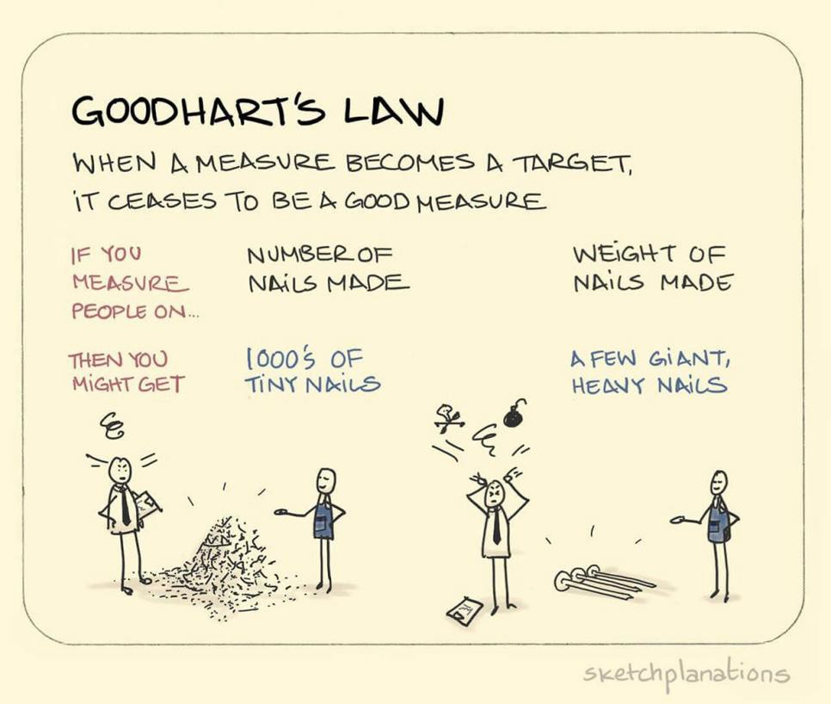
1. Don’t rely too heavily on any one measure

Slide 30
Author
2. Match the metric to the level of evaluation
/
Group Journal of
Works
Article
/ Work

Slide 31
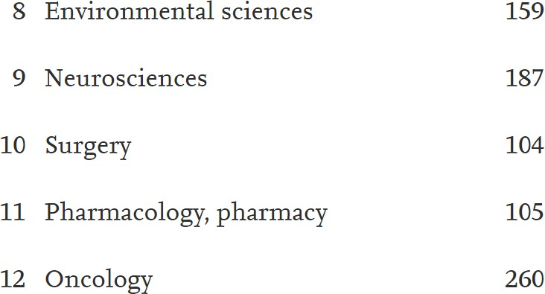
Average(ish) citations in top papers by field
3. Normalize for your field, use weighted measures, and benchmark when possible
https://www.sciencedirect.com/science/article/pii/S24058440 16322800

Slide 32
Use Cases & Demos

Slide 33
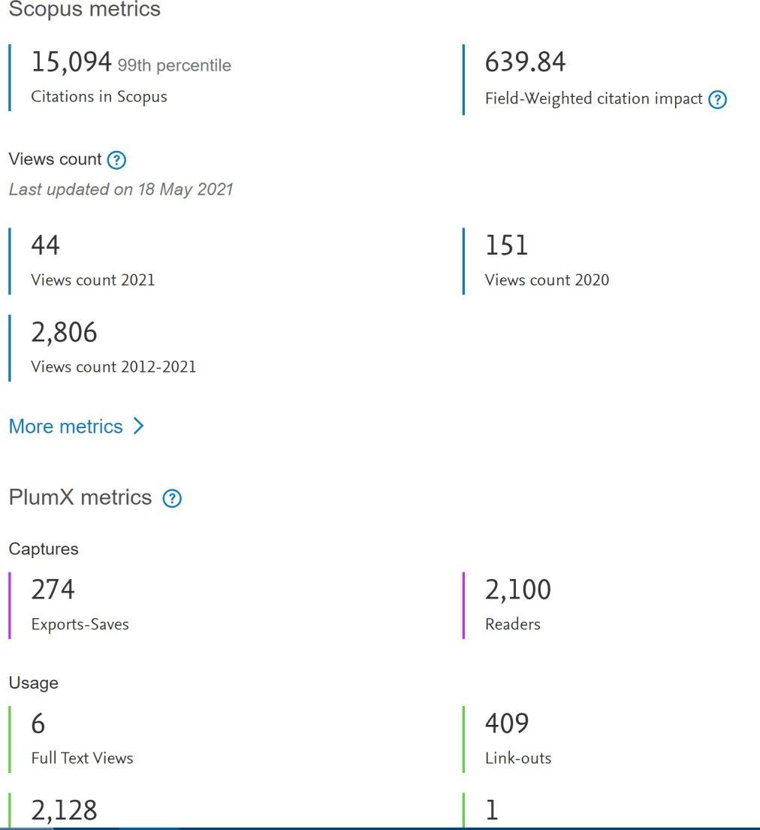
Scopus
Easy to use author profiles and article metrics, evaluate a group of authors using author search, evaluate and explore journal information

Slide 34
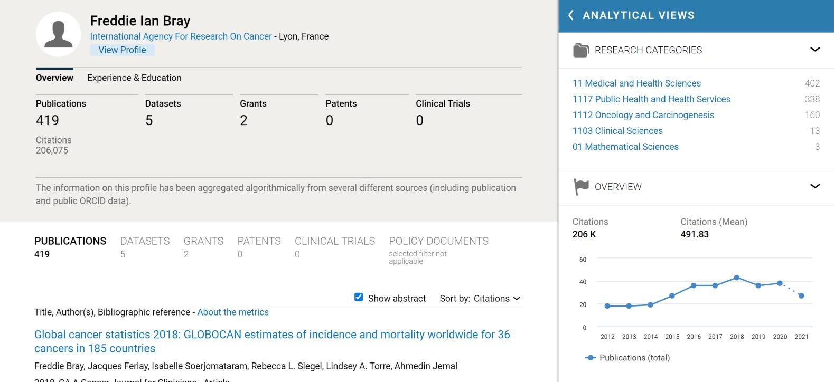
Dimensions
Unique content and researcher profiles

Slide 35
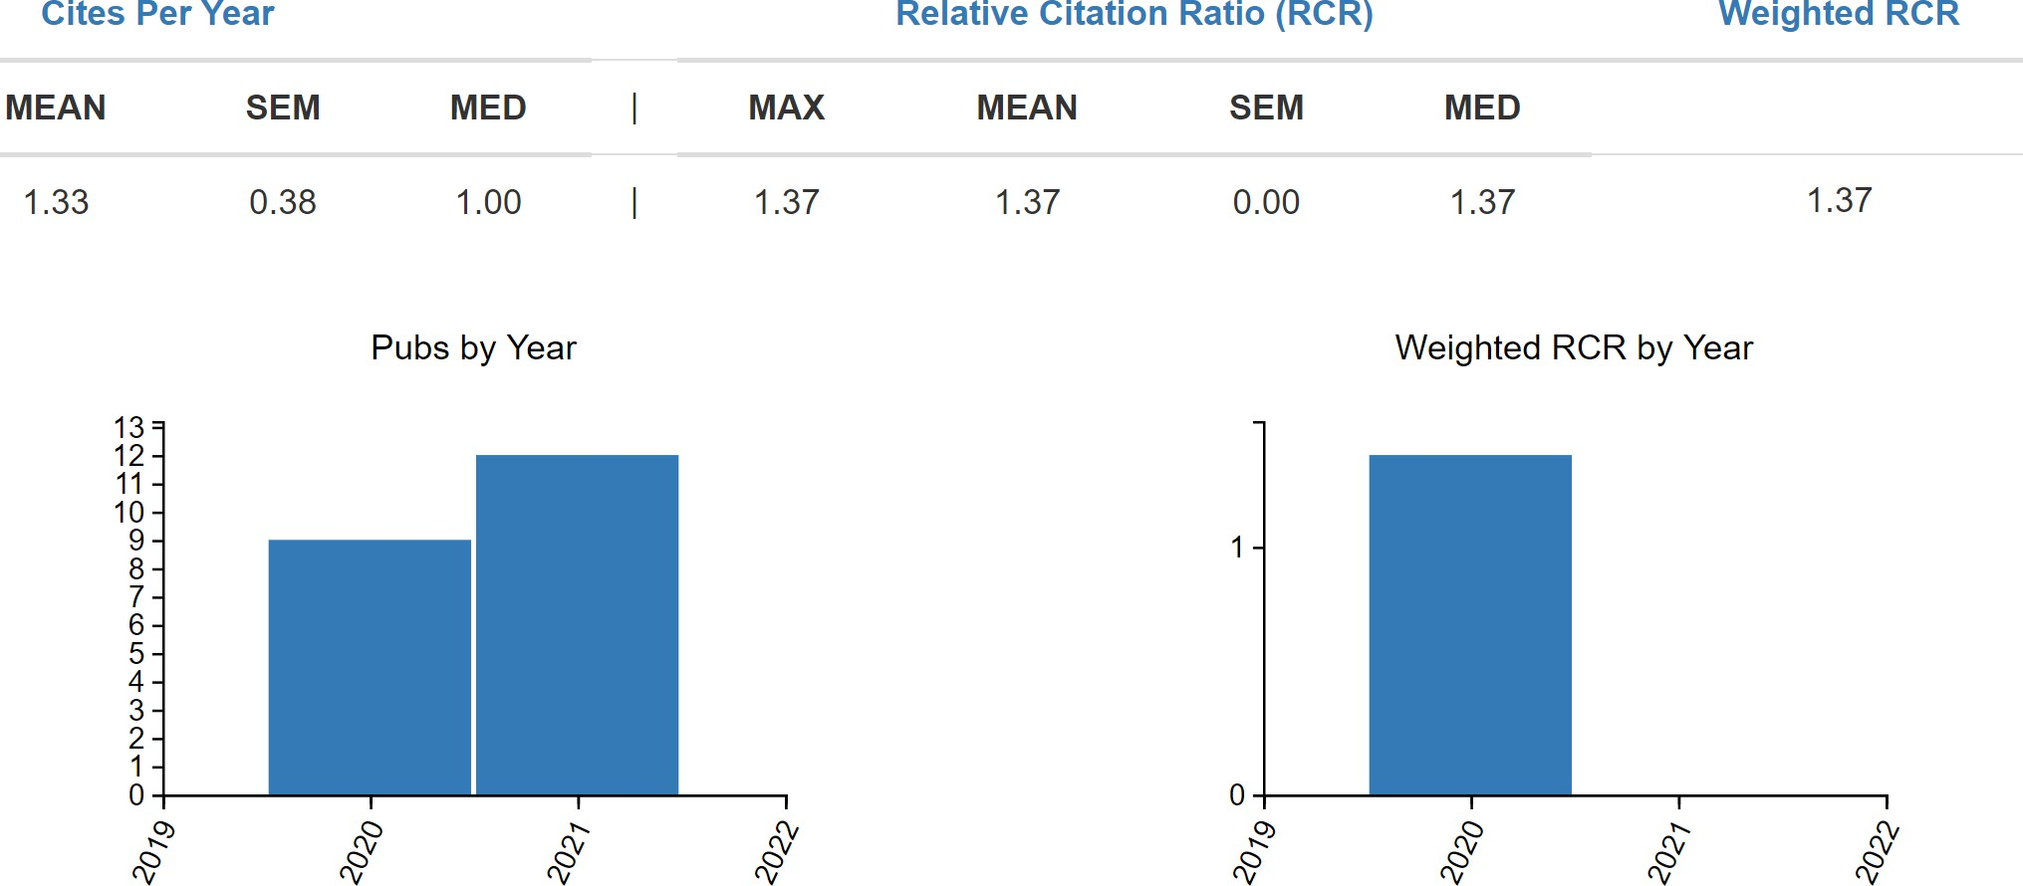
iCite
NIH supported tool for analyzing groups of works based on author name or PMID lists

Slide 36
Library Research Guide for Clinical Researchers
https://libguides.uthsc.edu/clinicalre searchers

