Slide 1
Research 101 sponsored by

Slide 2
Informed Consent / Assent and Documentation of the Informed Consent Process
Margaret Lynn, LMSW, RDN, CCRP, CIP
Director, Office of Clinical Research Development
University of Tennessee Health Science Center

Slide 3
Conflict of Interest Disclosure
Conflicts of Interest
A Conflict of Interest occurs when an individual has an opportunity to affect educational content about healthcare products or services of a commercial interest with which she/he has a financial relationship.
There is no conflict of interest for this presentation.
Commercial Support
No commercial support for this seminar
Non-Endorsement of Products
Non-applicable

Slide 4
Objectives
This slide presentation is of general information and should not be considered all-inclusive of information regarding informed consent process.
The Informed Consent Process (ICP) will be discussed for subjects who are capable of giving consent for themselves and will not include waiver or alteration of the process
During this session we will discuss components and best practices when conducting the informed consent process.

Slide 5
Regulations/Guidance for Informed Consent
1947, Nuremberg Code, Voluntary consent is essential.
1964 Declaration of Helsinki, World Medical Association, Consent should be obtained if at all possible and increased vigilance is needed for vulnerable subjects.
1979, Belmont Report had three core principals, Respect for persons, beneficence and justice. It clarified the informed consent. Informed consent is necessary part of showing respect for all persons.
1981 FDA harmonized 21 CFR 50 with OHRP 45 CFR 56, Subpart A. These code of federal regulations outline requirements for obtaining informed consent.

Slide 6
Regulations/Guidance for Informed Consent
1991, The Common Rule, 45 CFR 46, was adopted by many of the governmental agencies. The common rule is the baseline standard of ethics by which any government-funded research in the US is held. Nearly all academic institutions hold their researchers to these standards regardless of funding. The revised common rule was implemented on January 21, 2019.
199I International Conference for Harmonisation Good Clinical Practice [GCP E6 (R2)]. Freely given informed consent should be obtained from every subject prior to clinical trial participation.

Slide 7
Regulations/Guidance for Informed Consent
Other sources:
FDA Guidance Documents
IRB SOPs
Protocol
Department/Institution policies
State or local laws
Follow the most restrictive policies regarding the informed consent process.

Slide 8
Regulations/Guidance for Informed Consent
FDA 21 CFR 50 vs OHRP 45 CFR 46
The Elements of informed consent are virtually identical except:
FDA requires the confidentiality statement to note "the possibility that the FDA may inspect the records.“
FDA requires a statement regarding study registry in Clinicaltrials.gov.

Slide 9
Why is the Informed Consent Necessary?
Ethical requirement---respect for persons
Ensures the subject is fully and accurately informed
May demonstrates comprehension of the information
Authenticates decision is voluntary
Protect the rights, safety and well-being of subjects

Slide 10
Respect for Persons
Respect for persons demands that subjects enter into the research voluntarily and with adequate information
The principle of respect for persons thus divides into two separate moral requirements: the requirement to acknowledge autonomy and the requirement to protect those with diminished autonomy
Respect for persons requires that subjects, to the degree that they are capable, be given the opportunity to choose what shall or shall not happen to them. This opportunity is provided when adequate standards for informed consent are satisfied.

Slide 11
Informed Consent Process
More than the signing of the Informed Consent Form (ICF)
It is an ongoing process
Begins with recruitment material such as flyers, ads, emails.
Continues with the first conversation regarding the study with the potential subject
Discussion/Exchange of information/Dialogue regarding the actual consent form
Consideration of participation (allow time for thought, discussion with family / friends)
Need for additional information and/or clarification of information (Always allow time for questions)

Slide 12
Informed Consent Process
The process must occur without the possibility of
coercion or undue influence.

Slide 13
Informed Consent Process
Coercion: The practice of persuading someone to do something by using force or threats
Examples:
“Ms. Smith, you will not be able to obtain medical care from this clinic if you choose not to participate in this study.”
“Prisoner Jones, you will lose your canteen rights and / or will lose potential parole if you do not participate in a research study.”

Slide 14
Informed Consent Process
Undue influence, by contrast, often occurs through an offer of an excessive or inappropriate reward or other overture in order to obtain compliance.
Examples:
An investigator might promise psychology students extra credit if they participate in the research. If that is the only way a student can earn extra credit, then the investigator is unduly influencing potential subjects. If, however, the investigator offers comparable non-research alternatives for earning extra credit, the possibility of undue influence is minimized.
Undue influence also can be subtle. For example, potential subjects might feel obligated to participate in research if their physician is also the investigator, or students might feel pressure to participate in research if everyone else in the class is doing so.
Excessive payments for participation or compensation for time and travel.

Slide 15
Avoiding Coercion of Subjects: Example from University of California Santa Barbara Policy Statement
A subject's participation in research must be completely voluntary. Great care should be taken by investigators to avoid even the appearance of coercion or undue influence when recruiting potential study subjects. For this reason, the Human Subjects Committee (HSC) is required to review and approve all subject recruitment procedures and materials to make sure they do not downplay serious risks, give the impression that participation is mandatory, or emphasize financial inducements. Also, to reduce the potential for real and apparent coercion of study subjects, UCSB discourages investigators from direct solicitation of students in their own classes and employees in their own department. An investigator may recruit students or personnel from their department with general recruitment advertisements (such as a poster hanging in a lounge) or additional safeguards protecting subjects from actual or perceived coercion must be added to the protocol.

Slide 16
QUIZ
To reduce the potential for coercion or undue influence during recruitment of UCSB-affiliated human research subjects, investigators should:
1. Use general, public recruitment tools (such as posters, fliers and other advertisements) to recruit off-campus audiences only
2. Require participation by only those employees, students, and staff in their own departments
3. Completely exclude UCSB faculty, students, and staff from participation in research
4. Avoid directly approaching or soliciting employees, students or staff in their own classes and departments

Slide 17
Informed Consent Process
Informed consent does not end with the signing of a document
At each subsequent study visit, the following should occur and be documented:
Assessment that the subject understands what is being asked of him/her for the subsequent visit
The subject has an opportunity to ask questions and they are answered to their satisfaction
The subject truly wants to continue participation in the study

Slide 18
Who can obtain the IC?
The person obtaining consent must be qualified by
education, training, and/or experience!
Principal Investigator
Person obtaining Informed Consent should be/have:
listed as key study personnel on IRB application as being able to obtain IC
delegated on the Delegation of Authority Log by PI for this task
current CITI HSP/GCP training, (as applicable)
protocol training and documentation of the training
adequate medical knowledge/understanding understanding of the protocol procedures and Investigational Product (as applicable)
good communication skills

Slide 19
Where should the ICP be Conducted?
Setting:
quiet,
comfortable, and
private

Slide 20
When Should the ICP be Conducted?
Obtain consent before initiating ANY study-specific procedures, this includes wash-out periods (as applicable)
Every subject contact is an opportunity to reiterate information and ensure the subject continues to be fully informed and is voluntarily participating
If new information is learned that could affect the subject’s willingness to continue participation or changes to the protocol occur for the subject, the subject should be re-consented

Slide 21
How to Conduct the ICP?
The consent process can be analyzed as containing three elements and broken up into three sections:
information,
comprehension, and
voluntariness

Slide 22
How to Conduct the initial ICP?
Introduce yourself (establish a relationship with the subject)
Know the protocol
Explain the consent procedures and process to the subject
Make sure you explain procedures consistent with IRB approved process
Discuss the Informed Consent Form with potential subject
Allow adequate time to read the ICF and consider participation and all options
Allow appropriate amount of time for the subject to ask questions and have them answered in a satisfactory manner
Ensure subject is fully informed

Slide 23
How to Conduct the ICP?
Keep the subject in the center of the process
Be an active listener
Ask open-ended questions to assess understanding and comprehension
Be aware of non-verbal messages
Do not rush the process or the subject/ample time to consider participation

Slide 24
How to Conduct the ICP?
We focus on the “Yes” statement from the subject.
Verbally stating that they would like to participate in the research study
Signing the Informed Consent form
Equally important as the ability to say “Yes” is the ability of a subject to say “No”.
Is your subject feeling pressure or undue influence
Is your subject trying to please another (parent, provider, friend) by saying “Yes”
Is your subject cognitively able to say “No”.
Does your subject say “Yes” but actually means “No”.

Slide 25
How to Conduct the ICP?
Using language understandable to the subject
Correct version of the ICF was utilized
Usage of ICF aids: visual, demonstrations, etc. (must be IRB approved)

Slide 26
How does your consent form measure up when it comes to lay language?
Federal regulations §46.116 General requirements for informed consent.
The information that is given to the subject or the legally authorized representative shall be in language understandable to the subject or the legally authorized representative.
National Institutes of Health (NIH) recommendations, readability of patient education materials should not exceed a sixth-grade reading level. The average reading skill of U.S. adults is at the eighth-grade level.

Slide 27
This is what the consent form may look like to your subject.

Slide 28
Some Common language mistakes in the informed consent form.
Hi Ms. Smith.
At today’s visit you are going to have an EKG.
The electrocardiogram (EKG) records from the body surface and registers the differences in electrical potential generated by the heart. The signal recorded is determined by action potentials generated by millions of individual cells and their sequence of activation.

Slide 29
Some Common language mistakes in the informed consent form.
Replay:
Hi Ms. Smith:
At today’s visit you are going to have an EKG. The electrocardiogram (EKG) is a picture of electrical tracing of your heartbeat or your heart rhythm.

Slide 30
Some Common language mistakes in the informed consent form.
Ms. Smith: The study that you would be participating in, if you choose to volunteer, is a multi-armed research study. Each arm of the study would receive a different dose of the study drug.

Slide 32
Some Common language mistakes in the informed consent form.
Replay:
Ms. Smith: The study that you would be participating in, if you choose to volunteer, has four groups. Each group will receive a different dose of the study drug.

Slide 33
Some Common language mistakes in the informed consent form.
Mr. Smith, the study that you will be participating in, if you choose to volunteer, is a double-blinded study. At the end of the study you will be unblinded.

Slide 34
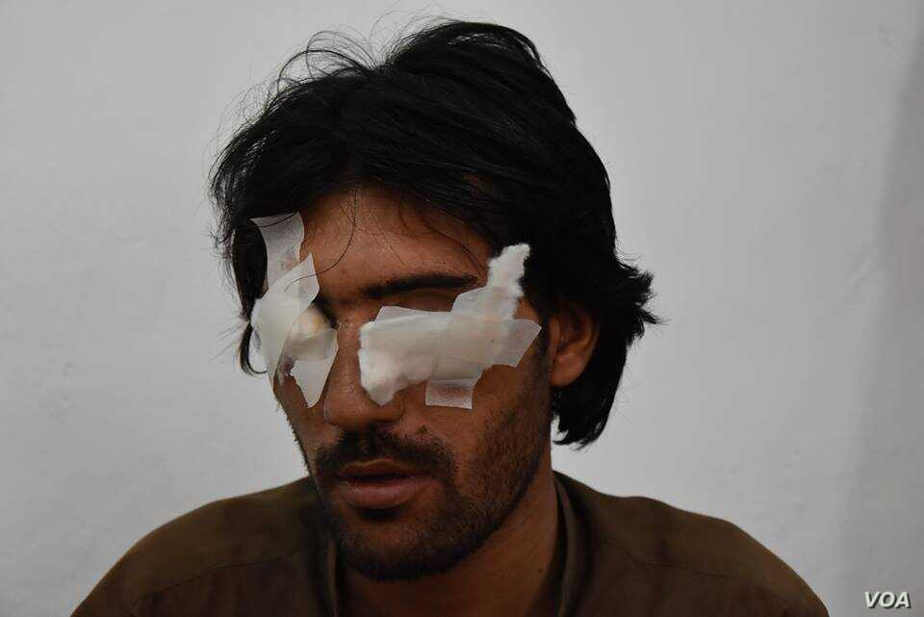

Slide 35
Some Common language mistakes in the informed consent form.
Replay
Mr. Smith, if you choose to participate in this study, you will not know which medication group you have been assigned to and your study doctor will not know either. This is called a double-blinded study. At the end of the study you will be find out to which group you were assigned.

Slide 36
Some Common language mistakes in the informed consent form.
Ms. Smith, this trial will last for three years.

Slide 38
Some Common language mistakes in the informed consent form.
Replay
Ms. Smith, this research study will last for three years.

Slide 39
How to Assess Understanding?
Assessing comprehension:
Teach-back ( “Tell me in your own words”)
Ask open-ended questions
How would you describe the purpose of the study to your family?
What will happen to you in this study?
What are the benefits of your participation in the study?
What are the potential risks involved if you participate?
What are the alternatives treatments available to you if you do not participate?

Slide 40
What Will be Discussed During the ICP?
The essential elements of the ICF
Research Voluntary participation Length of participation | Purpose/Procedures Which procedures are research and which are considered standard of care Risk/benefits/discomforts | Alternatives to participation Confidentiality Compensation for injury Contact Information

Slide 41
What Will be Discussed During the ICP?
The additional elements of the ICF:
Risks if the subject is or may become pregnant | Circumstances under which the subject’s participation may be terminated by the PI | Additional costs to the subject
New findings that may affect willingness to participate | Approximate number of subjects | Consequences of a subject’s decision to withdraw

Slide 42
What Are Some Barriers to Conducting the ICP?
For the subject:
Cognition/capacity
Level of education
Social/cultural values
Language
Age
Environment
Anxiety/fear
Readability of the ICF
Length of the ICF

Slide 43
What Is Needed After Obtaining Consent?
Original to be maintained with research documents unless approval by IRB to maintain in different manner
Give a copy to subject. Give a signed copy if following ICH GCP E6(R2)
Completion of the ICP documentation
Document and place a copy of the signed ICF in the subject’s medical record (if required)
Document continued desire to participate at each subsequent study visit
Re-Consent if needed
Remember--- IT IS an ONGOING PROCESS.

Slide 44
What to Document regarding the ICP?
Utilize a template for documentation of the process
Sufficient opportunity to consider participation
ample time and opportunity to inquire details of the trial
ICP conducted without coercion or undue influence
Subject states understanding of procedures, risks, and benefits
ICF signed and dated before any study procedures were performed

Slide 45
Example of consent documentation
Subject Name: ________________________________
On the _____ day of ________,_______ I discussed the possibility of participating in a clinical research trial for
Protocol __________________IRB #:__________________with the above named subject. The study was explained in
detail including, but not limited to, the contents of the informed consent, purpose of the study, visits and procedures
involved, risks and benefits, alternative treatments, confidentiality, right to withdraw from the study at any time,
treatments provided, arms of the study, and randomization. The subject was encouraged to ask questions. All questions
were answered to the satisfaction of the subject.
The subject was given adequate time to read the informed consent and the opportunity to discuss it. The subject demonstrated
understanding of the informed consent and a copy was given to the subject. The discussion was free of undue influence or coercion.
The informed consent was signed on _____/_____/______ at ______ am/pm prior to any study-related procedures being performed.
If the primary language of the adult subject or LAR; or of the child subject or parent/legal guardian is not English:
Primary language: ____________________________
A translator participated in the informed consent interview.
OR
A translator did not participate in the informed consent interview because the person who obtained consent is fluent
in both English and the primary language.
_______________________________ _______________
Signature of person obtaining consent Date
______________________________ _______________
Signature of PI (if different from above) Date

Slide 46
What Are Some Audit Findings Associated with the ICP?
Use of incorrect ICF/expired ICF
Research team completing dates/times for subject
Missing signatures/Omission of initials on each page (if this is a requirement)
Subjects not re-consented with revised consent
Incomplete/Incorrect dates/times
Check boxes within the consent incomplete

Slide 47
What Are Some Audit Findings Associated with the ICP?
Correction does not follow the SLIDE rule (single line, initialed by person making correction, date, explanation of correction if needed) or the use of white out
Investigator signature outside of 72-hour window (if this is a requirement)
ICP documentation not found
Person obtaining consent not qualified (not on Delegation Of Authority Log, not on IRB application)

Slide 48
What Needs to be Performed to Correct Errors?
Re-training
Maybe, use a buddy system to check for errors so that errors may be corrected prior to subject leaving the facility
Memo/Note to files for additional clarification
Report to the IRB per IRB SOPs
Internal audits
CAPA (Corrective and Preventive Action)

Slide 49
Summary-Doing IT Right!
Remember:
Follow the applicable regulations, guidance, and/or SOPs for obtaining consent
The ICP is conducted to protect the rights, safety, and well-being of subjects
Ensure that the subject is fully informed and has a good understanding of the research procedures
Be proactive if mistakes/errors occur, implement the appropriate CAPA
The process is on-going
Take your time and DO IT RIGHT!!

Slide 50
“No man is good enough to govern another man without the other’s consent .”
Abraham Lincoln
Presidential Term 1861- 1865

