Slide 1
Partnership: Collaborating to Offer COVID-19 Testing to the Community
Diana Dedmon, DNP, FNP-BC
Notes:
Hello, I am Diana Dedmon and I am an Assistant Professor and Director of Clinical Affairs for UTCON, I will be sharing a brief summary of how the CON collaborated with our community partners to volunteer during the COVID- 19 pandemic. In mid to late March 2020 the CON leadership began to have discuss of how the CON could contribute to service efforts. In the following days the CON began to communicate with the UTHSC Director of Student Affairs and Community Engagement office since they had begun the process of developing a management system to facilitate and track the volunteer efforts in an organized manner.

Slide 2
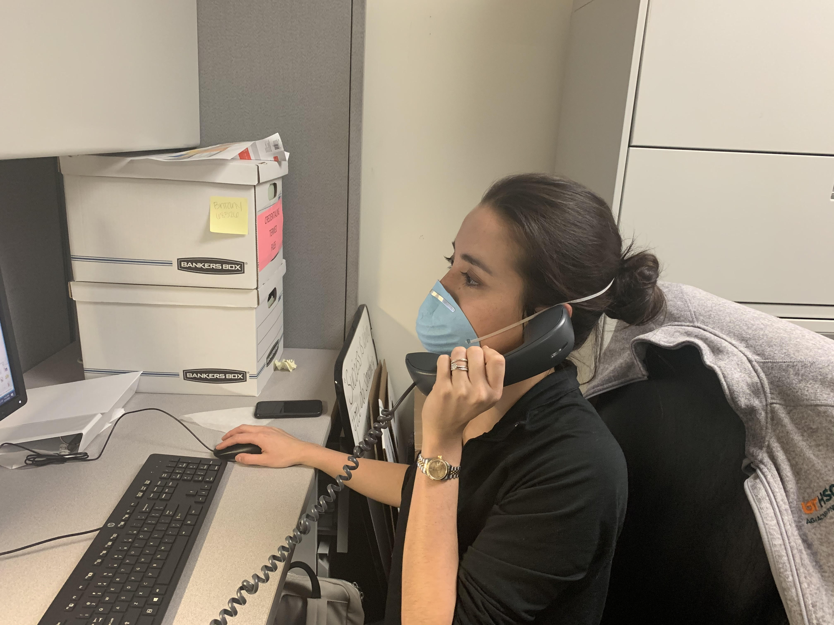
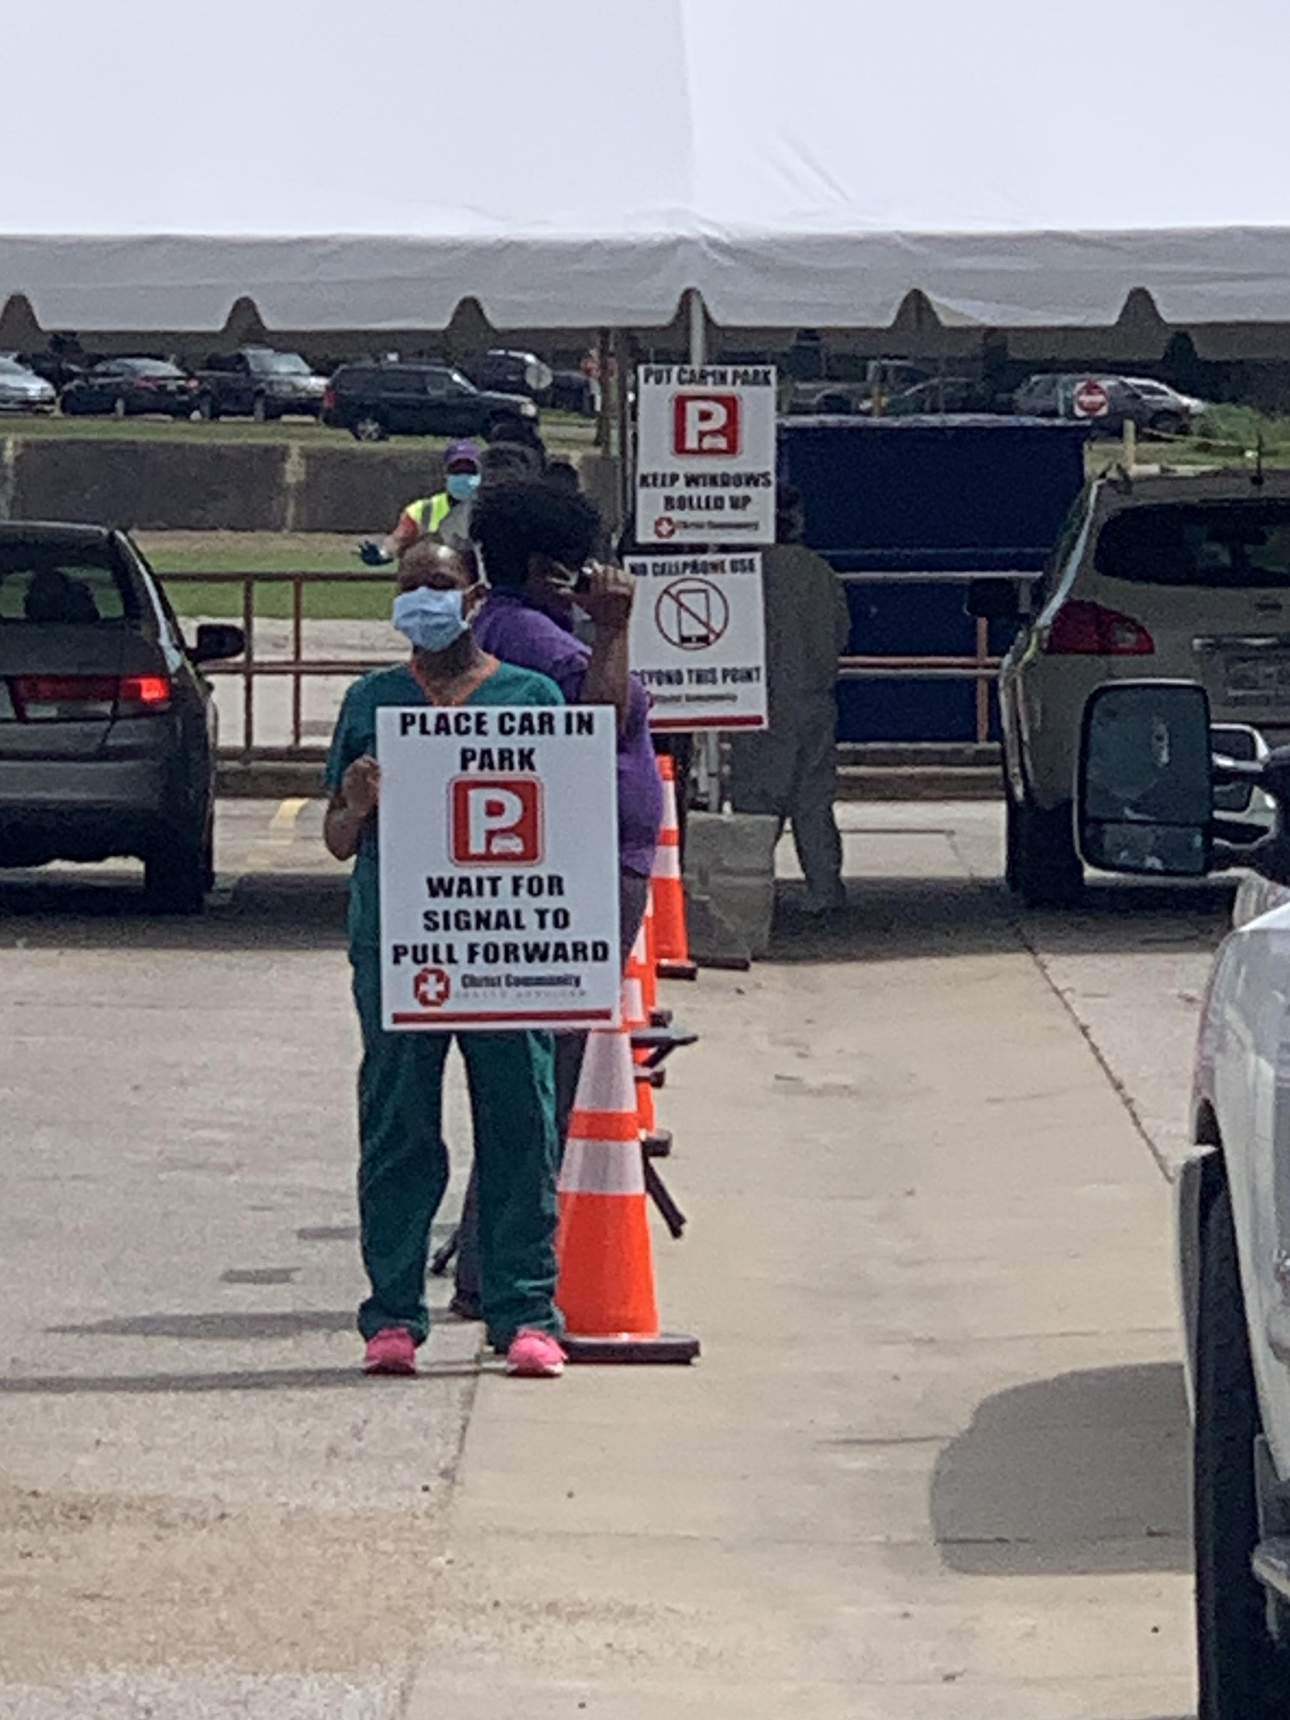
VOLUNTEER OPPORTUNITES
Volunteer Partners
• UTHSC/University Clinical Health
COVID-19 drive thru testing sites
Scheduling call center
Results call center
• Christ Community Health Services
Drive thru testing sites
Notes:
The COM and UCH developed one of the initial drive thru COVID testing sites in Memphis at the old Mid-South Fairgrounds or most recently known as Tiger Lane. The CON immediately recruited several senior DNP students to work with the COM at the initial drive thru site. Soon after the CON joined the UCH call centers who schedule patients and call positive results to patients who have been tested at Tiger Lane. In the next few weeks there was a request for help from Christ Community Health Center in Memphis. The CON volunteers began to serve at two different Christ Community drive thru locations that were located in zip codes with identified high COVID-19 positivity rates.

Slide 3
CON COVID-19 Volunteer Efforts
• 77 student and faculty volunteers
730 volunteer hours
Predictions/high risk areas
Targeted testing
Notes:
77 student and faculty volunteers have come together to serve our Mid South partners for a total of 700 hours. No one was required to volunteer, so these selfless individuals did not serve out of a place of obligation, but rather to give back to our community. According to Kaiser Health News, TN is performing more than double the number of tests needed to identify areas of outbreak, which assists officials with making decisions about re-opening the economy.

Slide 4
Collaborating with Partners
Build relationships
Share knowledge
Experience
Passion
Notes:
Serving with other colleges and organizations has given the CON the opportunity to further build relationships with other disciplines and with our community partners. There has been an exchange of knowledge between the CON and the partners that we have served alongside. The CON was able to demonstrate how our unique set of skills proved beneficial to each volunteer opportunity. The faculty used this time as an opportunity to better prepare our students to serve with interdisciplinary teams, collaborate and connect with partners, develop their creativity, teach different leadership styles and the importance of engaging in our community.

Slide 5
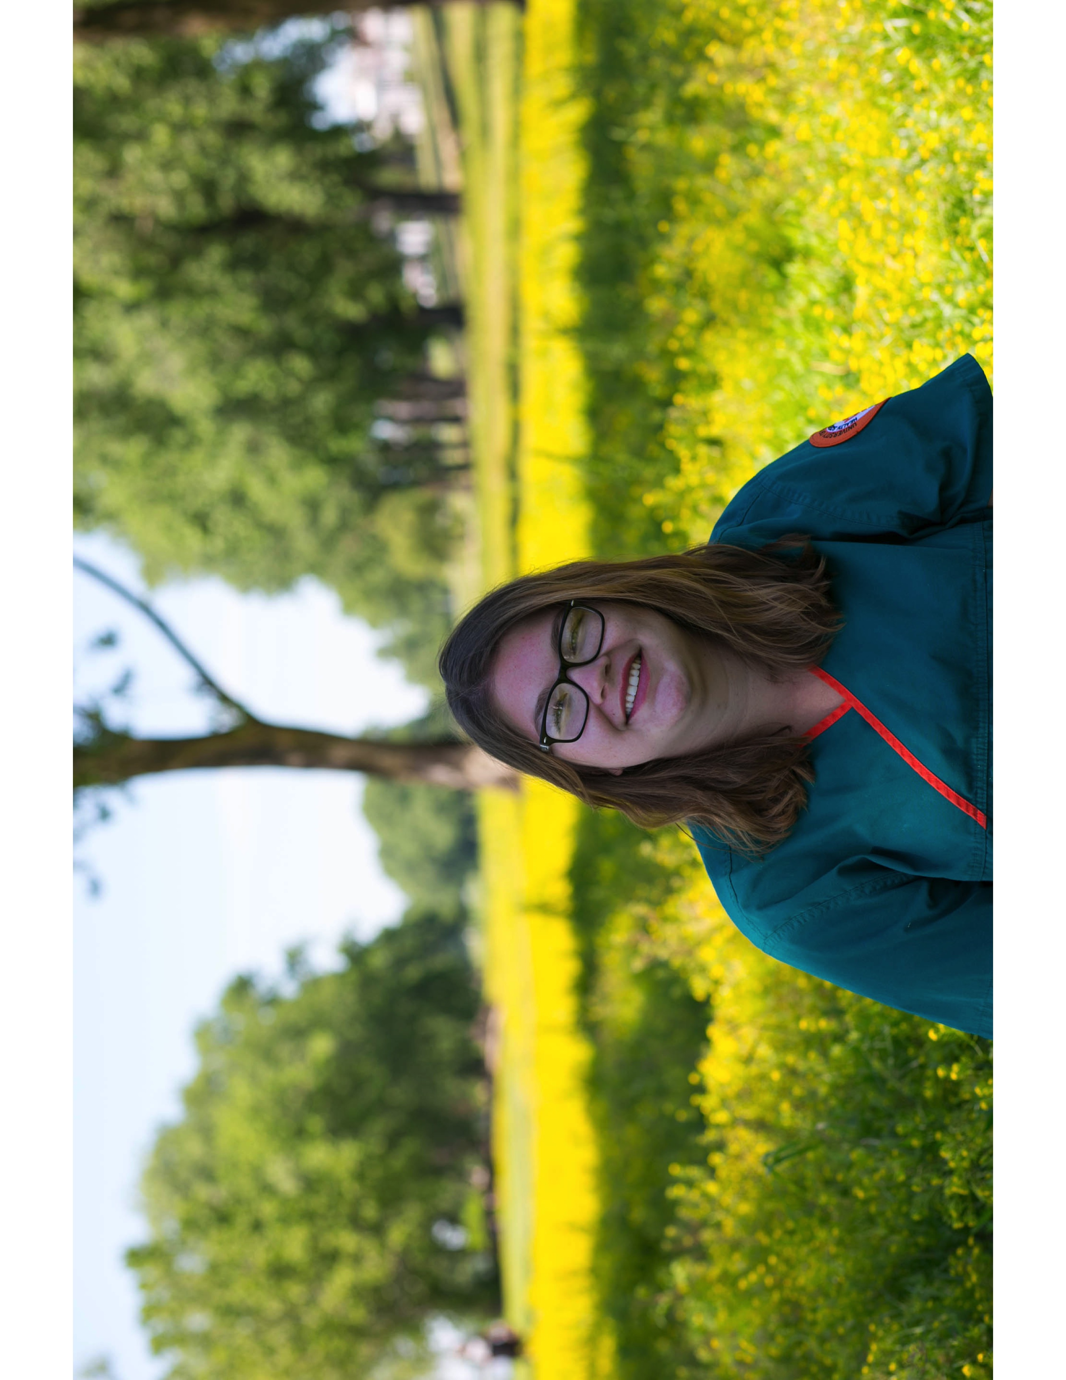
Notes:
This is one of out BSN students, Lacey Ballard, she served with a truly altruistic attitude. Lacey served M-F at the Christ Community location on Third Street for greater than 4 weeks. One day I asked her to write a narrative and explain to me why she felt compelled to serve so often, she offered a very inspirational response. She simply said that, “The opportunity to serve embodies the spirit of a nurse.” She went on to explain how she felt compelled to help in any way that she could. Lacey said, “There were some days that I felt as if I really wasn’t doing anything, but other days I know I helped a lot.” Lacey has been happy to serve in whatever capacity was needed, she has served as an administrative assistant, a translator, directing traffic and as a lab tech. It is obvious that Lacey has been glad to help.

Slide 6
Needs are met
Questions are answered
Fears are calmed
Comfort is given
Notes:
Needs are met for patient and organizations.
Questions are answered for the community.
Fears are calmed (example of man in drive thru).
Comfort is given through service.

Slide 7
Notes:
The CON answered the call to help with the COVID-19 volunteer efforts and had the opportunity to collaborate in sometimes very creative ways with our partners. Many volunteers have expressed that they find it a privilege to be a part of helping others through assisting like-minded partners motivated by the same goal. I believe volunteering has offered a distraction and a sense of direction in such an uncertain time. Volunteerism makes a difference in our communities while making us stronger individually and as a college. It has been a privilege to serve alongside our community partners and I am thankful for everyone that felt the call to serve in the volunteer efforts.

