Slide 1
Spectrum of Metabolic Bone Diseases in CKD: Pathogenesis, Clinical Significance, and Diagnosis
Tiffani R. Garrett
Renal Grand Rounds
March 6th, 2012

Slide 2
Learning Objectives/Relevant Questions
Function of bone
Review normal bone remodeling
Types of bone disease
Prevalence
Clinical significance
Vascular calcifications
fractures
Diagnosis
Bone Biopsy
PTH
Bone turnover markers in CKD

Slide 3
Function of bone
Structural
Locomotion
Respiration
Protection of internal organs
Metabolic
Calcium
Phosphorus
Carbonate
Contributes to hydrogen ion concentration
Notes:
aR

Slide 4
Types of Bone
Cortical bone is dense and compact.
the outer part of all skeletal structures.
The lamellae may be extensive (circumferential) or tightly packed in concentric circles in osteons.
comprises 80 percent of the skeletal weight.
Its major function is to provide mechanical strength and protection, but it can participate in metabolic responses, particularly when there is severe or prolonged mineral deficit.

Slide 5
Types of Bone
Trabecular (cancellous) bone is found inside the long bones, particularly at the ends
Located throughout body of vertebrae and inner portions of the pelvis and other flat bones
Important contributor to mechanical support
More metabolically active than cortical bone, supplies initial minerals in acute deficiencies

Slide 6
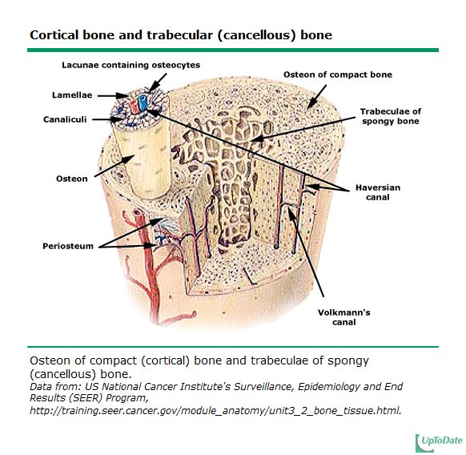

Slide 7
Normal bone remodeling
Remodeling: replacement of old bone with new bone at the same location. Responsible for complete regeneration of the adult skeleton every 10 years.
Removal of bone (resorption) is the task of osteoclasts.
Formation of new bone is completed by osteoblasts
Both processes are controlled by osteocytes

Slide 8
Cellular Components of Remodeling
Osteocytes 90-95% of all bone cells
Viable for years (even decades)
Osteoblast <5% of bone cells
Lifespan of weeks
Osteoclast <1 % of bone cells
Lifespan of days

Slide 10
The purpose of remodeling in the adult skeleton is unclear but most likely it serves to remove
dead osteocytes
maintain oxygen and nutrient supply
maintain the appropriate level of matrix hydration
and repair fatigue damage, thus preventing excessive aging and its consequences.
Stages of remodeling have different lengths
Resorption 2 weeks
Reversal 4 to 5 weeks
Formation up to 4 months

Slide 11
Osteocytes
choreographers of the remodeling process on the bone surface by virtue of their ability to:
sense worn-out bone
direct osteoclasts to the site that is in need of remodeling
produce the RANKL and sclerostin that regulate osteoclast and osteoblast generation, respectively
control and modify the mineralization of the matrix produced by osteoblasts*
Mechanical forces sustain osteocyte survival
Control and modify the mineralization of the matrix produced by osteoblasts by secreting factors MEPE and FGF23*
Bonewald L.F., Ann N Y Acad Sci. 2007 Nov;1116:281-90. Epub 2007 Jul 23.

Slide 13
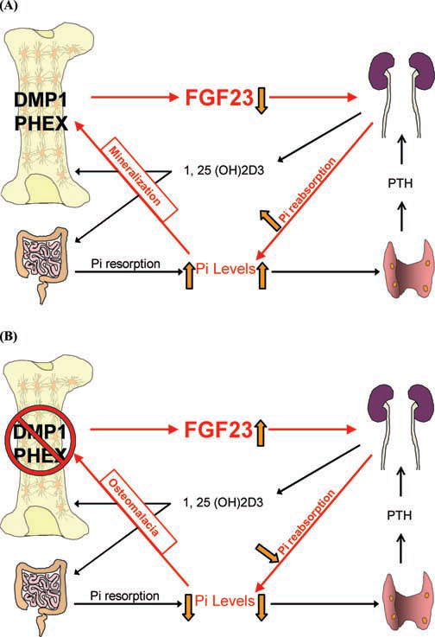
ANNALS OF THE NEW YORK ACADEMY OF SCIENCES
FIGURE 2. Simplified diagram of the interactions between Dmp1, Phex, and FGF23,
all shown to be expressed in osteocytes. Both Dmp1 and Phex appear to downregulate
FGF23 expression, which in turn allows reabsorption of phosphate by the kidney thereby
maintaining sufficient circulating phosphate to maintain bone mineral content (A). In the
absence of eitherDmp1or Phex, FGF23 is highly elevated in osteocytes leading to phosphate
excretion by the kidney thereby lowering circulating phosphate leading to osteomalacia and
rickets (B). Osteocytes appear to play a major role in mineral homeostasis.

Slide 14
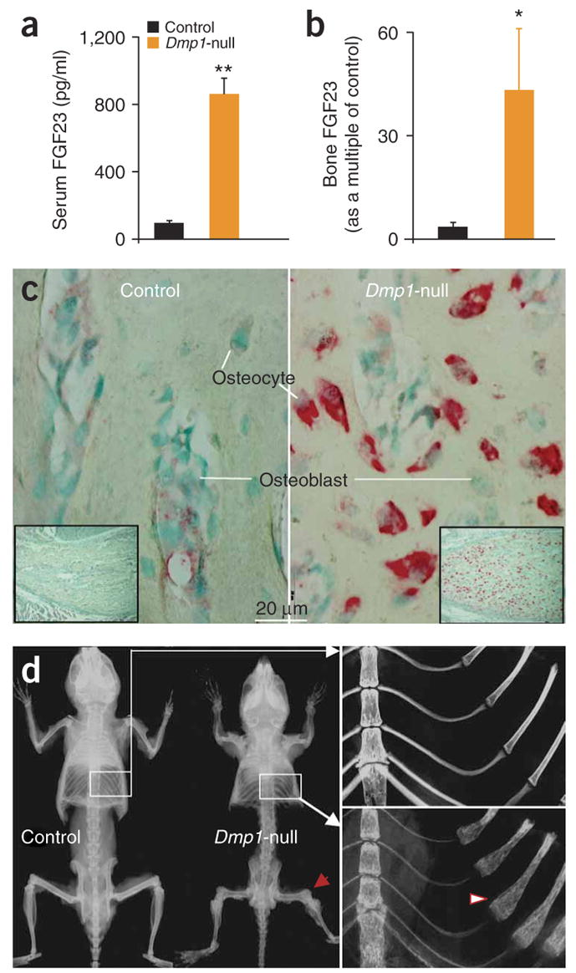
FENG, J.Q., L.M. WARD, S. LIU, et al. 2006. Loss of DMP1 causes rickets and osteomalacia and identifies a role for osteocytes in mineral metabolism. Nat.Genet. 38: 1310–1315.

Slide 15
Renal Osteodystrophy

Slide 16
DEFINITION

Slide 17
KDIGO ( Kidney Disease: Improving Global Outcomes) sponsored a Controversies Conference on Renal Osteodystrophy
Develop a clear, clinical revelant, and internationally acceptable definition and classification system
Develop a consenus for bone biopsy evaluation and classification
Evaluate laboratory and imaging markers for the clinical assessment of patients with CKD
Moe S, Drueke T, Cunningham J, et al. Definition, evaluation, and classification of renal osteodystrophy: a position statement from Kidney Disease: Improving Global Outcomes ( KDIGO), Kidney Int 2006; 69:1945

Slide 18
Renal Osteodystrophy
“recommended that the term be used exclusively to define alterations in bone morphology associated with CKD, which can be further assessed by histomorphometry, and the results reported based on a unified classification system that includes parameters of turnover, mineralization, and volume”
Moe S, Drueke T, Cunningham J, et al. Definition, evaluation, and classification of renal osteodystrophy: a position statement from Kidney Disease: Improving Global Outcomes ( KDIGO), Kidney Int 2006; 69:1945

Slide 19
CKD-Mineral and Bone Disorder
“A broader clinical syndrome that develops as a systemic disorder of mineral and bone metabolism and/or extra- skeletal calcification”
Moe S, Drueke T, Cunningham J, et al. Definition, evaluation, and classification of renal osteodystrophy: a position statement from Kidney Disease: Improving Global Outcomes ( KDIGO), Kidney Int 2006; 69:1945

Slide 20
Background

Slide 21
Approximately 26 million Americans ( 1 in 9 adults) have CKD
Bone abnormalities are common complications
Complications usually start in CKD stage 2 and are found in almost all patients with CKD stage 5
Increasing evidence that these complications are associated with increased risk of cardiovascular calcification, morbidity, and mortality
In practice bone biopsy is used infrequently because it is invasive and often expensive and procedure that requires special processing not widely available*
*Moe S, Drueke T, Cunningham J, et al. Definition, evaluation, and classification of renal osteodystrophy: a position statement from Kidney Disease: Improving Global Outcomes ( KDIGO), Kidney Int 2006; 69:1945
Malluche HH, Faugere MC. Renal Osteodystrophy in the first decade of the new millennium: analysis of 630 bone biopsies in black and white patients. Journal of Bone and Mineral Research. June 2011 1368-1376

Slide 22
Most common forms of renal osteodystrophy are attributable largely to variations in the plasma levels of parathyroid (PTH)
Circulating PTH levels have been used a surrogate indicator of bone turnover, along with serum calcium, phosphorus, and alkaline phosphatase levels to evaluate, diagnosis and guide treatment
Several clinical trials have questioned the specificity of PTH as an indicator of bone turnover
Moe S, Drueke T, Cunningham J, et al. Definition, evaluation, and classification of renal osteodystrophy: a position statement from Kidney Disease: Improving Global Outcomes ( KDIGO), Kidney Int 2006; 69:1945

Slide 23
CLASSIFICATION

Slide 24
Types of Renal bone disease
Osteitis fibrosa cystica
Adynamic bone disease
Osteomalacia
Mixed uremic osteodystrophy

Slide 26
Osteitis fibrosa (OF)
High bone turnover
Secondary hyperparathyroidism mediated
3 main abnormalites contribute to pathogenesis
Phosphate retention
Decreased free calcium level
Decreased calcitriol level
Increased PTH levels first become evident when GFR drops below 60ml/min/1.73m(2), serum calcium and phosphate levels are normal until eGFR decreases to approximately 20ml/min/1.73m(2)
Low levels of calcitriol are commom at higher levels of GFR

Slide 27
Phosphorous and Secondary Hyperparathyroidism

Slide 29
Direct Phosphorus effect on PTH
Clin Invest. 1996 Jun 1;97(11):2534-40.
Phosphorus restriction prevents parathyroid gland growth. High phosphorus directly stimulates PTH secretion in vitro.
Slatopolsky E, Finch J, Denda M, Ritter C, Zhong M, Dusso A
Source Department of Internal Medicine, Renal Division, Washington University School of Medicine, St. Louis, Missouri 63110, USA.
Experimental study that examined dietary phosphate restriction in rats with ESRD. Results revealed that normalization of plasma phosphate lowered PTH levels from 130 to 35 pg/ml. Also prevented parathyroid cell growth
serum calcium and calcitriol levels were not altered

Slide 30
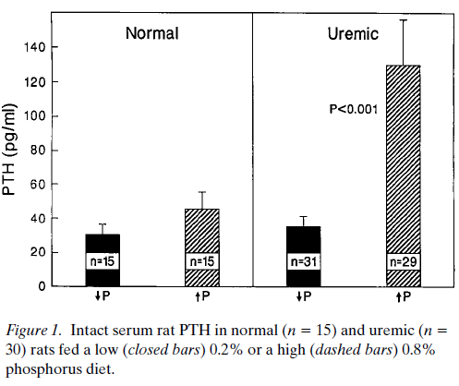

Slide 31
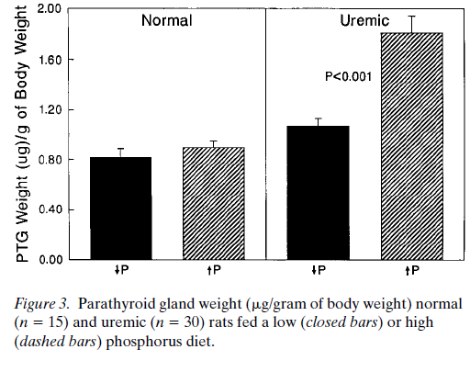

Slide 32
Calcitriol and Secondary Hyperparathyroidism

Slide 33
Decreased calcitriol activity
Renal calcitriol production declines due to several mechanisms
Decline in GFR: limits delivery of 25- hydroxyvitamin D to the site of 1 α-hydroxylase activity in PCT
Phosphate retention: indirectly stimulates FGF-23 which directly decreases activity of 1 α-hydroxylase
PTH fragments directly decrease calcitriol activity
Low levels of calcitriol contribute to the pathogenesis of hyperparathyroidism

Slide 34
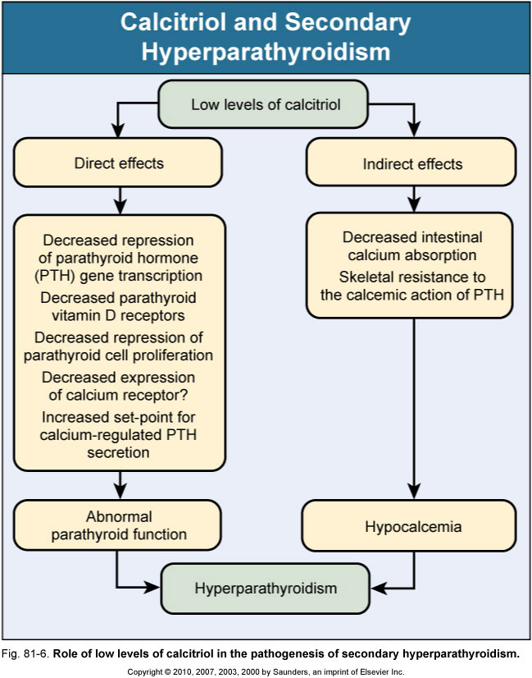

Slide 35
Other Factors
Hypocalcemia
Increases PTH mRNA levels and stimulates proliferation of parathyroid cells over days to wks
Decrease number of calcium-sensing receptors
FGF 23
Acts to suppress PTH secretion
Skeletal resistance to PTH
Downregulation of PTH receptors
Metabolic acidosis
Stimulates cell mediated bone resorption via osteoclastic activity

Slide 36
Adynamic bone disease
Bone turnover is markedly reduced
Lack of bone cell activity (osteoblasts and osteoclasts)
No increase in osteoid formation as seen in osteomalacia
Consequence of inadequately low PTH which causes suppression or cessation of both osteoblast and osteoclast
Iatrogenic oversuppression ( high doses of calcium containing phosphate binders, high dialysate calcium concentration, high dose active vitamin D metabolites, and after parathyroidectomy)

Slide 38
Effects of Sevelamer Hydrochloride and Calcium Carbonate on Renal Osteodystrophy in Hemodialysis Patients Ferreira A, Frazao JM, Monier- Faugere MC, et al.
54 week randomized, open label study
119 hemodialysis patients received baseline bone biopsy
Assigned to calcium carbonate or sevelamer hydrochloride for 1 year, then second biopsy perfomed
Serum phosphorus, calcium, and iPTH were controlled
ABD most frequent baseline bone abnormality (59%)
Primary end points (1) changes from baseline in mineralization lag time in lamellar bone and osteoid thickness and (2) changes in bone turnover
Secondary end points were the percentage of patients who developed (1) Osteomalacia, (2) HPBD, and (3) ABD

Slide 39
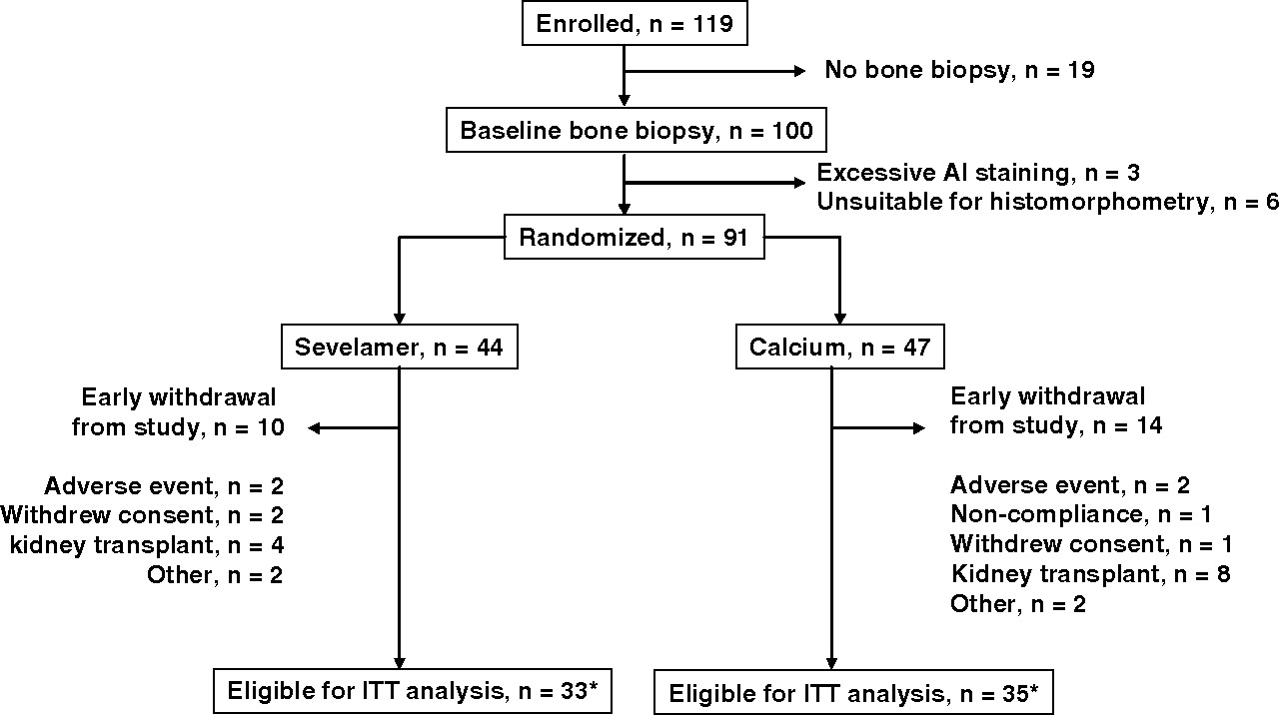
Ferreira A et al. JASN 2008;19:405-412

Slide 40
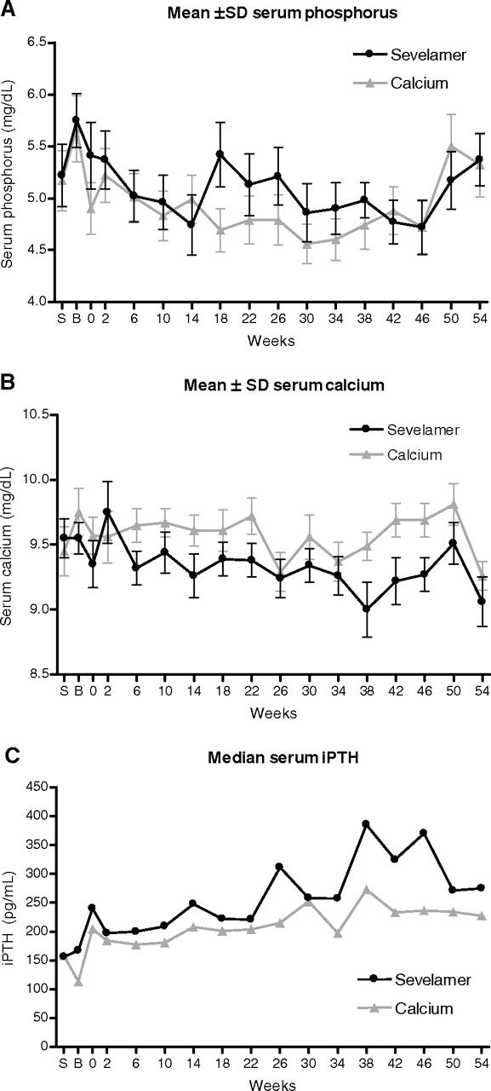
Ferreira A et al. JASN 2008;19:405-412

Slide 41
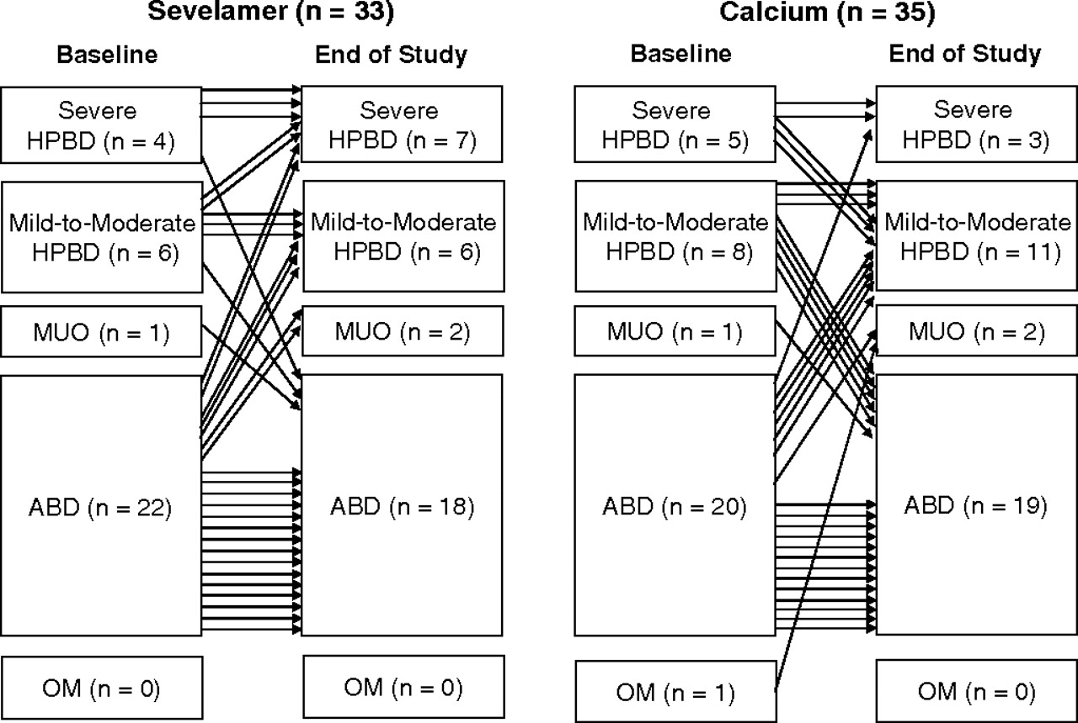
Ferreira A et al. JASN 2008;19:405-412

Slide 42
Results/Discussion
No statistically significant difference in bone turnover or mineralization between the two groups
Sevelamer group showed increased bone formation and trabecular architecture improvement*
Higher use of calcitriol and vitamin d analogs in sevelamer group ( lower calcium levels)
High prevalence of ABD despite most patients being treated in accordance with K/DOQI guidelines
98% were on calcium carbonate prior to study
65% had received calcitriol
May explain why baseline mean iPTH value were low (150 to 300 pg/ml)

Slide 43
Osteomalacia
Reduction in bone turnover, bone- forming cells and bone-resorbing cells
Marked increase in the volume of unmineralized bone
Historically associated with aluminum toxicity in ESRD patients
Incidence has decreased with abandonment of aluminum- based phosphate binders and more efficient techniques for water treatment

Slide 44
Mixed Uremic Osteodystrophy
Elements of high and low bone turnover
Marrow fibrosis and increased unmineralized osteoid

Slide 45
Histology

Slide 46
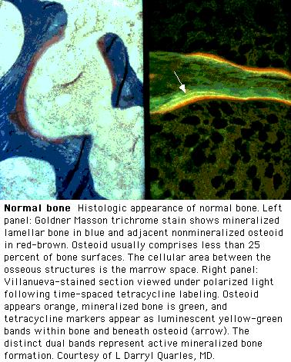
Normal Bone

Slide 47
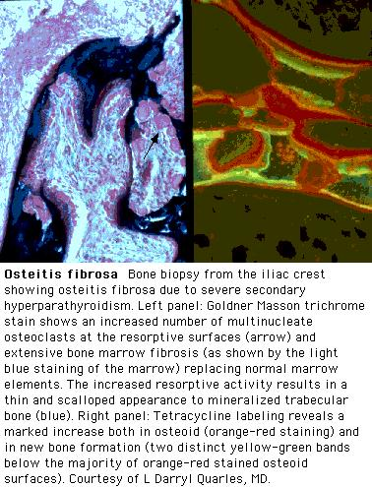
Osteitis Fibrosa

Slide 48
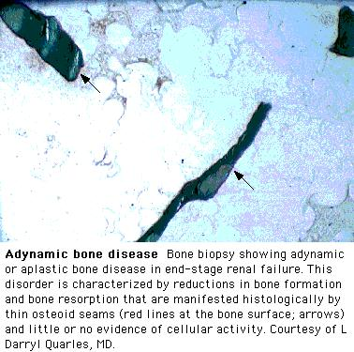
Adynamic Bone Disease

Slide 49
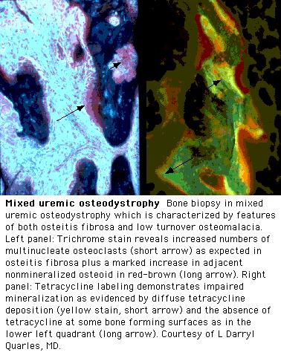
Mixed Uremic Osteodystrophy

Slide 50
Osteomalacia

Slide 51
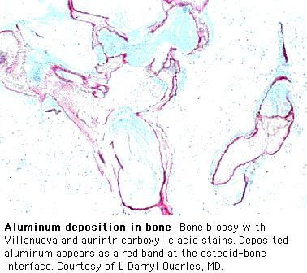

Slide 52
EPIDEMIOLOGY

Slide 53
In hemodialysis patients OF and adynamic bone disease now occur with almost equal frequency
In peritoneal dialysis patients adynamic bone lesion predominates
Currently adynamic bone disease represents the principal bone lesion likely due to an increasing diabetic population
Among CKD patients not yet on dialysis adynamic bone disease is more prevalent

Slide 54
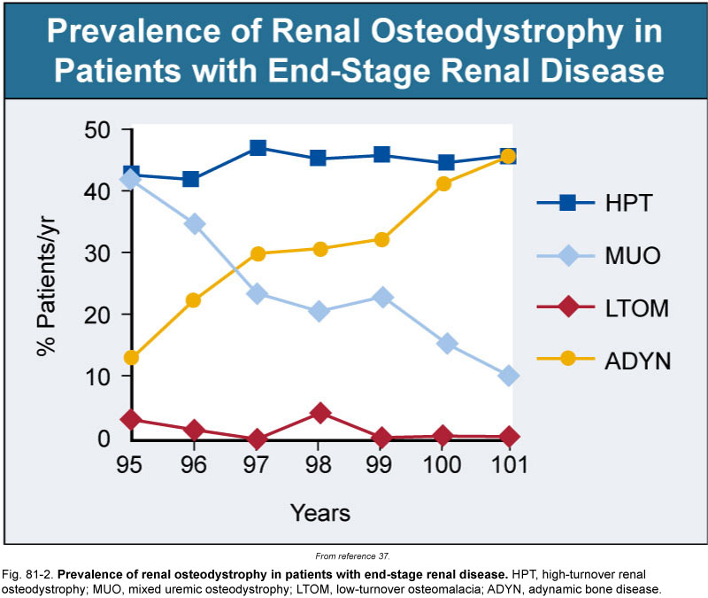

Slide 55
Purpose: (1)describe the distribution of different types of ROD in patients not yet on dialysis (2) establish risk factors that might influence the development of various types of ROD
84 ESRD pts underwent transiliac bone biopsies before starting dialysis
Patients were recruited within 10 months
Calcium carbonate was the only prescribed phosphate binder used
None of the patients received vitamin D analogs
30 % had undergone urgent dialysis session prior to biopsy

Slide 56
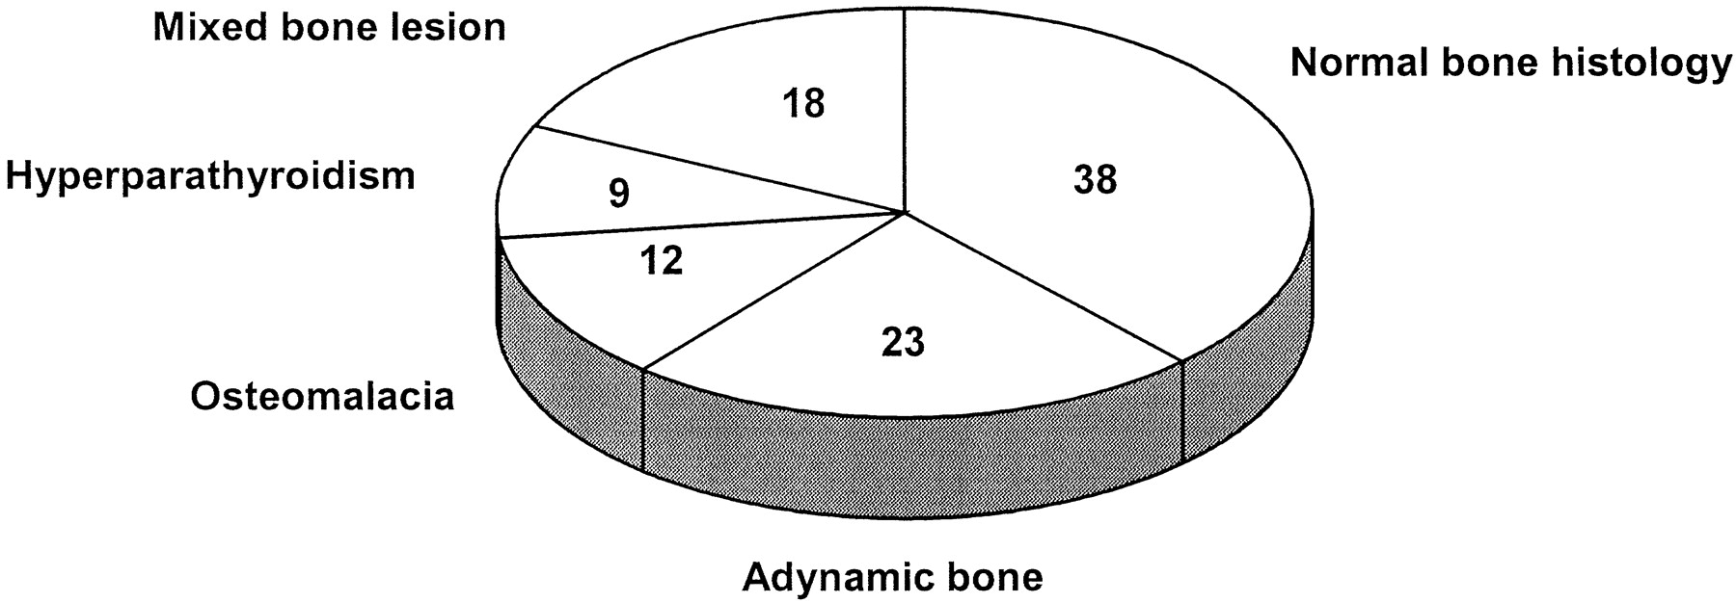
Distribution (%) of the various types of ROD of the study population.
Spasovski G B et al. Nephrol. Dial. Transplant. 2003;18:1159-1166

Slide 57
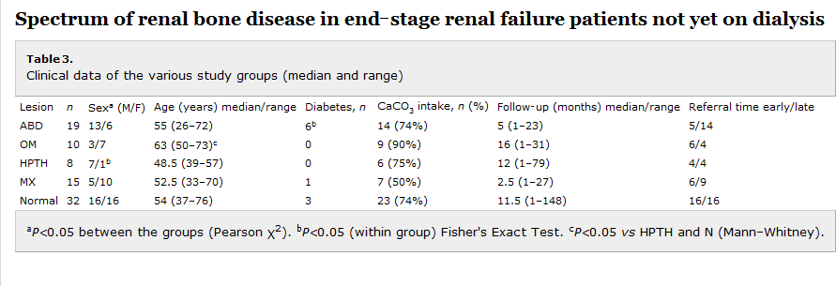

Slide 58
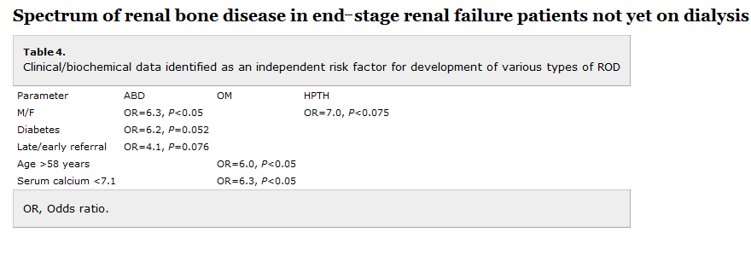

Slide 59
Purpose of study to provide information about histology abnormalities related to race, gender, diabetes, and treatment with active vitamin d or phosphate binders
bone biopsies were done from 2003 to 2008, only baseline biopsy where included
316 patients from US, 314 from Europe
All patients volunteered to enter study
All patients received routine dialysis support for at least 6 months ( phosphate binders, active vitamin D, or calcimimetics)

Slide 60
Exclusion
Uncontrolled systemic disease ( except DM), such as liver disease, malabsorption, malignancy, thyroid dysfunction
Treatment within last 12 months with bisphosphonates, fluoride, calcitonin, glucocorticoids, immunosuppressive agents or hormone replacement therapy
Chronic alcoholism and/or drug addiction
Lack of double tetracycline labeling
60o patients were on HD
30 patients were on PD
87 black patients ( all from US)
141 diabetics
109 treated with active vitamin d analog
429 treated with calcium containing phosphate binder
Only 4 patients received calcimimetics

Slide 61
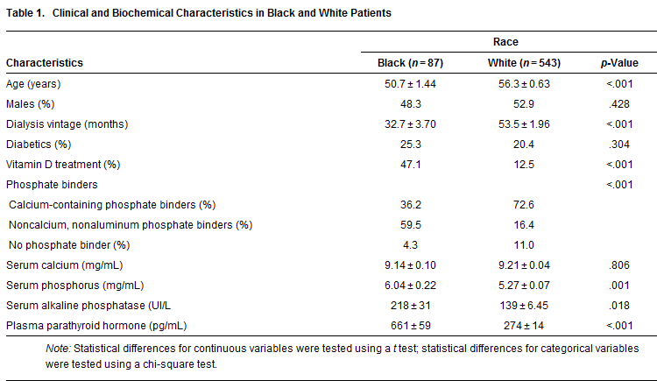

Slide 62
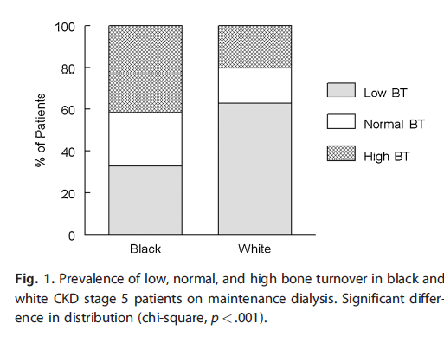

Slide 63
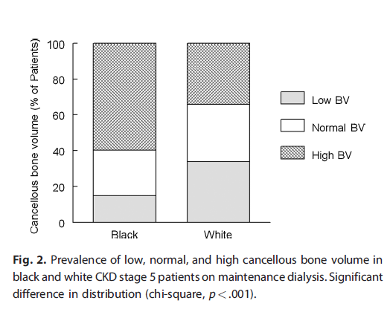
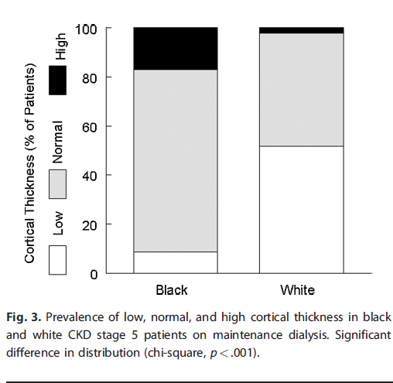

Slide 64
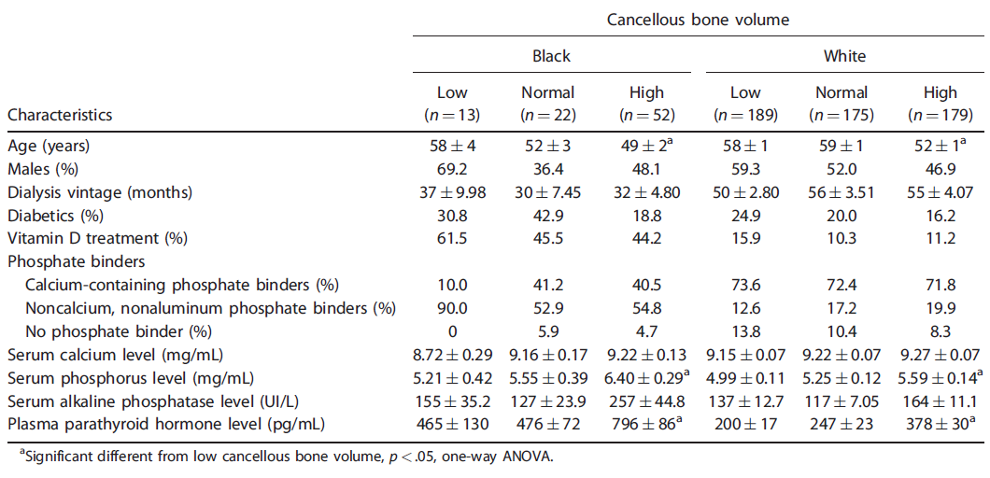

Slide 65
Study findings
Racial differences
TMV system should be expanded to include the architecture of cancellous and cortical bone
Mineralization defects are now rarely observed
Adjustment of current therapeutic paradigm that takes into consideration risk for low bone turnover and volume given association with increased vascular calcifications

Slide 66
Limitations of study
Relatively low number of white patients treated with active vitamin d ( 12.5% white vs. 47.1% blacks)
Patients volunteered to participate possible bias favoring clinically uncomplicated patients
no information included on 25 vitamin d or FGF-23

Slide 67
Clinical Implications of ROD

Slide 68
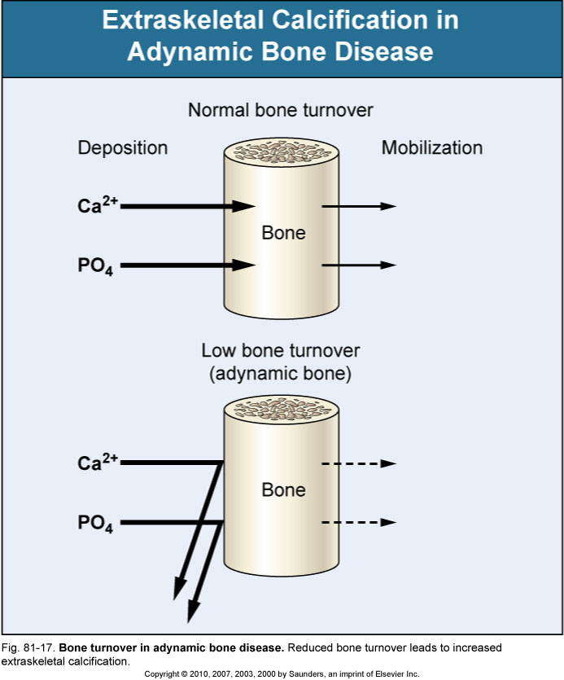

Slide 69
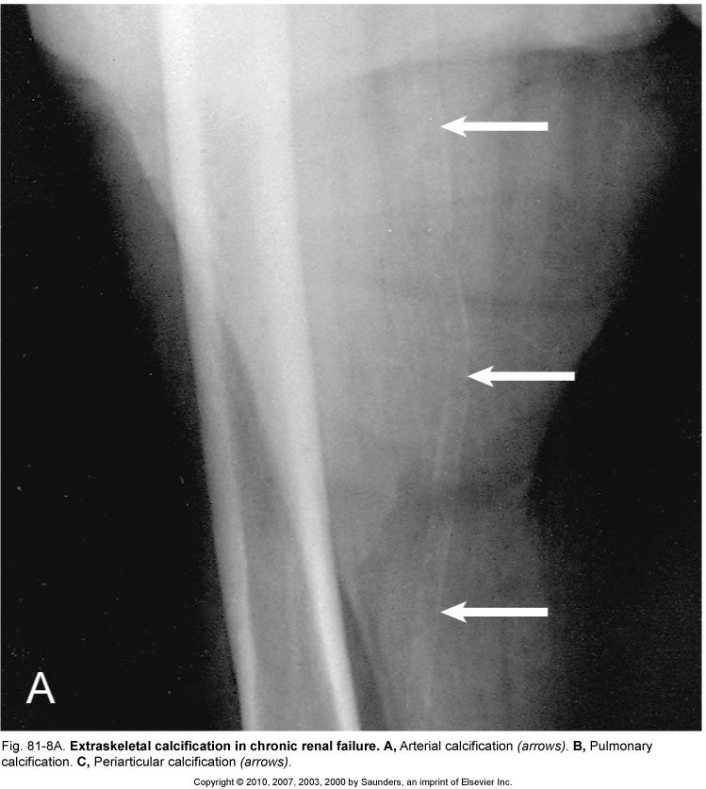

Slide 70
Extraosseous calcification
Results from changing effect of PTH on phosphate balance as renal failure progresses
PTH causes calcium and phosphate release from bone
High PTH levels induce vascular calcification, in dialysis patients markedly high levels may enhance coronary artery calcification

Slide 71
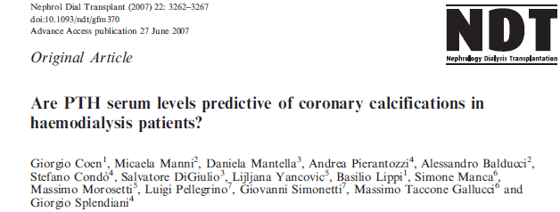
There is a general opinion that low levels of serum PTH in hemodialysis patients are associated with increased vascular and cardiac calcium deposits
This opinion is based on the concept that low bone turnover, associated with low serum PTH levels, is a condition of decreased calcium phosphate buffering capacity of bone
Therefore, increased serum levels of calcium and phosphate, associated with low bone turnover, may induce increased severity of vascular calcifications.
increased cardiovascular mortality is difficult interpret since low levels of PTH may also be associated to malnutrition and inflammation, known causes of vascular damage, anemia and cardiovascular death

Slide 72
The study aimed to evaluate the association between PTH serum levels and coronary calcifications, in favor of a direct association between PTH serum levels and coronary calcium deposits.
cohort of 197 hemodialysis patients.
133 males and 64 females. 22 patients had DM
Average age was 58.6 years.
Patients were divided into groups of intact PTH levels, 0–150 (A), 150–300 (B), 300–600 (C) and >600 (D) pg/ml.

Slide 73
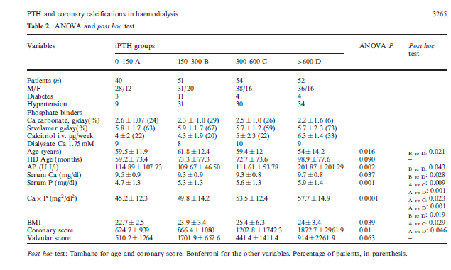

Slide 74
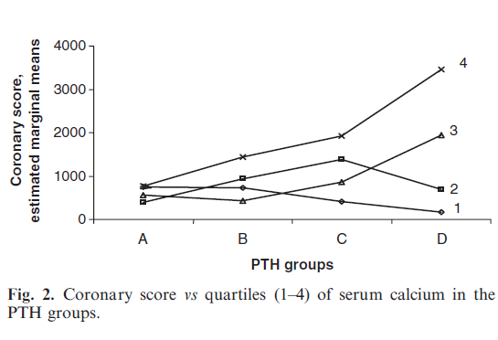

Slide 75
Limitations/ Discussion
Limitations
cross-sectional nature, with patients selected from different dialysis units, with possibly somewhat different therapeutic approaches
Single biochemical assay being related to long term arterial lesions
the finding of no major association between low turnover bone disease and the severity of coronary calcium deposits in hemodialysis patients bears practical implications
Special attention should be paid to the control of elevated levels of secondary hyperparathyroidism and the related calcium phosphate derangements.

Slide 76
Arterial Calcifications and Bone Histomorphometry in End-Stage Renal Disease
Gérard M. London*, Caroline Marty†, Sylvain J. Marchais*, Alain P. Guerin*, Fabien Metivier* and Marie-Christine de Vernejoul†
*Service d’Hémodialyse, Hôpital F.H. Manhès, Fleury-Mérogis, †Hôpital Lariboisière, INSERM Unité 606, Paris, France.
evidence that low bone turnover is associated with increased arterial calcifications
They studied 58 hemodialysis patients subjected to bone biopsy and evaluated for arterial calcifications with an
X-ray survey of some other indicative arterial sites. The extent of arterial calcifications was inversely related to histomorphometric bone turnover.
Limitations: the cohort of patients included a relatively large number of patients with aluminum deposition, and also previously parathyroidectomized cases, with low turnover induced by surgery.

Slide 77
Fractures
The morbidity and mortality associated with hip fractures have been well established in the general population
Coco and Rush examined the incidence of hip fractures in dialysis patient over a 10 year period
They found an association of lower PTH levels and hip fractures
The 1 year mortality rate from the hip fracture event was nearly two and half times greater than the general population

Slide 78
Methods
Hospital admission list and medical records of patients treated for at least 6 months at outpatient dialysis unit affiliated with Montefiore Medical Center (NY), 1,272 patients reviewed, 56 hip fractures documented
Hip fracture was defined as an event diagnosed by radiology
Pathologic fractures secondary to metastatic malignancies were excluded
Chemistry test were performed monthly except PTH which was measured quarterly
Chemistry test results of patients who sustained a hip fracture were included only up to time of fracture
Patients divided into four groups based on their average PTH value

Slide 79
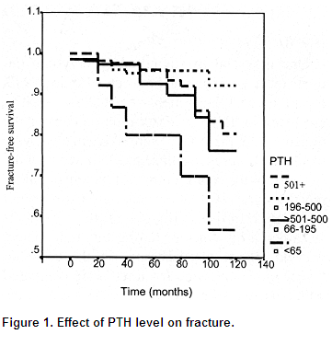

Slide 81
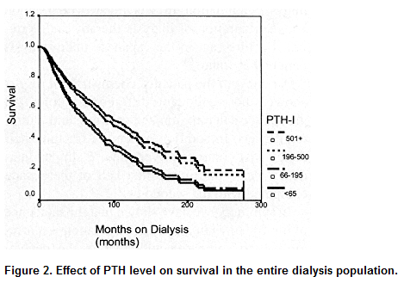

Slide 83
Similar trends with respect to race and gender, however overall incidence of hip fractures in the dialysis population was 17.4 times greater than that in the general population
Age at time of fracture in dialysis population was 11 to 15 years younger than their counterparts in the general population
1 year mortality rate 64% after hip fracture in dialysis patients compared to 15% to 20% in general population
Bone biopsy were not systemically performed, can not exclude a contribution from aluminum bone disease

Slide 84
Bone Biopsy

Slide 85
Guidelines
2003 K/DOQI guidelines
Bone biopsy is not necessary for settings, it can be considered in patients with ESRD and the following
Fractures with minimal or no trauma
iPTH levels between 100 and 500 pg/ml in association with unexplained hypercalcemia, severe bone pain, or unexplained increases in bone alkaline phosphatase activity
Suspected aluminum bone disease
2009 KDIGO
Bone biopsy is reasonable in the following settings:
Unexplained fractures, unexplained hypercalcemia, and /or unexplained hypophosphatemia
Persistent bone pain
Possible aluminum toxicity
Before therapy with bisphosphonates

Slide 86
Additional implications
Establish ABD in symptomatic patients with serum PTH levels below 100 pg/ml
Determine the extent of bone aluminum accumulation prior to chelation therapy with DFO
Also prior to parathyroidectomy, since low bone turnover disease with enhanced aluminum deposition may be precipitated if there is significant aluminum overload
Direct therapy in patients with intermediate PTH levels (100-450 pg/ml)

Slide 87
Barriers to performing bone biopsies
Cost
Invasive
Lack of local resources to properly procure, process, and reliably interpret the bone biopsy
Reimbursement
Can other noninvasive test reliably aid in diagnosis of renal bone disease?

Slide 88
PTH
Intact serum PTH values below 100 pg/mL are associated with a decreased likelihood of osteitis fibrosa and an increased incidence of adynamic bone disease.
An intact serum PTH level above 450 pg/mL is typically associated with hyperparathyroid bone disease and/or mixed uremic osteodystrophy.
Intermediate PTH levels between 100 and 450 pg/mL may be associated with normal, elevated bone remodeling, or even reduced bone remodeling.
Circulating intact PTH levels predict the presence and severity of hyperparathyroidism; they may not, however, predict underlying bone disease, particularly when PTH levels are only moderately elevated
Second generation assays may be the optimal test for assessing abnormal parathyroid hormone dynamics, all current data is based on intact PTH, however the NKF/DOQI guidelines currently state that is premature to rely clinically on the newer assays

Slide 89
New worldwide trends in presentation of renal osteodystrophy and its relationship to parathyroid hormone levels. Clinical Nephrology 2005 Apr;63(4):284-9. Gal- Moscovici A, Popovtzer MM
study was undertaken to evaluate the current prevalence of different forms of bone disease in a large population on chronic hemodialysis and its relationship to PTH levels
96 chronic hemodialysis patients underwent double tetracycline-labeled bone biopsy
Serum PTH levels were obtained in 52 patients at the time of biopsy.
40% of all patients were affected by osteitis fibrosa , in the remaining 60%, various forms of low-turnover bone disease were observed
There was no correlation between PTH and BFR (Bone formation rate) in all patients and in subgroups whose PTH levels ranged between 150 - 500 and 500 - 1,200 pg/ml (r = 0.027, r = 0.21)
A close correlation between PTH and BFR (r = 0.84, p < 0.05) was found only in the subgroup with a PTH level (0-150pg/ml) ranging low-turnover bone disease.

Slide 90
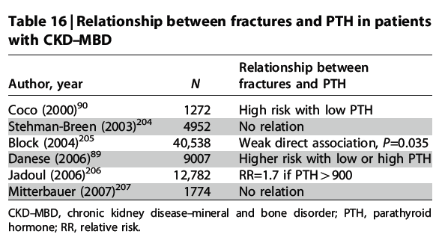
KDIGO clinical practice guidelines for the diagnosis, evaluation, prevention, and treatment of chronic kidney disease-mineral and bone disorder (CKD-MBD)

Slide 91
Bone Turnover Markers
Bone-specific alkaline phosphatase (b-ALP)
Osteocalcin
Tartrate-resistant acid phosphatase (TRAP)
Collagen degradation products
FGF-23
Osteoblasts secrete b-ALP, osteocalcin, and collagen based bone markers
Osteoclasts secrete TRAP
Osteocytes secrete FGF-23 in response to high serum phosphorous levels

Slide 92
KDIGO 2009 recommendations
In patients with CKD stage 3-5, [we] suggest that measurements of serum PTH or bone- specific alkaline phosphatase can be used to evaluate bone disease because markedly high or low values predict underlying bone turnover (2B)*
Level 2 weak recommendation
Grade B moderate quality of evidence
Bone biopsy is not practical in the majority of clinical patients, when PTH and b-ALP are above or below thresholds, they can be used to estimate bone turnover.
Large discrepancies between serum PTH and b-ALP should prompt further investigation

Slide 93
Plasma total versus bone alkaline phosphatase as markers of bone turnover in hemodialysis patients Urena P, Hruby M, Ferreira A, et al. Service de Néphrologie et d'Hémodialyse, Clinique de l'Orangerie, Aubervilliers, France. JASN 1996
This study surveyed 42 hemodialysis patients who underwent a systematic transiliac bone biopsy for histomorphometry study.
Plasma bAP values were compared with those of two other plasma markers of bone metabolism, tAP and intact parathyroid hormone (iPTH), for the correlations with bone histomorphometric parameters.
Patients with high-turnover bone disease (N = 32) had significantly higher plasma bAP levels than patients with normal or low bone turnover (N = 10)
Bone formation and resorption were highly correlated in patients with high bone turnover, and plasma bAP levels were positively correlated with bone resorption parameters.
The bone formation rate was better correlated with plasma bAP levels than with either plasma tAP or iPTH concentrations.
Plasma bAP level equal or higher than 20 ng/mL, either alone or combined with plasma iPTH of 200 pg/mL, had the highest sensitivity, specificity, and predictability values for the diagnosis of high-turnover bone disease, and formally excluded patients with normal or LTBD

Slide 94
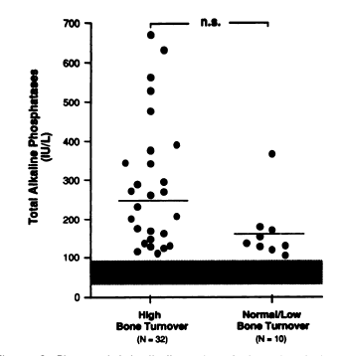
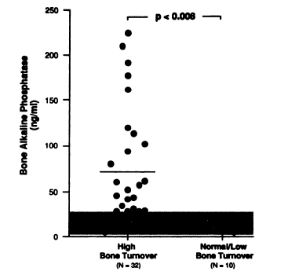
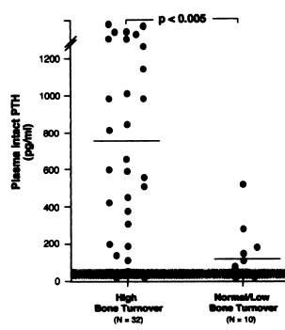
Total alkaline phosphatase
bone specific alkaline phosphatase
Intact PTH

Slide 95
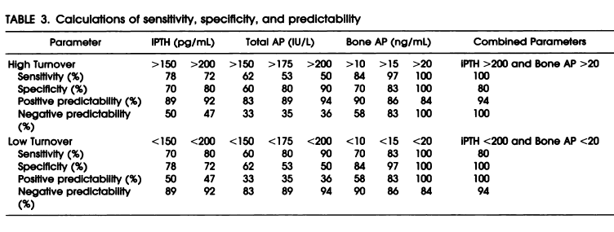

Slide 96
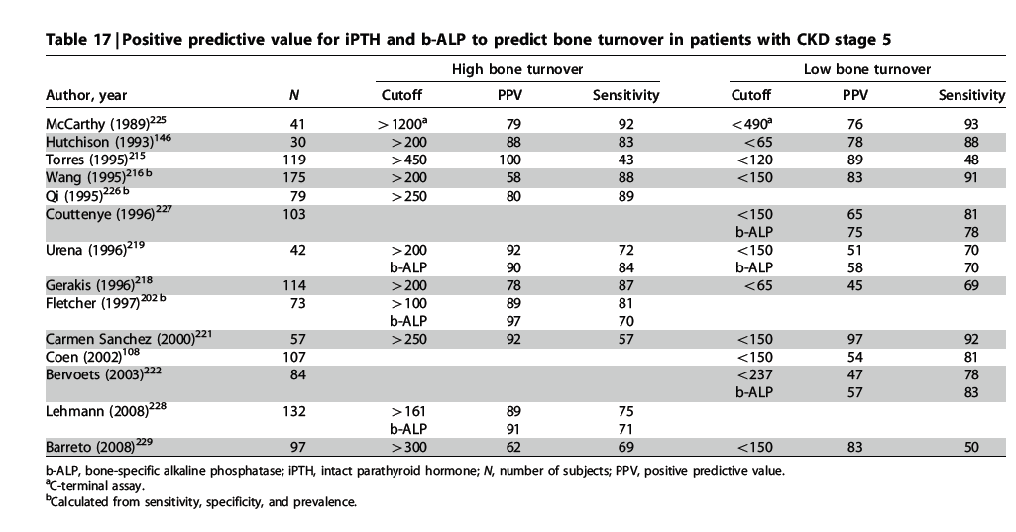
KDIGO clinical practice guidelines for the diagnosis, evaluation, prevention, and treatment of chronic kidney disease-mineral and bone disorder (CKD-MBD)

Slide 97
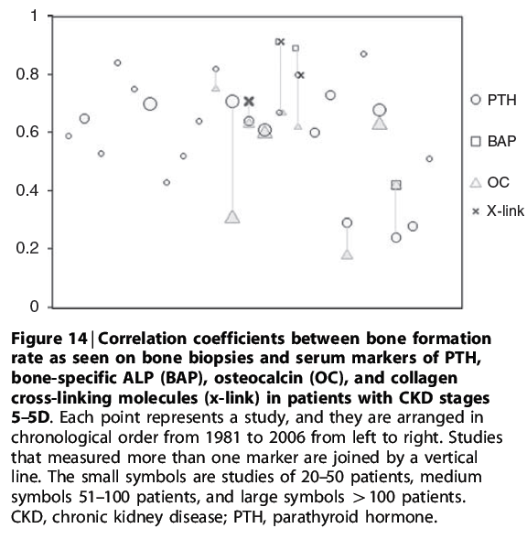

Slide 98
KDIGO 2009 recommendations
In patients with CKD stages 3-5D, [we] suggest not to routinely measure bone- derived turnover markers of collagen synthesis and breakdown. (2C)
Level 2 weak recommendation
Grade c low quality of evidence
Collagen-based markers of bone turnover, measured in the serum, have not been extensively evaluated in patients with CKD stages 4–5.
The available studies show that these markers do not predict clinical outcomes or bone histology any better than does circulating PTH or b-ALP.
Therefore, at this time, they are not recommended for diagnostic purposes in patients with later stages of CKD–MBD.

Slide 99
K/DOQI practice guidelines PTH levels
35 to 70 pg/mL for patients with an estimated GFR of 30 to 59 mL/min per 1.73 m2 (stage 3 chronic kidney disease)
70 to 110 pg/mL for patients with an estimated GFR of 15 to 29 mL/min per 1.73 m2 (stage 4 chronic kidney disease)
150 to 300 pg/mL for patients with an estimated GFR less than 15 mL/min per 1.73 m2 (stage 5 chronic kidney disease)

Slide 100
Summary
Mineral and bone disorders are complex abnormalities that cause morbidity and decreased quality of life in patients with CKD.
The prevalence of the different types of bone disease has changed with adynamic bone disease being the most common, likely due to an increasing diabetic population and more aggressive PTH therapeutic parameters
The principal factor underlying ABD appears to be oversuppression of PTH release, which may be induced by the relatively high doses of vitamin D analogues and possibly calcium-based phosphate binders
Patient with ABD are at increased risk of fractures and cardiovascular calcification
Bone biopsy remain gold standard for diagnosing bone disease
Intact PTH levels predict the presence and severity of hyperparathyroidism but not necessarily the presence of underlying bone disease
Bone specific alkaline phosphatase may provide useful information in conjunction with PTH measurements
Additional evidence-based evaluation is required to determine the correlation of outcomes with various biochemical parameters

Slide 101
References
Pictures: L. Darryl Quarles, MD
Up To Date
American Society of Bone and Mineral Research
Internal Society of Nephrology
National Kidney Foundation
Journal of American Society of Nephrology
Nephrology Dialysis and Transplantation
American Journal of Kidney Disease
Comprehensive Clinical Nephrology 4th ed.
Floege J, Johnson R, and Feehally J.

