Slide 1
Inclement Weather Policy
Each campus makes own closing decisions
Students on clinical services are expected to continue to provide care for their patients,
Provided traveling would not place the student at serious risk of injury
Consult with physician supervisors risks/benefits of travel
If you can’t travel, call resident ASAP

Slide 2

MATCH 301
Class of 2020
December 4, 2018
Dr. Susan Brewer
Associate Dean of Student Affairs and Admissions
Notes:
Welcome to the orientation for 4th year
Welcome those watching from Chattanooga and Knoxville
Hope that all goes well with the M3 year thus far
Goal –Strategies from M4’s for making the most of your time from

Slide 3
Demands on an M4
Schedule required and elective clerkships
Decide on a specialty
Decide on Visiting Electives
  Over winter break
  have pre-requisites
Take USMLE Step 2 CK and CS$$$
$$$-Budget for this in your financial aid award

Slide 4
Demands on an M4
Assemble your ERAS application
  Prepare credentials- CV and personal statement
  LOR’s and Chair letter
  CK and CS
  Medical Student Performance Evaluation (MSPE) (not a LOR)
  Submit application starting September 15th
Schedule Interviews$$$
Complete all graduation requirements
  Preferably 30-days prior to Commencement
$$$-Budget for this in your financial aid award

Slide 5
Apply Smart for Residency
Access the Residency Process Timeline
  https://www.aamc.org/cim/residency/application/applying/337902/matchtimeline.html

Slide 6
How We Will Help
Residency Exploration Day November 27, 28, 29,2018
Specialty Advisor Meetings November-January
Preparing Credentials-Match 301 Dec. 4, 2018
Matched Student Panel-Match 302 March -April 6, 2019
Strolling Through the Match-Match 401 May, 2019
ERAS Tokens Late June-Early July
MSPE Interviews July-September, 2019
Residency Interviews October-January 2019-20
Early Match Results Dec.-Feb. 2019- 20
NRMP Match Week Mid-March

Slide 7
Timeline

Slide 8
MATCH TIMELINE
Class YR | Period | Activities and Tasks
Year 3 | November-March | Work on updating your curriculum vitae (CV) Write your personal statement Meet with specialty advisor: Review competitiveness of specialties, realistically Discuss best time to take USMLE Step 2; Register for CS-spots go fast - sign up tonight Review VSLO over winter break
 | April | Search residency programs Finalize personal statement; advisor review
 | May-June | My ERAS opens - Obtain token from Debbey Hester Complete your residency application Register for Match (NRMP, San Fran, Uro) Take Step 2 Make appointment for your Medical Student Performance Eval Identify and contact faculty for LOR’s

Slide 9
Specialty Choice Form

Slide 10
Specialty Choice Form

Slide 11
MATCH TIMELINE
Class Yr | Period | Activities and Tasks
Year 4 | June-Aug | Research residency programs; MSPE
 | September | Start applying to residency through ERAS (Programs start Sept 15) Register for NRMP starting September 15 Check email constantly & respond to interview invitations Start preparing for residency interviews https://www.aamc.org/cim/residency/application/interviewing/338080/interviewquestions.html Schedule a mock interview or practice with FAQ’s
 | October | MSPE’s released to all programs in ERAS on October 1 If fewer than 10 interviews by mid-late OCT, come see me Go to residency interviews
 | November-December | Early registration for Main Match closes November 30 Go to residency interviews Evaluate and compare programs Residency Preference Exercise Meet with advisor to discuss how to rank your programs Military Match results available

Slide 12
MATCH TIMELINE
Class Yr | Period | Activities and Tasks
Year 4 | January-February | Urology residency match results available Enter rank order list for early match by January deadline Enter rank order list for the Main Residency match mid-February deadline
 | March | Log in to NRMP R3 system on Monday of Match Week to see if you matched If you didn’t match, enter Supplemental Offer and Acceptance Program (SOAP) Participate in Match Day ceremony
 | April-June | Sign contract with residency program ERAS season ends on May 31. Save application and records before season ends Graduate medical school-YEAH!!!! Prepare to start residency

Slide 13
Preparing Your Credentials
Curriculum Vitae Template
  A resume is about a job. A CV is about a career.
Personal Statement
  Start with something personal and active
MSPE Template
  Evaluation - Not a letter of recommendation

Slide 14

Curriculum Vitae
Font: size 12-18 for name, 12-14 for headings, 10-12 for text, choose a simple font and stick with it
Format: consistent, concise, reverse chronological order
  name header on each numbered page
Paper: off white/white matching envelope
Proofread: spellcheck and read backwards
Active voice; Minimal use of first person
Be honest (they will check)

Slide 15
Curriculum Vitae
Downloaded from
AAMC website

Slide 16
Personal Statement
Open with something active
Include personal experience (within boundaries)
Show “fire in the belly” for the specialty
OTO require a program-specific paragraph
Have others review and proof-read

Slide 17
MSPE
Medical Student Performance Evaluation
  Formerly “Dean’s Letter”
  Not a letter of recommendation
  Second year of new format
  Standardized across schools
  Should highlight six ACGME competencies

Slide 18
MSPE
Medical Student Performance Evaluation
  Details on professionalism deficiencies
  Holistic characterization of the applicant
  Noteworthy Facts/History-Limited to 2-3 bullet points
  Comparative data in the body
  How grades and comparative data derived

Slide 19
MSPE Sample
MSPE Sample 1: Leslie Lee
University of America
Walter Cronkite School of Medicine
October 2016
IDENTIFYING INFORMATION
Leslie Lee is a fourth-year student in the University of Maine, Walter Cronkite School of Medicine in
Portland, ME.
NOTEWORTHY CHARACTERISTICS
During her second year, Ms. Lee served as the student coordinator for the Community-Based Sanctuary Clinic and secured a $500,000 grant from the United Way of Maine to equip a new seven-room ophthalmology suite for the facility.
❖ Ms. Lee passed her USMLE Step 1 examination two months after the death of her mother in a motor vehicle accident.
❖ Ms. Lee gave birth to a son this past August. She successfully completed all her M3 clinical rotations on time, spent the month of August on a pre-arranged research rotation, and commenced her Emergency Medicine rotation in mid-September.

Slide 20

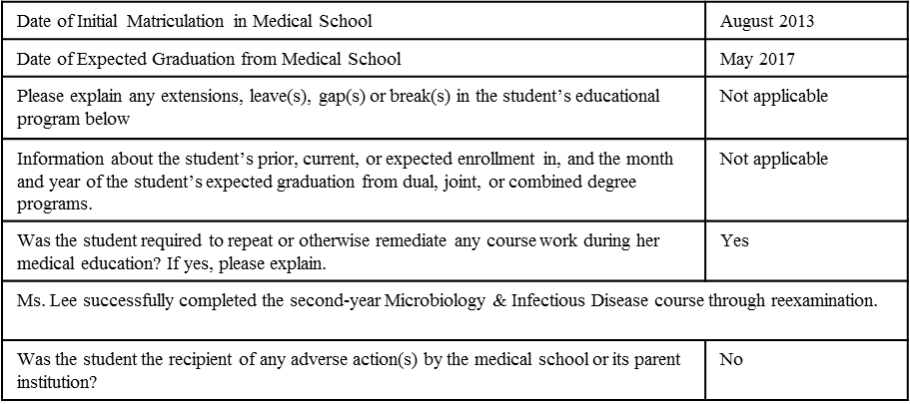
MSPE Sample
ACADEMIC PROGRESS
Professionalism

Slide 21
MSPE Sample
MSPE Sample 1
Re: Leslie Lee
Page 2 of 4
Preclinical Coursework
Ms. Lee successfully completed the Foundational Sciences curriculum, which is graded pass-fail. In the first-year Introduction to Clinical Medicine course, the faculty said, “Ms. Lee had worked as a
scribe in an ER, and she put her experience to good use. She consistently did outstanding write-ups. She contributed well and was willing to share her knowledge and experience with the class. She was willing
to listen to feedback and was thoughtful about it. She did a lovely job as the group’s representative to the ICM Student Advisory Council—always soliciting feedback and sharing reports from the meetings.
Leslie was also very reflective about her learning and worked hard to improve her own and others’ experiences.”
In the second-year Introduction to Clinical Medicine course, the faculty noted, “Ms. Lee consistently contributed a strong team mindedness and a reassuring, amiable, and uplifting collegiality with peers and
patients alike. Progressively through the year, Leslie honed commendably facilitative interview rapport and repartee with individual patients from a striking diversity of backgrounds. She also demonstrated
advanced skills with written and oral clinical communications and clinical reasoning. Her OCPs became direct, crisp, and effective across bedside and work-room zones. Leslie could be counted on to be eager
and spirited with all learning opportunities. She was on a good road to good doctoring. It was a pleasure to serve as her mentor and preceptor.”
Clerkships (in chronological order)
Surgery (August - October 2015) Grade: Pass
Overall grade based on: Clinical: 33%, Exam: 33%, OSCE: 34% Ms. Lee had a strong start for clinical rotations. Residents
reported, “[She] conscientiously cared. Eager to help. Asked good questions. Always wanted to learn in each setting." Her
anesthesiology attending said, “Came promptly each day.” She was assigned to neurological surgery for her specialty rotation and
her attending commented, “Good student for this time of year. Will be able to present more succinctly as she gains clinical
experience. She passed her OSCE without difficulty. We advised her to practice focused presentations.
Good job for the first rotation.”
Psychiatry (October - November 2015) Grade: High Pass
Overall grade based on: Clinical: 50%, Exam: 20%, OSCE: 30%
Ms. Lee had an excellent rotation. Her child psychiatry team commented, “We enjoyed having Leslie work on 3SW with us.
She rapidly developed rapport with our patients and actively participated in group meetings. She not only knew her patients,
but also obviously had read about the other patients on the team. In one case, she noted that her patient, a gymnast, developed
worsened symptoms of anxiety when she was not able to exercise. This led her to a study of mood and exercise with Dr. Bernard Shaw.
Staff found her to be caring and to communicate well. Initially, she was a bit terse in her presentations, but this quickly resolved
within one week. Very unexpectedly, she had difficulties with the shelf exam, but passed upon retaking it. We hope she chooses psychiatry!”

Slide 22
Program Director Survey 2018
All Specialties

Slide 23
Charting Outcomes in the Match 2018

Slide 24
Charting Outcomes in the Match 2018

Slide 25
Charting Outcomes in the Match 2018

Slide 26
Research?

Slide 27
Do I Have to Do Visiting Audition Rotation(s)?
YES
  Dermatology
  Emergency Medicine
  Interventional Radiology
  Neurosurgery
  Orthopedics
  Otolaryngology
  Ophthalmology
  Radiation Oncology
  Surgery
  Urology
  Specific locale
No
  Primary Care
  Neurology
  Psychiatry
Maybe
  Med/Peds
  OB/GYN
  Radiology
  Psychiatry

Slide 28
Careers In Medicine Timeline
https://apps.aamc.org/account/#/login?gotoUrl=https:%2F%2Fwww.aamc.org%2Fcim%2F&allowInternal=false
Apply Smart video
Notes:
Great website Full of hyperlinks to information and documents

Slide 29
Additional Information
Match/ERAS information– Note Any Message from Debbey Hester
Interviews ? Take 2 option blocks for interviewing
May be subject to drug/urine screening at any clerkship site
Notes:
Need volunteers Feb 10 knox and chatt

Slide 30
No Brainer
Check your UT email regularly
Clean your mailbox
Reply to messages addressed to You the individual
Notes:
Important messages on scheduling, USMLE, Match, Graduation
Direct Gmail accounts, but don’t forget to clean out UT email
Frustrating to need to contact one of you and not get a reply.
OME and SA try not to send email unless it is important.

