Slide 1
Clinical Policies
Kristen Bettin, MD, MEd
Assistant Dean, Clinical Curriculum
Pediatrics Clerkship Director
Valerie Jameson, MD
Senior Assistant Dean, Clinical Curriculum

Slide 2
Topics to Cover
Medical Education Resource Link (MERL)
Excused Absences and Wellness Days
Inclement Weather
COVID Policies and Procedures
Case Logs and Time Logs
Work (Duty) Hours
Clerkship Grading

Slide 3
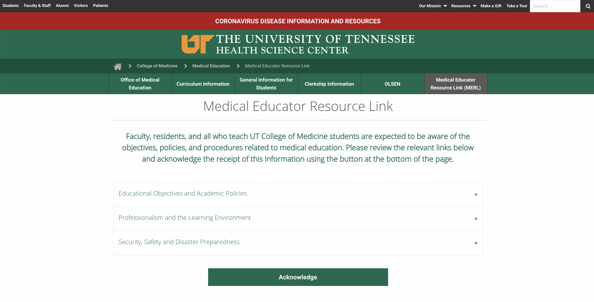
Medical Education Resource Link (MERL)
https://uthsc.edu/medicine/medical-education/merl.php
Acknowledge by May 3, 2021

Slide 4
Excused Absences and Wellness Days

Slide 5
Rationale
Excused absences – Students should be able to attend general preventive medical care, urgent/acute medical care, and have appropriate time off for sickness.
Wellness Days – Goal is to promote mental health and wellness among students.
Take a day to rest, recharge, reboot, etc.
NOT a substitute for professional counseling or mental health treatment for a student experiencing a more significant mental health concern!

Slide 6
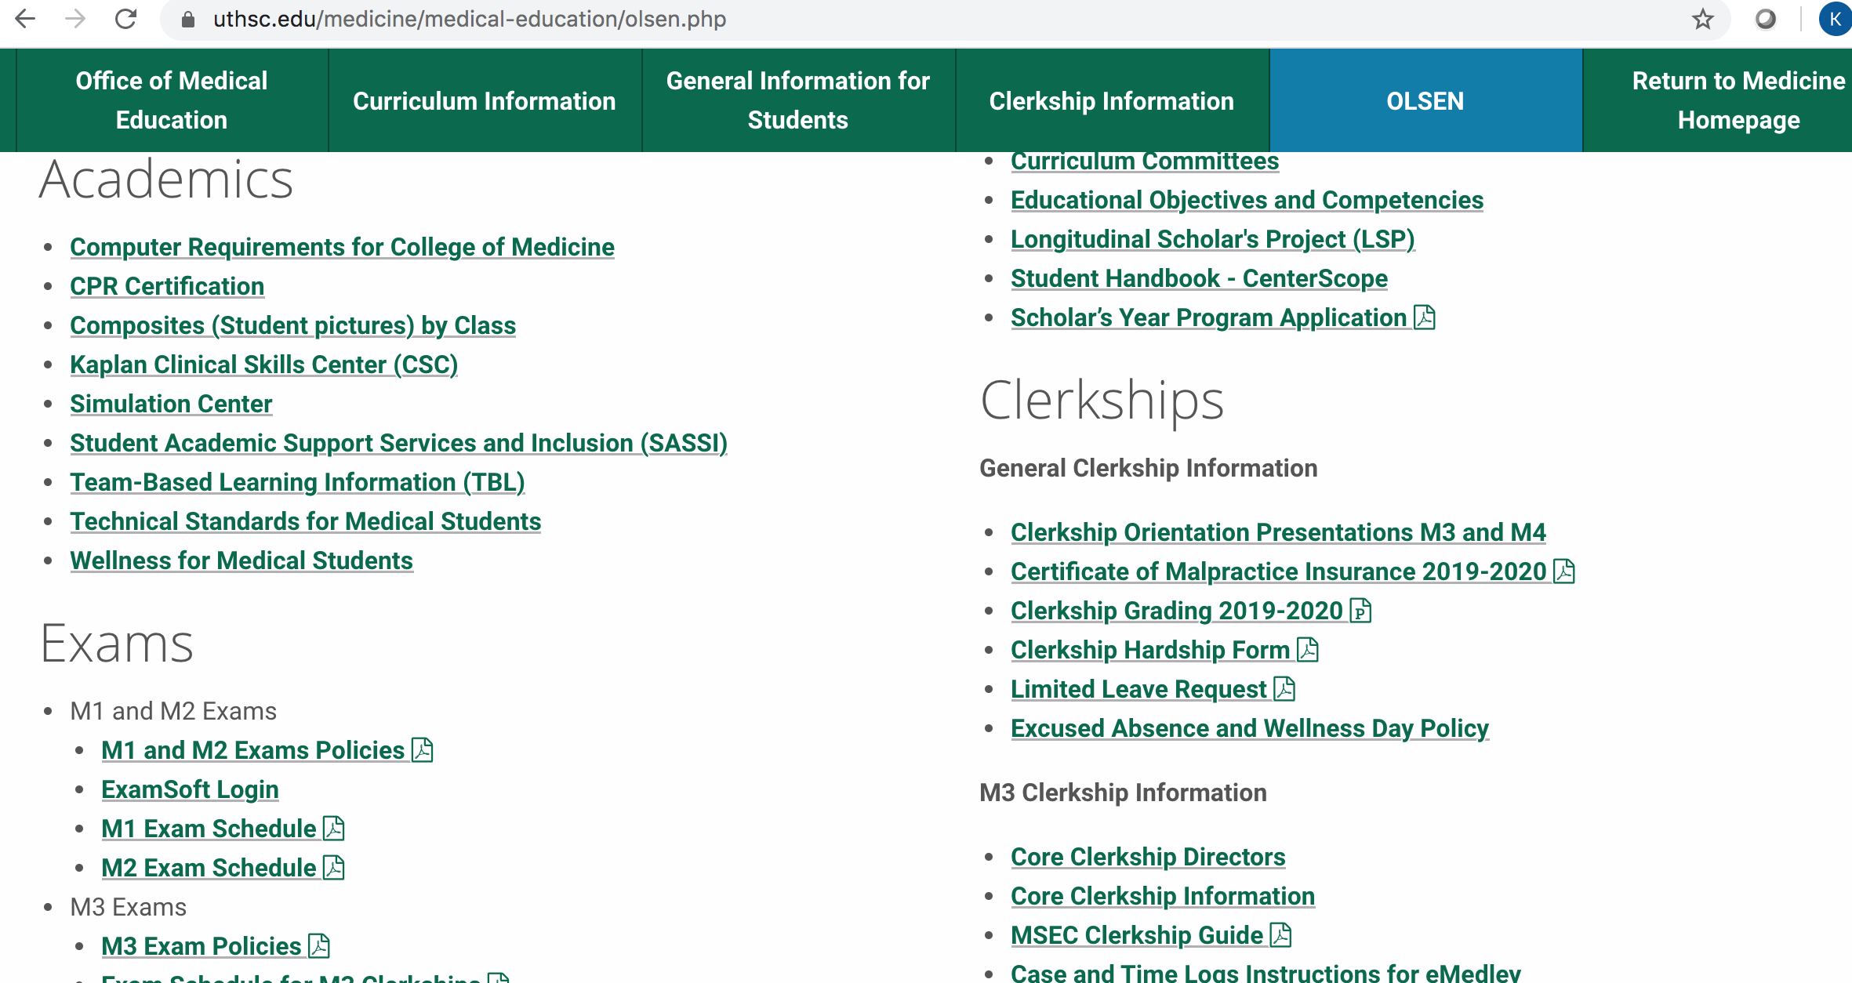

Slide 7
How to Request an Excused Absence or Planned Wellness Day
1. Notify (email) your Clerkship Director and Clerkship Coordinator 30 DAYS IN ADVANCE of the START of the clerkship to request permission.
2. Please be professional in your interactions with your administrators!
3. Complete a Limited Leave Request form (on OLSEN) once approved.

Slide 8
Requesting Permission
“I will be taking a wellness day for my sister’s wedding on xx/xx/xx.”
vs.
“I am emailing you to request the possibility of a wellness day on xx/xx/xx for my sister’s wedding. Thank you!”

Slide 9
What counts as an Excused Absence?
Funerals (death of a close family member)
Acute illness/urgent medical appointments (includes SICK DAYS!)
Preventive or routine healthcare (e.g. PCP appointment, dentist, etc.)
Religious observances/Holy Days
Jury duty and other legal obligations
Step 2 CK*
Residency interviews*
Attendance at professional meetings if presenting or representing the College of Medicine
* Step 2 CK and residency interviews NOT allowed on M3 clerkships.

Slide 10
Sick Days
Notify your Clerkship Director, Clerkship Coordinator, and your team/attending AS SOON AS YOU KNOW you will miss the day.
Prompt notification is not only the professional thing to do, but also let’s us know that you are alive and not missing!!
Complete a Limited Leave Request as soon as you return.
Doctor’s note is required if you miss more than 2 days for any illness.

Slide 11
Professional Meeting Attendance
Notify CD/CC 30 days prior to the START of the affected rotation.
Must be either presenting (poster/oral) or representing the COM.
Provide documentation (email/letter) of your acceptance to the meeting AS SOON AS YOU GET THIS.
Goal is to maximize your participation in your event while also minimizing the time away from your clerkship.
Approval is at the discretion of the Clerkship Director.

Slide 12
Wellness Days
Four wellness days per year (Maximum 2 per clerkship)
No half days or hourly counts

Slide 13
Anticipated (Planned) Wellness Days
Notify CD/CC 30 day prior to the START of the rotation.
May NOT be used during:
Course/shelf exams
Clerkship orientations
Simulation/skill training days
OSCEs
Oral, slide exams
JI rotations
On-call days
Days before or immediately after vacations or administrative closings (i.e. MLK Day)

Slide 14
Emergent (Unplanned) Wellness Days
Available for when a student has an urgent/emergent need for a day away from clerkships that does not fall into an excused absence category.
Notify (email) the clerkship director or clerkship coordinator ASAP when you need to take an emergent wellness day. Does not require 30 days advanced notice.
Be professional. Complete a Limited Leave Request as soon as you return to the clerkship.
No questions asked policy to preserve student privacy.
However, if you are struggling, please reach out to your CD. We can help you!

Slide 15
Examples
Planned Wellness Days
Emergent Wellness Days
Weddings
Family reunions
Planned mental health day
Nondisclosed reasoning (e.g. appointment that you prefer not to disclose)
Other important events that don’t fall under an excused absence
Unplanned mental health day
Need for urgent counseling
Any other unforeseen event that does not qualify for an acute excused absence
Notes:
What counts as a wellness day?
Important life events (weddings, reunions, etc.)
Nondisclosed reasons (counseling appointments, “mental health day”, rest, recharge, reboot)

Slide 16
Wellness and Mental Health
SASSI Take Care
https://uthsc.edu/sassi/
Counseling services
https://www.uthsc.edu/student-health-services/behavioral-health/index.php

Slide 17
Inclement Weather
During the clinical years, management of a weather event must balance the demands of patient care and personal safety.
Students and faculty with clinical responsibilities are professionally obligated to maintain inpatient care even though a particular campus may be closed.
Students on clinical services are expected to continue to provide care for their patients, provided students feel that traveling would not place them at risk of injury.
In all such situations students should immediately contact their supervising resident or attending regarding potential risks associated with travel, to report any anticipated absence or delay in arrival, and to make appropriate alternative arrangements.
Students who are unable to travel to the ambulatory sites should contact preceptors as soon as possible to advise them of the individual situation and whether the student could reach the site later in the day.
Students should also immediately report an inability to participate in patient care to the Clerkship Coordinator and/or Clerkship Director.

Slide 18
Inclement Weather
Clinical experience missed due to inclement weather is considered an Excused Absence.
Complete a LLR form and indicate “weather” as the cause. A single form can be submitted for a series of days missed during the same weather event.
Submit an LLR form even if your ambulatory clinical site was closed for the day or if you were excused from clinical activities by your resident supervisors.
A student missing more than 2 days of a rotation may be required to make up the missed time, at the discretion of the Clerkship Director.
Students should make every effort to fulfill their patient responsibilities. However, they should not place themselves at undo risk and should not be subject to harassment for choosing to avoid travel under conditions perceived to be unsafe. Any such behavior should be reported directly to the Clerkship Director, or anonymously in the course evaluation.

Slide 19
Work (duty) Hours

Slide 20
Work Hours Policy
No more than 80 hours/week averaged over a 4-week period
Continuous on-site duty cannot exceed 28 (24+4) consecutive hours, inclusive of clinical care and educational activities
Overnight call may not be more frequent than every 3 days
Night shifts cannot exceed 16 hours and you must have 10 hours off in between shifts.
Students must have 1 day off in 7 averaged over a rotation.
Students must log work hours (Time Logs) for all core clerkships and JI rotations in eMedley.
Any violation of work hours should be reported to the clerkship/course director and is considered mistreatment.

Slide 21
Time Logs and Case Logs
Must be logged in eMedley eClas by the end of the clerkship.
If not done within one week of the end of the clerkship, you will receive an email from the CD/coordinator with the Dean of Student Affairs copied.
If not completed within 4 weeks of the end of the clerkship, there will be an automatic drop of one letter grade.
If not completed within 6 weeks of the end of the clerkship, the student will fail and must repeat the entire clerkship.
If you are having trouble seeing a particular case, reach out to your CD ASAP! Do NOT wait until the last week of the rotation to ask for help!

Slide 22
Case Log template - Diagnosis
Select: Level of participation
Active Participant is preferred and expected for all diagnoses
You may select alternative experience – standardized patient or alternative experience – online case for 1-2 diagnoses if you are not able to see them in person, but you should discuss this with your CD first.
Select: Competency (diagnosis). Student may use the same patient for multiple competencies but must have the same template/paragraph below for each competency.
Include in paragraph in “Notes” section:
Preceptor/Attending name
Presenting signs/symptoms of patient
Pertinent exam/labs/studies
Final diagnosis/treatment plan
One thing you learned from this patient/diagnosis

Slide 23
Case Log template - Procedure
Select: Level of participation (observed, assisted, performed)
Select: Competency (procedure)
Select: Physician who supervised the procedure (Select “Other” if preceptor is not listed)
Include in paragraph in “Notes” section:
Preceptor name
Indication for procedure
Key steps
State level of involvement using active language (e.g. I sutured the wound, etc.)

Slide 24
COVID Policies and Procedures
Refer to the COVID Quarantine Rules at the top of OLSEN for the most updated information.
Students should follow standard PPE precautions as directed by the clinical facility in which they are rotating.
At minimum, surgical face mask and eye protection (goggles or face shield) for every patient encounter regardless of vaccination status.
Face masks should be worn at all times in clinical facilities unless you are actively eating, regardless of vaccination status (includes team workrooms).
Students are now permitted to see COVID patients and PUIs if 1) they are fully vaccinated against COVID, and 2) the clinical facility allows students to see COVID patients.

Slide 25
COVID Vaccination
Most clinical sites are now requiring COVID vaccination. Refer to the COVID Quarantine Rules at the top of OLSEN for the most updated information.
Be prepared to provide proof of vaccination to your clerkship coordinator prior to the start of EACH rotation.
If you are not vaccinated, you may not be able to rotate at certain clinical sites. UTHSC cannot ensure that there is an alternative location for you to rotate. This may result in delayed clinical rotations or delayed graduation.
Even if you are fully vaccinated, some sites still require negative COVID tests prior to rotating.

Slide 26
Housing
UT will provide housing to M3 students on core clerkships who are required to go to an East location due to capacity and whose primary domicile is in Memphis.
Know that we are at maximum capacity this year due to COVID delays and the need for M4s to also complete core clerkships this year.
Requests for housing MUST be submitted at least 30 days in advance of the rotation, but the sooner the better.
Students on core clerkships, Geri-Palli, and Capstone get priority. If there is housing left over then CE, JI, and elective students may utilize housing.
Maximum of 6 months of housing will be covered by UT.
Do NOT assume that you will have housing for an East rotation if you have not requested housing.

Slide 27
Contacts for Housing
Chattanooga: Ms. Courtney Orloski, courtney.orloski@erlanger.org
Housing request form can be found on COLSEN at https://uthsc.edu/comc/medical-education/colsen.php
Knoxville: Ms. Brittany Bracco, bbracco@utmck.edu
Housing request form can be found on the UTMCK GSM website at http://gsm.utmck.edu/students/housing_request.cfm.
Nashville: Ms. Rachel McLaughlin, rachel.mclaughlin1@ascension.org

