Slide 1
Fourth Year Orientation
Class of 2021
November 20th, 2019
Valerie P. Jameson, MD.
Senior Assistant Dean for Clinical Curriculum
Miranda Fairley Kennedy
Lead Clinical Curriculum Coordinator
Catherine Womack, MD
Associate Dean of Student Affairs and Admissions
Notes:
Welcome to the orientation for 4th year
Welcome those watching from Chattanooga and Knoxville
Hope that all goes well with the M3 year thus far

Slide 2
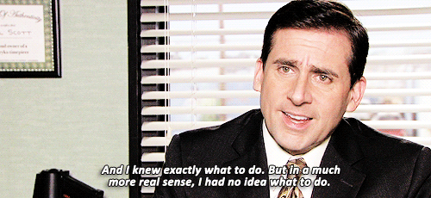

Slide 3
Orientation Agenda
Welcome
Overview of Fourth Year – Jameson
Revised M3 Grading - Jameson
Overview of the M4 Scheduling Process– Kennedy
All things Student Affairs – Womack
M4 Year Cost Budgeting - Latrisia D. Wallace Financial Aid Counselor
Stroud Photography Class of 2021 ERAS Graduation composite photos – Debbey Hester
M4 Orientation Part Deux – January 15th, 2020
Notes:
This session will generate many questions
The answers to which are located on OLSEN

Slide 4
The
New and Improved
M4 Curriculum

Slide 5
Overview of Fourth Year –
52 weeks
Required Courses | Weeks
Junior Internship- Any | 8
Capstone | 4
Geri-Palli Required Senior Rotation | 4
Longitudinal Scholars Project | longitudinal
M4 PCM | longitudinal
Electives (N=4) | 16
Option (N=5) (8 weeks in Blocks 11-1) | 20
Notes:
Required clerkships
Capstone- October, January, February, March
LSP longitudinal
Electives – 4 blocks
5 Option months –
for residency interviewing,
studying for Step 2 CK
personal business (weddings, births, family issues, vacation, moving),
Adjusting to off-cycle away rotations
Must take 2 option block between Nov and Jan

Slide 6
Junior Internship (JI)
(aka-Senior Clerkship, Acting Internship)
Two Patient Care Intensive Rotations
  Junior Internship – Any
    FM, Med, Neuro, Ob-Gyn, ENT, Peds, Psych, Surgery, Urology, EM, ICU
    58 JI’s across the state
Evaluation based on clinical performance
Graded A-F
Must take place at UTHSC
Notes:
JI-Any doesn’t mean Anything you want
You will select these from a list of approved JI’s
Strongly consider doing a Medicine JI
these are the questions that will be on Step 2 CK and Step 3

Slide 7
New Evaluation Forms
Based on EPA’s
  Entrustable Professional Activities
  The COM has to verify that our graduates are ready to act safely and independently as interns on Day One of residency.
  Junior Internships are the ideal location for documenting performance in these competencies.

Slide 8
Junior Internship Evaluation Form
Notes:
Based on EPA’s- Entrustable Professional Activities
The COM has to verify that our graduates are ready to act safely and independently as interns on Day One of residency.
Junior Internships are the ideal location for documenting performance in these competencies.

Slide 9
Junior Internship
Act more like a Real Intern
  More direct role in patient care than an M3
    Much higher level of responsibility for patients.
    More patients, more procedures
    Involved in all patient care decisions
    Write progress notes, H&P’s and discharge summaries
      Can be used for billing purposes?
      Depends on facility
    Write orders that need to be cosigned
    COM verifies that student can pass EPA’s

Slide 10
An Intern for all intents and purposes
Adhere to Resident Duty Hour Rules
  Begin documenting in eMedley May 2020
No excused absences for Step 2 CK
  But now can schedule CS on a Monday
No excused absences for Interviews
Therefore, DO NOT take JI’s during the interview season.
  Several schools simply close during the interview season to accommodate all the interviews
  Instead, UT COM requires all M4’s to take 2 option blocks during Block 11, 2020 through Block 1, 2021.

Slide 11
This is your first and last chance!
This is your first chance
  To really show your stuff
  To write orders
  To write notes, H&P’s, discharge summaries that someone actually reads.
  To see the patient first
  To come up with your own plan first
  To do many more procedures
  To be truly responsible for a patient’s outcome
  To audition for a residency spot

Slide 12
This is your last chance:
  To be very closely watched as you care for patients
  To be provided with detailed feedback on skills you will be expected to know as an intern
  To have someone more knowledgeable to give you the answers in the heat of battle
  To make a mistake in an environment with a broad safety net
    And where you are expected to make mistakes so that you can learn from them without patients suffering the burden of that education.
  To prove that you are entrustable to be an intern.
Notes:
There have been students in the past who made it all the way to the M4 year
But were unable to pass their JI

Slide 13
The JI is the culmination of all your education!
Do yourself a favor –
CD’s agree that M3’s should be allotted more responsibility in Block 3-4 of their junior year.
Take advantage of that opportunity to be able to take on more of a JI role in that last rotation.
It will jump start you in your real JI’s.
Your performance in the JI is significant for your residency application.
Let your Block 3-4 experience help you with that.

Slide 14
Other Required Senior Rotations
Capstone
Geri-Palli
LSP
PCM
Notes:
In your pre-study you have more detailed information about each of these required M4 courses.

Slide 15
Electives
Over 230 two and 4-week electives in UT System
Description of electives online:
UTHSC COM Bulletin
UT system or other LCME accredited medical schools
    Visiting/Away (3 of 4 electives) allowed outside UT System
    Other colleges or international
    Remember - Visiting Electives have Pre-requisites
VSAS/VSLO – Visiting Student Application System
Visiting Student Learning Opportunities
Notes:
We’ve asked all 230 faculty members to come tell us about their rotations

Slide 16
Evaluation in the Senior Year
With few exceptions
  Based entirely on your clinical performance on the rotation
  A, B, C, F

Slide 17
International Electives
LCME requirements
  http://www.uthsc.edu/Medicine/students/international.php
  Completed all core clerkships
  8 weeks notice
  Overseas mentor
  Develop learning objectives
  Letter of Acceptance
  Complete application form
  Mentor information
  Must receive a grade
  Must complete Hall S. Tacket evaluation
  Seek approval from Assistant Dean of Clinical Curriculum

Slide 18
Off-cycle Students
For rising M4’s who still have Core Clerkships to complete after Spring 2020
  Delayed taking Step 1
  Were unsuccessful with Step 1
  Returning Scholar’s Year after Block 5
  LOA
Must schedule M3 courses in after Block 5-6, or C of their senior year.
  Must assure that we have enough slots for the rising M3’s first
However, after M3’s schedule in February
  Most M4’s will be able to move M3 work to Block 5-6, C if desired.
If you’ve used up more than 3 option blocks- make an appointment with me or Dr. Whitt.
We will work with you

Slide 19
Calendar

Slide 20

Graduation: May 28th, 2021

Slide 21
USMLE Step 2 Exams

Slide 22
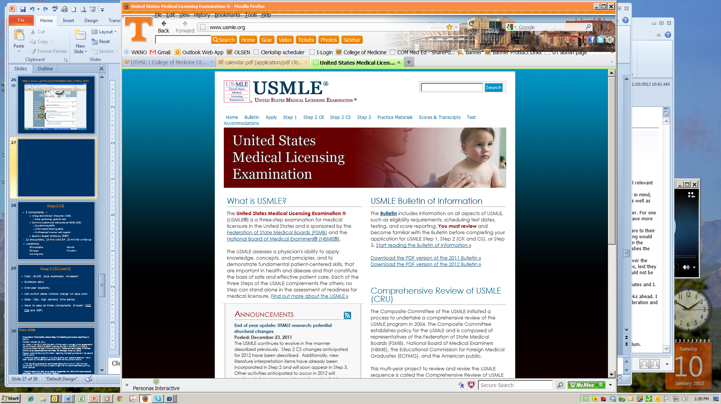
www.USMLE.org
Notes:
Click 2X to fade in arrows to highlight
2 publications that will offer invaluable information, samples
CS Content and Description
Video
Patient note information

Slide 23
USMLE Step 2 CK Exam

Slide 24
USMLE Step 2 CK Exam

Slide 25
USMLE Step 2 CK Exam

Slide 26
USMLE Step 2 CS Exam
Notes:
Take CS seriously – Must pass to graduate. Assess ability to apply gather information perform physical exams and communicate findings to patients and colleagues
People do fail these tests – 6-7 failures

Slide 27
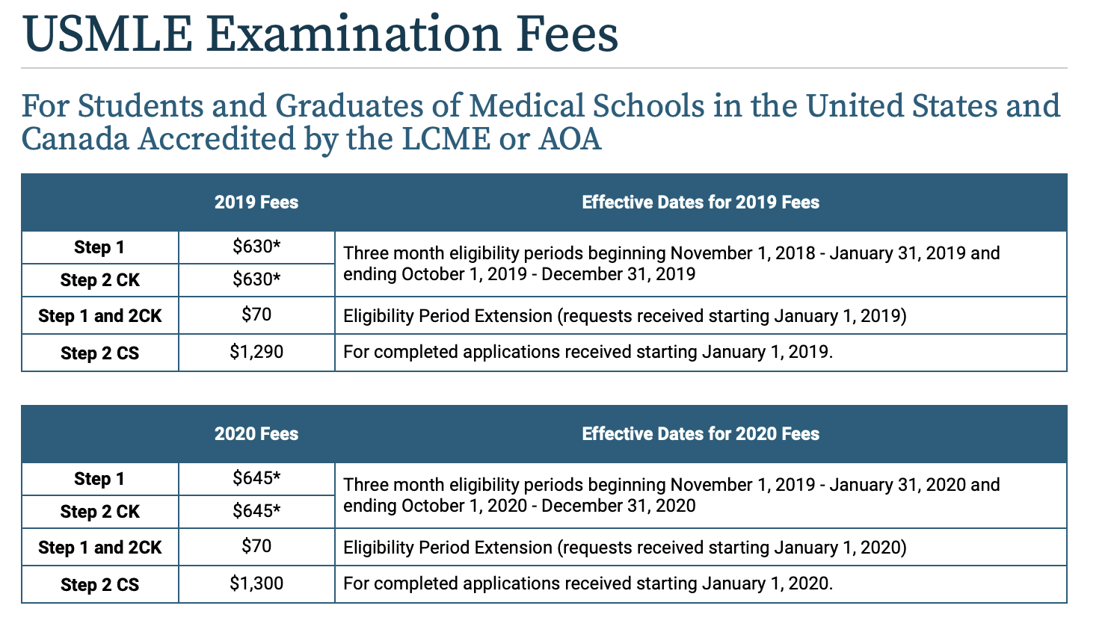

Slide 28
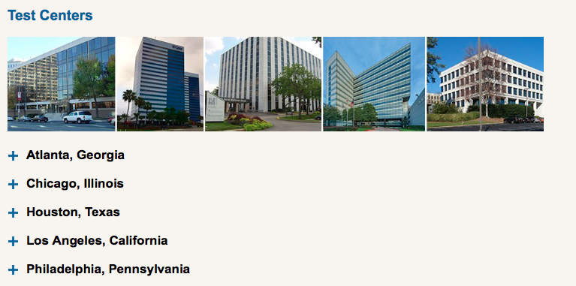

Slide 29
Step 2 CS (cont’d)
Cost - $1300 (plus expenses) (CK=$645)
One-year eligibility
Can switch dates without charge 14 days prior
Have to pass all three components of exam
Sept.- Dec. high demand time period
New Ruling – may schedule CS during JI’s but only on a Monday
Deadline for taking Steps
  Step 2CK (NLT Oct 31)
  Step 2CS (NLT Oct 31)
Notes:
Schedule Early – one year eligibility period to take after registering
The deadline is there for several reasons
make sure you have a result available to residency committees when the submit their match list in mid-February
if you do a lot better than you did on Step 1 it will help your residency application
If you are not successful the first time around, it will give you enough time to retake it twice so that you can graduate with your peers and start residency on time.

Slide 30
All Core Clerkships
MUST
be completed
before taking
USMLE Step 2CK
The best preparation for CK are the core clerkships.
Notes:
CS could be taken during your M3 spring break

Slide 31
Mistreatment Policy
You’ve heard about this policy at Orientation to med school and every clerkship since
Some of you have come forth to let us know about faculty, residents and ancillary hospital personnel who were in need of professional development.
Follow the directions in the Mistreatment policy on whom to contact in case of a complaint.
For JI’s and electives, it’s your instructor of record.
If the problem is the IOR, contact Dr. Womack or Dr. Jameson.
Or you can talk to the CD for that discipline, e.g., Dr. Bettin for a problem with the IOR for a peds specialty elective.

Slide 32
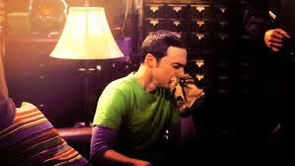
Approach to the M4 year?
Less a year and more a Fall

Slide 33
Best Year of Your Life!
Especially after Match
Time to make the memories with friends before you disperse across the country.
Time to get your life in order before moving
Travel if you have the time and money
But, do yourself a favor . . .

Slide 34
Put some icing on that cake
Time to make conceptual connections
  Apply that foundational basic science to what you’ve learned clinical
  You’ll be amazed at how they support each other
Create your 10 minute On-the-Fly teaching talks
  You know what you are mostly likely going to see
  Prepare a short “UpToDate” page for these
  It will arm you during the heat of battle
    Knowledge is POWER!
    It will make you a great teacher!

Slide 35
Everything You Wanted To Know About Scheduling
Miranda Fairley Kennedy, BPS.

Slide 36
