Slide 1
Baptist Memorial Medical Education
6025 Building
Suite 417
Notes:
Hello and welcome to Baptist! The Baptist Memorial Medical Education Team (hereby referred to as BMME) is committed to your success and a quality educational experience while training within our facilities.
The purpose of the BMME Department is multi-faceted. We are here to assist you in the completion of administrative tasks while rotating at our facilities to allow you to concentrate on your patient and educational experiences. This presentation will provide you information on the steps necessary to rotate at a Baptist facility as well as general information on the GME Team.

Slide 2
Why we are here

Slide 3
Baptist Memorial Medical Education Administration
Anne Sullivan, MD – Chief Academic Officer, Designated Institutional Official (DIO)
Allyson Dyer – System Director
Gina Rogers – System Manager – (901) 226-3843
Nikki Swan – Finance and Accreditation Supervisor– (901) 226-1356
Zach McBroom – Program and Project Supervisor – (901) 226-1060
Laura Martin – Administrative Assistant – (901) 226-1350
Andre Hernandez – System Coordinator – (901) 226-1358
GME Main Line: (901) 226-1350

Slide 4
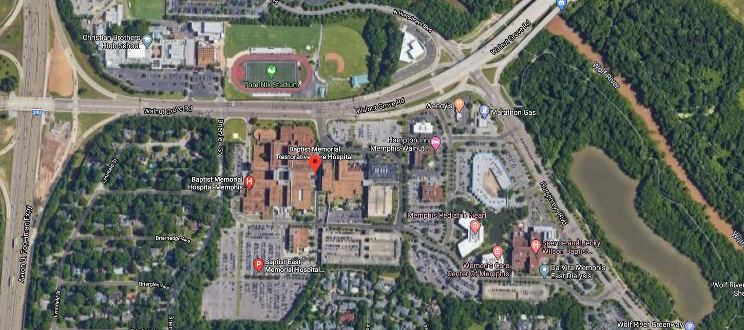
Where are we located?
6019 Walnut Grove Road
Memphis, TN 38120
GME Suite
Baptist Memphis Campus
6025 Building, Suite 417

Slide 5
What do we need from you?
Personal Demographics
Non-Employee Orientation Form
Internet Access Form

Slide 6
Personal Demographics No less than 3 Weeks prior to rotation.
Full Legal Name
Date of Birth
Social Security Number
NPI Number
Degree
Specialty

Slide 7
Non-Employee Orientation and Internet Access Forms No less than 3 Weeks prior to rotation.
Available on UT Website under Baptist Resources

Slide 8
gme@bmhcc.org
or
GME Office: (901) 226-1350

Slide 9
Link to Baptist Resources
https://uthsc.edu/graduate-medical-education/incoming-residents/registration-materials/baptist-registration-materials.php

Slide 10
COVID-19

Slide 11
What you will get from us!
Badges
Julia McGowan (901) 226-5582
Schedule appointment 2 weeks before rotation start date
Meal Card/Physician’s Lounge
Parking

Slide 12
Electronic Medical Record (EPIC)
No less than 3 Weeks prior to rotation.
Physician Overview
Surgeon Overview
Emergency Room EMR (ASAP)

Slide 13
We are here to help!
(901) 226-1350
A checklist of all forms and requirements is available on the UT-Baptist Resource page

Slide 14
Link to Baptist Resources
https://uthsc.edu/graduate-medical-education/incoming-residents/registration-materials/baptist-registration-materials.php

