Slide 1

January 13, 2021

Slide 2

Outline
What is the COHP?
Mission
History of the College
Current College
Accredited programs
College structure
Department of Audiology and Speech Pathology
Recent accomplishments
Long-Term College Goals From our Strategic Plan
Critical Needs

Slide 3
Overview
What is the College of Health Professions?
A unique collection of undergraduate and graduate (professional and research) programs (many are accredited by professional organizations) producing highly skilled practitioners, educators, and researchers through high quality educational programs, using an academic scholar-researcher-clinical practitioner model to prepare health professionals that contribute to the physical, social, mental, and behavioral well-being, to promote health, address disability, and injury through rehabilitation and therapy, and provide assistance to in local and global communities.
We have multiple programs and degrees and are developing others

Slide 4
Overview
Mission
To provide the people of Tennessee access to quality higher education by pursuing an integrated program of education, research, clinical care, and public services.
The College ​graduates outstanding health professionals ​who address the health care needs of the people of Tennessee, provide leadership in the respective health professions, contribute to ​evidence-based practice through cutting edge research, and promote healthy lifestyles and lifelong learning.

Slide 5
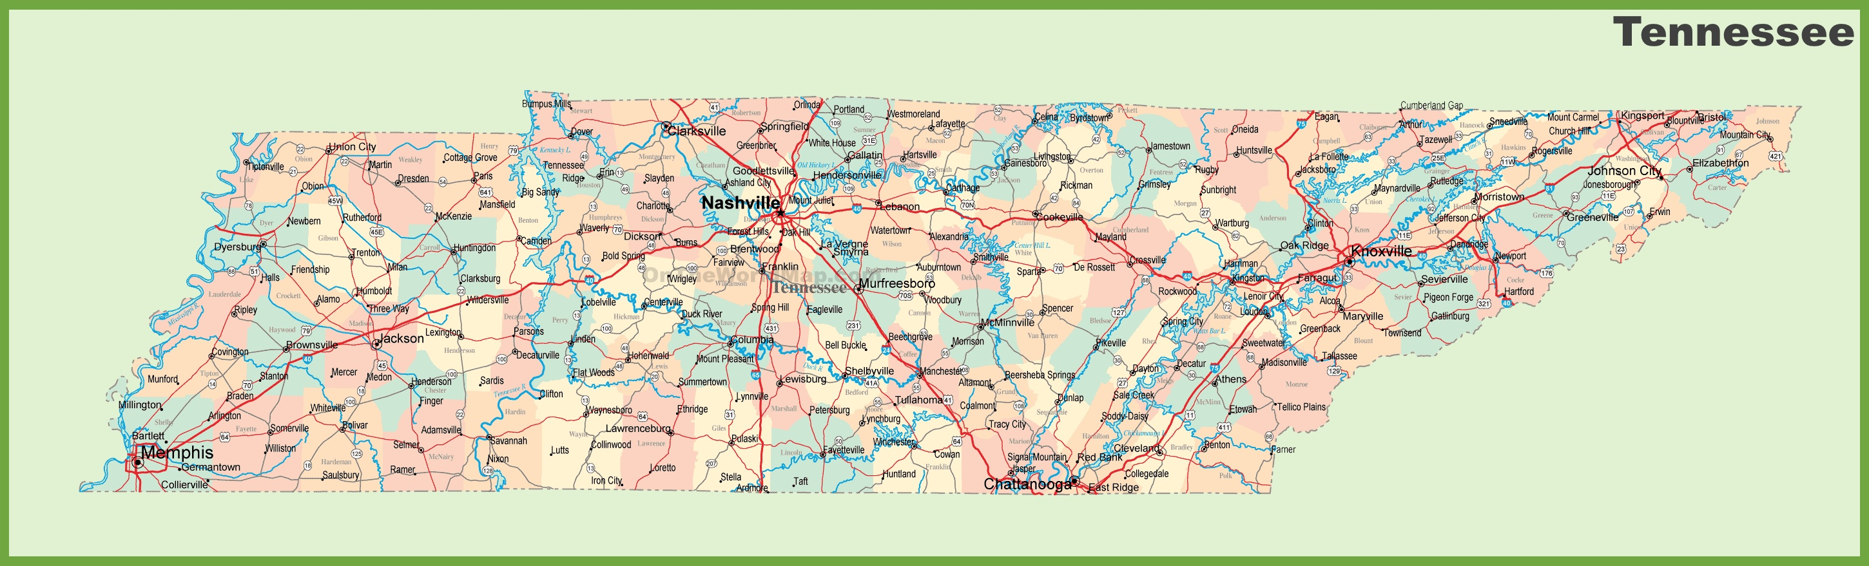

Dept of Diagnostic and Health Sciences
Programs in: Cytotechnology & Histotechnology, Medical Laboratory Sciences, Health Informatics and Information Management (HIIM)
DPT expansion ~40 students (target for 2024)
OTD (accreditation target, 2026)
MS, Master of Cytopathology Practice
BS, in MLS
MS in CLS
MS, HIIM (entry level and post graduate tracks)
MS, Pathology Assistant (2022)
BS, Human Health Sciences (2022)
PharmD/MHIIM
Certificates in Histotechnology, Clinical Chemistry, Clinical Microbiology, Telemedicine, HIIM
KNOXVILLE
Dept of Audiology & Speech Pathology
Dept of Physical Therapy
KNOXVILLE
DPT, Doctorate of Physical Therapy
Programs in: Audiology & SLP
BS in Audiology and Speech Pathology
MS in Speech Pathology
AuD – Clinical Doctorate In Audiology
PhD in Speech and Hearing Science
Dept of Occupational Therapy
MOT, Master of Occupational Therapy
MEMPHIS
COLLEGE OF HEALTH PROFESSIONS

Slide 6
Overview
Accredited Programs
AuD Degree Program in Audiology
MS Degree Program in Speech-Language Pathology
Cytotechnology Curriculum of Master of Cytopathology Practice Degree Program
Histotechnology Curriculum of Master of Cytopathology Practice Degree Program
MS, Medical Laboratory Science
MS, Health Information Management
Post-graduate Health Information Management Program
MOT, Occupational Therapy Program
DPT, Physical Therapy Program

Slide 7
Overview
History
1972 the College was founded as the College of Community and Allied Health Professions
    Laboratory sciences (which included programs in medical technology, cytotechnology, histotechnology and blood banking)
    Dental hygiene
    Medical record administration (now health informatics and information management)- came from Baptist Memorial Hospital
    Physical therapy
    Radiologic technology
1985 Renamed the College of Allied Health Science

Slide 8
Overview
History
Audiology & Speech Pathology added at UTK
Physician Assistant, (MS) program added
Renamed College of Health Professions
PA program moved to COM
College Restructuring for Planned Growth
    College Strategic Plan adopted
    Established the Division of Rehabilitation Sciences
    Combined Dept. of Clinical Laboratory Sciences and Dept. of Health Informatics and Information Management into the Department of Diagnostic and Health Sciences (DDHS)

Slide 9
History
2019
    Formed the Center for Muscle, Metabolism & Neuropathology (CM²N)
      Muscle injury and rehabilitation
      Metabolism/fatigue disorders
      Movement disorders related to stroke and other neurological diseases
      Muscle loss with cancer and aging
2020
    Approval for MS Pathology Assistance Program (DDHS)
    Approval for BS in Human Health Sciences Program (DDHS)

Slide 10
Enrollment
Overview
400
300
200
100
2.3%
2016
2017
2018
2019
2020
7.1%
Instate
Out of State
5.4%
~15%

Slide 11
Graduation
Overview
BS
Certificate
MS
Graduate Certificate
Doctorate
150
100
50
2017-2018
2018-2019
2019-2020
267
292
318

Slide 12
College Structure
College of Health Professions
Dean
Academic, Faculty, Student Affairs
Research
Finance
Academic, Faculty and Student Affairs
Executive AD
Research and Graduate Studies
Senior AD
Assistant Dean for Finance and Operations
Asst. D
Departments
Dept. ASP
Dept. DDHS
Student Affairs
Asst D.
Office of Research
pre award & post award
Research Coordinator
Dept. PT
Dept. OT
Student Services and Recruitment
Coordinate/Recruit
Division of Rehabilitation Sciences
Research
Centers
Human Performance Research and Clinical Care Laboratory
Admin IBS RS - PHD

Slide 13
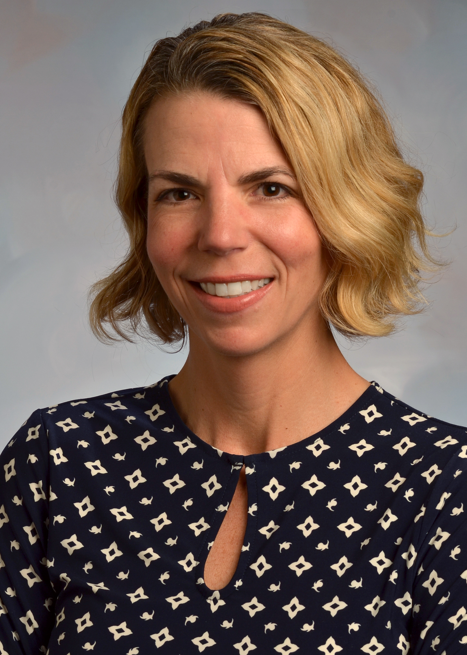
Department of Audiology and Speech Pathology
Department of
Audiology and Speech Pathology
Ashley Harkrider, PhD
Professor and Department Chair
26th Nationally in Audiology
39th Nationally in Speech Language Pathology

Slide 14
Long-term Goals
Long-Term College Goals From our Strategic Plan (2018-2025)
The overall goal is to strategically add new programs and student enrollment, grow research, increase community outreach and elevate our national ranking of programs in our college to the top 20.

Slide 15

Recent Accomplishments in the College of Health Professions

Slide 16
Submitted Grants in the College of Health Professions

Slide 17
AWARDED Grants in the College of Health Professions

Slide 18
Overview
College Research Goals
Increase faculty research productivity and support:
Plan for a new clinic and clinical research laboratory
Increase federal grant applications by 20% – engage Hanover Consulting
Reestablish recruitments (post COVID) for research faculty appointments

Slide 19

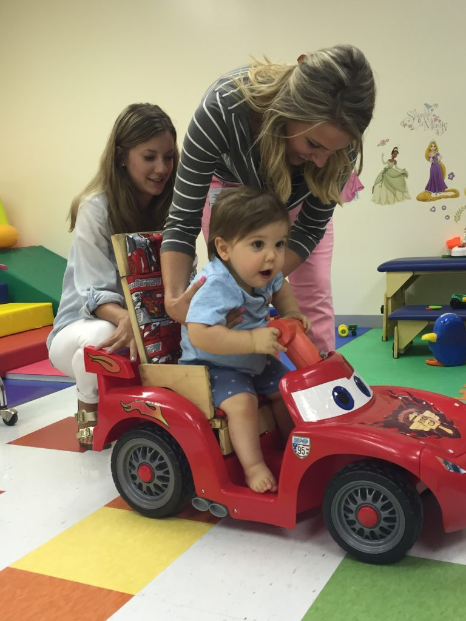
COMMUNITY ENGAGEMENT
  Expand & Strengthen Key Community & Other Partnerships
Tamika Catchings (Lady Vol) basketball camp
Audiology & Speech Pathology
Faculty participation in school career fairs
ASP – Your voice summer student camp for communications
Go-Baby-Go
PT/OT/CBU
Rachel K. Stevens pro bono Occupational Therapy clinic

Slide 20
Overview
College Clinical Outreach Goals
Plan for a new interdisciplinary clinic and clinical research laboratory
  OT/PT/ASP

Slide 21

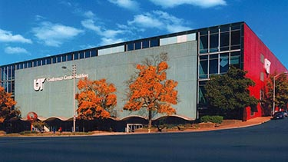
Overview
College Program Goals 2021-2025
Grow student enrollment – PLAN for new enrollments and hires:
BS of Human Health Sciences (BSHS) + 40 yr/ = 80
Pathology Assistant (MSPA) +10 20 yr =40
Expanding DPT (Memphis and UTK) = 20 Memphis x 3 yr; 40 x 3 yr at UTK =180
Develop and expand OTD (Memphis and UTK) = 20 Memphis x 3 yr; 40 x 3 yr at UTK =180
Grow by 480 students to ~ 1085

Slide 22
Overview
Potential New College Programs
Develop application for new programs
Doctorate of Health Science (DHSc)
Doctorate of Psychology (PsyD)
Explore new degrees
Respiratory Care/Therapy (BS/MSRT)
Clinical Nutrition (MS)
Cardiac Rehabilitation (MS)
Plan for college expansion
DPT, OTD– new faculty, more students and new sites - Knoxville

Slide 23
COHP
Critical Areas to Address for Success
Infrastructure and resources for clinical lab
Research faculty recruitments, research space, – critical for funding, and scholarship to increase national visibility
New building on Memphis campus (3-5 yrs?) – critical for recruitment and retention of faculty and students - student area, clinic area, research area
Expand clinical sites around the state for student training
Increase student and faculty diversity in college

Slide 24
COHP
Thank you
Questions?

