Slide 1
Work-Life Balance Strategies
Dr. Kimberly Williams Collins, Ph.D./HSP
Counseling Psychologist, UHS & SASSI
Kathy Gibbs, M.S., M.Ed., NCC, BCC
Assistance Vice Chancellor, SASSI
Tia Kofahl, MS, BCC
Assistant Director, SASSI

Slide 2
Work-Life Balance - the distribution of time/attention/energy between personal and professional components of our lives.
What makes Work-Life Balance important?
. . . because of its relationship to stress, burnout, illness and emotional/mental health.
How can we have healthy Work-Life Balance?
. . . build the lives we want by identifying our priorities and make room for them in our lives. Choose how to distribute time/attention/energy.

Slide 3
Work-Life Balance Activity – Plan for Your Life
You Have 168 Hours in A Week
Sleep = 56 Hours/Week
Work = 40 Hours/Week
Self/Personal = 72 Hours/Week
This is . . .
Your Life
Your Time

Slide 4
Work-Life Balance Activities & Tips
Breathe – 4 – 7 – 8
Visualize Yourself One Year From Now
Schedule time with family, friends and doing things that recharge you;
Evaluate current activities;drop those that drain your time or energy;
Think outside the box and use your village;
MOVE!
Set yourself up to succeed and achieve.

Slide 5
What questions are you asking yourself during this uncertain time?

Slide 7
Switching Questions to Get Back in Learner Mode
Am I in Judger thinking? (Usually the answer is, “yes!”)
Is that what I want to be feeling right now?
Is what I’m thinking right now helping me? (The answer is often a resounding, “NO!!!”)
Is what I’m thinking true?
What is something different I could be thinking?

Slide 8
Generating Learner Questions
What questions could you add to your toolbox that could help you stay in Learner?
What can I learn from this difficult situation?
What do I have to be grateful for now?
Who do I choose to be in this moment?
When I look back on the pandemic what do I want to say about how I behaved?
What questions would you generate for yourself?

Slide 9
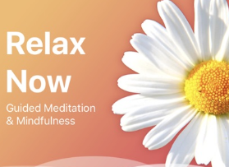
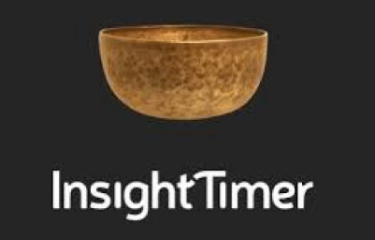
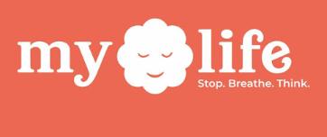
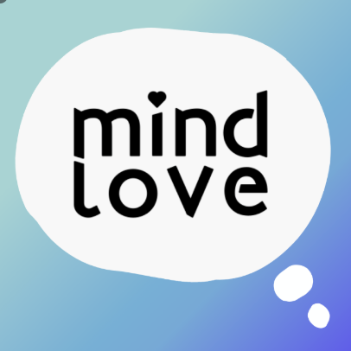
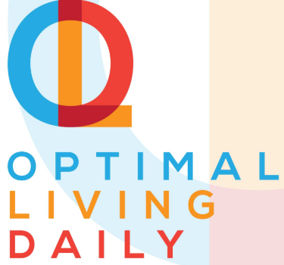
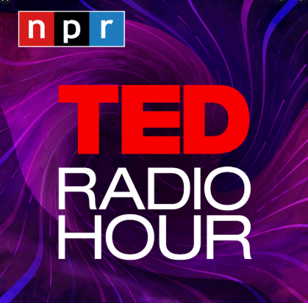
Resources and Apps for Well-Being
Meditation and Mindfulness Apps
Podcasts

