Slide 1
Student Academic Support Services and Inclusion
Student Academic Support Services and Inclusion
Notes:
Welcome! This presentation will highlight services available through the office of Student Academic Support Services and Inclusion, also known as SASSI. The mission of SASSI is to provide quality programming, services, and resources to assist students in adjusting to the emotional, academic, social, and physical demands of the health science curricula and health care professions. Through SASSI methods, resources, and techniques, the environment is enriched to support adjustment, coping, learning, and performance. SASSI services target accessibility, engagement, learning, prevention, counseling, case management, and connection to promote a diverse and inclusive environment for all students.

Slide 2
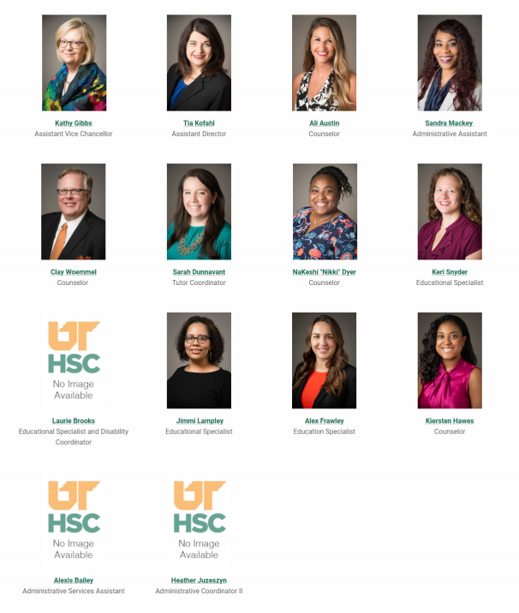
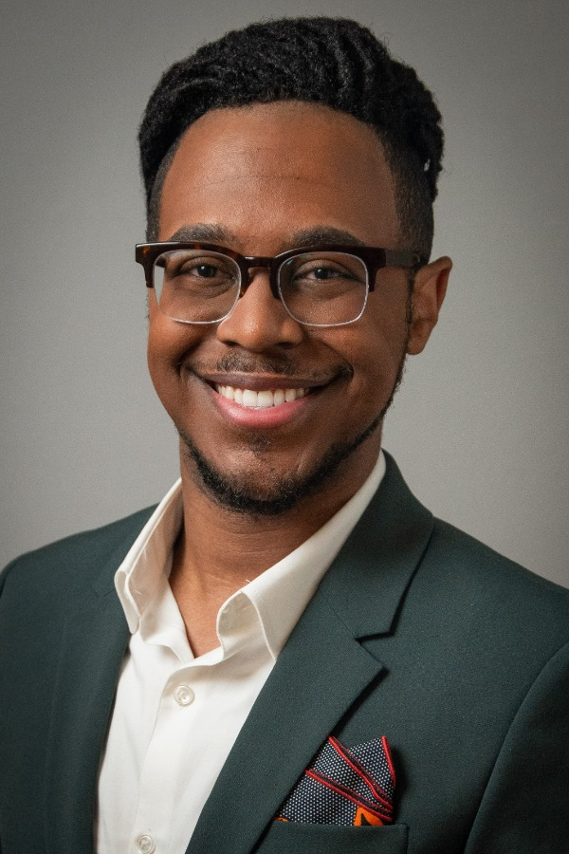
Staff
Student Academic Support Services and Inclusion
Corbin Watson
Counselor
Notes:
SASSI offers many services that can assist students at every level of academic proficiency to meet their own academic and personal goals. SASSI has 15 staff members whose primary goal is to facilitate and enhance the learning effectiveness and coping of all students in the various UTHSC programs of study.

Slide 3
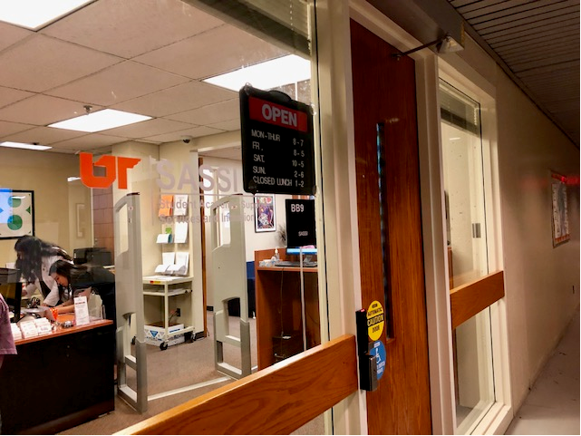
Location and Hours
Student Academic Support Services and Inclusion
Notes:
SASSI offices are located in the basement of the General Education Building in room BB9, although, due to COVID, SASSI is currently working remote. Appointments with counselors and educational specialist/coaches are still available though Monday – Friday, 8 AM – 5 PM.

Slide 4
Educational Coaching
Student Academic Support Services and Inclusion
Notes:
SASSI offers educational coaching services to every student at UTHSC. Educational Specialists are available to meet with students, individually or in a group, to develop personalized learning strategies with the goal of maximizing learning and performance to adjust quicker to the demands of the curricula. Students can meet with an Educational Specialist to discern areas of strengths and weaknesses to enhance success. Some of the areas of focus include, but are not limited to, identifying learning preferences, addressing study and test taking strategies, discussing effective time management skills, and board preparation. Educational Specialists are available to meet with students at this time, online or over the phone. Services are free for all UTHSC students, both on-campus and off-campus, and all consultations are confidential.

Slide 5
Workshops and Learning Resources
Student Academic Support Services and Inclusion
Notes:
In addition to individual appointments with students, SASSI Educational Specialists/Coaches also offer workshops and printed materials that cover topics geared towards students in the health sciences. These topics include: preparing for board and licensure exams; managing time more efficiently; effective study strategies and test taking strategies; identifying learning preferences; as well as a variety of other topics. You can also find recorded workshops, videos, and informational handouts on these topics and more on the SASSI webpage.

Slide 6
Disability Services
Student Academic Support Services and Inclusion
Notes:
SASSI facilitates and coordinates disability services for UTHSC students. On the SASSI webpage, students can find information on the process for requesting accommodations, documentation guidelines, and forms needed to initiate the process for requesting disability services. Faculty can also find SASSI’s testing guidelines, FAQ’s, and a Disability Services Faculty Handbook.

Slide 7
Counseling
Student Academic Support Services and Inclusion
Notes:
SASSI offers counseling services and support groups to UTHSC students, including students off site. The goal of SASSI counseling is to impact the culture of the campus for students by normalizing self-care and removing any barriers or stigma associated with utilizing support earlier, so that students will thrive, not just survive in navigating and adjusting to the demands of our challenging programs and training. Trained, certified, and licensed or licensed-eligible counselors are available to assist students and can assist students with test anxiety, personal issues, adjustment, relaxation techniques, EMDR, biofeedback, stress management, heart math, and more. Counseling in SASSI is confidential and no information related to sessions can be released without the written permission of the student, unless abuse or risk of harm to self or others is communicated. Appointments with a Counselor can occur with students residing in the state of Tennessee at this time online, or over the phone.
If a student needs to speak with a counselor after normal business hours or on weekends, there is an afterhours counseling line, 901-690-CARE. That’s 901-690-2273. Students can also utilize their student health insurance or private insurance to access providers off campus. Links to providers can be located on the SASSI website, also.

Slide 8
Student Academic Support Services and Inclusion
No one expects you to have the answers…only to help connect to the people who do.
Notes:
UTHSC cares about our students and we work hard to foster a caring campus environment through resources and support. We’ve invested in a service for prevention and intervention efforts through our SASSI Care Navigator and our CARE Team, which connects students, both on-campus and off-campus, to different support resources to in managing and addressing their challenges preventively before they begin to interfere with academic success and emotional wellbeing.
In SASSI, the Care Navigator’s role is to work with students to problem solve; connect students to resources; provide ongoing support; promote the safety of our UTHSC community; serve as a resource for faculty, staff, and students; and work hand-in-hand with the CARE Team to support students and the campus.

Slide 9
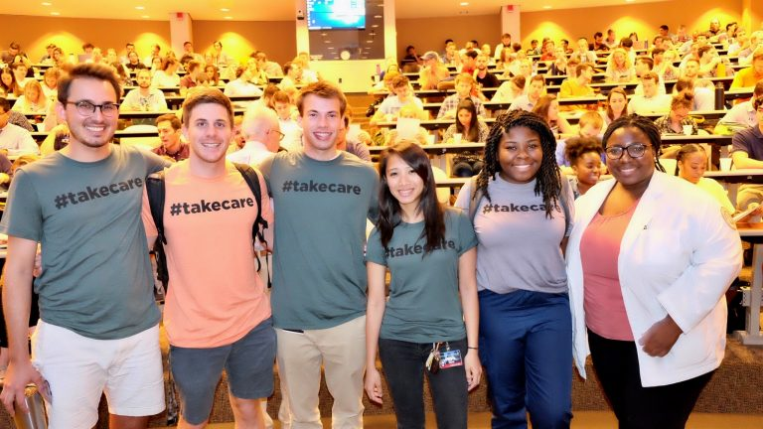
#takecare Share a Concern
Student Academic Support Services and Inclusion
Early intervention results in prevention. See the CARE Navigator to share a concern or request resources/support.
Notes:
UTHSC is here to #takecare of students with quality, holistic, and inclusive campus services. Students can readily access resources available on the #takecare webpage, which can be located at uthsc.edu/take-care. Faculty play a valuable role in often being the first to know when one of their students is significantly struggling. Concerns about the safety and well-being of a student can be shared at uthsc.edu/care-concern. It’s anonymous, unless you want to be known, and it will connect students with the Care Navigator and the CARE Team so that holistic services can be coordinated. You could be a key factor in saving a student’s academic career and life.

Slide 10
Appointments
Student Academic Support Services and Inclusion
Notes:
As mentioned, SASSI services are available to all UTHSC students, including students at distance sites. Students can schedule an appointment with an Educational Specialist, the Disability Coordinator, or a Counselor through our online portal. Online scheduling can be accessed through the SASSI website by clicking “Schedule an Appointment” on the main page. Appointments can take place, at this time, online or over the phone and are confidential, unless abuse or risk of harm to self or others is communicated.

Slide 11
Tutoring
Student Academic Support Services and Inclusion
Notes:
The Campus Wide Tutoring Program works directly with colleges at UTHSC. Each semester colleges and programs may identify up to two courses for tutoring through this program. For the first two assessments, tests, or exams administered within the two identified courses, free large group tutoring will be provided as available. After the first two exams, students who qualify may continue to receive tutoring. For more information related to tutoring please visit the SASSI webpage or contact the SASSI Tutoring Coordinator at sassi@uthsc.edu.

Slide 12
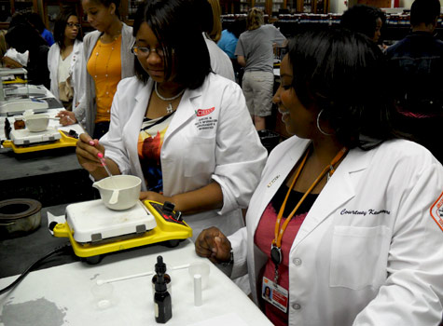
Acceptability, Diversity, & Inclusion
Student Academic Support Services and Inclusion
Notes:
SASSI has a record of commitment to enhancing and promoting accessibility, diversity, and inclusion on campus. It is a unique office with demonstrated value that has created and developed initiatives to provide and promote inclusion that have directly affected UTHSC student success and retention. SASSI provides resources and services to students who are veterans and work with various student organizations across campus and provide support services for student group members.
For additional information on the inclusive services SASSI provides, please visit the SASSI webpage at uthsc.edu/sassi.

Slide 13
Contact Information
Student Academic Support Services and Inclusion
Student Academic Support Services & Inclusion
General Education Building (GEB) Basement Level – Room BB9 901-448-5056
sassi@uthsc.edu uthsc.edu/sassi
Notes:
SASSI looks forward to working with you to support our students academically and emotionally. Please don’t hesitate to contact us if you have any questions, concerns, or need additional information.

