Slide 1
Clerkship Grading 2022-2023
Kristen Bettin, MD, MEd
Sr Asst Dean, Clinical Curriculum

Slide 2
Three components of clerkship grading
Medical knowledge (expertise)
Professionalism
Clinical skills and performance
Notes:
More complex
Now students must also be graded on
Clinical skills – patient interaction, communication, eye-hand coordination, reasoning skills, team integration, self-perception, etc.
Professionalism, ethical behavior
While the opinion of an experienced faculty member in judging student performance is considered “objective”, the reality is that subjectivity and perception have an increased influence on feedback.
While this may seem to allow for unfair variability, this is exactly how patients and peers judge physicians in the real world. (Learning how people perceive you is incredibly valuable knowledge and that’s what you get in your clinical grade).

Slide 3
How to achieve this goal?
Exams (NBME Subject exams, Oral exam, Slide exam) → assess medical knowledge and expertise
Clinical evaluations → assess clinical skills, performance, and professionalism
Notes:
Clinical evaluations → assess clinical skills, performance, and professionalism
Faculty use a standardized evaluation to evaluate where students are on a given set of behavior (performance) descriptors.
Faculty do NOT assign grades to students.
Clinical evaluations use the Entrustable Professional Activities (EPA) framework.
NBME Subject exams (shelf exams) → assess medical knowledge and expertise
Every clerkship utilizes shelf exams.
Minimum passing scores and scores to be eligible for receiving a “A” are standard percentiles across clerkships and across the state.

Slide 4
Clinical Evaluations
Moved to evaluations based on Entrustable Professional Activities (EPAs) in 2019.
EPAs = 13 core skills or tasks for physicians.
Each clerkship evaluates a sampling of EPAs.
Numeric adjustment is applied to each clinical evaluation based on student’s level of experience (i.e. what number clerkship they are on)

Slide 5
Entrustable Professional Activities (EPAs)
1. Gather a history and perform a physical exam.
2. Develop a prioritized differential diagnosis.
3. Recommend and interpret common diagnostic and screening tests.
4. Enter and discuss orders and prescriptions.
5. Provide documentation of a clinical encounter.
6. Provide an oral presentation.
7. Form clinical questions and retrieve evidence.
8. Give or receive patient handover.
9. Participate as a member of an inter-professional team.
10. Recognize a patient requiring urgent/emergent care.
11. Obtain informed consent.
12. Perform the general procedures of a physician.
13. Identify system failures and contribute to a culture of safety and improvement.

Slide 6
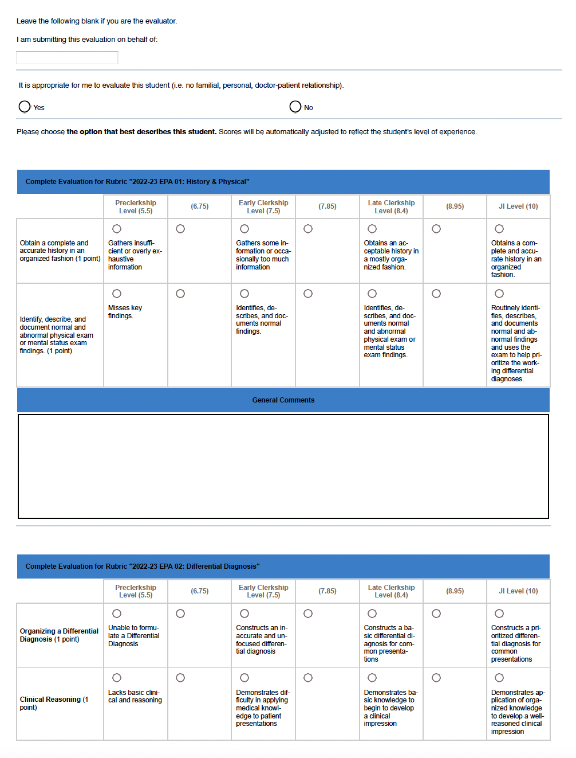
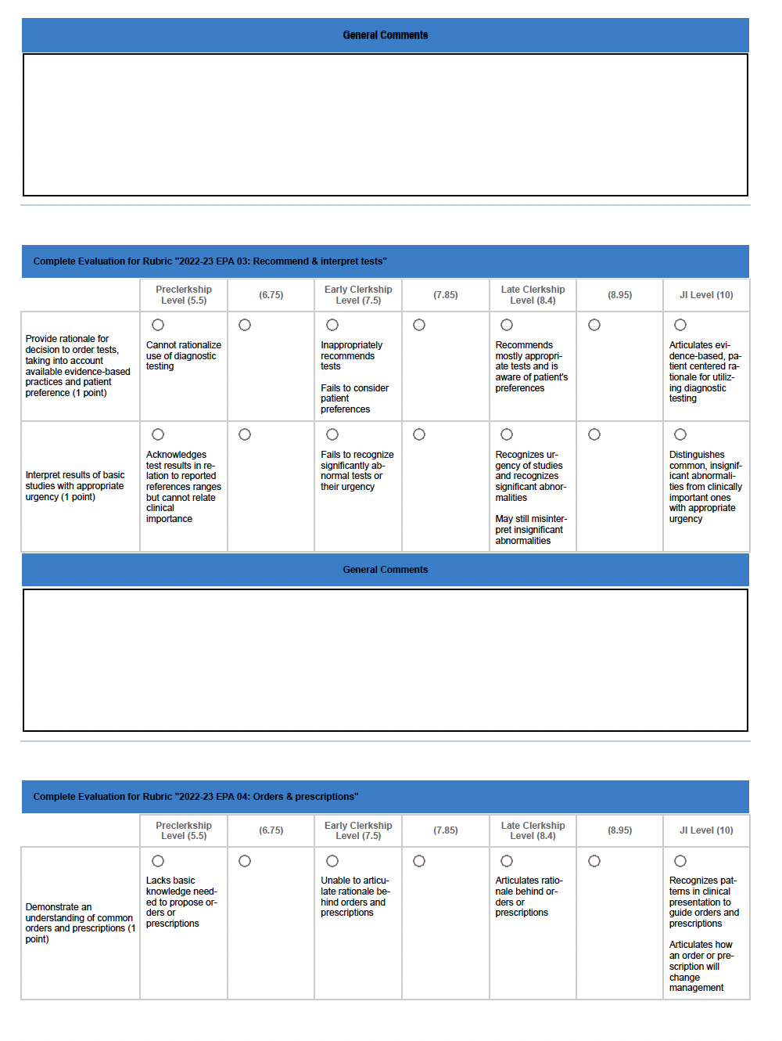
Notes:
To get an "A" you would need to be functioning at a late clerkship level with a few that are in the box between Late Clerkship and JI, so a mix of 8.4 and 8.95. Column numbers above.
Recall that we expect the majority of students to be in the "B" range (see graphs below on future slides). It should be students that are truly going above and beyond that earn the grade of an A. So, essentially, a "B" is average/good and acceptable. A "C" is below average, and an "A" is significantly above average. Please rest assured that we are going to be monitoring grades very closely after every block and will intervene as appropriate if we see anything that looks like a significant decline in student grades!!!

Slide 7
What is average, below average, above average?
Average – moves from Early Clerkship (now) to Late Clerkship throughout the course of the year.
Clinical Evaluation Grade? B
Below average – Pre-clerkship (now) or Early Clerkship (later in the year
Clinical Evaluation Grade? C
Above average – Late Clerkship and few between Late Clerkship/JI level (now) then mix of level between Late Clerkship/JI level and JI level later in the year
Clinical Evaluation Grade? A

Slide 8
Clinical Score Adjustment
The purpose of this adjustment is to account for level of experience in evaluation.
Typically, clinical performance substantially improves as students gain more experience in clerkships.
Points are added to the final clinical evaluation scores based on the number of core clerkships previously completed.
This will help ensure that evaluation scores on your first few clerkships will not be excessively low due to inexperience.
Likewise, it will reassure evaluators that they can simply select the options that best describe the students’ performance regardless of expectations, which can be widely subjective.

Slide 9
Clinical score adjustment
# of Core Clerkships Completed | Percentage points added (2022-23)
0 | 3
1 | 2.5
2 | 2
3 | 1.5
4 | 1
5 | 0.5
6 | 0
Based on the past 2 years of data, average performance increased about 3 total percentage points from the 1st clerkship to the 7th, therefore, for 2022-2023, the following adjustments will be applied:

Slide 10
NBME Shelf Exams: Minimum Passing and Honors Scores
Minimum passing score | 5th percentile
Minimum score to be eligible for an “A” in the clerkship | 50th percentile
Score that is equal to an “A” on the shelf exam. | 75th percentile
The NBME reports scores as “raw scores” which are mean equated percent correct scores, like a percent correct.
Notes:
A 89.5-100 B 78.5-89.49 C 67.5-78.49 F < 67.49
The NBME reports give a nationally recommended passing score range (between 3rd-6th percentile) for each specialty’s exam, as well as a recommended score for “honors” (generally between the 60th-80th percentile)
UTHSC has decided on the minimums listed in the table, which are within the nationally recommended acceptable ranges for passing and “honors”

Slide 11
What about students at the beginning vs. the end of clerkships?
# of Clerkships Completed | Score used
0-1 | Q1
2-3 | Q2
4-5 | Q3
6-7 | Q4
Students naturally improve their performance on the shelf exams throughout the year.
These cutoff scores will be based on the “Quarter” of the year and based on how many clerkships a student has completed.
NBME reports all of these scores!

Slide 12
Family Medicine Shelf Exam Cut-off Scores 2022-2023
Quarterly Conversions |  | Q1 | Q2 | Q3 | Q4
Number of clerkships completed PRIOR to the START of THIS rotation |  | 0-1 | 2-3 | 4-5 | 6
Raw shelf score = 89.5 (i.e. A on the shelf) | 75th percentile | 80.2 | 80.4 | 81.2 | 81.2
 |  | 76 | 76 | 76 | 77
Raw shelf score to be eligible for an A in the clerkship | 50th percentile
 |  | 63 | 63 | 64 | 65
Minimum passing raw shelf score | 5th percentile

Slide 13
Internal Medicine Shelf Exam Cut-off Scores 2022-2023
Quarterly Conversions |  | Q1 | Q2 | Q3 | Q4
Number of clerkships completed PRIOR to the START of THIS rotation |  | 0-1 | 2-3 | 4-5 | 6
Raw shelf score = 89.5 (i.e. A on the shelf) | 75th percentile | 79.6 | 80.8 | 82 | 82.2
Raw shelf score to be eligible for an A in the clerkship | 50th percentile | 73 | 74 | 76 | 76
Minimum passing raw shelf score | 5th percentile | 56 | 58 | 59 | 59

Slide 14
Neurology Shelf Exam Cut-off Scores 2022-2023
Quarterly Conversions |  | Q1 | Q2 | Q3 | Q4
Number of clerkships completed PRIOR to the START of THIS rotation |  | 0-1 | 2-3 | 4-5 | 6
Raw shelf score = 89.5 (i.e. A on the shelf) | 75th percentile | 85 | 85.4 | 86 | 86.8
Raw shelf score to be eligible for an A in the clerkship | 50th percentile | 80 | 81 | 82 | 82
Minimum passing raw shelf score | 5th percentile | 65 | 66 | 68 | 68

Slide 15
OB/GYN Shelf Exam Cut-off Scores 2022-2023
Quarterly Conversions |  | Q1 | Q2 | Q3 | Q4
Number of clerkships completed PRIOR to the START of THIS rotation |  | 0-1 | 2-3 | 4-5 | 6
Raw shelf score = 89.5 (i.e. A on the shelf) | 75th percentile | 82.6 | 83.2 | 84 | 84
Raw shelf score to be eligible for an A in the clerkship | 50th percentile | 77 | 78 | 79 | 79
Minimum passing raw shelf score | 5th percentile | 63 | 63 | 65 | 65

Slide 16
Pediatrics Shelf Exam Cut-off Scores 2022-2023
Quarterly Conversions |  | Q1 | Q2 | Q3 | Q4
Number of clerkships completed PRIOR to the START of THIS rotation |  | 0-1 | 2-3 | 4-5 | 6
Raw shelf score = 89.5 (i.e. A on the shelf) | 75th percentile | 83 | 83.4 | 85 | 85
Raw shelf score to be eligible for an A in the clerkship | 50th percentile | 77 | 78 | 79 | 80
Minimum passing raw shelf score | 5th percentile | 62 | 63 | 65 | 65

Slide 17
Psychiatry Shelf Exam Cut-off Scores 2022-2023
Quarterly Conversions |  | Q1 | Q2 | Q3 | Q4
Number of clerkships completed PRIOR to the START of THIS rotation |  | 0-1 | 2-3 | 4-5 | 6
Raw shelf score = 89.5 (i.e. A on the shelf) | 75th percentile | 88.4 | 88.5 | 88.6 | 88.6
Raw shelf score to be eligible for an A in the clerkship | 50th percentile | 84 | 84 | 84 | 84
Minimum passing raw shelf score | 5th percentile | 72 | 73 | 73 | 73

Slide 18
Surgery Shelf Exam Cut-off Scores 2022-2023
Quarterly Conversions |  | Q1 | Q2 | Q3 | Q4
Number of clerkships completed PRIOR to the START of THIS rotation |  | 0-1 | 2-3 | 4-5 | 6
Raw shelf score = 89.5 (i.e. A on the shelf) | 75th percentile | 79.2 | 80.5 | 81.2 | 81.2
Raw shelf score to be eligible for an A in the clerkship | 50th percentile | 73 | 74 | 75 | 75
Minimum passing raw shelf score | 5th percentile | 57 | 59 | 59 | 60

Slide 19
Apples and oranges
⍯
The NBME reports the raw scores (mean equated percent correct score).
It is essential to convert these to the same format so that they can be used with other components of the grade.
All “raw scores” are converted to the UTHSC grading scale to be included in the final grade calculation.
UTHSC Clerkship Grading Scale:
A = 89.5-100 B = 78.5-89.49 C = 67.5-78.49 F < 67.49

Slide 20
Shelf Score Conversion
The purpose of the conversion is to apply the raw shelf scores, which are on variable scales, to a normative (compared to national peer performance) and standardized scale (0-100%).
This allows comparison of students’ performance across clerkships and in relation to their peers nationally.
75th percentile aligns with 89.5% (equivalent of an A on the shelf).
5th percentile aligns with 67.5% (cutoff for passing).
Note: Recall that the 50% is the minimum cutoff to be eligible for an A in the clerkship.

Slide 21
Shelf score conversion formula
Here is the formula for converted shelf score:
89.5 – [(75th%ile – Raw Shelf Score) * 22 / (75th%ile – 5th%ile)]
Notes: The percentiles are variable for each clerkship each year. The 22 is derived from the difference between an A and F (89.5-67.5) in the UT grading scale.

Slide 22
Why don’t we just give all A’s?!
Notes:
Until recently, the Dean’s Letter, MSPE, simply provided a GPA along with the student transcripts.
Now, the MSPE must include the grade distribution for each clerkship.
Residency Program directors will know that getting an A when 80% of the class did as well is meaningless.
Getting an A when only a third of the class did as well is discerning.
Our goal is to identify the top third of the class in any given clerkship, BUT our job is to also assure that that assignment is fair and valid.
Recall that we expect the majority of students to be in the "B" range (see graphs below on future slides). It should be students that are truly going above and beyond that earn the grade of an A. So, essentially, a "B" is average/good and acceptable. A "C" is below average, and an "A" is significantly above average. Please rest assured that we are going to be monitoring grades very closely after every block and will intervene as appropriate if we see anything that looks like a significant decline in student grades!!!

Slide 23
Weighting clinical and exam scores
The competent student excels in all areas (patient care, medical knowledge, professionalism)
if all student clinical evaluations are “A”s, then the shelf exam becomes the discriminating factor.
Goals:
1.Create evaluationS THAT ARE fair, helpful, and DISCERNING
2. weigh it sufficiently to balance the shelf exam

Slide 24
Correct weighting
Potential outcomes
Super nice, hard working student but average performance on the shelf
Clerkship Grade B
Never available and only putting in the minimal work on the ward in order to be off studying for the shelf which they blow out of the water
Clerkship Grade B
Excellent performance on the wards, integrated into the team, barely makes above the cutoff for honors on the shelf
Clerkship Grade A
The student must excel in all areas to receive an A in the clerkship.
Notes:
So just because a student achieved the minimum honors score on the shelf, it does not guarantee that he/she will get an A for the clerkship.

Slide 25
Planned Review of Grades for 2022-2023
We will be reviewing grades at the end of every month and every block, including the following:
Average clinical evaluation score
Average shelf exam score
Average overall numerical grade
Percentage of As, Bs, Cs, Fs compared to prior years
Goals:
Ensure fair and accurate clinical evaluations
Ensure that overall grades are fair and accurate
Ensure that we don’t have a precipitous drop in # of As or a precipitous increase in # of Cs.
Future goals:
Pass/Fail Task Force has been convened.
Looking at alternatives for ABCF grades on clerkships.

Slide 26
Questions? Email us!
Kristen Bettin, MD, MEd – Senior Assistant Dean for Clinical Curriculum
kbettin@uthsc.edu
Bill Dabbs, MD – Assistant Dean for Clinical Curriculum
wdabbs@utmck.edu
Jenn Wilson, CAP – Lead Clinical Curriculum Coordinator
jmcadoo3@uthsc.edu
Ke’Nosha (Ken) Anderson – Clinical Records Specialist
kande110@uthsc.edu

