Slide 1

Informational Update
Catherine R Womack, MD, FACP
Associate Dean of Student Affairs and Admissions

Slide 2
Reviewing the following
MSPE
Careers in Medicine
Specialty Advisor
Residency Explorer

Slide 3
Medical Student Performance Evaluation (MSPE)

Slide 4
The MSPE…
  Is neither a letter of recommendation nor a prediction of future performance in residency

Slide 5
The MSPE…
  The MSPE is a comprehensive assessment regarding comparative performance.
  Sequential description of performance, as compared to peers, through all years of school
  An assessment of both academic performance and professional attributes.
  It should be 2-3 pages in length and appropriately formatted with appendices.

Slide 6
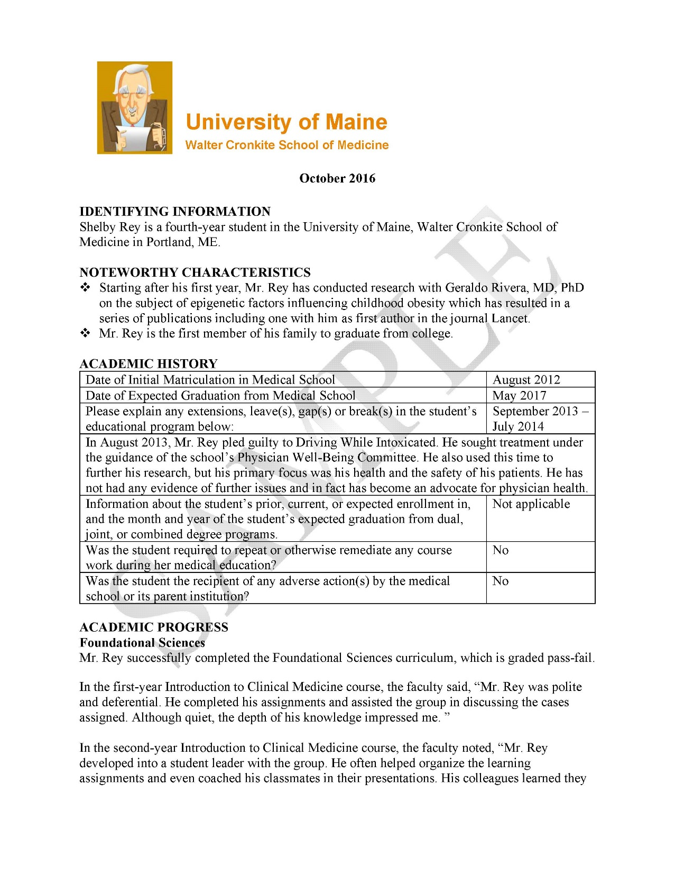

Slide 7
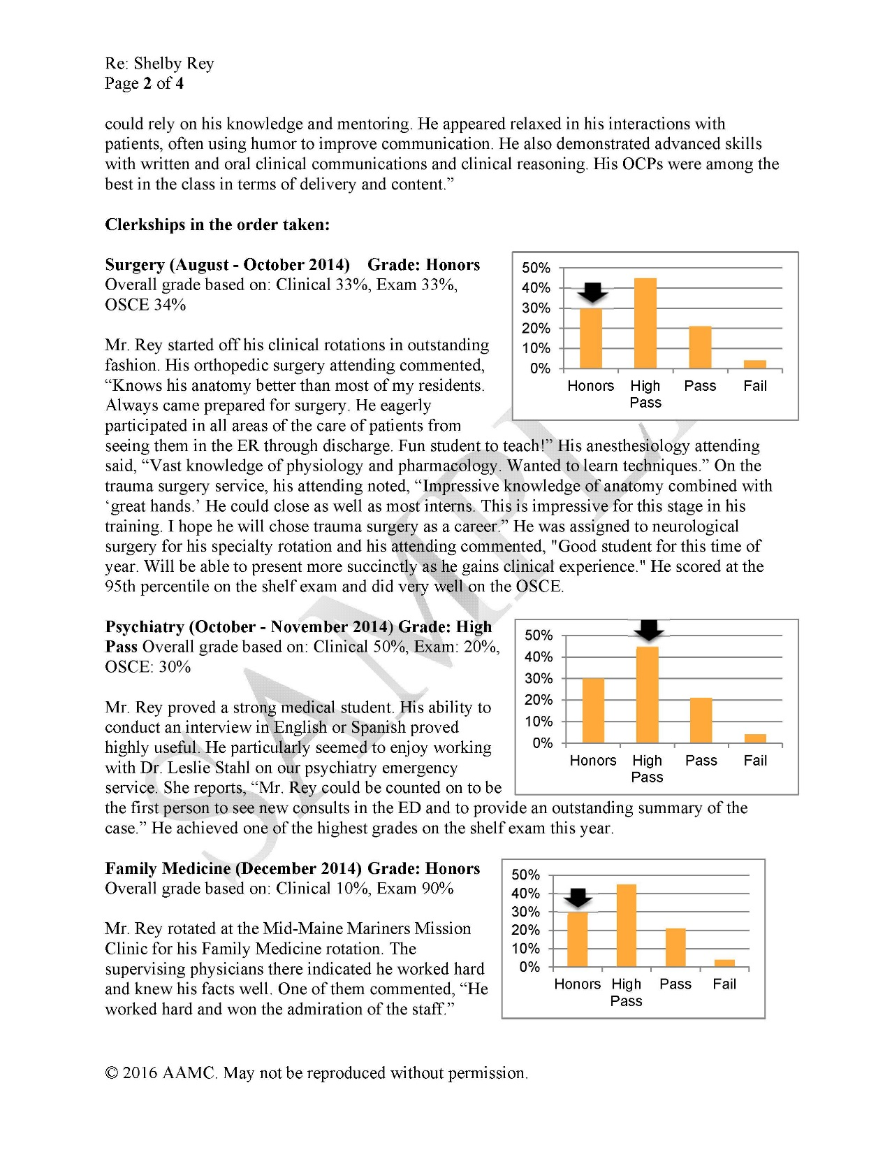

Slide 8
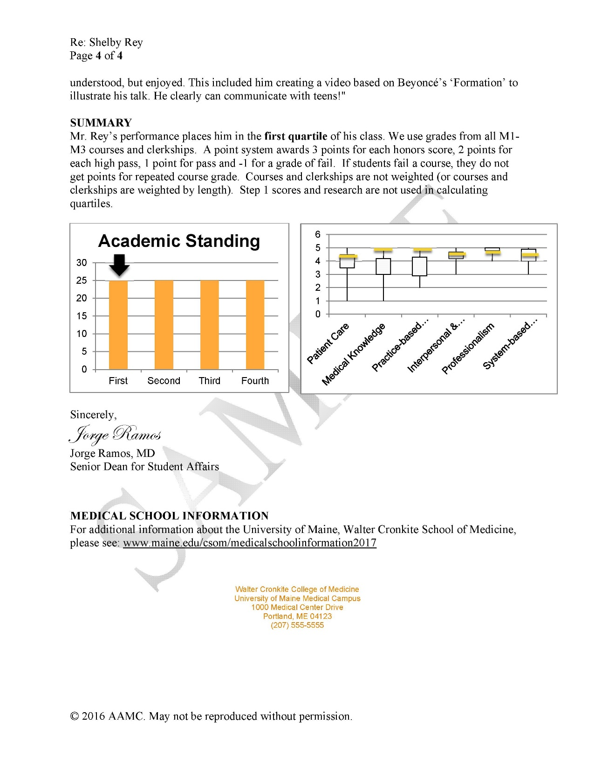

Slide 9
MSPE Format

Slide 10
MSPE

Slide 11
MSPE
Academic History
Notes:
Academic History
graduation and matriculation dates
breaks, gaps, LOA
transfer school and dual degreed program information, if applicable
explanation of remediated coursework
explanation of adverse actions

Slide 13
MSPE
Academic Progress – Includes Professionalism
Preclinical Coursework – PCM comments
Clerkships – Basis of Overall Grade
  Example (Clinical:33%, Exam 33%, OSCE 34%)
  Brief synopsis of performance
Chart – Comparative performance

Slide 14
ACADEMIC PROGRESS
Foundational Sciences
Mr. Rey successfully completed the Foundational Sciences curriculum, which is graded pass-fail.
In the first-year Introduction to Clinical Medicine course, the faculty said, “Mr. Rey was polite
and deferential. He completed his assignments and assisted the group in discussing the cases assigned. Although quiet, the depth of his knowledge impressed me. ”
In the second-year Introduction to Clinical Medicine course, the faculty noted, “Mr. Rey
developed into a student leader with the group. He often helped organize the learning
assignments and even coached his classmates in their presentations. His colleagues learned they could rely on his knowledge and mentoring., etc., etc

Slide 15
MSPE Format
Identifying Information
  Identifies you as a fourth-year student at UTHSC
  AOA distinction automatically (if applicable)
Personal Comments / Noteworthy Achievements
  3 main points about you
  You help write them
Academic History
  Graduation and matriculation dates
  Breaks, gaps, LOA
  Transfer school / dual degreed program info
  Explanation of remediated coursework
  Explanation of adverse actions

Slide 16
MSPE Format
  Academic Progress
    basic sciences & introduction to
    clinical medicine (PCM)
    required clinical core clerkships and electives reported thru mid-October

Slide 17
MSPE Format
  Summary
    summative assessment of comparative performance relative to peers (i.e. quartile)
    Information on how the quartiles are determined (GPA)
    Step scores and research aren’t included

Slide 18
MSPE Format
  Appendices
    A – bar graph of performance relative to peers in each preclinical course

Slide 19
MSPE Format
    B – bar graph of performance relative to peers in each core clinical clerkship
    C – assessment of professional attributes relative to peers **
    D – bar graph showing overall performances relative to peers

Slide 20
MSPE Format
  E – medical school information page
    Special programmatic emphases, strengths, mission/goal(s).
    Average length of enrollment (matriculation to graduation).
    Description of the evaluation.
    Med school requirements for successful completion of USMLE.
    Med school requirements for successful completion of (OSCE)
    Utilization of the course, clerkship, or elective director’s narrative comments in MSPE.
    Utilization by the med school of the AAMC “Guidelines for Medical Schools Regarding Academic Transcripts.
    Description of the process by which MSPE is composed.
    Are permitted to review the MSPE prior to its transmission.

Slide 21
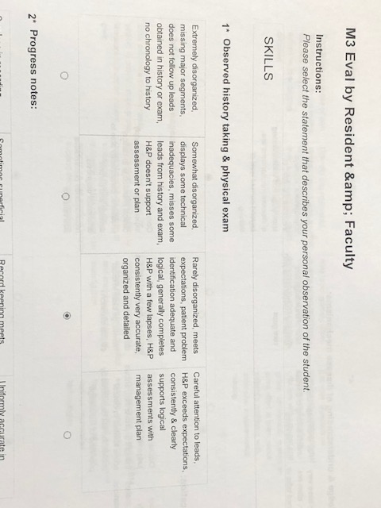
Clerkship Evaluation

Slide 22

Questions about the MSPE?

Slide 23
Careers in Medicine
You will need to log onto the AAMC website
You last used this before medical school
If problems, please contact Debbey Hester (dhester@uthsc.edu or 901-448-5531)

Slide 24
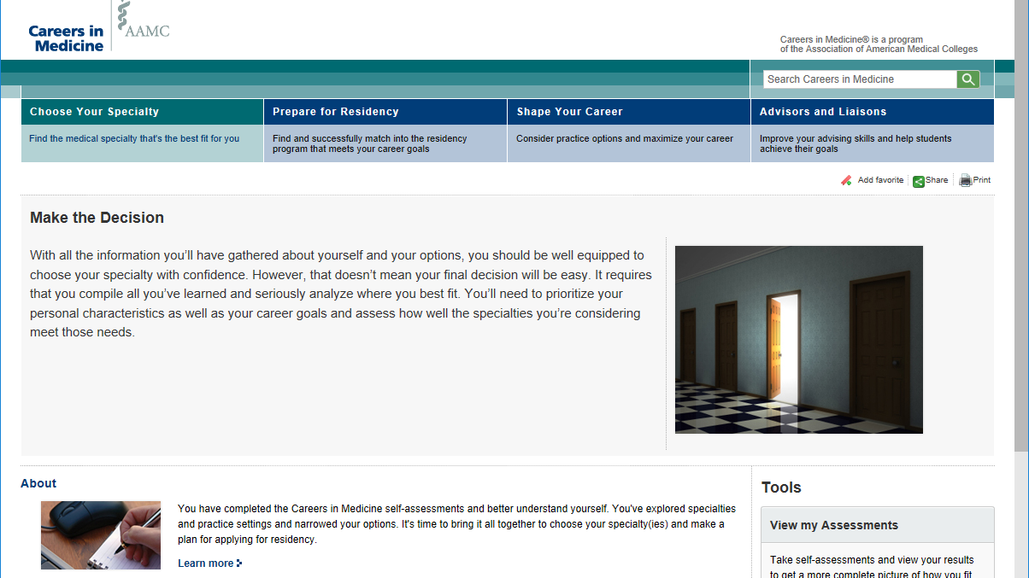

Slide 25
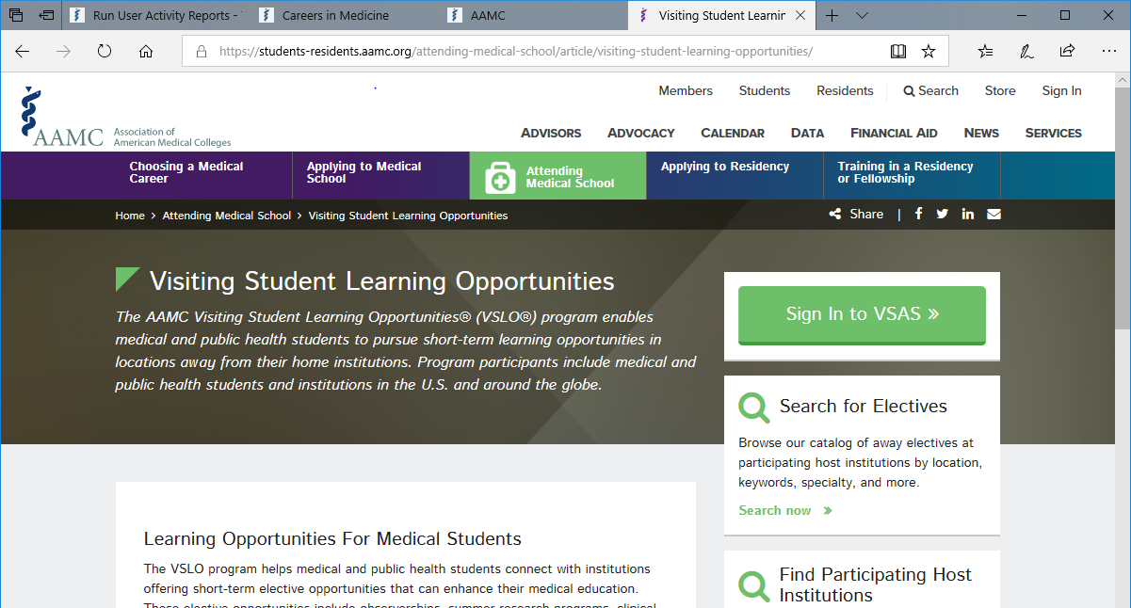

Slide 26


Slide 27
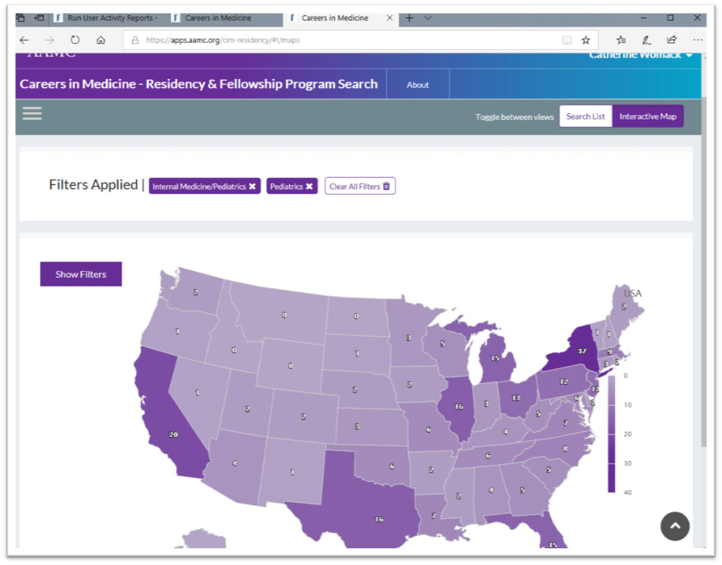
Locations for programs
Internal Medicine
Pediatric

Slide 28
Specialty Advisors
Specialty Advisor Form:
https://uthsc.edu/medicine/student-affairs/counseling/m3.php
COM Specialty Advisor Listing:
https://uthsc.edu/medicine/student-affairs/documents/specialty-advisor-listing.pdf
You will need to meet with your Specialty Advisor. Send your form back to our office by 2/1/20.

Slide 29
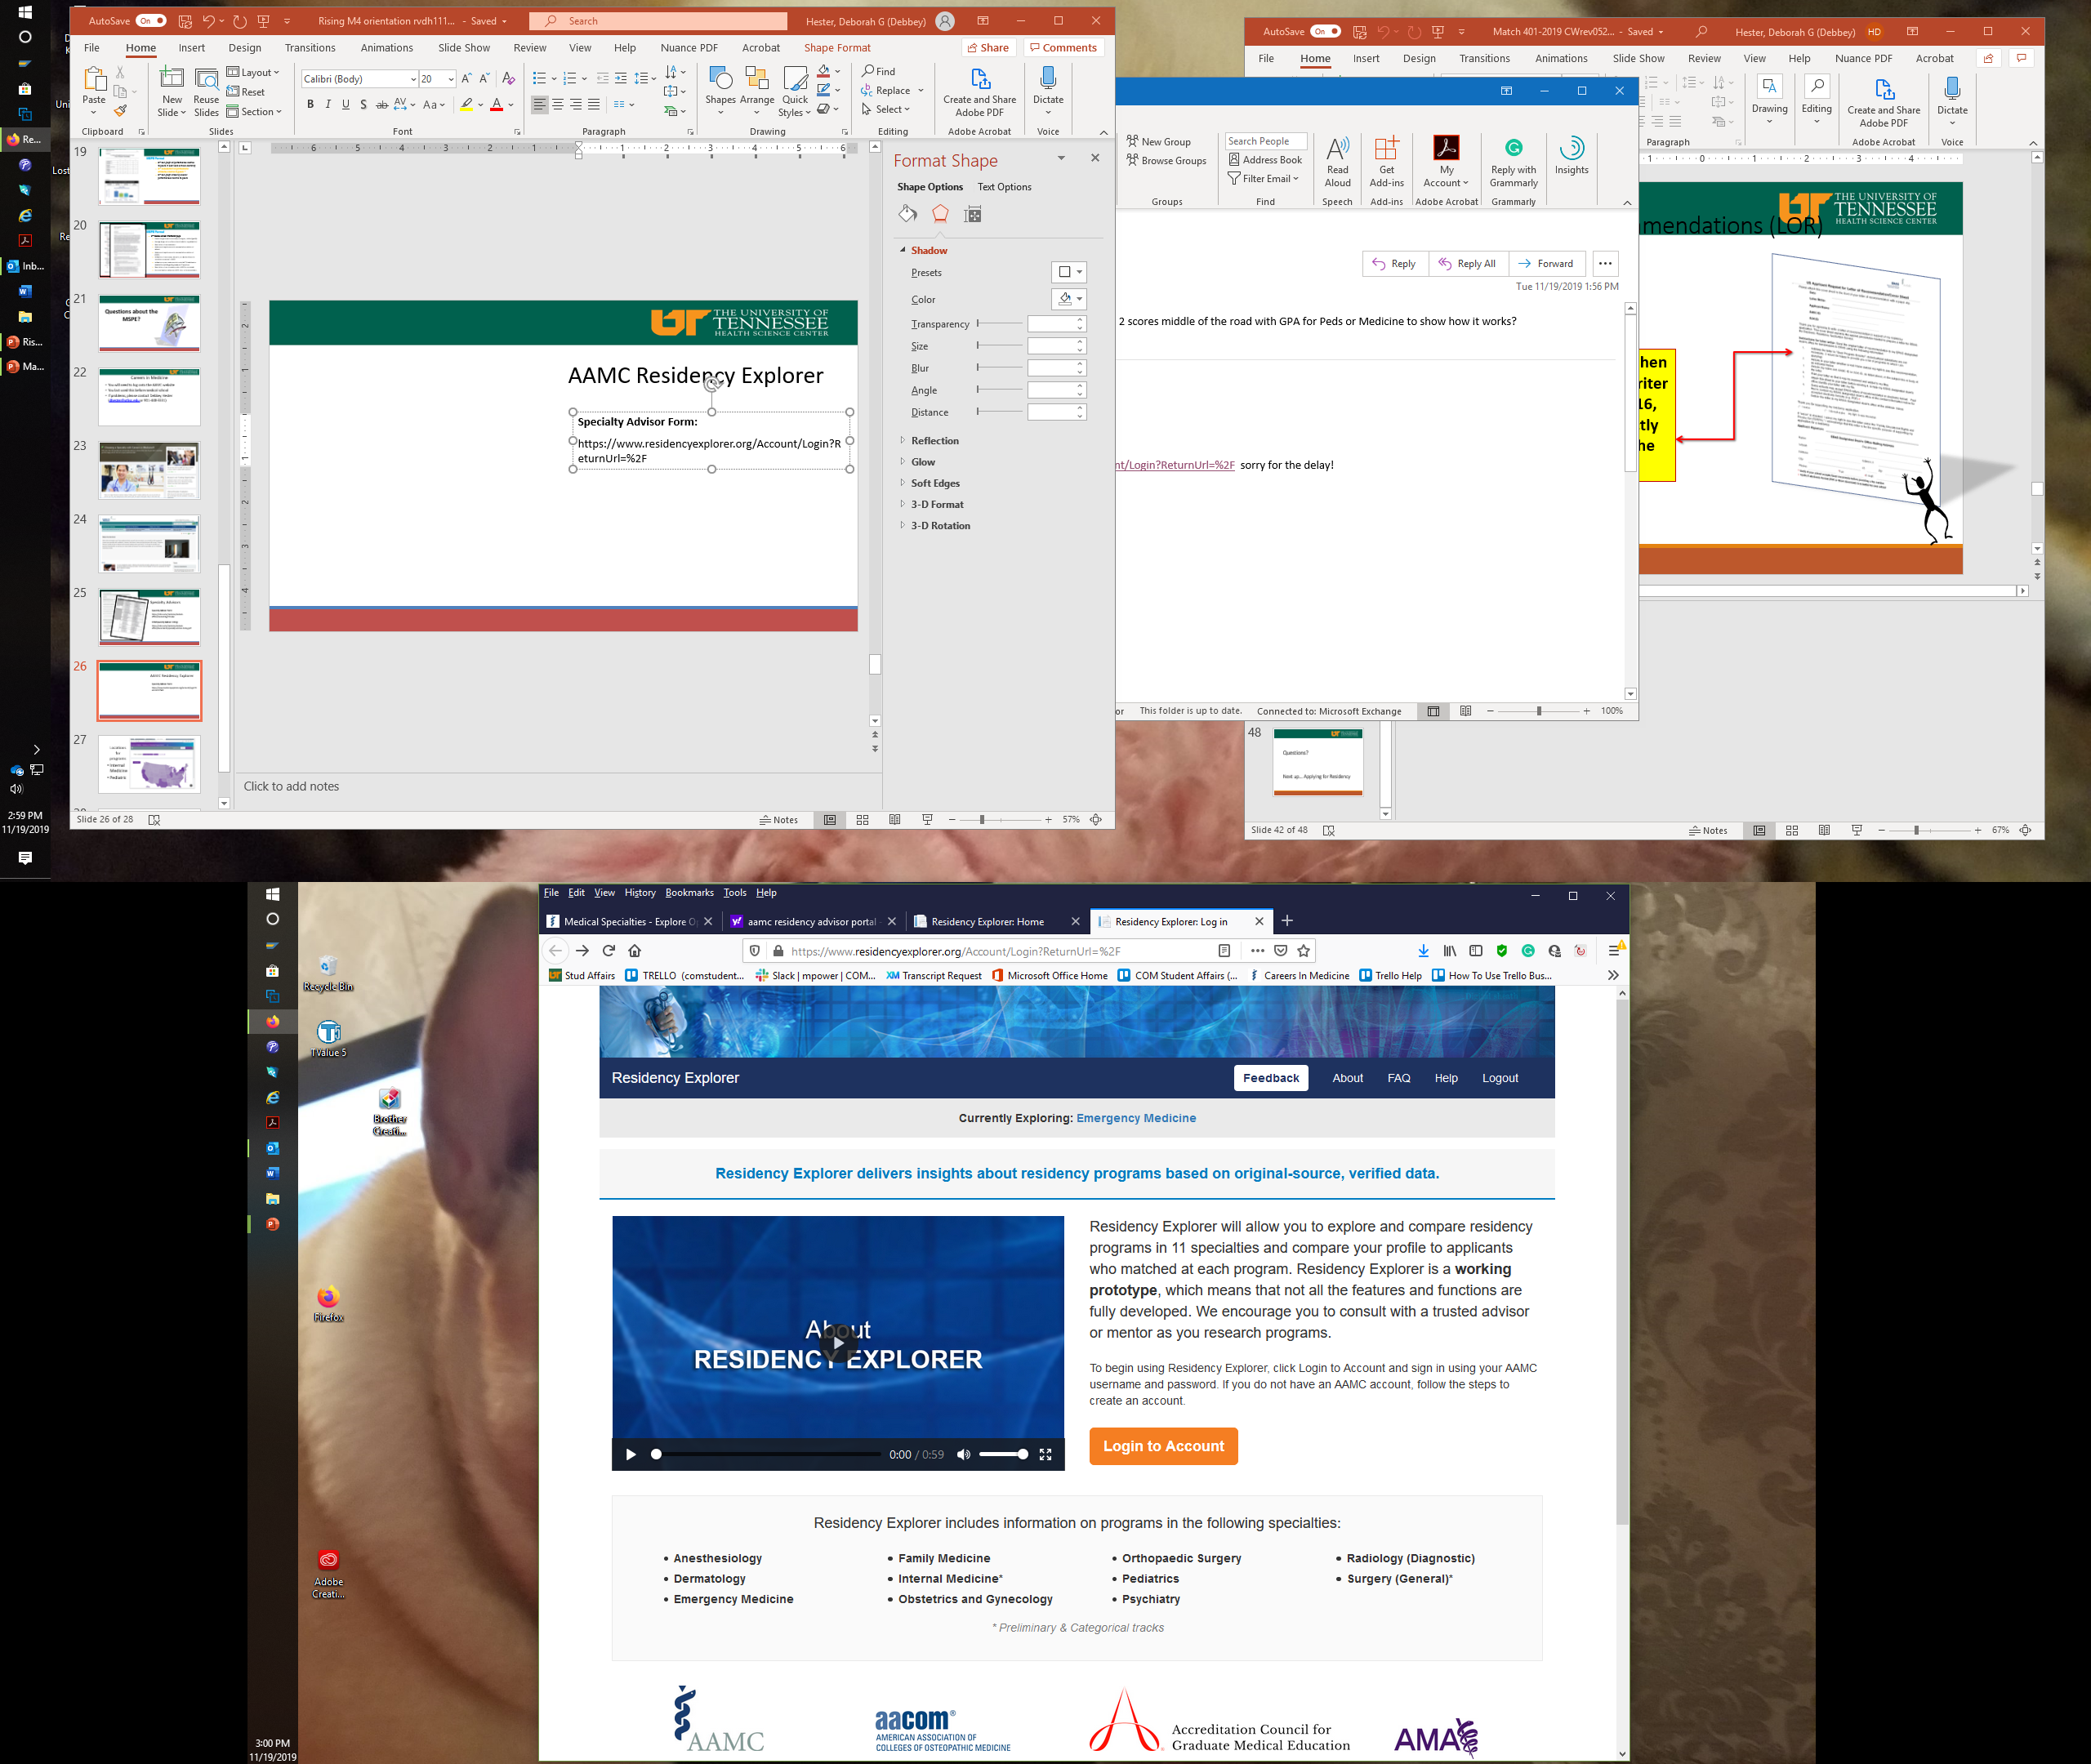
AAMC Residency Explorer
About Residency Explorer
Residency Explorer will allow you to explore and compare residency programs in 11 specialties and compare your profile to applicants who matched at each program.
https://www.residencyexplorer.org/images/Residency%20Explorer%20Video%20FINAL%203.mp4

Slide 30
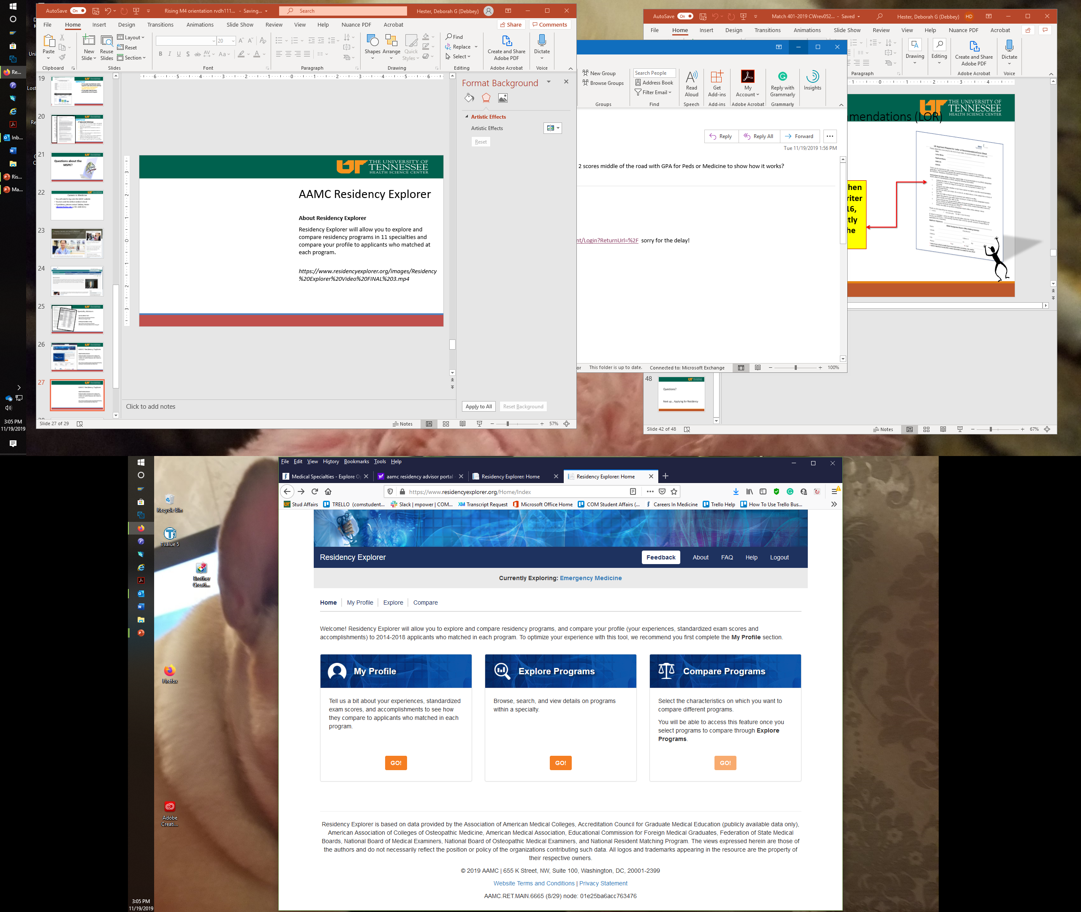
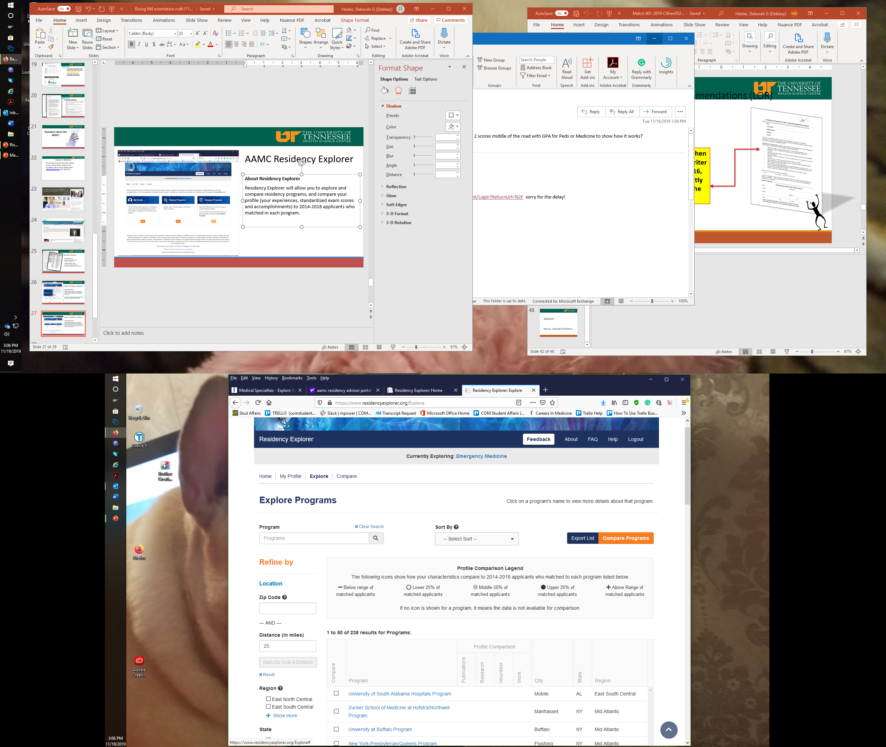
AAMC Residency Explorer
Residency Explorer will allow you to explore and compare residency programs, and compare your profile (your experiences, standardized exam scores and accomplishments) to 2014-2018 applicants who matched in each program.

Slide 31
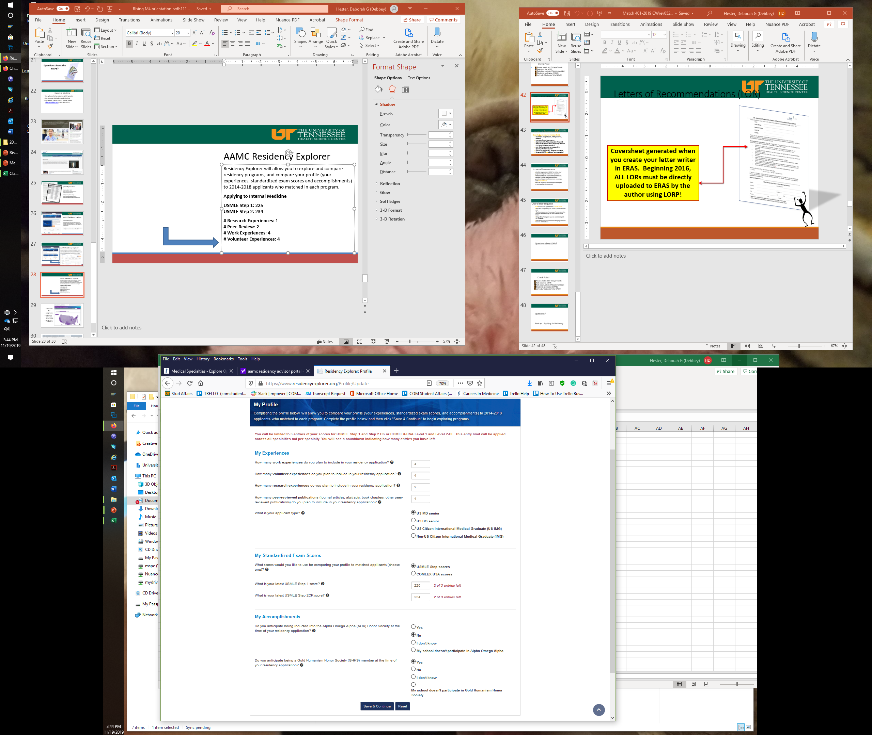
AAMC Residency Explorer
Residency Explorer will allow you to explore and compare residency programs, and compare your profile (your experiences, standardized exam scores and accomplishments) to 2014-2018 applicants who matched in each program.
Applying to Internal Medicine
USMLE Step 1: 225
USMLE Step 2: 234
# Research Experiences: 1
# Peer-Review: 2
# Work Experiences: 4
# Volunteer Experiences: 4

Slide 32
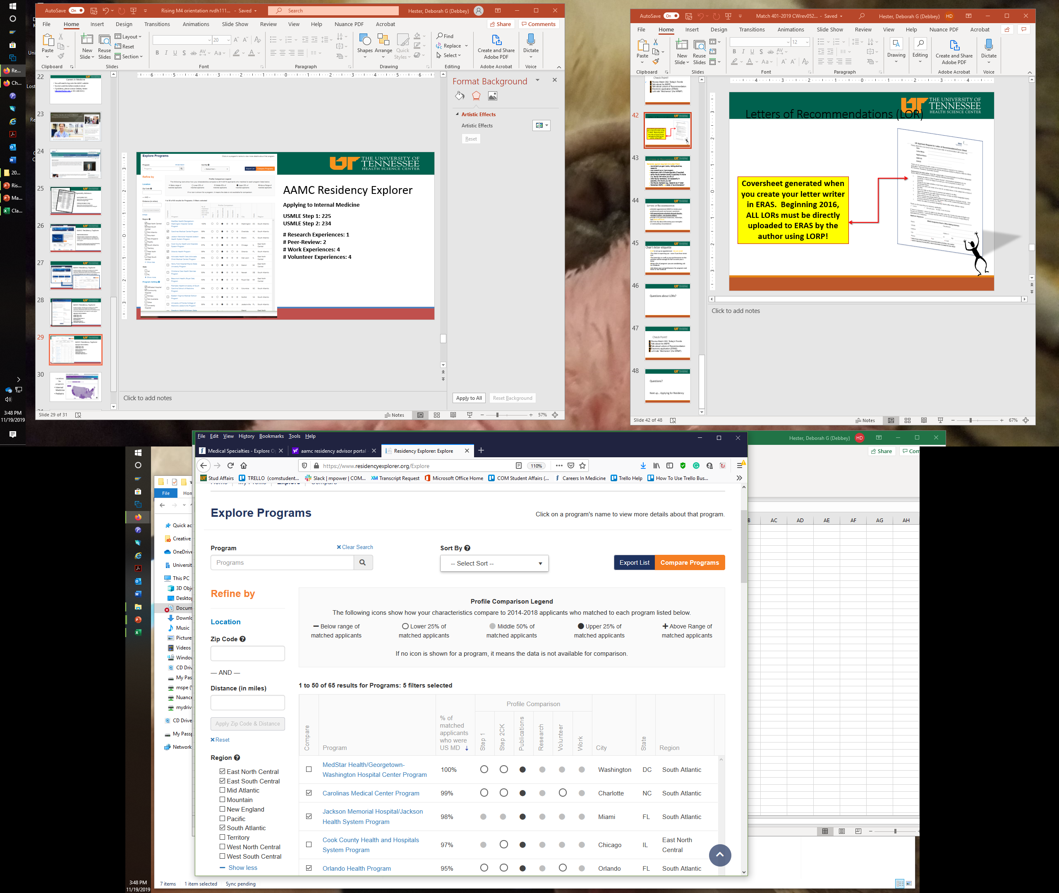
COMPARE PROGRAMS
Applying to Internal Medicine
USMLE Step 1: 225
USMLE Step 2: 234
# Research Experiences: 1
# Peer-Review: 2
# Work Experiences: 4
# Volunteer Experiences: 4

Slide 33
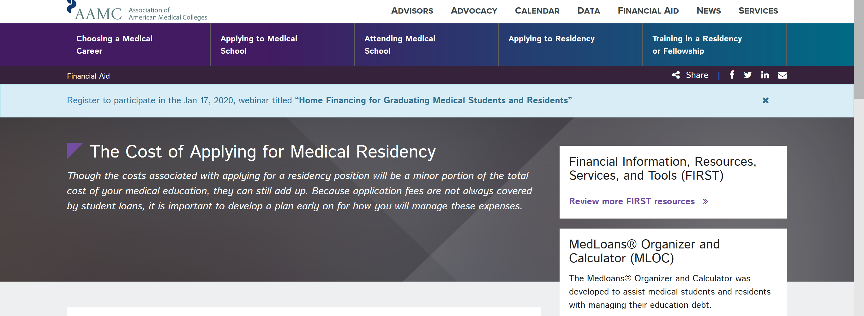
Many Resources on the AAMC website
https://students-residents.aamc.org/applying-residency/apply-smart-residency/managing-your-finances-during-residency/

Slide 34
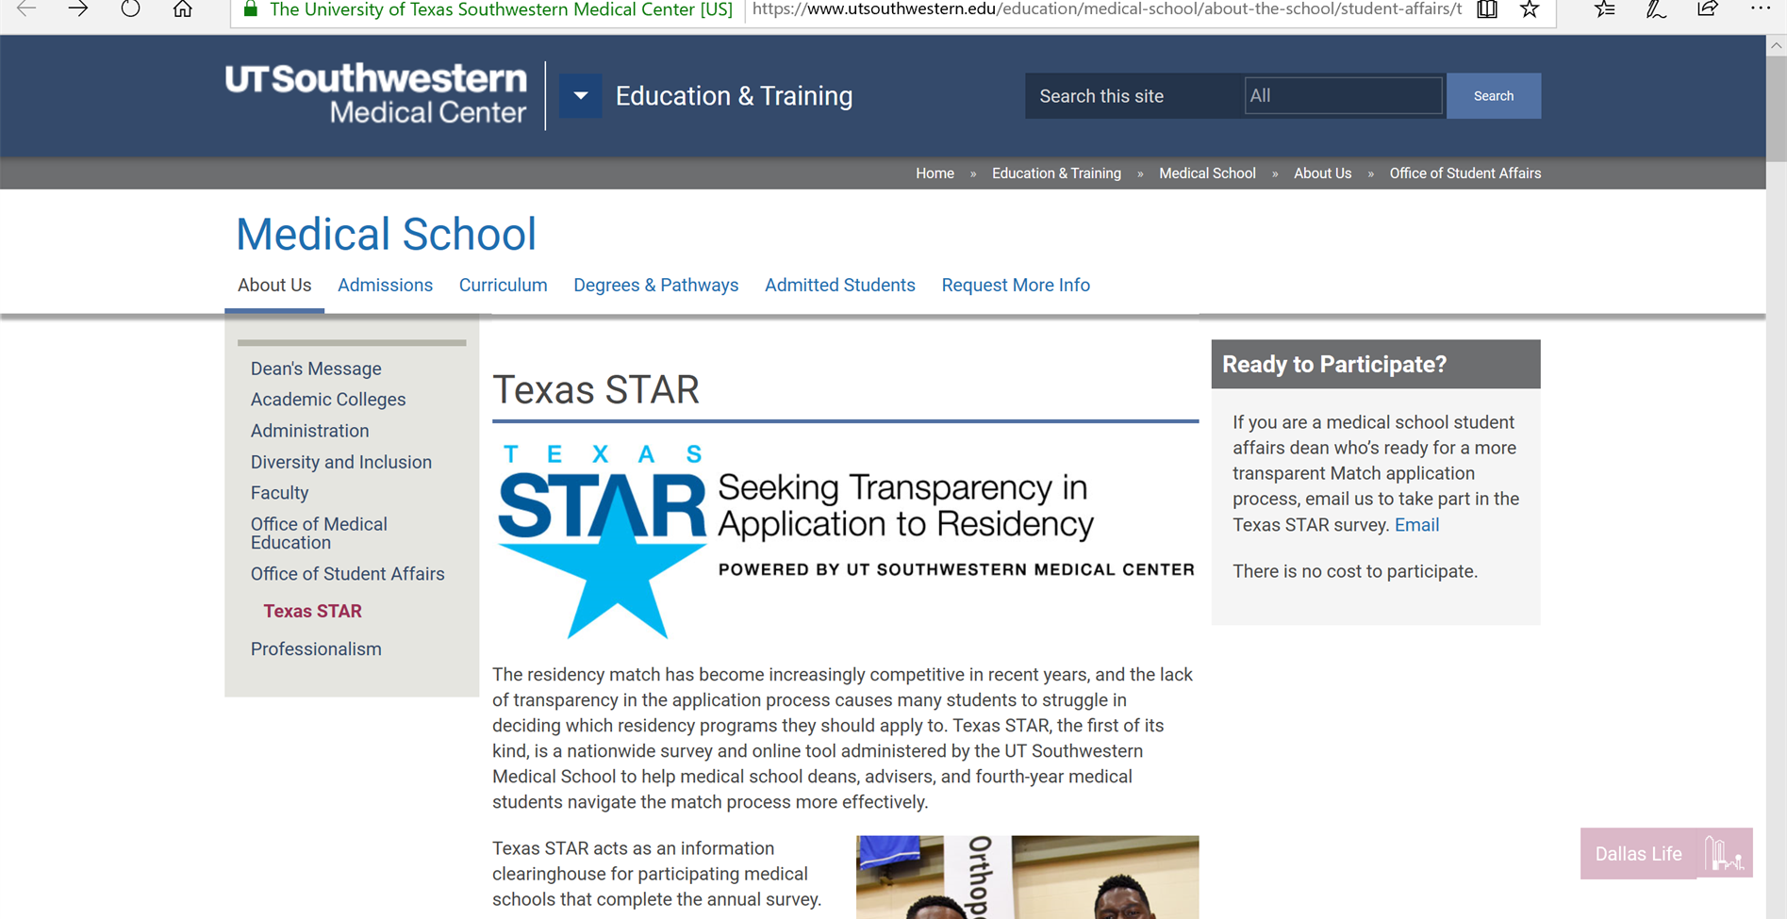
Discuss at Strolling through the Match

Slide 35
Questions?

