Slide 1
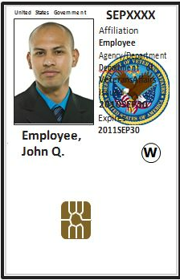
Lt. Col. Luke J. Weathers VAMC Trainee Onboarding
2023-2024 Academic year

Slide 2
VA Onboarding Team
Carolean bolden, management & Program assistant
Sylvia flowers, management & program assistant
TALISHA DOTSON, MANAGEMENT & PROGRAM ASSISTANT
ELIZABETH MOORE-BROWN, MANAGEMENT & PROGRAM ASSISTANT

Slide 3
vhamemtraineeonboarding@va.gov

Slide 4
Initial Steps for VA On-Boarding:
1. APD (Account Provisioning and Deprovisioning) system invite and application completion.
2. VHA Mandatory Training for Trainees (MTT)
3. Fingerprinting
***Steps 1-3 must be completed by Thursday November 16th , 2023 for all NEW Medical Students. If this deadline is not met, we cannot guarantee computer access prior to first rotation.
3-4 trips to VA.
Fingerprinting
Photo
Oath and signing ceremony
Pick up PIV card

Slide 5
Important Deadlines:
New Medical Students (who are NOT currently completing VA research projects):
Should complete Steps 1-3 of the Process by November 16th, 2023 to ensure they have computer access prior to the first rotation. New Medical Students may start submitting applications as soon as they receive an invite via APD system.
1. Completed Application packet
2. Completed TMS Training
3. Completed Fingerprints
The On-boarding Team will request their computer accounts and then email instructions for photographs and badges to new students.
Current UT Medical Students:
(Example: UT M1s & M2s completing research do not have to submit another application or complete another appointment)
Will sponsor trainees for new badges (if needed)
Ensure TMS training has been completed within the last 30 days
Will provide instructions if assistance is needed with completing MTT (TMS computer training)

Slide 6
INVITATION
Email invite will go to the email address provided by your school

Slide 7
Your Invite

Slide 8
For the APD you check this option!

Slide 9
Select IAM Invitation Service

Slide 10
Sign in with ID.me

Slide 11
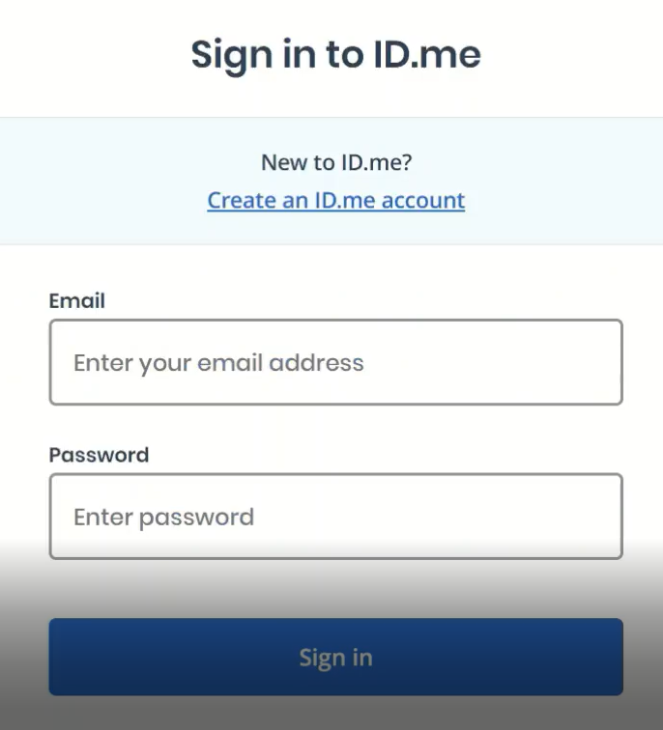

Slide 12
Special Situations
You already have an ID.me account
Do NO NOT even think about using parents ID.me account. Insure you are using your ID.me account every time. *Name in system must match your legal name or be updated in your ID.me account.
Single name
Name change
Worked at VA before

Slide 13
Paste in the Invitation Code from Email

Slide 14
Copy

Slide 15
Click Here

Slide 16
Paste

Slide 17
Invitation Code
NEVER share the code
Check JUNK MAIL if no invitation received.

Slide 18
Now you are ready to start

Slide 19
Plus ICON very important

Slide 20
Check ID information for accuracy

Slide 21
Medical Student will skip this!

Slide 22
For Naturalized Citizens

Slide 23
NAME must exactly match TWO IDs

Slide 24
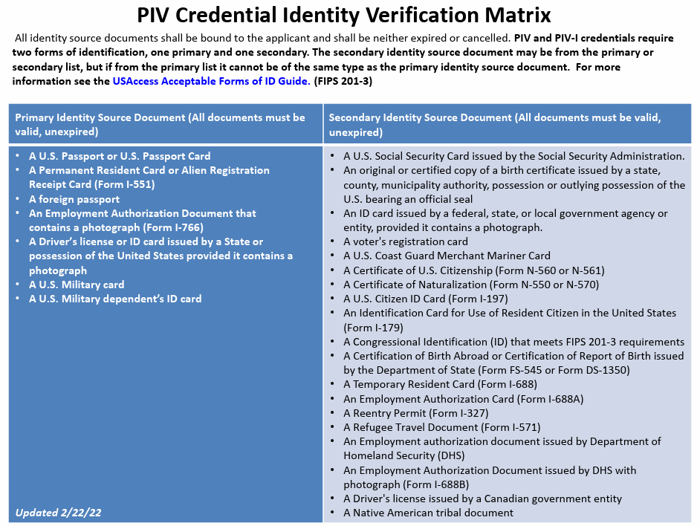

Slide 25
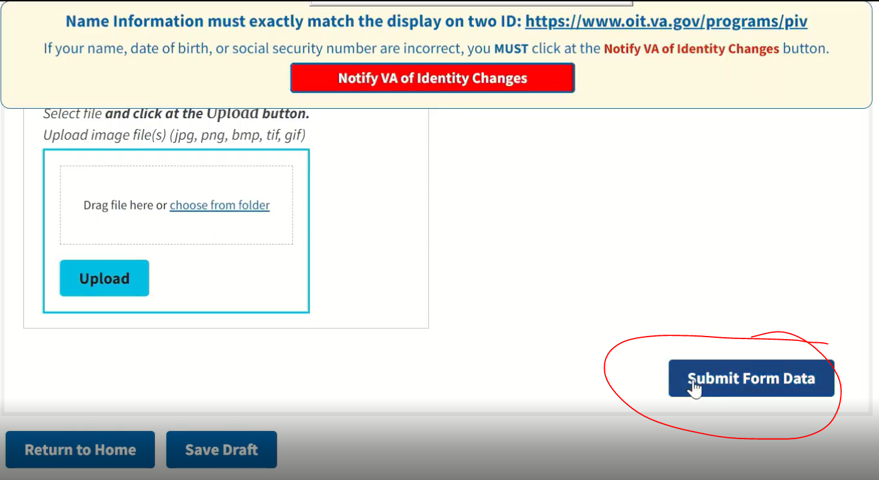

Slide 27
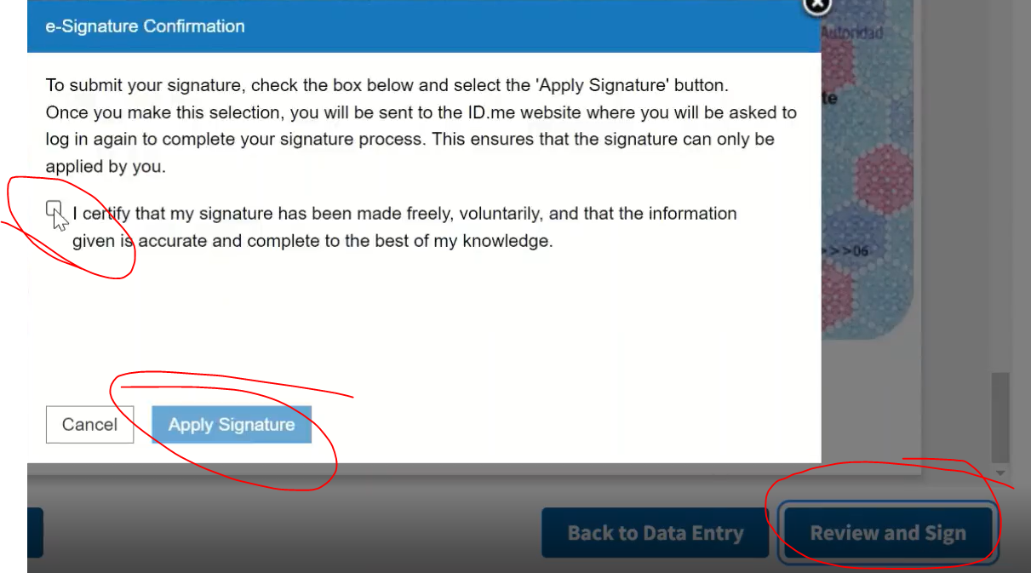

Slide 28
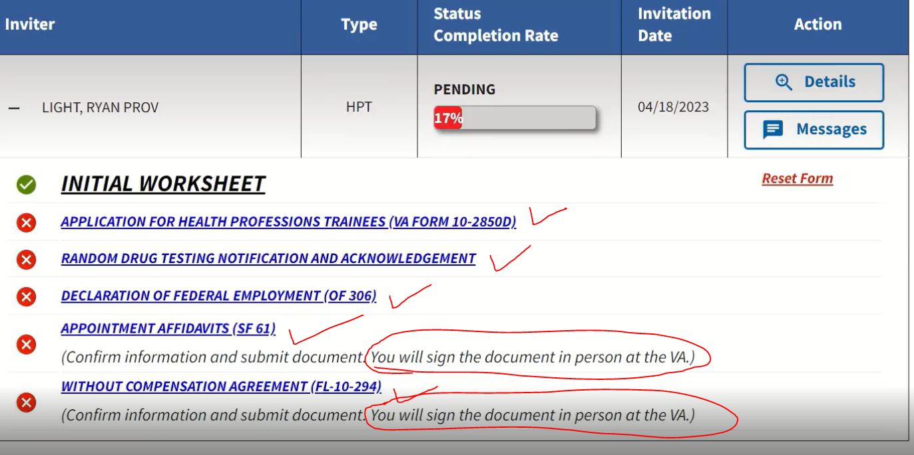

Slide 30
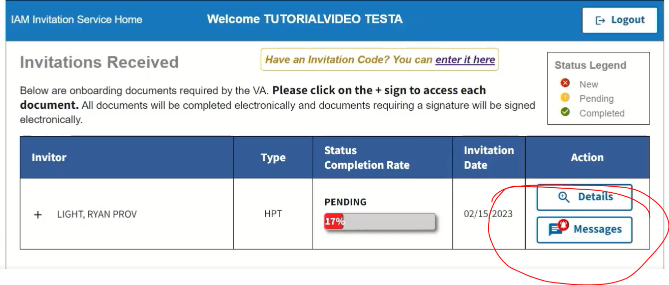

Slide 31
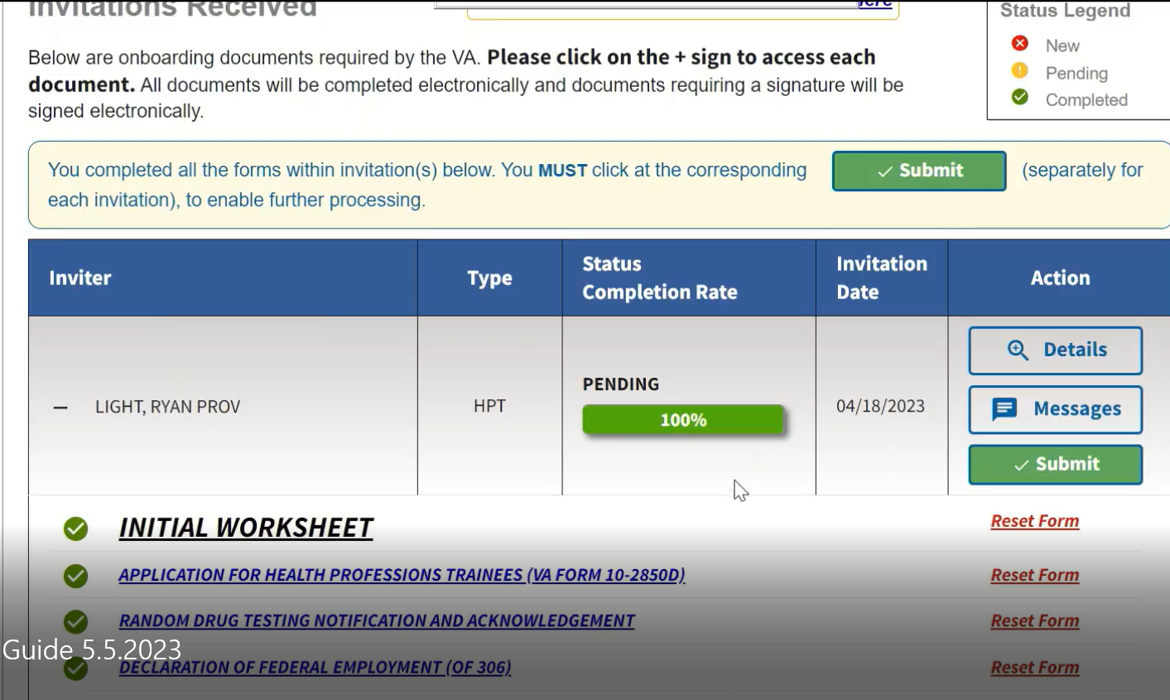

Slide 32
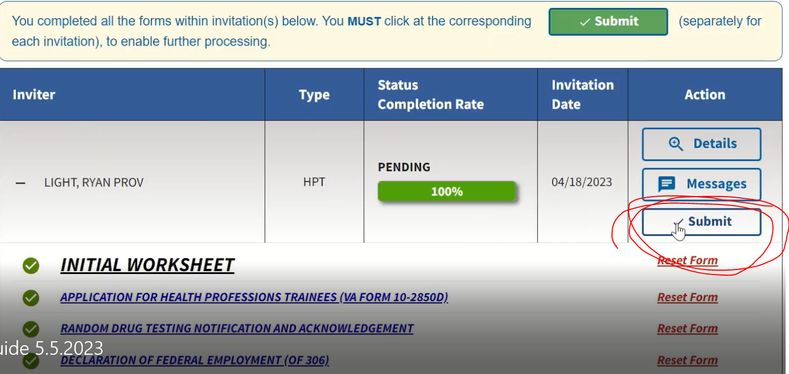

Slide 33
After all is approved for Appointment

Slide 34
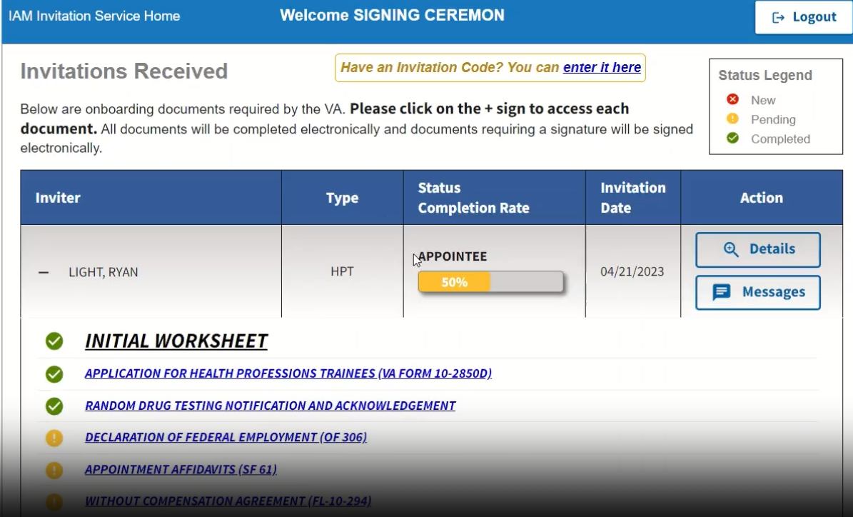

Slide 35
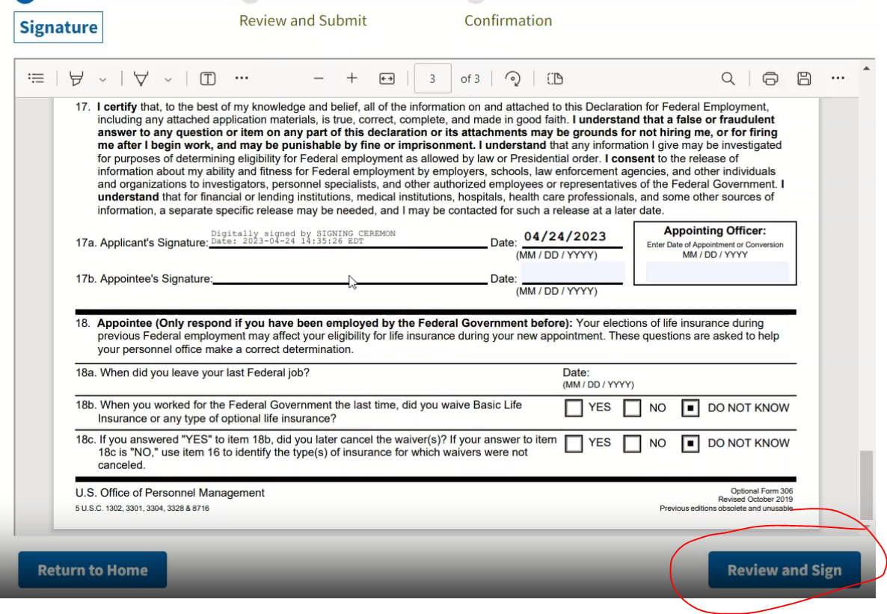

Slide 36
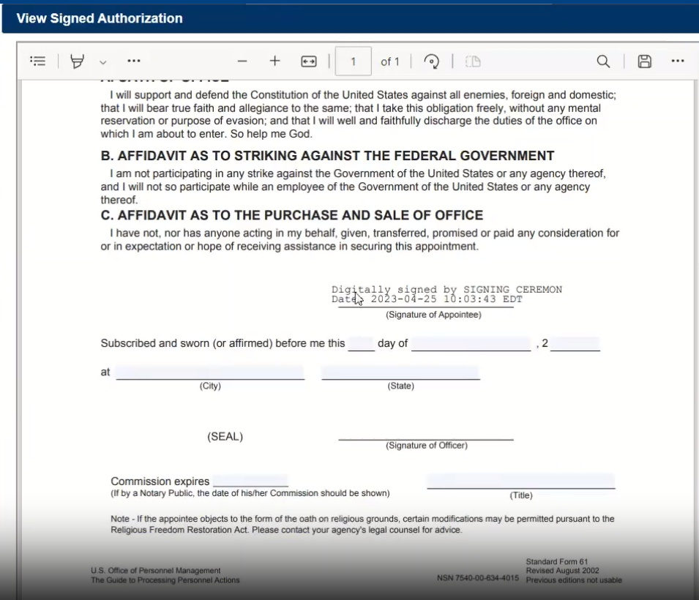

Slide 37
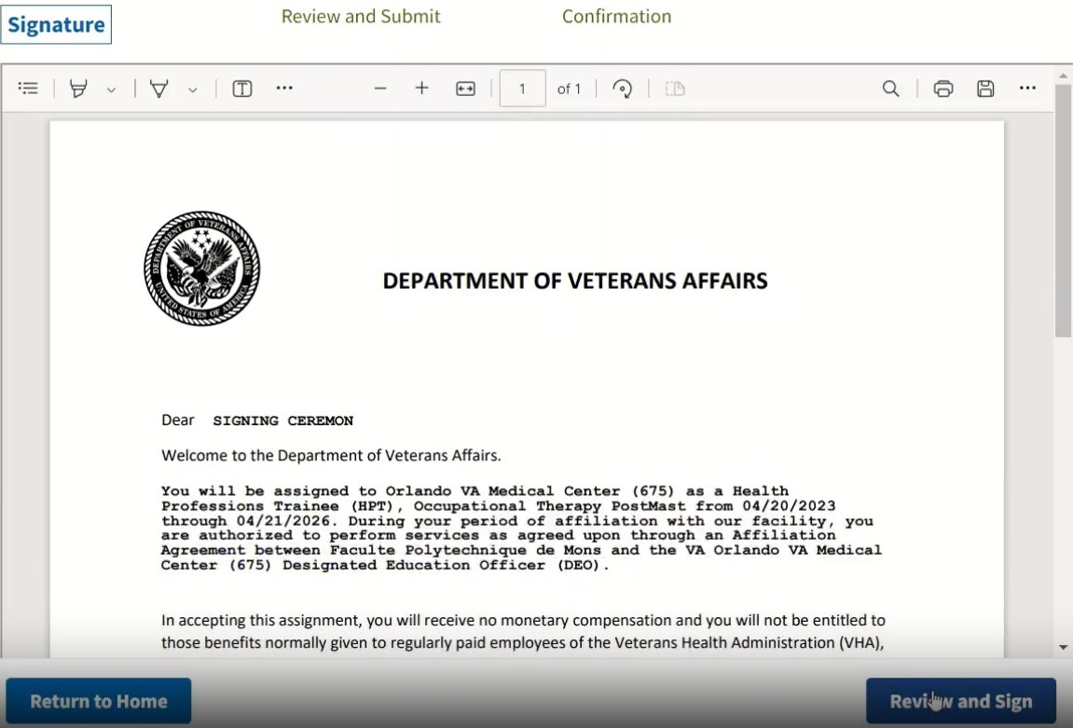

Slide 38
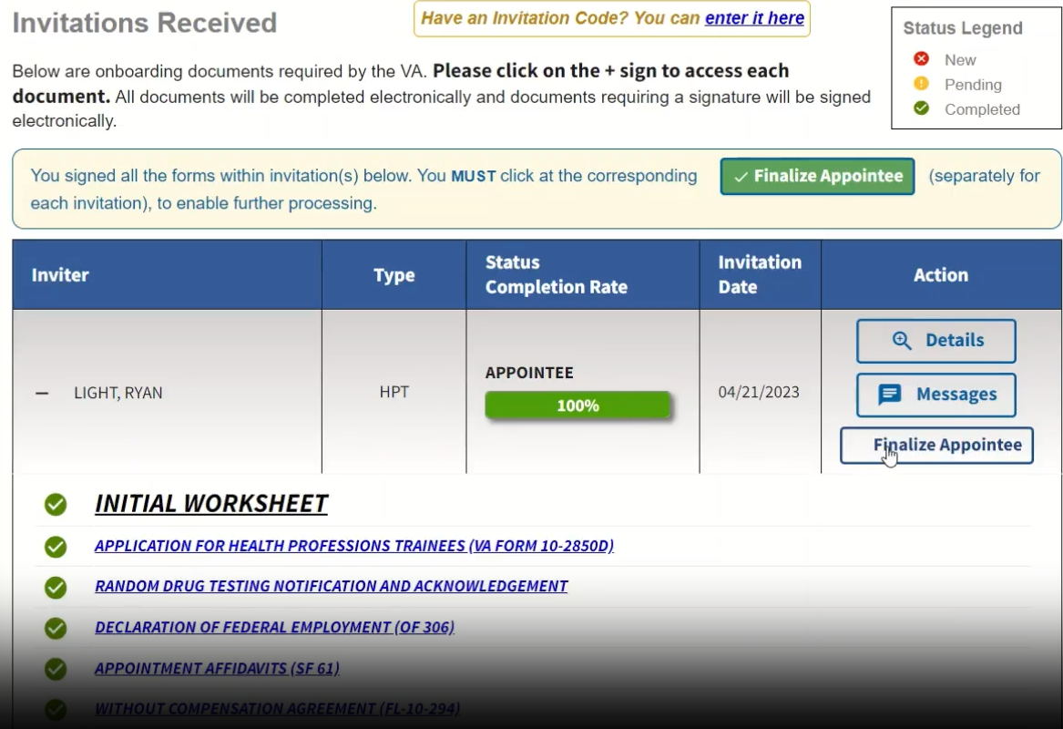

Slide 39
Step 2: Fingerprints
Fingerprinting is required for all Federal Appointments within the Department of Veterans Affairs:
Fingerprints can be performed at the Lt. Col. Luke J. Weathers Jr. VA Medical Center (Memphis VA)
Two –forms of Identification are required http://nvlpubs.nist.gov/nistpubs/FIPS/NIST.FIPS.201-2.pdf

Slide 40
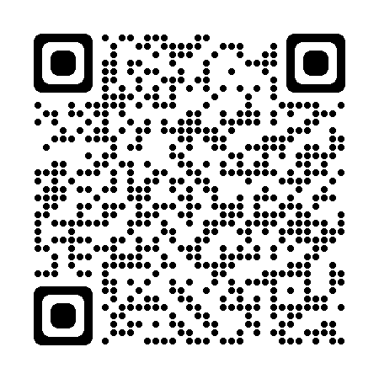
Step 3: TMS/MTT Training
All Trainees must complete one Online training module to satisfy VA requirements before they can work at the VA
Training is Call “Mandatory Training for Trainees” aka “MTT” aka “TMS Training”
The MTT can be completed from any computer or mobile device
TMS training found here ->
Complete using Chrome or Microsoft Edge
Enroll using your UTHSC email address and cell phone number to access the training easily in the future.

Slide 41
Status Updates:
The Onboarding Team will email Ms. Kimberlee Norwood with status updates on applications, VA ID Badges, or computer access.

Slide 42
What will cause a Health Professions Trainee to lose VA computer access?
Failure to login a VA computer > 60 days
After 1 year of no login, the account is deleted, and the VA sponsoring program will be required to resubmit a new User Provisioning and new EPAS request.
After 60 days of inactivity your account will be disabled, and you will need to call the HelpDesk to be enabled.
Note- If applicable Please check in with the Onboarding team 3-4 weeks before your rotation starts to ensure any account issues can be resolved prior to your rotation start date
Failure to complete the VA MTT training (annual requirement), a VA computer system access restoration will be required
Restoration Steps:
After the MTT training is completed, the trainee will call their sponsoring VA contact for restoration of computer access
The VA sponsoring program will be required to submit a request for restoration before the trainee regains VA computer access

Slide 43
Common Pitfalls
Failure to adhere to the fingerprint schedule (24 hour cancellation notice required prior to appointment)
Improper forms of identification (copies of documents, handgun permit and drivers license as two separate forms of ID, etc.)
School ID not valid
Acceptable IDS: https://uthsc.edu/medicine/medical-education/clerkships/documents/va-acceptable-ids.pdf
Not adhering to directions given by the Onboarding Team and Ms. Norwood
Failure to have photograph taken and be sworn-in in a timely manner

Slide 44
Questions & Answers

