Slide 1
Class of 2023 M3 Orientation: Part 1
Kristen Bettin, MD, MEd
Assistant Dean, Clinical Curriculum
Pediatrics Clerkship Director
Valerie Jameson, MD
Senior Assistant Dean, Clinical Curriculum
January 29, 2021
1:00-4:30pm CST

Slide 2
Topics to Cover:
Breaks and Delays
Clerkship Policies and Grading
Housing
M3 Clerkships and Requirements
Hardship and East Only
Step exams

Slide 3
Where to get information about M3 & M4 years
M3 Orientation: Part 1 – January 29, 2021
M3 Orientation: Part 2 – February 5, 2021
Prep for Clerkships week – April 26-30, 2021
OLSEN
Clerkship Directors and Clerkship Coordinators
Assistant Deans for Clinical Curriculum
Current M3 and M4 students

Slide 4
Step 1
Eligibility: GPA of ≥ 2.25 and passing all courses
Must take Step 1 before starting Clerkships
Deadline is April 25th
Minimum passing score is 194

Slide 5
Step 1 Stats
Class of 2021
First-time pass rate – 95% (National 97%)
First-time mean – 227 (National 231)
Class of 2020
First-time pass rate – 93% (National 96%)
First-time mean – 228 (National 230)
Class of 2019
First-time pass rate – 96% (National 96%)
First-time mean – 229 (National 229)
Class of 2018
First-time pass rate – 94% (National 95%)
First-time mean – 227 (National 228)

Slide 6
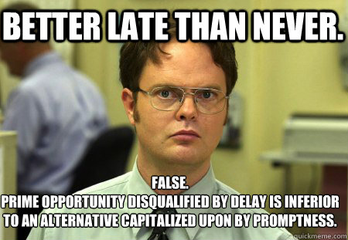
Delay Taking Step 1?
Not in your best interest!

Slide 7
Why must we take a test to prove that we need to delay?
Most students do not feel ready!
Many will think that 1 or 2 more weeks will make a difference, but SASSI data indicate that for most students this doesn’t help.
In the past, several students delayed unnecessarily.
The M4 fall is simply too busy to be doing core clerkships!
Too many delays skew the clerkship schedules for the M3’s
Cannot delay simply to improve your Step 1 score.
If you feel you are in jeopardy of failing Step 1, reach out to one of your academic deans (Dr. Cantrell, Dr. Whitt, Dr. Jameson or Dr. Bettin)
Regardless of delaying Step 1, students will need to participate in Prep for Clerkship week

Slide 8
Prior to Starting M3 Year
Take USMLE Step 1 by April 25, 2021
3-month eligibility period
If you don’t pass USMLE, two options:
Come out of the first clerkship (Block 5/6 or C), study for a month, take test, pass, re-enter clerkships OR
Complete the first clerkship, study the following block, take test, pass, re-enter clerkships
Cannot start back into the clerkships without having a passing Step 1 score
Re-take no later than July 23, 2021
Financial Aid issue
Must take at least 5 credits in the semester to be able to be eligible to receive financial aid
Notes:
Check UT registration deadline
New semester start date July 1
Financial Aid checks in July, not May

Slide 9
Prep for Clerkships Week
April 26-30, 2021
Mandatory for all rising M3 students
Likely combination of virtual and in-person sessions this year
Watch for emails from Kimberlee Norwood
HIPAA, Sterile technique, CPR, Blood and Fluids, Communication, EMR, Clerkship Policies, Risk Management, Clinical Skills sessions

Slide 10
Things to get done while taking a break from Anki
Tb skin test/Mask fitting
Make sure BLS is up to date
VA onboarding
Check your immunizations
Check for holds on your account for Fall
Notes:
Kimberlee Does these slides

Slide 11
DON’T FORGET:
Register for UTHSC Fall 2020 late April through June 2021
Late fees will apply
Fall semester starts July 1
Check for holds on your account!

Slide 12
Clerkship Requirements

Slide 13
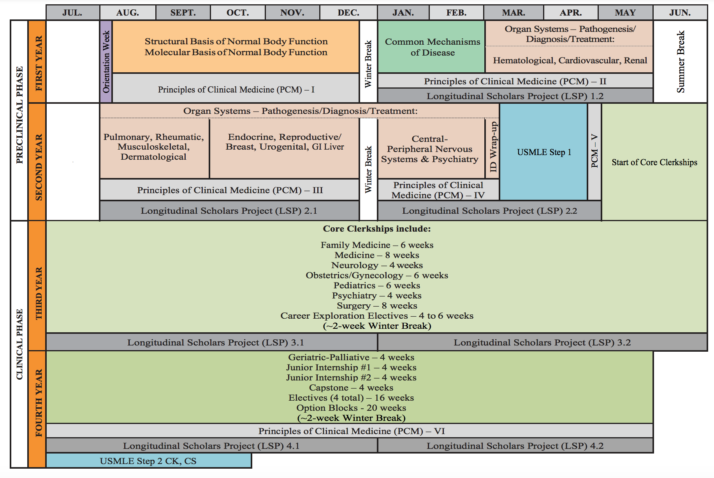

Slide 14
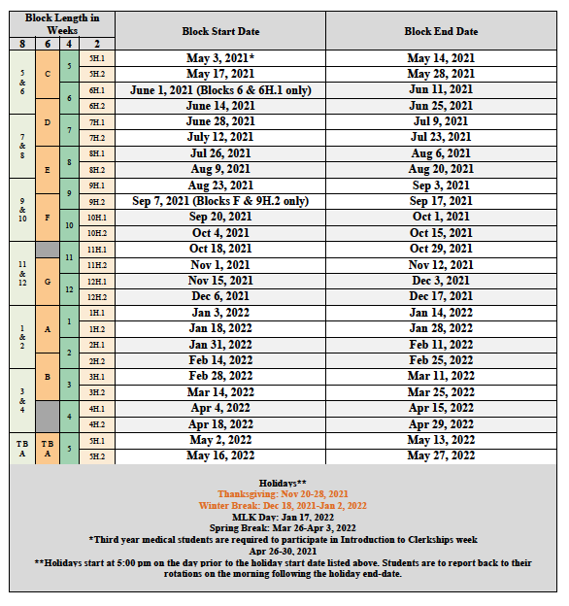
Clerkship Calendar 2021-2022
Notes:
Notice there are only 5 holidays
no 4th of July
no Labor Day,
no Memorial Day
Block F actually starts September 8th

Slide 15
7 Required “Core” Clerkships
Internal Medicine – 8 weeks
Surgery – 8 weeks
Family Medicine – 6 weeks
OB/GYN – 6 weeks
Pediatrics – 6 weeks
Neurology – 4 weeks
Psychiatry – 4 weeks

Slide 16
Internal Medicine
8 weeks
Adult inpatient care
Adult ambulatory care
Preventive and acute care
Subspecialty care
Locations: Chattanooga, Knoxville, Memphis, Nashville

Slide 17
Surgery
8 weeks
Trauma surgery
General surgery
Subspecialty exposure
Locations: Chattanooga, Knoxville, Memphis, Nashville

Slide 18
Family Medicine
6 weeks
Adult and pediatric care
Inpatient and outpatient
Preventive and acute care
Some obstetrics
Locations: Chattanooga, Jackson, Knoxville, Memphis, Nashville (Murfreesboro)

Slide 19
Obstetrics/Gynecology
6 weeks
Women’s Health
Benign Gynecology
Labor and delivery (obstetrics)
Gynecologic oncology
Locations: Chattanooga, Knoxville, Memphis, Nashville

Slide 20
Pediatrics
6 weeks
Inpatient pediatric care
Well child and acute ambulatory pediatric care
Subspecialty exposure
Newborn care
Locations: Chattanooga, Knoxville, Memphis

Slide 21
Neurology
4 weeks
Inpatient neurology
Stroke
Outpatient neurology
Pediatric neurology
Locations: Chattanooga, Knoxville, Memphis

Slide 22
Psychiatry
4 weeks
Inpatient psychiatric care
Outpatient clinic
Possible inpatient consults
Locations: Chattanooga, Knoxville, Memphis

Slide 23
Career Exploration
4- 6 weeks of elective experiences in the M3 year
Three 2-week blocks
One 2-week block can be taken as “option” time (family event, wedding, extra Step 1 studying, etc)
Some may have two 2-week blocks back-to-back and can take a 4-week CE
Opportunity to experience a specialty that is not one of the ‘core’ rotations

Slide 24
M3 Option Block Requests
Delays:
Illness or emergency situations ONLY
must be approved by Progress & Promotions Committee
Acceptable Reasons:
Academic/Research
Military obligations
Wedding (your own)
Maternity or Paternity Leave
Remember:
All students have the option to use one 2-week CE as a 2-week option block without any prior approval

Slide 25
East Rule
Due to our number of students and available capacity on the Memphis campus, all students are required to schedule 1 rotation at an East location (Chattanooga, Knoxville, Nashville, or Jackson) during the third year.
After all scheduling is complete, then students can ‘swap’ rotations for their desired location, if available.
Advantages include the ability to see a different hospital/clinic/city and work with a different group of residents/faculty.
Housing* is provided by UT for M3 students on required core clerkships in East cities if their primary domicile is in Memphis.

Slide 26
Housing
Provided by UT for Memphis-based students rotating at other locations for required clerkships
Limit 6 months maximum over both the 3rd and 4th years
M3s on core clerkships get priority, followed by M4s on required rotations (clerkships/Geri-Palli/Capstone), followed by M3s and M4s on optional rotations IF extra housing is available.
Housing is limited, fills up quickly, and cannot be guaranteed if request is submitted < 30 days prior to the start of the rotation
Submit housing request to the appropriate person/location as soon as your schedule is finalized.
Notify the appropriate person/location ASAP if your plans for a rotation change so that another student can have that housing

Slide 27
Housing - continued
Chattanooga:
Contact person: Courtney Orloski
Submit request online: http://www.comchattanooga.uthsc.edu/subpage.php?pageId=1053
Knoxville:
Contact people: Lolita Davis and Brittany Bracco
Submit request online: http://gsm.utmck.edu/students/housing.cfm
Nashville:
Contact person: Rachel McLaughlin

Slide 28
“East Only” option
Students can choose to complete all 3rd year rotations in the East.
Move to another city for the entire clinical phase.
Students in this category are considered “East Only”
Separate scheduling time
Options: Chattanooga, Knoxville, Nashville
*Note: only 4 core clerkships offered in Nashville
East only students will get the opportunity to schedule one Memphis rotation based on availability if desired, but only after the non-East Only students complete scheduling.
Notes:
1 step, meaning both CE’s and core clerkships can be scheduled at once.

Slide 29
Hardship Policy
The Hardship Policy was developed to allow exemptions from the East rotation requirement for those select students.
For information, go to OLSEN in the “General Clerkship Information” to find the Hardship application form.
Acceptable reasons for Hardship:
You have a child under the age of 18 years
You have a chronic illness that requires treatment from a local physician
You have a family member with chronic illness for whom you are the primary caregiver.

Slide 30
The Magic Schedule
Does it really matter how I schedule?
Clinical performance and NBME shelf exam scores tend to improve over the course of the year
Clerkship grading accounts for this expected improvement
In general, take the rotation you are most interested in during the middle of the year

Slide 31
SCHEDULING SCENARIOS
Smartest
2021
CE
CORE CLERKSHIP
CORE CLERKSHIP
CE
CORE CLERKSHIP
CORE CLERKSHIP
2022
CORE CLERKSHIP
CE
CORE CLERKSHIP
CORE CLERKSHIP
JI
Away
Elective
Geri-
Palli
Option
Option
ERAS opens
Take Step 2 CK
Notes:
Scheduling Scenarios
Speak with your Specialty Advisors
7 core clerkships/ 3 two week CE’s
In any order based on availability
Majority of students still take this route
You cannot take USMLE Step 2 until you have completed the core clerkships

Slide 32
SCHEDULING SCENARIOS
Use CE as an Option Block
2021
CE
CORE CLERKSHIP
CORE CLERKSHIP
CORE CLERKSHIP
CORE CLERKSHIP
Option
2022
Option
CORE CLERKSHIP
CE
CORE CLERKSHIP
CORE CLERKSHIP
JI
Away
Elective
Geri-
Palli
ERAS opens
Take Step 2 CK

Slide 33
SCHEDULING SCENARIOS
Ophthalmology-early match
2021
1
2
3
4
5
CE
7
8
9
10
CORE CLERKSHIP
CORE CLERKSHIP
CORE CLERKSHIP
CORE CLERKSHIP
CORE CLERKSHIP
CORE CLERKSHIP
2022
CORE CLERKSHIP
CE
2
CE
OPH JI
ELE AWAY
ELE OPH
9
10
11
12
CORE CLERKSHIP
8
Geri-Palli
ERAS opens
Take Step 2 CK
Notes:
BEWARE!
Some competitive residencies are requiring two away rotations and a home rotation in their discipline before you even apply!
But they also want you to have taken and smashed CK before you apply as well.
You can take CK before finishing core clerkships but you must take practice NBME in SASSi and pass it by 10 points first.
Trying to study for a clerkship and Step 2 dilutes your chances of doing well on both.

Slide 34
Step 2 CK
Must complete all Core Clerkships first
The best way to prepare of CK is to do core clerkships and take shelf exams!
Pressure to get result in early for interviews
If you want to take it early
Don’t! Finish all your clerkships this year!
Must take a practice NBME exam
Must score 10 points above passing

Slide 35
SASSI is NOT for DUMMIES!
It’s the smart move!

Slide 36
SASSI and the M3 Year
Same consultation services (test-taking, shelf exam preparation, test anxiety, time management, etc.) with educational specialists as in M1/M2 years
Here in Memphis or via phone or virtual appointments in Chattanooga, Knoxville, Jackson or Nashville.
Clerkship books on reserve in Chattanooga and Knoxville
To schedule an appointment – sassi@uthsc.edu or 901 448-5056

Slide 37
Clerkship Policies
The enormity of this statewide campus
Curriculum with lots of options from which students can choose to create a learning experience that best suits them.
Policies prevent chaos
Chaos leads to delayed graduation, loss of residency spot and loss of accreditation

Slide 38
Clerkship Policies
Available on:
OLSEN
MERL (Medical Educator Resource Link, https://www.uthsc.edu/medicine/medical-education/merl.php)
Policy Manager
Important Policies to review:
COM 106: Excused Absences and Wellness Day
COM 107: Grading for the MD Curriculum
COM 105: Progress, Promotion, and Graduation
COM 108: Student Mistreatment Policy and SA105: Preventing Student Mistreatment
COM 110: Narrative Feedback
COM 112: Work (Duty) Hours
UTHSC Student Code of Conduct
Dress code
Religious Accommodations Policy
SA 116: Student Substance Abuse Policy
Drug and Alcohol Policy
Sexual Harassment Policy
Inclement Weather, Incident reporting, Emergency Preparedness
Will also review important policies at Prep for Clerkships week

Slide 39
So many rules, so little time!
When in doubt, look it up.
If still confused, ask.
Don’t presume.
The Orange Vine isn’t always correct or up to date.
Get permission early! No later than 30 days prior to block
Make requests in writing.
Deadlines are immutable.

Slide 40
Excused Absences and Wellness Days

Slide 41
Rationale
Excused absences – Students should be able to attend general preventive medical care, urgent/acute medical care, and have appropriate time off for sickness.
Wellness Days – Goal is to promote mental health and wellness among students.
Take a day to rest, recharge, reboot, etc.
NOT a substitute for professional counseling or mental health treatment for a student experiencing a more significant mental health concern!

Slide 42
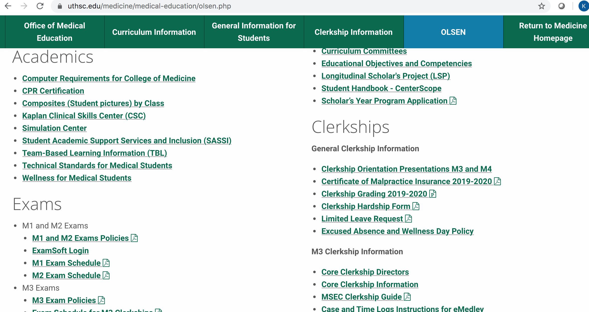

Slide 43
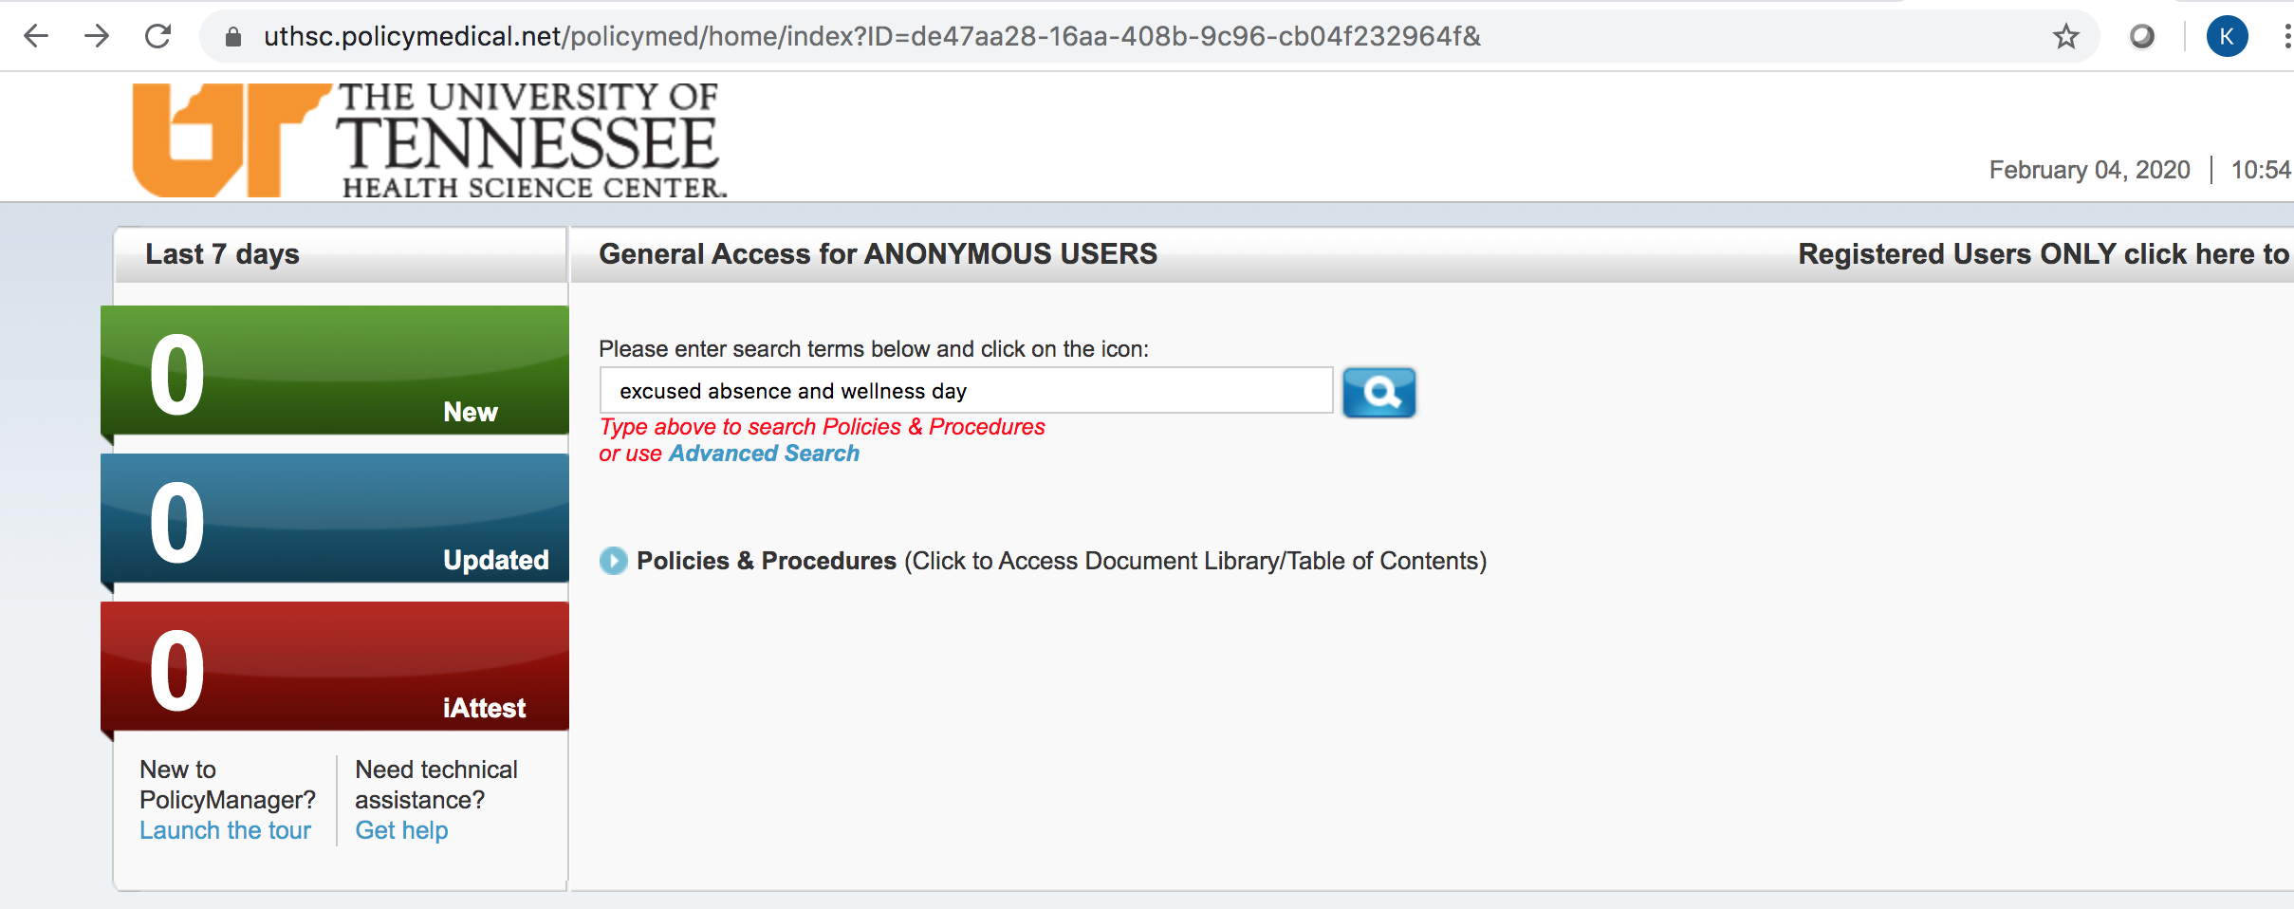
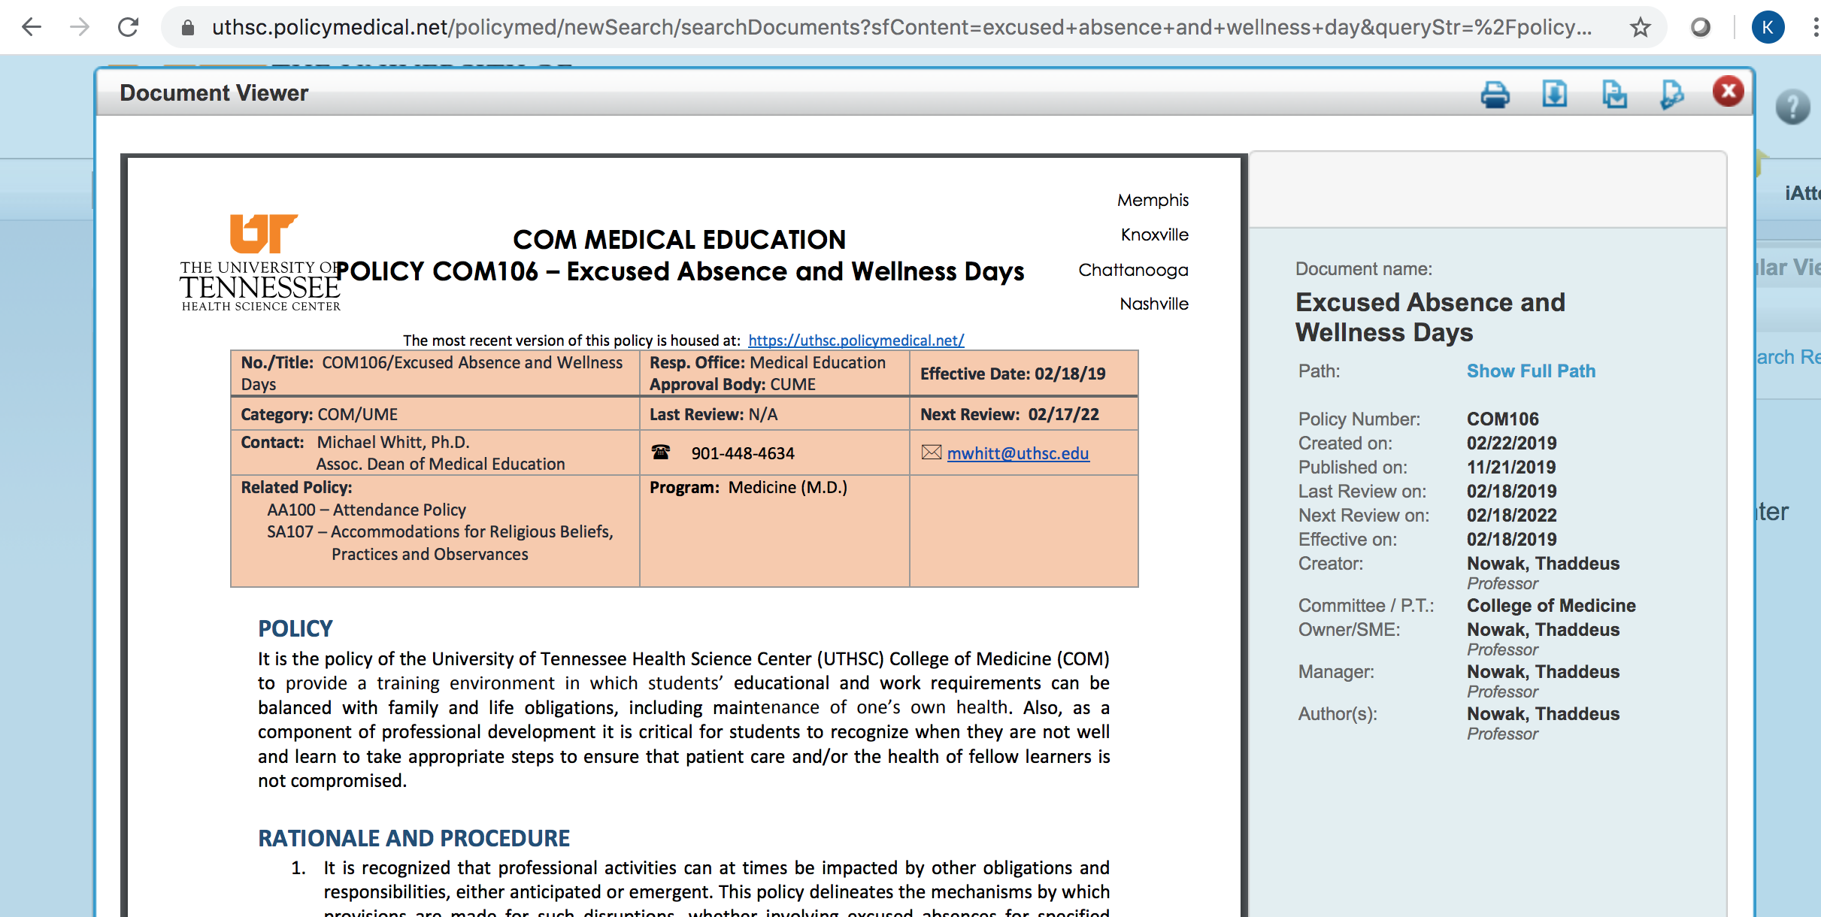
Policy Manager

Slide 44
How to Request an Excused Absence or Planned Wellness Day
1. Notify (email) your Clerkship Director and Clerkship Coordinator 30 DAYS IN ADVANCE of the CLERKSHIP to request permission.
2. Please be professional in your interactions with your administrators!
3. Complete a Limited Leave Request form (on OLSEN) once approved.

Slide 45
Requesting Permission
“I will be taking a wellness day for my sister’s wedding on xx/xx/xx.”
vs.
“I am emailing you to request the possibility of a wellness day on xx/xx/xx for my sister’s wedding. Thank you!”

Slide 46
What counts as an Excused Absence?
Funerals (death of a close family member)
Acute illness/urgent medical appointments (includes SICK DAYS!)
Preventive or routine healthcare (e.g. PCP appointment, dentist, etc.)
Religious observances/Holy Days
Jury duty and other legal obligations
Step 2 CK*
Residency interviews*
Attendance at professional meetings if presenting or representing the College of Medicine
* Step 2 CK and residency interviews NOT allowed on M3 clerkships.

Slide 47
Sick Days
Notify your Clerkship Director, Clerkship Coordinator, and your team/attending AS SOON AS YOU KNOW you will miss the day.
Prompt notification is not only the professional thing to do, but also let’s us know that you are alive and not missing!!
Complete a Limited Leave Request as soon as you return.
Doctor’s note is required if you miss more than 2 days for any illness.

Slide 48
Professional Meeting Attendance
Notify CD/CC 30 days prior to the START of the affected rotation.
Must be either presenting (poster/oral) or representing the COM.
Provide documentation (email/letter) of your acceptance to the meeting AS SOON AS YOU GET THIS.
Goal is to maximize your participation in your event while also minimizing the time away from your clerkship.
Approval is at the discretion of the Clerkship Director.

Slide 49
Wellness Days
Four wellness days per year
No half days or hourly counts

Slide 50
Anticipated (Planned) Wellness Days
Notify CD/CC 30 day prior to the START of the rotation.
May NOT be used during:
Course/shelf exams
Clerkship orientations
Simulation/skill training days
OSCEs
Oral, slide exams
JI rotations
On-call days
Days before or immediately after vacations or administrative closings (i.e. MLK Day)

Slide 51
Emergent (Unplanned) Wellness Days
Available for when a student has an urgent/emergent need for a day away from clerkships that does not fall into an excused absence category.
Notify (email) the clerkship director and clerkship coordinator ASAP when you need to take an emergent wellness day. Does not require 30 days advanced notice.
Be professional. Complete a Limited Leave Request as soon as you return to the clerkship.
No questions asked policy to preserve student privacy.
However, if you are struggling, please reach out to your CD. We can help you!

Slide 52
Examples
Planned Wellness Days
Emergent Wellness Days
Weddings
Family reunions
Planned mental health day
Nondisclosed reasoning (e.g. appointment that you prefer not to disclose)
Other important events that don’t fall under an excused absence
Unplanned mental health day
Need for urgent counseling
Any other unforeseen event that does not qualify for an acute excused absence
Notes:
What counts as a wellness day?
Important life events (weddings, reunions, etc.)
Nondisclosed reasons (counseling appointments, “mental health day”, rest, recharge, reboot)

Slide 53
Wellness and Mental Health
SASSI Take Care
https://uthsc.edu/sassi/
Counseling services
https://www.uthsc.edu/student-health-services/behavioral-health/index.php

Slide 54
Clerkship Grading

Slide 55
Why grade at all?
Grading is the summative (ultimate) feedback for student performance.
Grading allows outside entities (residencies) to know how a student’s performance compares with his/her peers in that institution.
Using national norms helps assure that the grading is meaningful outside of just our institution.
Notes:
Grading is the summative (ultimate) feedback to student performance.
Am I performing at a high, low, or acceptable level?
Do I have the skills necessary to be a competent physician?
Do I have the skills necessary to succeed in a highly competitive field?
Grading allows outside entities (residencies) to know how a particular student performance compares with his/her peers in that institution.
Using national norms helps assure that the grading is meaningful outside of the particular institution.

Slide 56
Three components of clerkship grading
Medical knowledge (expertise)
Professionalism
Clinical skills and performance
Notes:
More complex
Now students must also be graded on
Clinical skills – patient interaction, communication, eye-hand coordination, reasoning skills, team integration, self-perception, etc.
Professionalism, ethical behavior
While the opinion of an experienced faculty member in judging student performance is considered “objective”, the reality is that subjectivity and perception have an increased influence on feedback.
While this may seem to allow for unfair variability, this is exactly how patients and peers judge physicians in the real world. (Learning how people perceive you is incredibly valuable knowledge and that’s what you get in your clinical grade).

Slide 57
How to achieve this goal
NBME subject exams (shelf exams) → assess medical knowledge and expertise
Clinical evaluations → assess clinical skills, performance, and professionalism
Notes:
Clinical evaluations → assess clinical skills, performance, and professionalism
Faculty use a standardized evaluation to evaluate where students are on a given set of behavior (performance) descriptors.
Faculty do NOT assign grades to students.
Clinical evaluations use the Entrustable Professional Activities (EPA) framework.
NBME Subject exams (shelf exams) → assess medical knowledge and expertise
Every clerkship utilizes shelf exams.
Minimum passing scores and scores to be eligible for receiving a “A” are standard percentiles across clerkships and across the state.

Slide 58
Why are we talking about this now?
Both components (clinical evaluation and the shelf exam) are adjusted based on your experience
Goal: maintain fair and consistent grading across the year
Why is this important? So that you can worry less about the order of your rotations and worry more about your experiences!

Slide 59
Contact us:
Dr. Valerie Jameson – vjameson@uthsc.edu
Dr. Kristen Bettin – kbettin@uthsc.edu

Slide 60
Up Next….
How to Schedule your M3 Year
Jenn Wilson, CAP
Lead Clinical Curriculum Coordinator

