Slide 1
College of Medicine M4 Scheduling Information
Class of 2022
January 13th, 2021
JENN WILSON - Lead Clinical curriculum Coordinator

Slide 2
Scheduling Timeline – Review
January 5, 2021 – Deadline to send Hardship Request form and supporting documentation to Patricia Armstrong patricia.armstrong@uthsc.edu. The criteria for a Hardship can be found on OLSEN: Hardship Request Form
January 11, 2021 – Rising M4 lottery results will be posted.
January 11 - 15, 2021 – Students who need core clerkships in the 4th year will be scheduled by Dr. Bettin and Jenn Wilson. Once complete, an email will be sent to the listserv . *
*Although preferences will be taken into consideration, core clerkship block(s) and location(s) are not guaranteed.
Notes:
East Only requests and Hardship forms were due January 5.
The lottery results were posted Monday under the Clerkship Information tab on the Office of Medical Education website.
This week Dr. Bettin and myself scheduled those students who needed core completions or full rotations. While we did take your preferences from the survey into consideration, we cannot guarantee we were able to honor those. We also ask that you do not move these rotations around. We worked very hard getting everyone scheduled with also leaving room for the rising M3s to schedule their rotations.

Slide 3
Scheduling Timeline - Review Continued..
January 18, 2021 (8:00am to 5:00pm CST) – Scheduler open to Hardship and East Only students to enroll in Geriatrics - Palliative Medicine (MED-40000) and Capstone (IDE-40000) ONLY. *
January 19 & 20, 2021 – Round 1 Scheduling occurs based on lottery (odd blocks). **
January 21 & 22, 2021 - Round 2 scheduling occurs based on lottery (even blocks). **
*Students who in enroll in any additional rotations during this timeframe will be administratively dropped from the additional rotations.
**Time of day is dependent on lottery results, but assigned lottery times will fall within 8:00am-5:00pm (CST)
Notes:
East Only & Hardship students will schedule geri-palli and capstone only while the December 2021 graduates will schedule the remainder of their fourth year. *email will be sent to these groups tomorrow
Unlike 3rd year rotations, 4th year rotations are all 2 or 4 week blocks. So odd numbered blocks such as 5, 7, 9 etc. will be scheduled in round 1 while even numbered blocks will be scheduled during round 2.
The way the lottery works is eMedley randomly assigns you to groups A thru T. Each group will have their designated day and time for when the scheduler will open for you. Once the scheduler opens for you, it will remain open until Round 2 begins.
So for round 1, scheduling will open first for group A with each subsequent group opening an hour later. For round 2, it will go in reverse order - scheduling will open for group T first with each subsequent group opening an hour later.
This is to make things a little more fair.
***Again, please make sure you schedule AROUND your already scheduled clerkships and do not move them!! If you do, we cannot guarantee we will be able to get you back in.

Slide 4
Scheduling Rotations in eMedley
Refer to the "How to Schedule Your 4th Year" document posted on OLSEN, under the “Clerkships" section.

Slide 5
How To Schedule:
1. Check OLSEN for your lottery day/time and login to eMedley at your designated round 1 scheduling time: https://he.emedley.com/uthsccom.
2. In the upper right-hand side of the screen click the arrow icon and select “Switch Terms” from the dropdown.

Slide 6
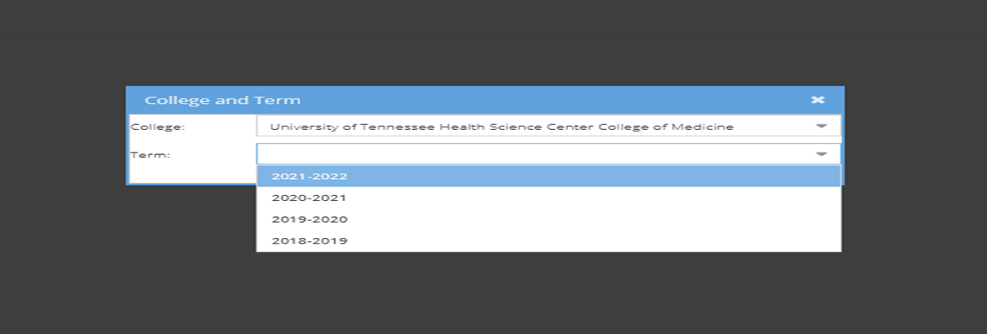
How To Schedule cont’d….
3. Select the upcoming academic year.

Slide 7
How To Schedule cont’d….
4. Once the term is selected, check that the upcoming academic term is displayed above your name in the upper right-hand side of the screen.

Slide 8
How To Schedule cont’d….
5. Go to the Applications on the left side of the screen and select “edusched.”

Slide 9
How To Schedule cont’d….
6. Click on “My Schedule Planner”

Slide 10
How To Schedule cont’d….
7. Click on “Actions” and select “Add Schedules”

Slide 11
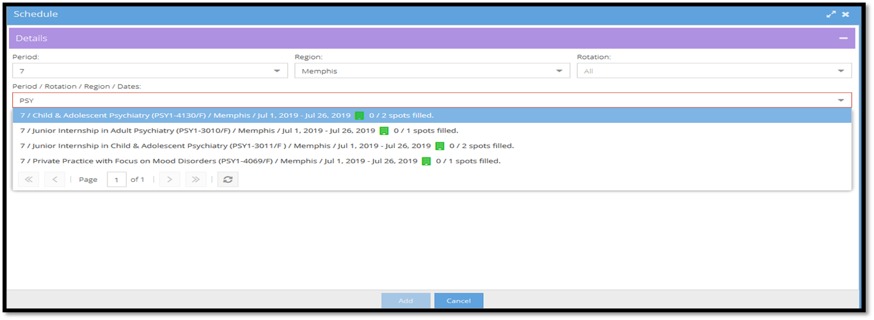
How To Schedule cont’d….
8. Use the search dropdowns to select by Period, Region, and/or Rotation and click “Add.”
Tip: for a broad search without additional filters, use the drop-down titled “Period/Rotation/Region/Dates” only.
Notes:
If you’d like to search by period, region, or rotation, you can use the individual filters.
For a broader search, you can simply type the department code or the course number if you know it into the period/rotation/region/dates section.

Slide 12
How To Schedule cont’d….
9. Repeat step 8 until all odd periods are scheduled for the upcoming academic year.
10. To remove scheduled rotations left click on the specific rotation and select “Remove.”

Slide 13
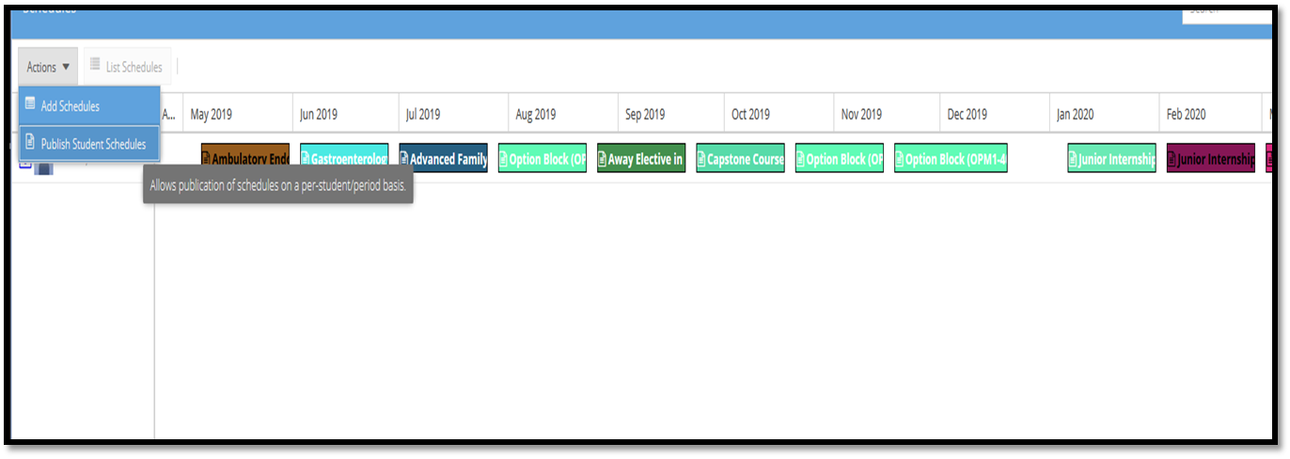
How To Schedule cont’d….
11. At your designated Round 2 scheduling day and time, repeat step 8 to add even period rotations to complete your schedule for the academic year. Odd blocks can be edited as needed in Round 2.
12. Once all desired rotations are added to your schedule, students can attempt to publish in order to finalize scheduling by clicking on “Actions” and then “Publish Student Schedules.”
Notes:
You will follow these same steps for scheduling during round 2.
Once you have scheduled all of your desired rotations, you will need to publish your schedule. You can do this by clicking on Actions and then selecting Publish Student Schedule.

Slide 14
Publication Rules
In order for schedules to be published, all of the below requirements must be met:
Any 2 Junior Internships are scheduled.
16 weeks of electives are scheduled.
8 weeks of option blocks scheduled in blocks 11, 12, or 1.
Capstone is scheduled.
Geriatrics/Palliative Medicine is scheduled.
All prerequisites have been met.
All courses requiring prior authorization have been approved.
Notes:
These rules exist because we want to be sure you have everything on your 4th year schedule needed to graduate.

Slide 15
Publication Rules - Continued..
Schedules must be published to be considered final.
Initial schedules should be published by February 5th.
Absolute publish date is April 1st or students risk being dropped from their unpublished rotations.
If you have trouble publishing your schedule, please reach out for assistance!
Notes:
We have designated February 5 as the publication date for initial schedules with April 1 being the absolute publish date. All schedules must be published 30 days prior to the academic year starting.

Slide 16
Publication Rule Exceptions
The option block requirement in blocks 11, 12, or 1, can be waived for early match students with approval from Dr. Bettin or Dr. Jameson.
A situation arises that necessitates a leave of absence, and the leave of absence is approved by Dr. Bettin or Dr. Jameson.
Fewer than 16 weeks of electives are needed due to extra electives being completed in the M3 year.
A student’s graduation is delayed until December of 2022.
*To request a publication rule exception, please contact me.
Notes:
There are exceptions.

Slide 17
Jenn Wilson Lead Clinical Curriculum Coordinator jmcadoo3@uthsc.edu 901-448-2928 910 Madison, Suite 1002 Office #1009
Don’t hesitate to contact me with any questions or concerns.

