Slide 1
Fourth Year Orientation Class of 2022 November 18th, 2020 Valerie P. Jameson, MD Senior Assistant Dean for Clinical Curriculum Kristen Bettin, MD, MEd Assistant Dean for Clinical Curriculum Jenn Wilson Lead Clinical Curriculum Coordinator Catherine Womack, MD Associate Dean of Student Affairs and Admissions

Slide 2
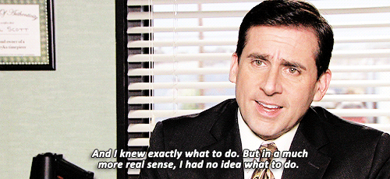
Notes:
Welcome to the orientation for 4th year
Welcome those watching from Chattanooga, Jackson, Nashville and Knoxville
What an interesting year it’s been!

Slide 3
M4 Orientation Agenda
4:00 – 4:05 – Welcome – Dr. Jameson
4:05 – 4:15 – All things Student Affairs – Dr. Womack
4:15 – 4:40 – Curriculum Overview – Drs. Jameson and Bettin
Junior Internships, Capstone, Geri-Palli – Dr. Jameson
LSP and PCM requirements – Dr. Jameson
Electives and Away rotations - Dr. Bettin
Completion of Core Clerkships – Dr. Bettin
4:40 – 4:45 – Evaluations and Grading – Dr. Bettin
4:45 – 4:50 – USMLE Step 2 CK and Step 2 CS – Dr. Bettin
4:50 – 5:00 – Summation – Dr. Jameson
5:00 – 5:15 – Q&A
Notes:
This session will generate many questions
The answers to which are located on OLSEN

Slide 4
All Things Student Affairs
Dr. Womack

Slide 5
Overview of Fourth Year – 52 weeks
Required Courses | Weeks
Junior Internships (2) | 8
Capstone | 4
Geriatrics – Palliative Medicine | 4
Longitudinal Scholars Project | longitudinal
M4 PCM | longitudinal
Electives* (N=4) | 16
Option** (N=5) (8 weeks in Blocks 11-1) | 20
*Need 20 total weeks of electives including CEs and Crisis Management
**If you need to make up core clerkships, you will have fewer option blocks
Notes:
13 block year
Required clerkships
2 Junior Internships
Capstone- October, January, February, March
Geri-palli
Longitudinal Rotations: LSP and PCM
Electives – 4 blocks
Holidays: 4 weeks
5 Option months –
for residency interviewing,
studying for Step 2 CK
personal business (weddings, births, family issues, vacation, moving),
Adjusting to off-cycle away rotations
Must take 2 option block between Nov and Jan

Slide 6
Junior Internship (JI) (aka - Sub-I, Acting Internship)
Two Patient Care Intensive Rotations
FM, Med, Neuro, Ob-Gyn, ENT, Ophtho, Ortho, Peds, Psych, Surgery, Urology, EM, ICU
60+ JIs across the state
Evaluation based on clinical performance
Graded A-F
Must take place at UTHSC
Notes:
Strongly consider doing a Medicine JI
these are the questions that will be on Step 2 CK and Step 3

Slide 7
Junior Internship This is your first chance . . .
To act more like a Real Intern- with more responsibility
To see the patient first
To write H&Ps, progress notes, and discharge summaries
Can be used for billing purposes?
Depends on facility
To come up with your own differential, diagnosis and plan
To write orders that need to be cosigned
To do more procedures
To be truly responsible for the patient’s outcome
To audition for residency and get LORs
And where the COM verifies that you can pass EPAs

Slide 8
Junior Internship This is your last chance . . .
To be very closely watched as you care for patients
To be provided with detailed feedback on skills you will be expected to know as an intern
To have someone more knowledgeable to give you the answers in the heat of battle
To make a mistake in an environment with a broad safety net
And where you are expected to make mistakes so that you can learn from them without patients suffering the burden of that education.
To prove that you are entrustable to be an intern.

Slide 9
The JI is the culmination of all your education!
Do yourself a favor –
CD’s agree that M3’s should be allotted more responsibility in Block 3-4 of their junior year.
Take advantage of that opportunity to be able to take on more of a JI role in that last rotation.
It will jump start you in your real JI’s.
Your performance in the JI is significant for your residency application.
Let your Block 3-4 experience help you with that effort.

Slide 10
Attendance and Work Hours
Document work hours (Time Logs) weekly in eMedley
Should mimic resident work hours
No excused absences for Step 2 CK or interviews*
Therefore, DO NOT take JIs during the interview season.
Excused Absence and Wellness Day Policy still applies
No planned wellness days on JIs
*Pre-COVID policy. Will adjust as needed based on events surrounding the current COVID pandemic.
Notes:
Several schools simply close during the interview season to accommodate all the interviews
Instead, UT COM requires all M4’s to take 2 option blocks during Block 11, 2021 through Block 1, 2022

Slide 11
Other Required Senior Rotations
Capstone
Geri-Palli
LSP
PCM
Notes:
In your pre-study you have more detailed information about each of these required M4 courses.

Slide 12
Capstone (IDE-40000)
Goal to prepare you for intern year:
Review of clinical and pre-clinical topics
Clinical skills practice
Practical advice regarding day-to-day tasks of interns
SDoH, Patient Safety (RCA), Professionalism
Business and legal aspects of medicine, financial wellness
Excused absences allowed for Step 2 and residency interviews
Offered: Blocks 10 (Memphis), 1 (Memphis), 2 (Chatt), 3 (Memphis, Knox)
Course administrator: Deborah Barton MBA dedwar30@uthsc.edu
Course director: Neena Thomas-Gosain MD MHS nthomasg@uthsc.edu

Slide 13
Geriatrics Palliative Medicine (MED-40000)
Exposure to both inpatient and outpatient Geriatrics and Palliative Care
Focus on communication skills
Narrative writing assignments
Offered in Memphis, Chattanooga, and Knoxville
Excused absences allowed for Step 2 and up to 2 residency interviews
Memphis course director: Dr. Jeff Nelson jnelso50@uthsc.edu

Slide 14
LSP (LSP-30410 and LSP-30420)
Remember
Please remember to submit your Student Mentor Agreement for your project by May 30th of M3 year.
Fall
Fall Semester: Deadline for Completion is December 17, 2021
Spring
Spring Semester: Deadline for Completion is March 30, 2022
Present
Presentations: Present your project in poster format
Templates are listed in eMedley under course documents
Memphis will have 2 dates in the winter and 2 in the spring
Coordinator
Course Coordinator: Ms. Kimberlee Norwood knorwood@uthsc.edu
Directors
Course Directors: Dr. Bhattcharya (sbhattachary@uthsc.edu) and Dr. Gerling (igerling@uthsc.edu)
Knoxville and Chattanooga will have at least one session each
Notes:
Remember that your project does NOT have to be research!! It can be research OR patient safety/QI OR service learning OR community or global health
Course is Pass/Fail

Slide 15
PCM (PCM 30410 and 30420)
Transition from role of learner to that of teacher of pre-clinical students
Required 20 total hours of teaching (10hrs per semester)
Most events will be virtual, so students at all campuses can participate
Experiential teaching reflections
Grading pre-clinical reflections
Small group debriefs
U/S labs
Clinical skills
Do not sign up for hours on JIs
Course director: Dr. Steve Nace (gnace@uthsc.edu)
Coordinators: Steven Henley (shenley8@uthsc.edu) & Alise Miller (akiraly1@uthsc.edu)

Slide 16
Electives – Dr. Bettin
20 total weeks of Electives are required for graduation.
16 weeks of which are typically done in the M4 year.
This includes:
CEs
Crisis medicine
Core Topics courses
M4 electives
We have over 230 2- and 4-week electives in UT System!
View course descriptions in the Academic Bulletin on OLSEN
Will be updated in January/February 2021 for the next academic year.
Can be done within UT system or at other LCME accredited medical schools
Notes:
We’ve asked all 230 faculty members to come tell us about their rotations

Slide 17
Away Rotations
Typically would allow 3 of 4 electives to be outside UT System
Other LCME-accredited medical schools or international
Visiting Electives may have Pre-requisites
Not required/recommended for all specialties!
When to do an away rotation?
Competitive fields (Derm, Ortho, Ophtho, ENT, EM, NSY, etc)
To “open up a region”
To get your foot in the door at your top program(s)
Apply through the Visiting Student Learning Opportunities (VSLO)/ Visiting Student Application Service (VSAS) website
COVID considerations
Still do not know if away rotations will be offered next year
Recommend scheduling UT electives for now and then can drop later if away rotations are available
Ms. Kimberlee Norwood is your contact person for questions about away rotations, VSAS/VSLO, away rotation evaluations

Slide 18
International Electives
LCME requirements
http://www.uthsc.edu/Medicine/students/international.php
Completed all core clerkships
8 weeks notice
Overseas mentor
Develop learning objectives
Letter of Acceptance
Complete application form
Mentor information
Must receive a grade
Must complete course evaluation
Seek approval from Sr/Assistant Dean of Clinical Curriculum

Slide 19
Completion of Core Clerkships
For rising M4s who still have Core Clerkships to complete
Delayed or were unsuccessful with Step 1
Returning from Scholar’s Year after Block 5
LOA
COVID
Jenn Wilson will be sending a survey asking your preferences for when to complete these core clerkships
Cannot schedule all make-ups in Blocks 5/6 & C because we must leave some spots for the rising M3s
Completions may be done between May 2021 - Feb 2022
Ms. Wilson and Dr. Bettin to schedule all remaining clerkships in January.

Slide 20
Core Clerkship completions
You will have an incomplete in Banner until all course requirements are completed.
Log all Time Logs and Case Logs under your ORIGINAL clerkship if you are coming back to make up a portion of the rotation.
All evaluations will be completed under the original clerkship.
Goal to have your grade posted by 4 weeks post-completion of the clerkship.
If you’d like your grade by the time you submit ERAS then try to finish the clerkship early in M4 year

Slide 21
Option Blocks
Typically would have 5 option blocks in M4 year:
1 for Step 2 exams
2 must be taken for interviews between Blocks 11-1
2 for your own choice (vacation/travel, preparation for residency, away rotations that don’t line up with UT calendar, extra study time)
COVID ruined this.
Core Clerkship completions must be done in place of option blocks
If you’ve used up more than 3 option blocks- make an appointment with Dr. Jameson, Dr. Bettin, or Dr. Whitt. We will work with you!
Our Goal is to Graduate you ON TIME!

Slide 22
Evaluation in the Senior Year
Junior Internships and Electives
Based entirely on your clinical performance on the rotation
A, B, C, F
Rare exceptions: Online electives and research electives are Pass/Fail
Geri-Palli and Capstone are Pass/Fail
LSP and PCM are Pass/Fail

Slide 23
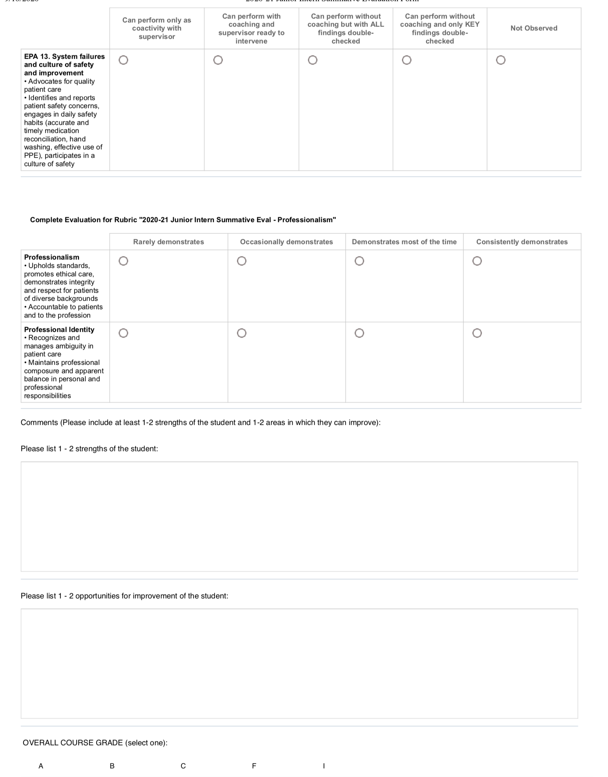
Junior Internship Evaluation Form
Notes:
Based on EPA’s- Entrustable Professional Activities
The COM has to verify that our graduates are ready to act safely and independently as interns on Day One of residency.
Junior Internships are the ideal location for documenting performance in these competencies.

Slide 24
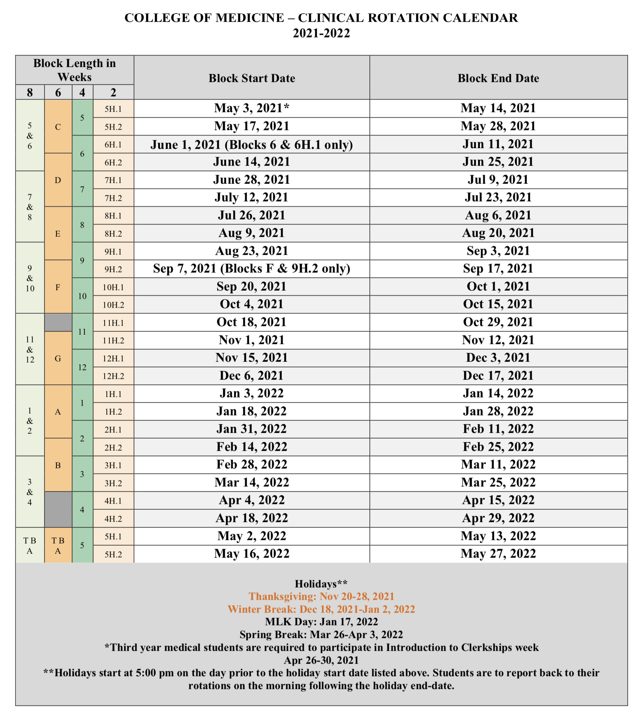
2021-2022 Clinical Rotation Calendar

Slide 25
USMLE Step 2 Exams
Step 2 CK is required for graduation
Must take no later than October 31, 2021!
Timing depends on:
Your Step 1 score
Your chosen specialty
Your preference
Can schedule up to 6 months in advance
Must complete all core clerkships prior to taking OR take an NBME practice exam and pass by 10 points
Email practice test results to Dr. Jameson or Bettin

Slide 26
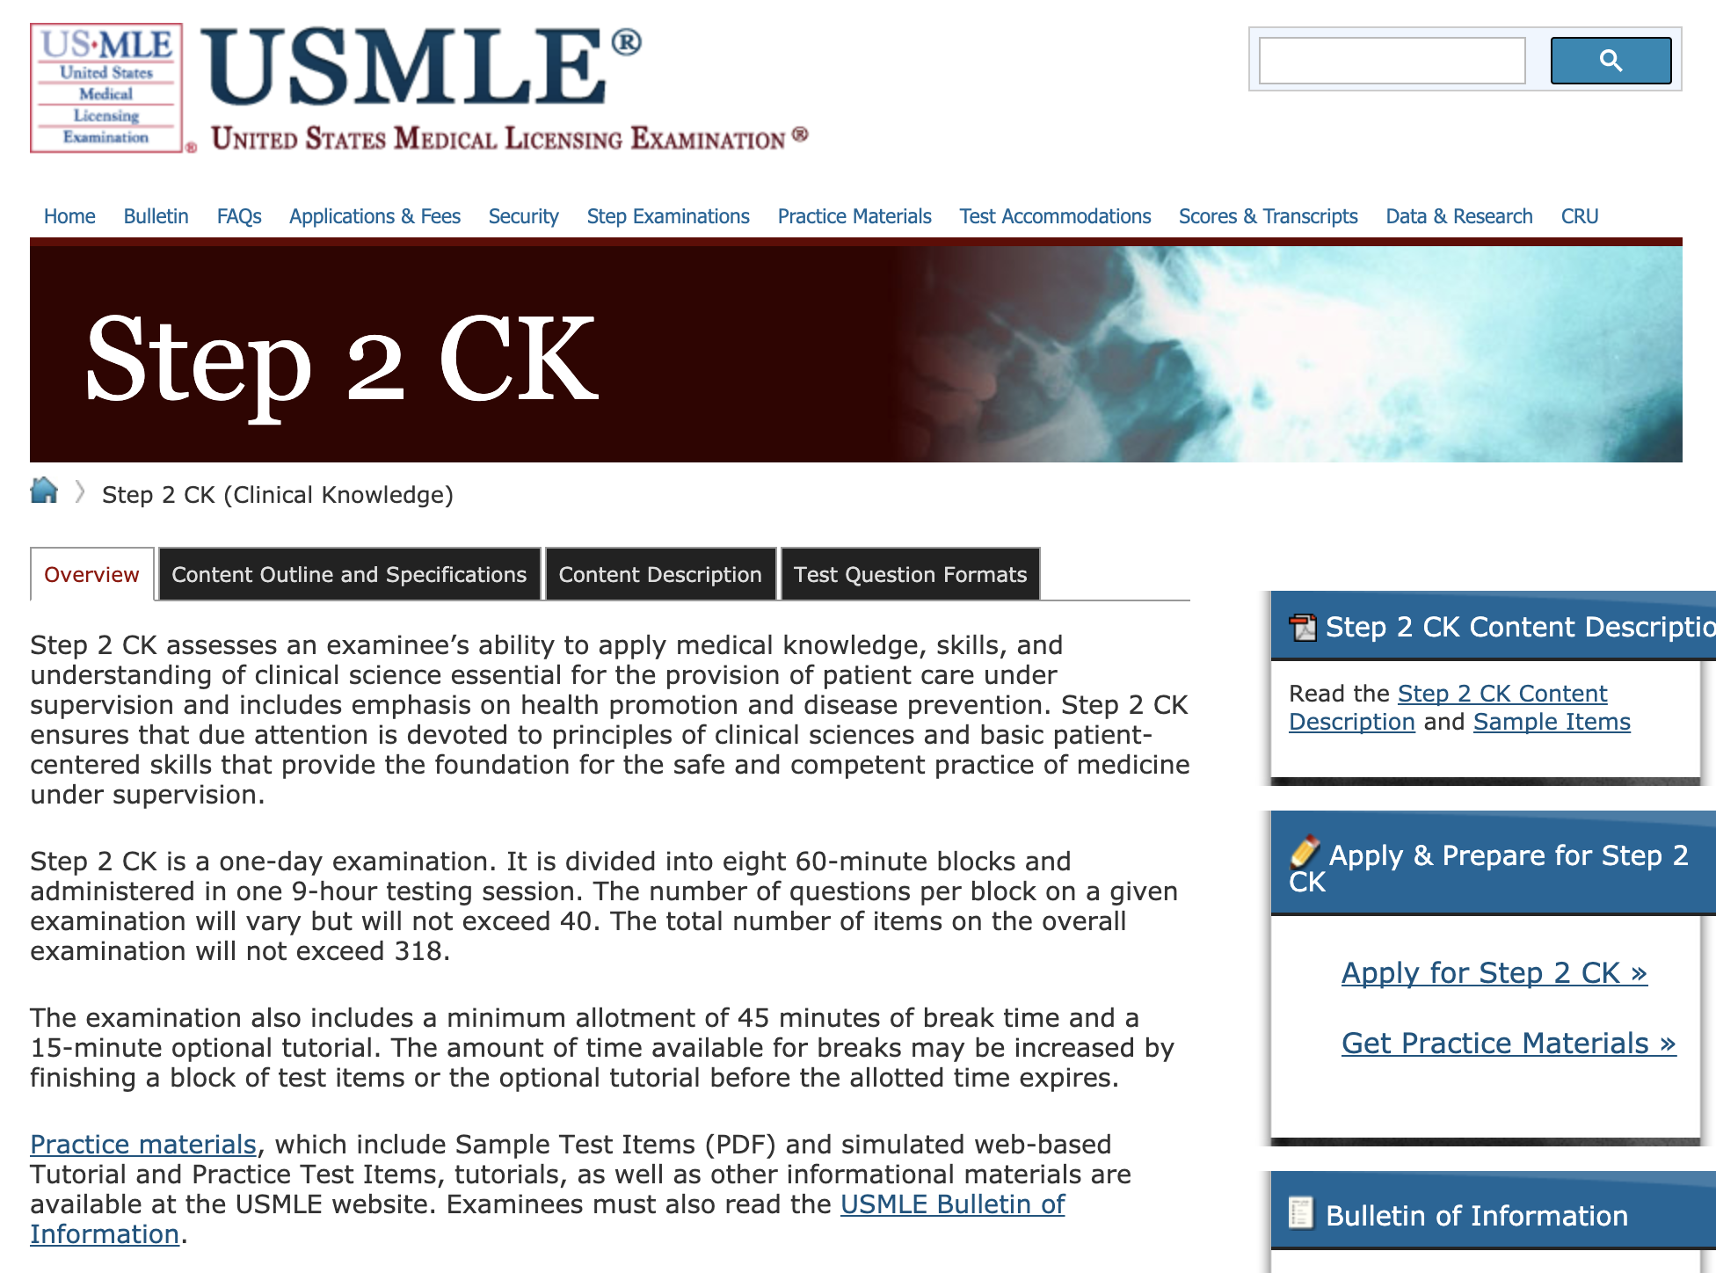
Step 2 CK - www.USMLE.org
Notes:
Click 2X to fade in arrows to highlight
2 publications that will offer invaluable information, samples
CS Content and Description
Video
Patient note information

Slide 27
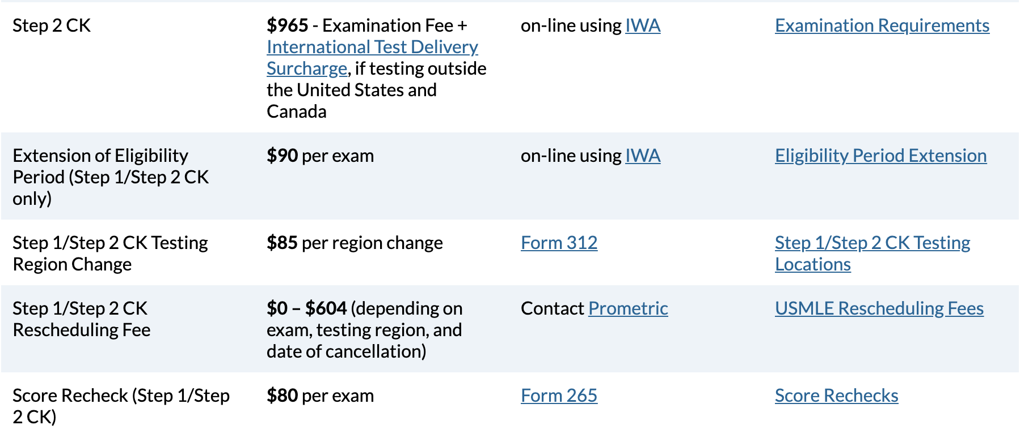
USMLE Step 2 CK Fees

Slide 28
Step 2 CS – Not required*
Notes:
Schedule Early – one year eligibility period to take after registering
The deadline is there for several reasons
make sure you have a result available to residency committees when the submit their match list in mid-February
if you do a lot better than you did on Step 1 it will help your residency application
If you are not successful the first time around, it will give you enough time to retake it twice so that you can graduate with your peers and start residency on time.

Slide 29
Mistreatment Policy- Dr. Jameson
You’ve heard about this policy at Orientation to med school and every clerkship since
Some of you have come forth to let us know about faculty, residents and ancillary hospital personnel who were in need of professional development.
Follow the directions in the Mistreatment policy on whom to contact in case of a complaint.
For JI’s and electives, it’s your instructor of record.
If the problem is the IOR, contact Dr. Womack or Dr. Jameson.
Or you can talk to the CD for that discipline, e.g., Dr. Bettin for a problem with the IOR for a peds specialty elective.

Slide 30
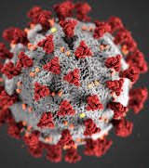
COVID Updates
Email CD, coordinator, and Dr. Bettin for exposures and positive tests.
Remember appropriate PPE when seeing patients (face mask AND eye protection for ALL patients) and in workrooms.
Please be responsible, wear masks, social distance when in social settings.
Recent uptick in quarantines/isolations - almost always due to social exposures.
Holiday travel:
Staying home is best.
If you must travel, then drive.
Wear a mask.
Social distance (including during meals).
Avoid large groups.
COVID tests are not required upon restarting rotations, but please be vigilant about watching for symptoms.

Slide 31
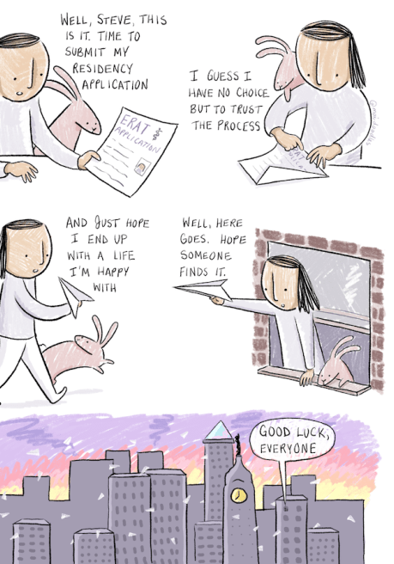
Approach to the M4 year?
Less a year and more a Fall

Slide 32
Best Year of Your Life!
Especially after the Match
Time to make the memories with friends before you disperse across the country.
Time to get your life in order before moving
Travel if you have the time and money (and current pandemic permitting)
But, do yourself a favor . . .

Slide 33
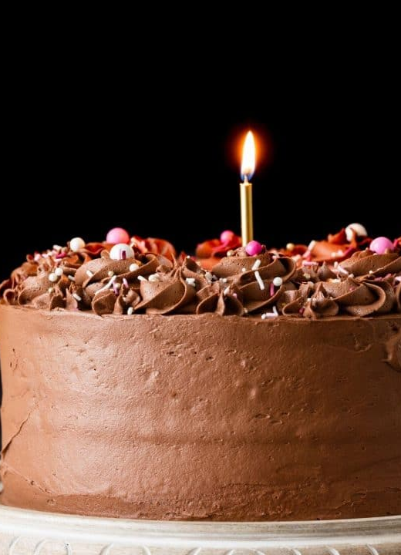
Put some icing on that cake
Time to make conceptual connections
Apply that foundational basic science to what you’ve learned clinically
Create your 10 minute On-the-Fly teaching talks
You know what you are most likely going to see
Prepare a short “UpToDate” page for these
It will arm you during the heat of battle
Knowledge is POWER!
It will make you a great teacher!

Slide 34
Graduation: May 27th, 2022

Slide 35
M4 Orientation Part 2: Scheduling
Wednesday, January 13th @ 4:00pm CST/5:00pm EST
M4 Scheduling Process
Updates on Step 2 (if any)
Updates on Away Rotations

Slide 36
GHHS Nominations
Due tomorrow Friday November 30th
Will be listed in Graduation Program
These people supposedly represent the best of your class
These people represent you!
Make it count by sending in your vote!

