Slide 1
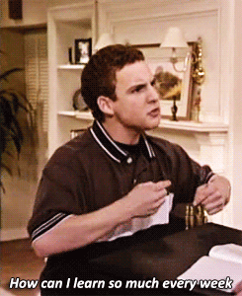

Slide 2

Orientation to the Clinical Years
Class of 2022
February 4th, 2020
Memphis, Tennessee

Slide 3
TODAY’S AGENDA
A Shameless Plug
Overview of Clinical Curriculum
Dr. Womack- Career Planning
Overview of the East Campuses
Exclusively East Students mini-meeting
SIM Event – at Chips hosted by UT CoM Chattanooga

Slide 4
Student Committee Members
Admissions Committee
  Gerald Presbury, MD.
    Chair, COM Admissions
  Nelson Strother, MA.
    Assistant Dean, COM Admissions
Clinical Sciences Subcommittee
Curriculum Committee for UME

Slide 5
Overview of the Clinical Curriculum
M3/M4 years Class of 2022
Valerie P. Jameson, MD. (Sr. Asst. Dean Clinical Curriculum)
Miranda Kennedy (Lead Clinical Curriculum Coordinator)
Kimberlee Norwood (Medical Educator)

Slide 6
Orientation TOPICS
Overview of Curriculum
  USMLE
  Prep for Clerkship Week
  Requirements – M3 and M4 years
Scheduling
  Distribution across the state
  Scheduling Scenarios
  Schedule overload
Clerkship Policies

Slide 7
WHERE DO I GET INFORMATION?
Clinical Curriculum Orientations:
  M-3 year and overview, today and Friday
  M-4 year - late fall 2020 and Jan 2021
OLSEN web page includes:
  Clerkship Directors
  Clerkships M3 year
  Clerkships M4 year
  Bulletin
M-4 students
Clerkship Faculty/Staff/Mpower/Specialty Advisor
USMLE web site
Today’s presentations on web site

Slide 8
Prior to Starting M3 Year
Take the Pesky Step 1, USMLE
Notes:
Check UT registration deadline
New semester start date July 1
Financial Aid checks in July, not May

Slide 9
USMLE Step 1
Eligibility:
2.25 GPA and pass all courses
Take by April 26, 2020
Passing score Step 1 now 194

Slide 10
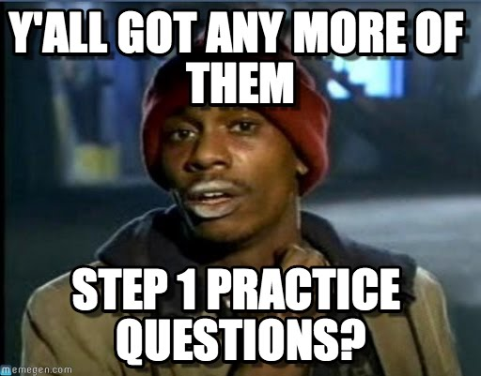
USMLE Step 1
Class of 2020 (partial)
First-time pass rate – 93% (National 96%)
First-time mean – 228 (National 230)
Class of 2019
First-time pass rate – 96% (National 96%)
First-time mean – 229 (National 230)
Class of 2018
First-time pass rate – 94% (National 96%)
First-time mean – 227 (National 229)
Class of 2017
First-time pass rate – 96% (National 96%)
First-time mean – 232 (National 229)
Class of 2016
First-time pass rate – 92% (National 96%)
First-time mean – 225 (National 230)
Class of 2015
First-time pass rate – 86% (National 96%)
First-time mean – 221 (National 228)
Notes:
USMLE
Passing Score – 194
11 people failed in partial 2018 list

Slide 11
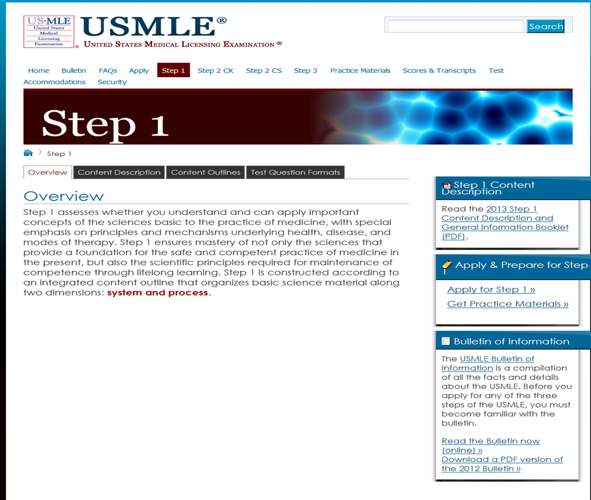
http://usmle.org/step-1/#overview

Slide 12
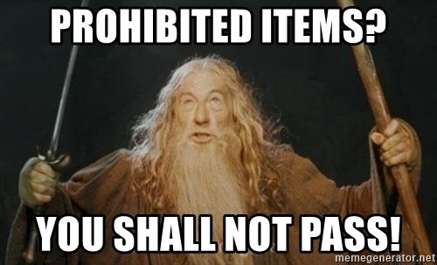
USMLE
For Step 1 unauthorized items include, but not limited to:
  mechanical or electronic devices, cell phones, PDAs, calculators, watches of any type, pagers, recording or filming devices, radios;
  outerwear, such as coats, jackets, head wear, gloves;
  book bags, backpacks, handbags, briefcases, wallets;
  ear plugs, books, notes, written materials,
or scratch paper;
  food, candy, gum, or beverages.
Notes:
USMLE
Have link from our website (Information for Students)
Take this seriously
SAME rules for NBME Shelf Exams in all M3 clerkships

Slide 13

Delay Taking Step 1?
Not in your best interest!

Slide 14
Why must we take a test to prove that we need to delay?
Most students do not feel ready
Many will think that 1 more week will make a difference
Sassi data indicate that it doesn’t help – 3 week peak
By the end of week 3 of preparation, many of you will be begging to take the exam early and get it over with.
Cannot delay simply to improve your Step 1 score.
Several students delayed unnecessarily.
The M4 fall is simply too busy to be doing core clerkships
Too many delays skew the clerkship schedules for the M3’s
Have to participate in Prep for Clerkship week anyway

Slide 15
Prior to Starting M3 Year
Your Schedule:
Take Step 1, USMLE NLT April 26, 2020
  3-month eligibility period
Block 5-6 2020 May 4– June 26, 2020
  If you don’t pass USMLE, two options
    Come out of the clerkship, study for a month, take test, pass, re-enter clerkships
    Complete the clerkship, study Block 7 (June 29 – July 24, 2020)
    Cannot start back into the clerkships without posting a passing Step 1 score
  Re-take NLT July 29 to continue clerkships as of Block 9, 2020 (8/24/20)
Financial Aid issue
  Must take at least 5 credits in the semester to be able to be eligible to receive financial aid
Notes:
Check UT registration deadline
New semester start date July 1
Financial Aid checks in July, not May

Slide 16
Prior to Starting M3 Year
Your Schedule:
Take Step 1, USMLE NLT April 26, 2020
  3-month eligibility period
Block 5-6 2020 May 4– June 26, 2020
  If you don’t pass USMLE, two options
    Come out of the clerkship, study for a month, take test, pass, re-enter clerkships
    Complete the clerkship, study Block 7 (June 29 – July 24, 2020)
    Cannot start back into the clerkships without posting a passing Step 1 score
  Re-take NLT July 29 to continue clerkships as of Block 9, 2020 (8/24/20)
Financial Aid issue
  Must take at least 6 credits in the semester to be able to be eligible to receive financial aid
Prep for Clerkships Week April 27-May 1, 2020
  Watch for emails from Kimberlee Norwood
    Times to complete requirements
      Pre-recorded videos and exams
        Videos may actually help them prepare for Step 1.

Slide 17
Things to get done while taking a break from Anki
Pre-recorded videos and exams
  Complete exams by April 26th
Tb skin test/Mask fitting
Make sure BLS is up to date
Drug Testing
Notes:
Kimberlee Does these slides

Slide 18
Prep for Clerkship Week
April 27- May 1, 2020
HIPAA, sterile technique, CPR, Blood and Fluids, communication, EMR, Duty Hours, Patient logs, Risk Management, Needlestick Policy, etc.
Venipuncture, Foley caths, suturing and knot tying, Airway management, X-rays, EKG’s
Notes:
Kimberlee Does these slides

Slide 19
VA Onboarding
Don’t let your VA credentialing lapse!
  Even if you don’t plan to go to the VA
  Even if you are going entirely to the East
  Chattanooga Psych students go to the Chat VA
Every year someone unexpectedly
  has to come back to Memphis
  has to shift into a course they didn’t anticipate
  and of course, the rotation they need uses the VA!
Nothing happens rapidly at the VA
  Students have had to burn an option block waiting to get recredentialled
VA Swearing in – February
Notes:
Kimberlee Does these slides

Slide 20
Prior to Starting M3 Year
Your Schedule:
Take Step 1, USMLE NLT April 26, 2020
  3-month eligibility period
Block 5-6 2020 May 4– June 26, 2020
  If you don’t pass USMLE, two options
    Come out of the clerkship, study for a month, take test, pass, re-enter clerkships
    Complete the clerkship, study Block 7 (June 29 – July 24, 2020)
  Re-take NLT July 13 to continue clerkships as of Block 9, 2020 (8/24/20)
Financial Aid issue
  Must take at least 6 credits in the semester to be able to be eligible to receive financial aid
Prep for Clerkships Week April 27-May 1, 2020
  Watch for emails from Kimberlee Norwood
  Times to complete requirements
    Pre-recorded videos and exams
      Videos may actually help them prepare for Step 1.
Register for UTHSC Fall 2020 late April thru the End of June, 2020
  Late fees will apply
  Fall semester starts July 1 so no financial aid check until July, not May
Notes:
Check UT registration deadline
New semester start date July 1
Financial Aid checks in July, not May

Slide 21
Clinical Years REQUIREMENTS

Slide 22
M3 & M4 CURRICULUM
 | Jul | Aug | Sep | Oct | Nov | Dec | Jan | Feb | Mar | Apr | May | Jun
 |  |  |  |  |  |  |  |  |  | USMLE STEP 1 | Fam Med Medicine Ob/Gyn Pediatrics Psych/Neuro Surgery CE
Third Year | PCM/LSP Family Medicine - 6 weeks Medicine - 8 weeks Ob/Gyn - 6 weeks Pediatrics - 6 weeks Psych/Neuro - 4 weeks each Surgery - 8 weeks Career Exploration –2 weeks (three)
Fourth Year | PCM/LSP Junior Internship - 8 weeks Geri-Palli - 4 weeks Capstone - 4 weeks Electives - 16 weeks Option Block - 20 weeks USMLE Step 2 CK – Clinical Knowledge Exam USMLE Step 2 CS – Clinical Skills Exam
You are here

Slide 23
Notes:
Notice there are only 5 holidays
no 4th of July
no Labor Day,
no Memorial Day
Block F actually starts September 8th

Slide 24

M3 Scheduling Scenarios

Slide 25
The Magic Schedule
Does it really matter how I schedule?
Graduated evaluation
Improved NBME scores over the year
Later rotations
  Really shine by the end
  Seasonal affective disorder

Slide 26
SCHEDULING SCENARIOS
Smartest
2020
CORE CLERKSHIP
CE
CORE CLERKSHIP
CORE CLERKSHIP
CE
CORE CLERKSHIP
Option
2021
Option
CORE CLERKSHIP
CORE CLERKSHIP
CE
CORE CLERKSHIP
Away
Elective
JI
Any
Geri-
Palli
ERAS opens
Take Step 2 CK and CS
Notes:
Scheduling Scenarios
Speak with your Specialty Advisors
7 core clerkships/ 3 two week CE’s
In any order based on availability
Majority of students still take this route
You cannot take USMLE Step 2 until you have completed the core clerkships

Slide 27
SCHEDULING SCENARIOS
Use CE as an Option Block
2020
CORE CLERKSHIP
CE
CORE CLERKSHIP
CORE CLERKSHIP
CORE CLERKSHIP
Option
2021
Option
CORE CLERKSHIP
CORE CLERKSHIP
CE
CORE CLERKSHIP
Away
Elective
JI
Any
Geri-
Palli
ERAS opens
Take Step 2 CK and CS

Slide 28


SCHEDULING SCENARIOS
Ophthalmology-early match
2020
1
2
3
4
5
CE
7
8
9
10
CE
CORE CLERKSHIP
CORE CLERKSHIP
CORE CLERKSHIP
CORE CLERKSHIP
12
2021
CORE
CLERKSHIP
CE
2
ELE
OPH
ELE
AWAY
OPH
RES
7
CORE CLERKSHIP
9
10
11
12
Geri-Palli
CORE CLERKSHIP
ERAS opens
Take Step 2 CK and CS
Notes:
BEWARE!
Some competitive residencies are requiring two away rotations and a home rotation in their discipline before you even apply!
But they also want you to have taken and smashed CK before you apply as well.
You can take CK before finishing core clerkships but you must take practice NBME in SASSi and pass it by 10 points first.
Trying to study for a clerkship and Step 2 dilutes your chances of doing well on both.

Slide 29
SCHEDULING SCENARIOS
Ophthalmology-Creating a 4 week CE
2020
1
2
3
4
5
CORE CLERK
SHIP
7
8
9
10
CE
CORE CLERKSHIP
CORE CLERKSHIP
CORE CLERKSHIP
CORE CLERKSHIP
12
2021
CORE
CLERKSHIP
CORE CLERKSHIP
2
OPH
RES
7
OPH JI
9
10
11
12
CE
CE
Geri-Palli
OPH
AWAY
ERAS opens
Take Step 2 CK and CS
Notes:
You can take an elective in the 4 week CE slot

Slide 30
Step 2 CK
Must complete all CORE Clerkships first
  The best way to prepare of CK is to do COREs
Pressure to get result in early for interviews
If you want to take it early
  Don’t! Finish all your clerkships this year!
  Must take a practice NBME exam in SASSi
  Must score 10 points above passing

Slide 31
Step 2 CS
Only 4 locations
Limited slots
If you are Osler and applying to a residency with God – try to schedule during M3 spring break
If you are mortal, take it in the summer or fall after a clinical rotation and CS Bootcamp
Much tougher grading- it can be failed.
Must be taken before October 31, 2020
Notes:
Must be taken before October 31, 2020
so that the results can be in by the time the residencies submit rank lists
So, if you are unsuccessful, you have time to repeat and pass it.

Slide 32
2019-20 Core Clerkship Student Slots Across the State
Discipline | Total Capacity across the State | Memphis/ Jackson | Chattanooga | Knoxville | Nashville
Family Medicine | 31 | 12/9 | 4** | 4 | 2
Medicine | 38 | 22 | 6 | 6 | 4
OB/GYN | 32 | 20 | 6 | 4 | 2
Pediatrics | 24 | 16 | 6 | 2
Psychiatry | 16 (19**) | 14 | 2** | 3**(4)
Neurology | 14 (20**) | 14 | 3**(4) | 3**(4)
Surgery | 33 | 16 | 8 | 7 | 2
Total slots | 188 (197**) | 123 | 26 (35**) | 23 (29**) | 10
Housing Avail |  |  | 28 | 13 | ?
** Not offered in all blocks

Slide 33
Rate Limiting Factor
Psychiatry
Psych Memphis 14 slots x 12 blocks = 168
Psych Knox 3 slots x 4 blocks = 12
Psych Chatt 2 slots x 12 blocks = 24-5=19
Only 199 (+) slots for 174 students
  (170 plus a M4’s who delayed psych)

Slide 34
Chattanooga
Neurology
  Blocks 9, 11 (for 2020)
  2, 3 (for 2021)
  Maximum of 3 students per block
Psychiatry
  Blocks every block where not already filled
    Maximum of 2 students per block

Slide 35
Housing –Chattanooga
28 students per block
Up to six 4-week blocks maximum
Not available for East Only students
M3 students first priority
Submit requests on-line
Be sure and notify Courtney Orloski
immediately if you change your schedule
http://www.comchattanooga.uthsc.edu/subpage.php?pageId=1053
Notes:
Talk about housing is for students who are not going entirely to an East campus

Slide 36
Knoxville
Psychiatry (Conditional)
  Blocks 1, 3, 7, 9
    Maximum of 3 students per block
Neurology
  Blocks 2, 4, 8, 10
    Maximum of 3 students per block
Pediatrics
  All Blocks
    Maximum of 2 students per block

Slide 37
Housing – Knoxville
  13 students per block
  Up to 6 months maximum
  Not available for East Only students
  M3 students first priority
  Submit requests on-line
  Be sure and notify Lolita Davis immediately if you change schedules
  http://gsm.utmck.edu/students/housing.cfm

Slide 38
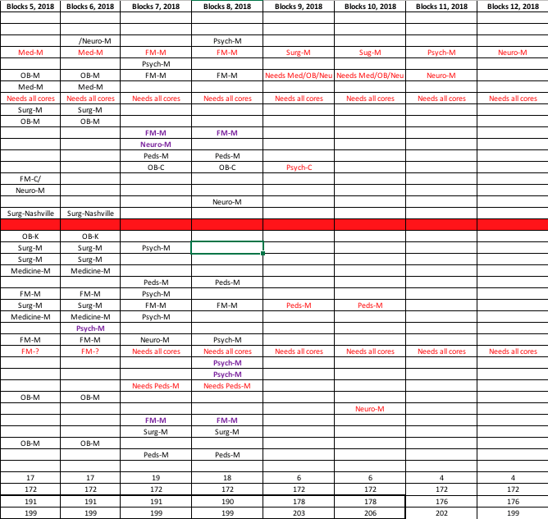
Schedule Overload
Notes:
36 students had issues with Step 1, failed clerkships, took option blocks
5 returning scholar’s year, dual degree, LOA

Slide 39
How to make this work?
We must utilize all our sites.
All students are required to choose an East rotation initially.
After everyone gets a spot, there will be opportunity to maneuver rotations.
Details of scheduling from Miranda Kennedy in the next session
Notes:
Here we are just addressing this overload issue.
You will get all the details of scheduling from Miranda Fairley in the next session

Slide 40

Top 4 Choices
You will indicate your Top 4 Choices
  Discipline, Block timing, Campus location

Slide 41
Potential Log Jam
eMedley software will generate the schedules based on student preferences.
Could potentially have puzzles that don’t work due to lack of clinical sites
Plan- we will rearrange clerkships to make sure everyone has a schedule while trying to accommodate as many preferences as possible.

Slide 42
M3 Option Block Requests
Delays:
  Illness or emergency situations ONLY
  must be approved by Progress & Promotions Committee
Acceptable Reasons:
  Academic/Research
  Military obligations
  Weddings (your own)
  Maternity or Paternity Leave

Slide 43
M3 Option Block Issues
If you need to request an option block as M3
  The Neuro rotation will need to be delayed
  You will complete the neurology rotation in Block 7 or 8, 2021
  Unable to move Psych due to limited number of slots.
  If you’ve already taken Neuro, you will have to drop a 6 or 8 week rotation and take two option blocks or one option block or an elective if possible
    Provided you fulfilled the prerequisite
Remember- you have a 2 week CE option block

Slide 44

New M4 Curriculum!

Slide 45

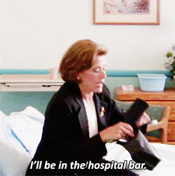
Why?
Students are experiencing significant stress due to increasing demands for more and more residency interviews and for away rotations.
  8 interviews in the past – now some doing 20-30 interviews!
  Unable to plan ahead – last minute interview offers
  Required away rotations – EM, Anesthesia, Dermatology
The majority of other institutions have drastically curtailed many of the required rotations in the senior year.
Some colleges actually close school during interview season.
Notes:
Away rotations: Remember to budget money for travel expenses

Slide 46
M4 Required Clerkships
One Junior Internship - Medicine
  JI, Acting Internship-AI, Senior Clerkship
  Internal Medicine
One Junior Internship -any discipline
Capstone
Geri-Palli
Surgical Subs
Medical Specialties
4 Electives
3 Option Blocks
Two Junior Internship
  JI, Acting Internship-AI, Senior Clerkship
  Any discipline
Capstone
Geri-Palli
4 electives
5 Option blocks
  2 must be in Block 11-Block 1

Slide 47

OPTION BLOCKS ARE NAMED “OPTION” FOR A REASON
The time may be used for:
  going on interviews
  arranging away rotations
  studying for CK
  preparing to move to the city of your future residency
  completing delayed third year rotations
  choosing to do more courses for credit at no additional tuition
This plan in no way limits your education. It simply provides more flexibility in accommodating USMLE exams and interviews.

Slide 48
SASSI is NOT for DUMMIES!
It’s the smart move!

Slide 49
SASSI and the M-3 Year
Same consultation services (test-taking, prep. for shelf exams, test anxiety, time management, etc.) with educational specialists as in M1/M2 years
Here in Memphis or via phone appointments and Skype in Chattanooga, Knoxville, Jackson or Nashville.
Clerkship Books on Reserve in Chattanooga and Knoxville
To schedule an appointment – SASS@uthsc.edu or 901 448-5056

Slide 50
Clerkship Policies
The enormity of this statewide campus
Curriculum with lots of options from which students can choose to create a learning experience that best suits them.
Policies prevent chaos
Chaos leads to delayed graduation, loss of residency spot and loss of accreditation

Slide 51
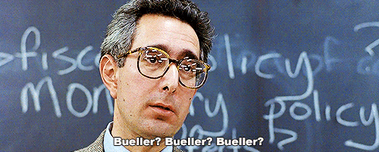
Attendance Policies
Class Attendance
  http://catalog.uthsc.edu/content.php?catoid=16&navoid=1375#Class_Attendance
Leave of Absence/Withdrawal
  http://catalog.uthsc.edu/content.php?catoid=16&navoid=1375#Leave_of_Absence/Withdrawal
Student Duty Hour Policy
  https://www.uthsc.edu/Medicine/medicaleducation/clerkships/workhourspolicy.php
Religious Accommodations
  https://academic.uthsc.edu/policy_docs/religious_beliefs.php

Slide 52

Professionalism Policies
Code of Professional Conduct
  http://catalog.uthsc.edu/content.php?catoid=16&navoid=1375#Code_of_Professional_Conduct
Dress Code
  http://catalog.uthsc.edu/content.php?catoid=16&navoid=1375#Dress_and_Identification
Inclement Weather Policy
  http://catalog.uthsc.edu/content.php?catoid=16&navoid=1375#Inclement_Weather_Policy

Slide 53
Student Wellbeing
Student Mistreatment
  http://catalog.uthsc.edu/content.php?catoid=16&navoid=1375#Student_Mistreatment
Drug and Alcohol Policy
  https://academic.uthsc.edu/policy_docs/student_drug_alcohol.php
Clerkship Wellness Policy
  https://www.uthsc.edu/Medicine/students/policies/clerkship-wellness-policy.pdf

Slide 54
Grades
Grading Policies
  http://catalog.uthsc.edu/content.php?catoid=16&navoid=1375#Grading_Policies
Drop/Add Policy
  http://catalog.uthsc.edu/content.php?catoid=16&navoid=1376#Dropping/Adding_Rotations
  NLT 30 days prior to the Block
Notes:
Must give the coordinators time to create these very complex schedules.

Slide 55
Clerkship Exam Retake
http://catalog.uthsc.edu/content.php?catoid=16&navoid=1375#General_Policy_on_Retaking_Examinations_in_the_Core_Clerkships
https://www.uthsc.edu/Medicine/documents/medical-education/exams/clerkship-shelf-exam-retake-policy.pdf

Slide 56
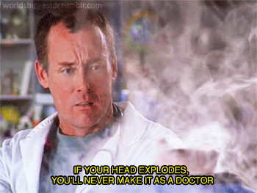
So many rules, so little time!
When in doubt, look it up.
  If still confused, ask.
Don’t presume.
  The Orange Vine isn’t always correct or up to date.
Get permission early! NLT 30 days prior to block
  Make requests in writing.
  Deadlines are immutable.

Slide 57
TO BE CONTINUED...
Friday:
Scheduling- Kennedy
What to Expect – Dr. Jameson
Clerkship Grading/Wellness Days – Dr. Bettin
Overview of Memphis Clerkships
Panel Discussion- M3/M4’s
Notes:
5 minute break
Introduce Chattanooga, Knoxville and Nashville CD’s

Slide 58
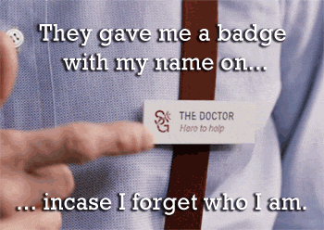
Questions:

Slide 59
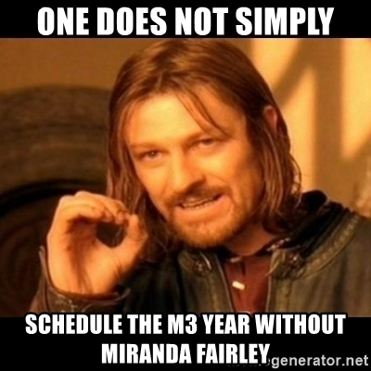
How to SCHEDULE the M3 Year
Miranda Kennedy, BPS.
(mfairle1@uthsc.edu)
448-2928
Notes:
Welcome Ruby to the podium

Slide 60
Welcome East CD’s
Chattanooga Campus
Betsy Close, M.D. (Family Med.)
Patrick Koo, M.D. (Medicine)
Abdelazim Sirelkhatim, M.D. (Neurology)
Jeanie Dassow, M.D. (OB/GYN)
Cathy Stevens, M.D. (Pediatrics)
Audrey Hime, M.D. (Psychiatry)
J. Daniel Stanley, M.D. (Surgery)
Nashville Campus
Benjamin Maddox, M.D. (Medicine)
Julie Boll, MD. (Surgery)
Craig Glass, MD. (Family Medicine)
Georgia Ferrell (OB-Gyn)
Knoxville Campus
William Dabbs, M.D. (Family Med.)
Janet Purkey, M.D. (Medicine)
Steve Rider, M.D. (Neurology)
Paige Johnson, M.D. (OB/GYN)
Joseph Peeden, M.D. (Pediatrics)
Paul Miller, M.D. (Psychiatry)
Michael McNally, M.D. (Surgery)
The Real Directors
Knoxville: Lolita Davis
Nashville: Tristin Casteel
Chattanooga: Pan Scott,
Courtney Orloski

