Slide 1
Catherine Womack, MD
Assistant Dean of Student Affairs

Slide 2
Catherine Womack, MD
Assistant Dean of Student Affairs

Slide 3
Topics
Our Students
Debt Initiative
Student Wellness
Campus Resources for our students

Slide 4
Rolling Data on Current Students
 | 2016 | 2017 | 2018 | 2019
Average GPA | 3.52 | 3.63 | 3.59 | 3.54
Diversity (Admit/Enroll) | 42/19 | 30/20 | 54/23 | 45/23
4 Year Grad Rate | 93% | 88% | 88% | 89.8%
Scholar’s Year | 4 | 5 | 3 | 8
Residency Placement | 99.4% | 99.3% | 99.4% | 99.4%
Match in TN | 67 (39%) | 58 (37%) | 69 (44%) | 69 (43%)
Primary Care | 46% | 47% | 65 (42%) | 71 (44%)

Slide 5
UTHSC Class of 2023 Admissions Process
2207
Applicants
462
Interviews
238
Acceptances
170
New Enrollees

Slide 6
2019 Applicant Class Characteristics
Average Age 23
Age Range (21-35)
Residency
Tennessee Residents 734
Non Tennessee Residents 1473
Diversity - underrepresented groups, first generation college students, military veterans, economically and educationally disadvantaged students, students from rural areas and medically underserved areas.

Slide 7
Incoming Class 2023 Currently Accepted Students

Slide 8
Academic Records of Incoming Students
100% with Baccalaureate Degrees
Average GPA
Total 3.74
Science 3.69
Total MCAT Score 511.42
Most Common Undergraduate Majors
Biochemistry
Biology
Chemistry
Neuroscience
Psychology

Slide 9
Most Represented Cities of Accepted Students
Brentwood
Chattanooga
Collierville
Germantown
Jackson
Johnson City
Knoxville
Memphis
Murfreesboro
Nashville

Slide 10
Institutions with Highest Number Accepted Students Represented in Class 2023
Emory
Lipscomb
Middle Tennessee State University
Rhodes College
University of Alabama
University of Memphis
UT Chattanooga
UT Knoxville
Vanderbilt University
Washington University

Slide 11
Tuition & Fees 2018-2019
Tennessee Residents
$35,833.00
Non Tennessee Residents
$68,925.00

Slide 12
UT Student Debt
%
AAMC Graduation Questionnaire, Class of 2012-2018

Slide 13
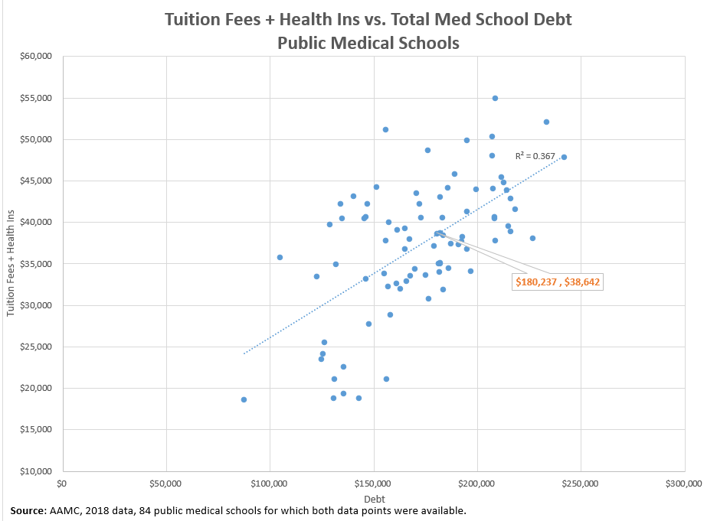
Student Debt Reduction
Student Debt Reduction:
Increase philanthropy for scholarships
Focus on student financial literacy

Slide 14
Student Debt Initiative Planning
Three Focus Areas
Financial Literacy Training
Increased training for current students and residents
Implement curriculum from enrollment through graduation
Plan
Maintaining stable tuition
Explore debt-forgiveness opportunities (military; underserved areas)
Increase Scholarship Support
Partnering with Development Office for future opportunities
Ongoing engagement of alumni, non-alumni, corporations, and foundations

Slide 15
Student Debt Initiative Overview
The Need and Case for Support
Average debt now > $196,000
All deserving students should be able to attend independent of financial status
Extent of future debt impacts specialty choice and practice location
Financial stress and wellness
Set students up for success in areas of passion
Affects everyone in Tennessee (and region)
Simply the right thing to do

Slide 16
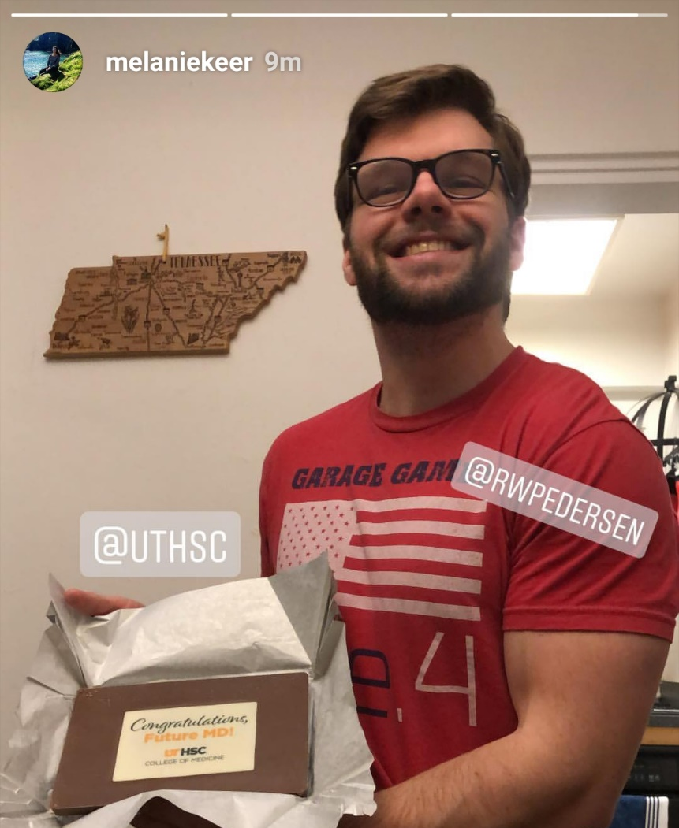
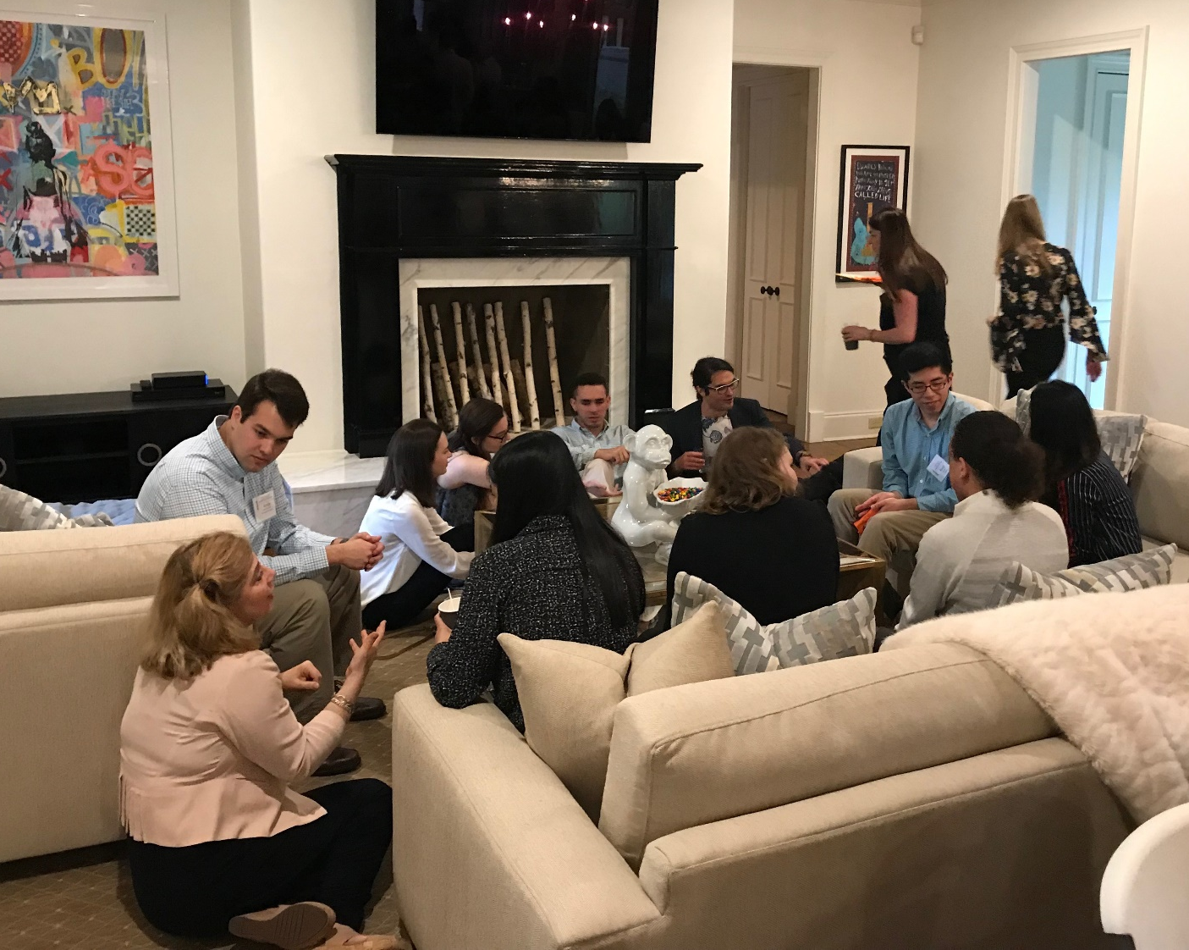
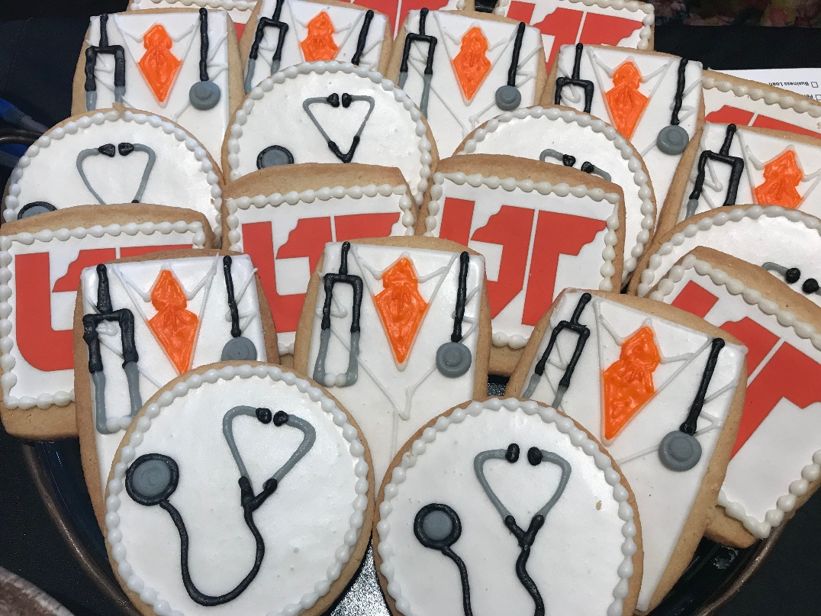
Initiatives for Applicants and Current Students
UT Chocolate Bars
Second Look for Accepted Students
Town Halls
Student Lunches with Dean

Slide 17
UTHSC MPOWER A Learning Communities Initiative
Mentoring
Professionalism
Opportunity
Wellness
Excellence
Research

Slide 18
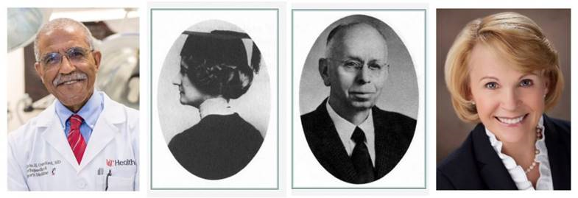
UTHSC MPOWER Houses Named for Famous UT Alumni & Faculty
Conyers-York-First female graduate
Crawford-First African American graduate
Diggs-First Blood Bank and Pioneer in Sickle Cell Disease
Seddon- First Female MD Astronaut

Slide 19
RESOURCES FOR OUR STUDENTS

Slide 20
Mind Body Wellness Center
Soon to be under construction on the 2nd floor
of the Student-Alumni Center:
Fully Equipped Studio
Yoga
Barre Classes
Pilates Studio
Meditation Studio
Resources for nutrition
Book Clubs
Speakers on topics of wellness
Kimberlee Strome, Director of the Wellness Center, leads the first YOGAhike for UTHSC students at Shelby Farms.

Slide 21
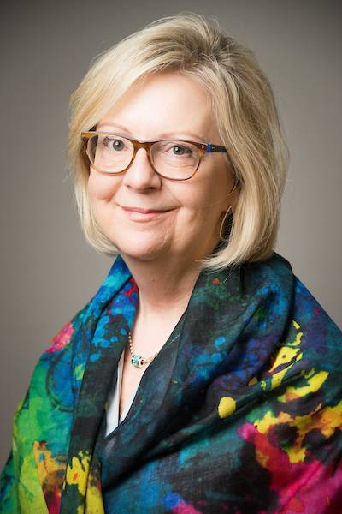
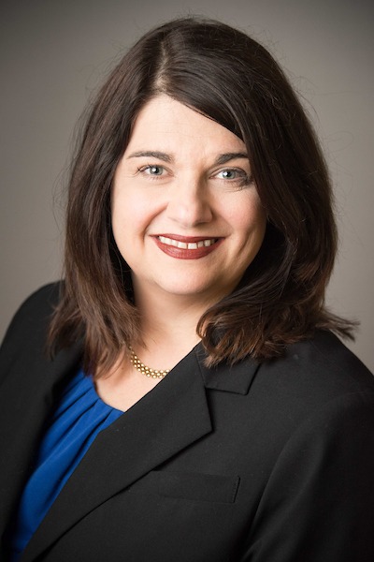
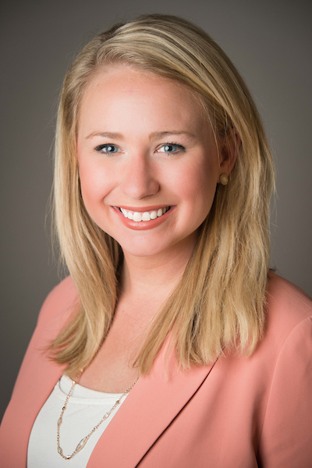
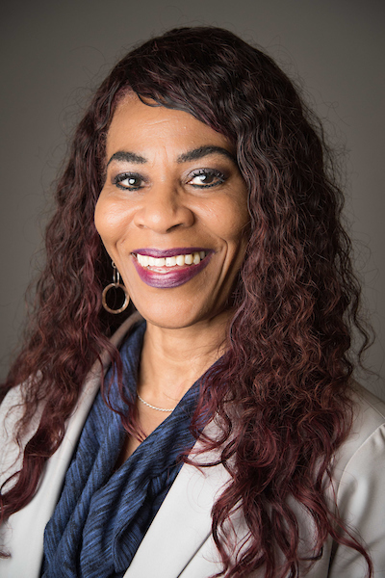
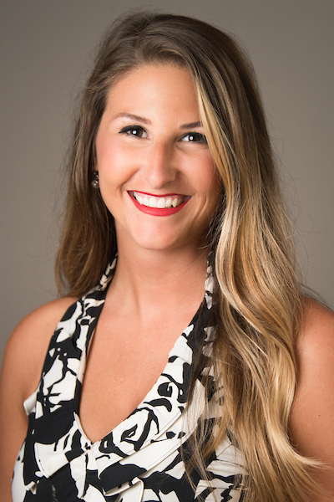
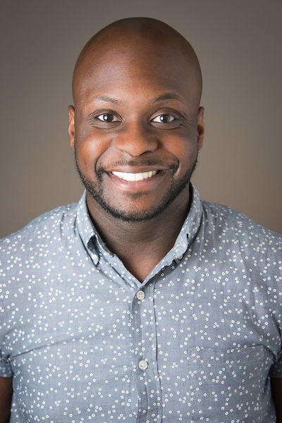
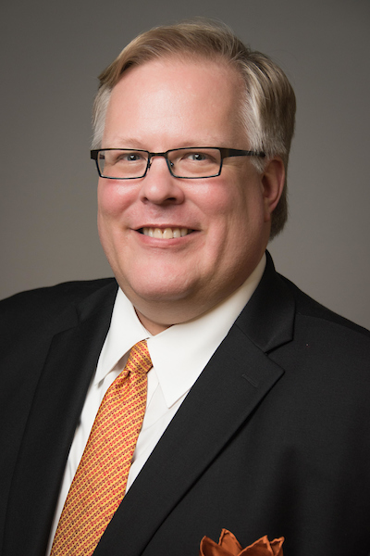
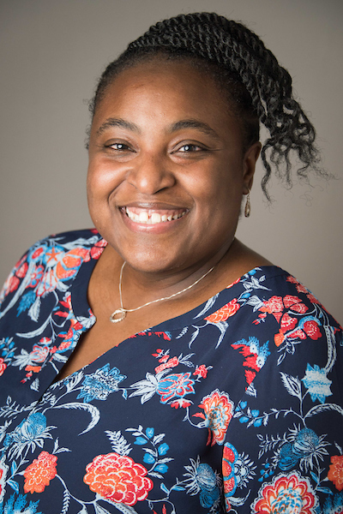
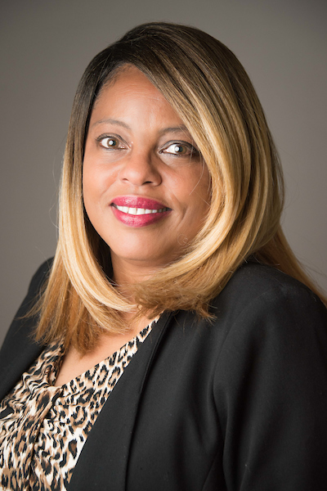
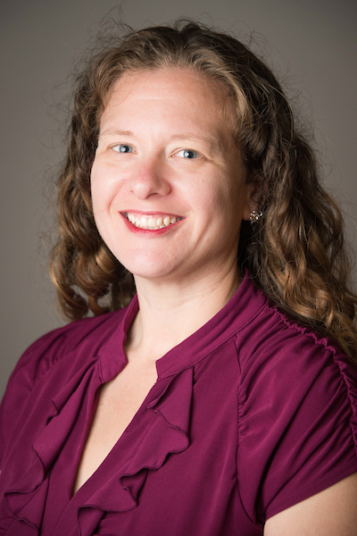
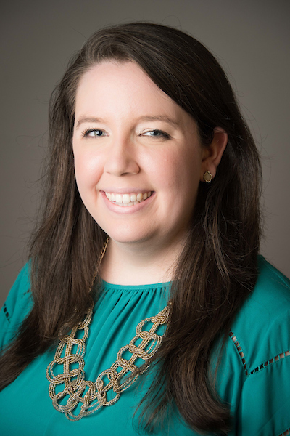
Student Academic Support Services and Inclusion
UTHSC
A Campus of Caring
#TakeCare
Director Gibbs
Counselors and Educational Specialists

Slide 22
Center for Healthcare Improvement and Patient Simulation
Notes:
You’ll see this later

Slide 23
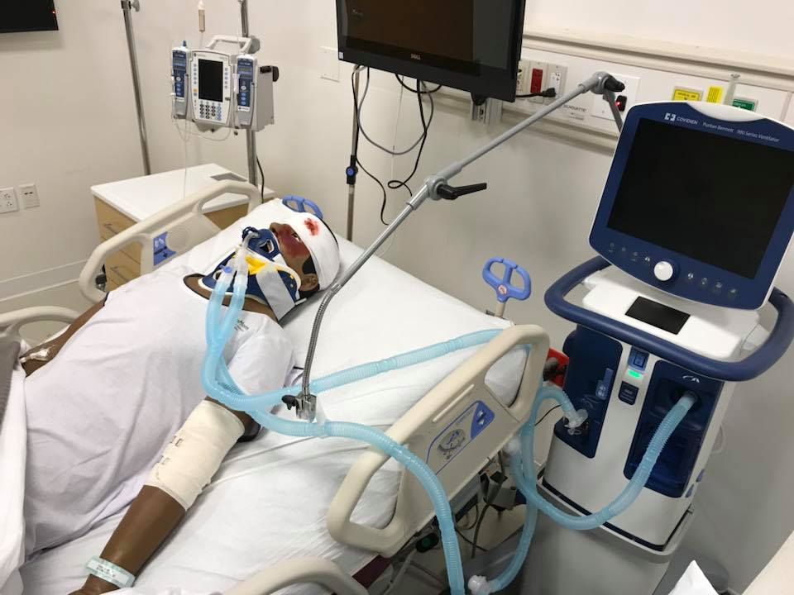
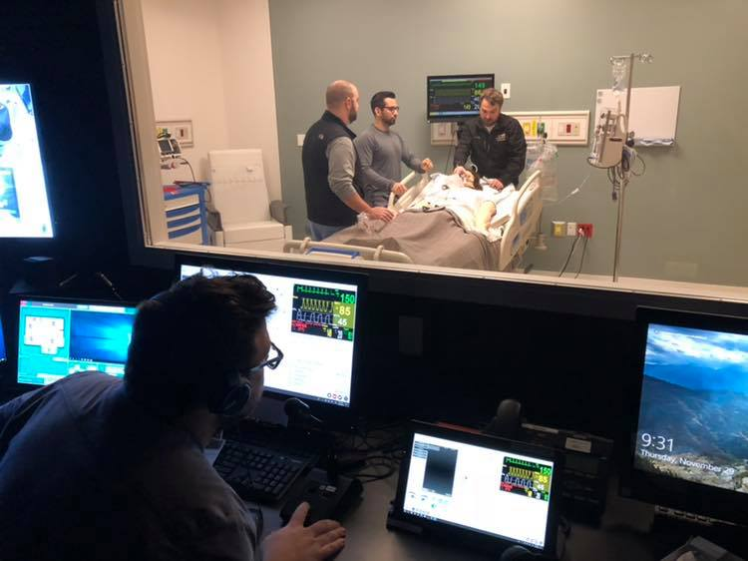
Teaching, Learning, Evaluating

Slide 24
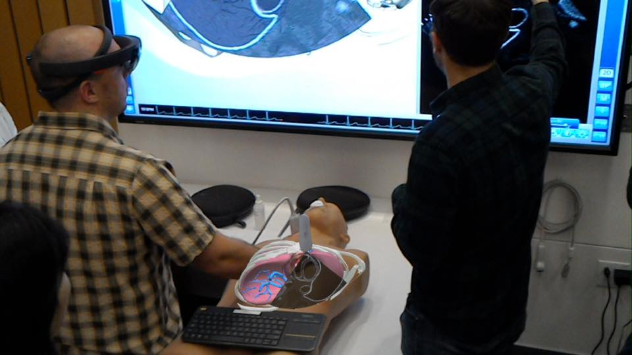
Ultrasound In M1

Slide 25
THANK YOU! QUESTIONS?

