Slide 1
2019-20
Advisory Board
Steve J. Schwab, MD
Chancellor

Slide 2
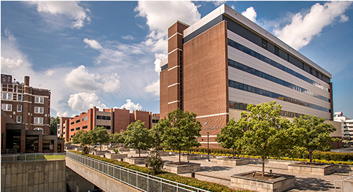
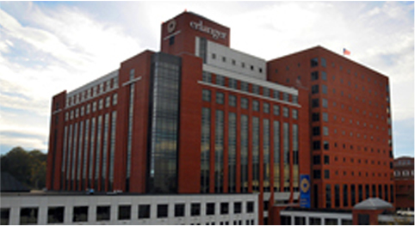
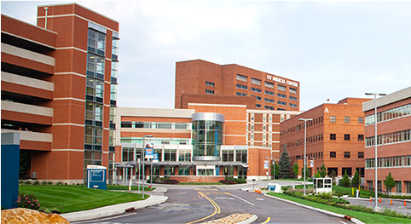
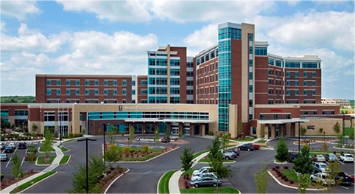
Major Locations
• Memphis • Chattanooga
Main campus; 6 colleges Colleges of Medicine and Dentistry
• Knoxville • Nashville
Colleges of Dentistry, Medicine, Colleges of Dentistry, Medicine, Health Professions (ASP), and Pharmacy and Pharmacy

Slide 3
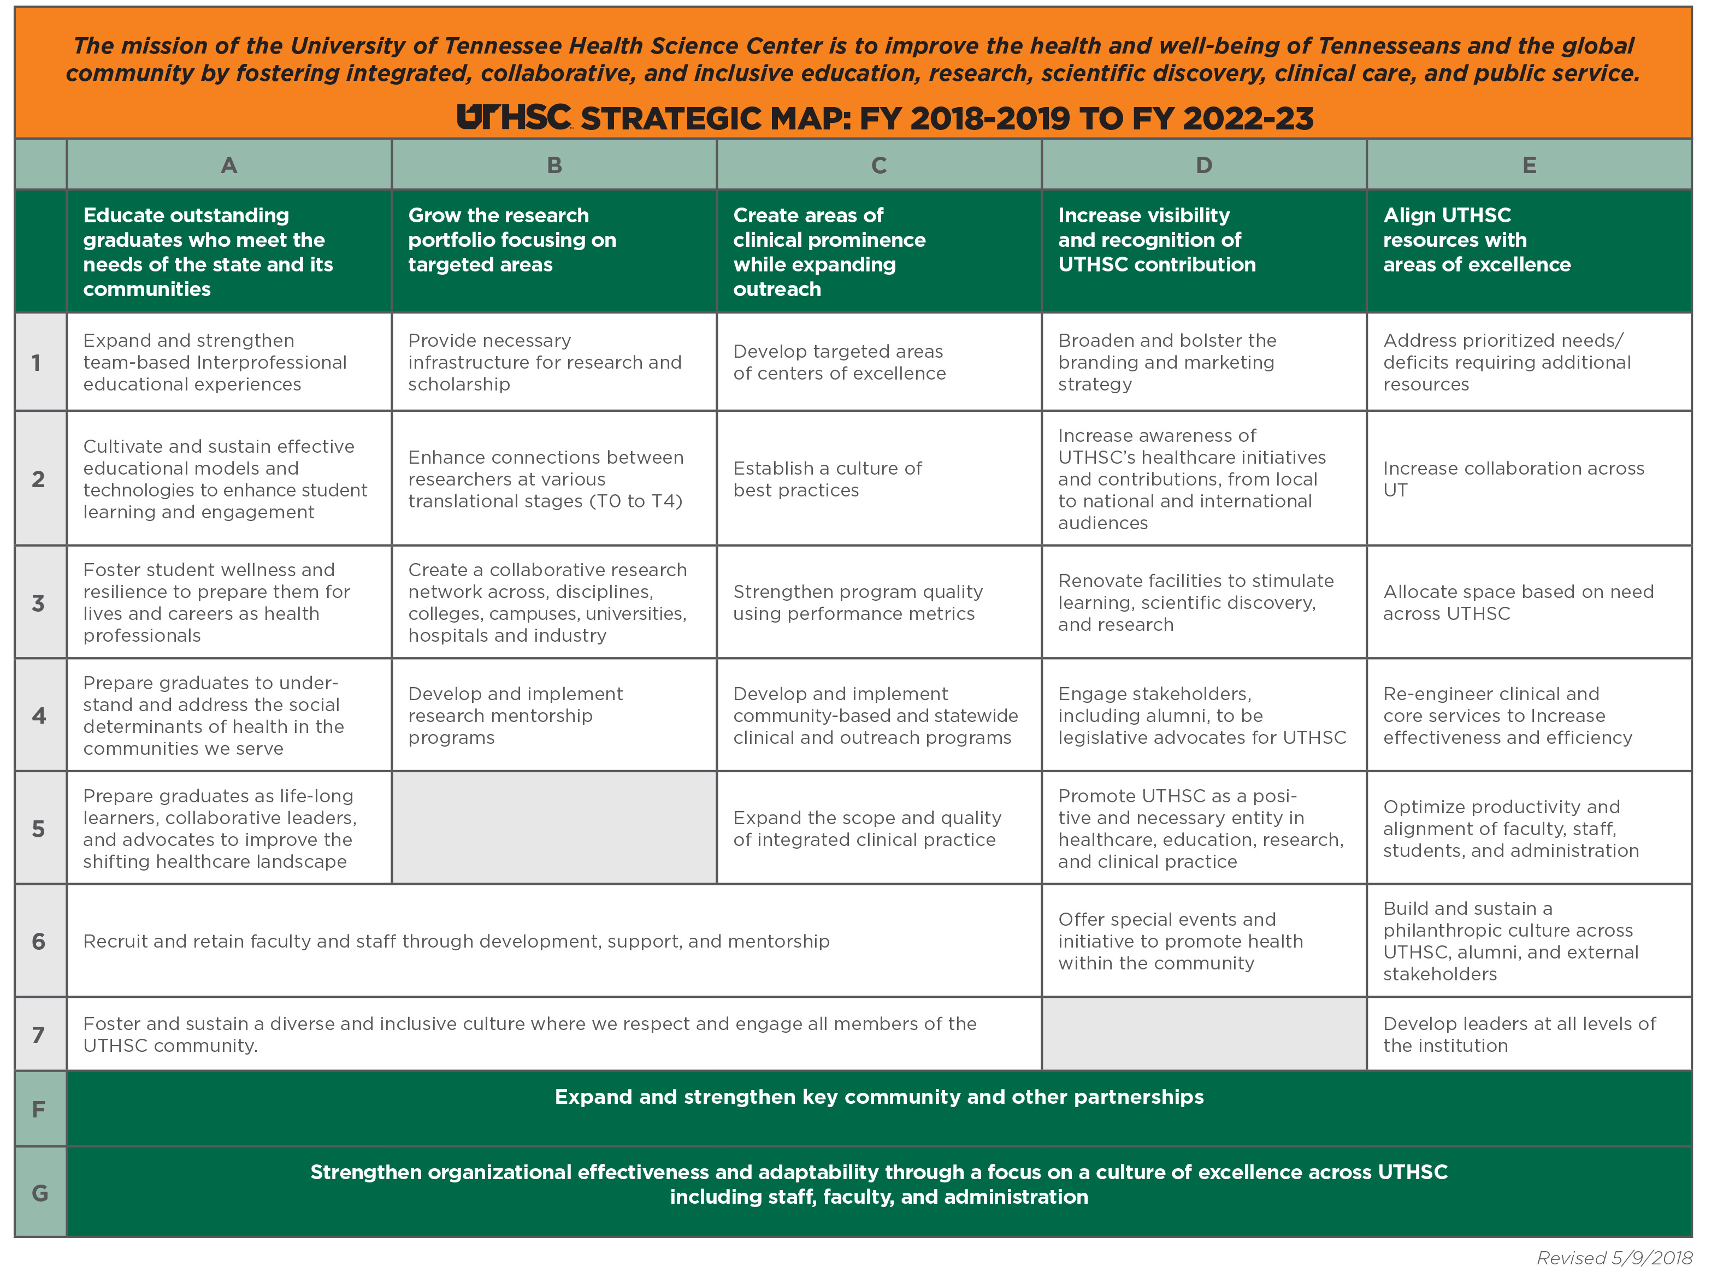

Slide 4
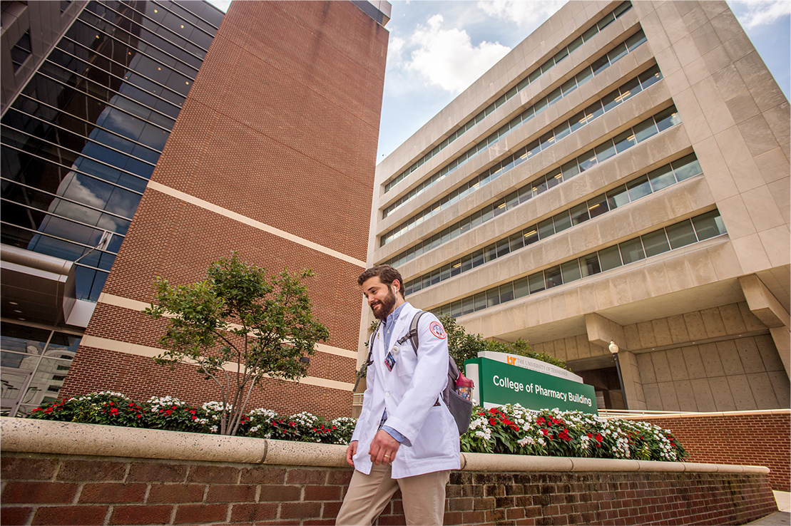
UTHSC Goal
• Become a top quartile academic health science center
• Metrics
- Education
- Clinical Care
- Research

Slide 5
CAMPUS DISTINCTIONS

Slide 6
CAMPUS DISTINCTIONS
UTHSC Records 2018-19
• Record revenue
- Record total revenue
- Record sponsored program revenue of $300 million
• Record graduates
- Awarded > 1,000 annual degrees
- Awarded > 400 specialty certificates
• Record research
- Annual research awards/expenditures exceed $100 million
• Record clinical activity
- $350-370 million

Slide 7
RESEARCH
Sponsored Program Expenditures

Slide 8
RESEARCH
Research Expenditures

Slide 9
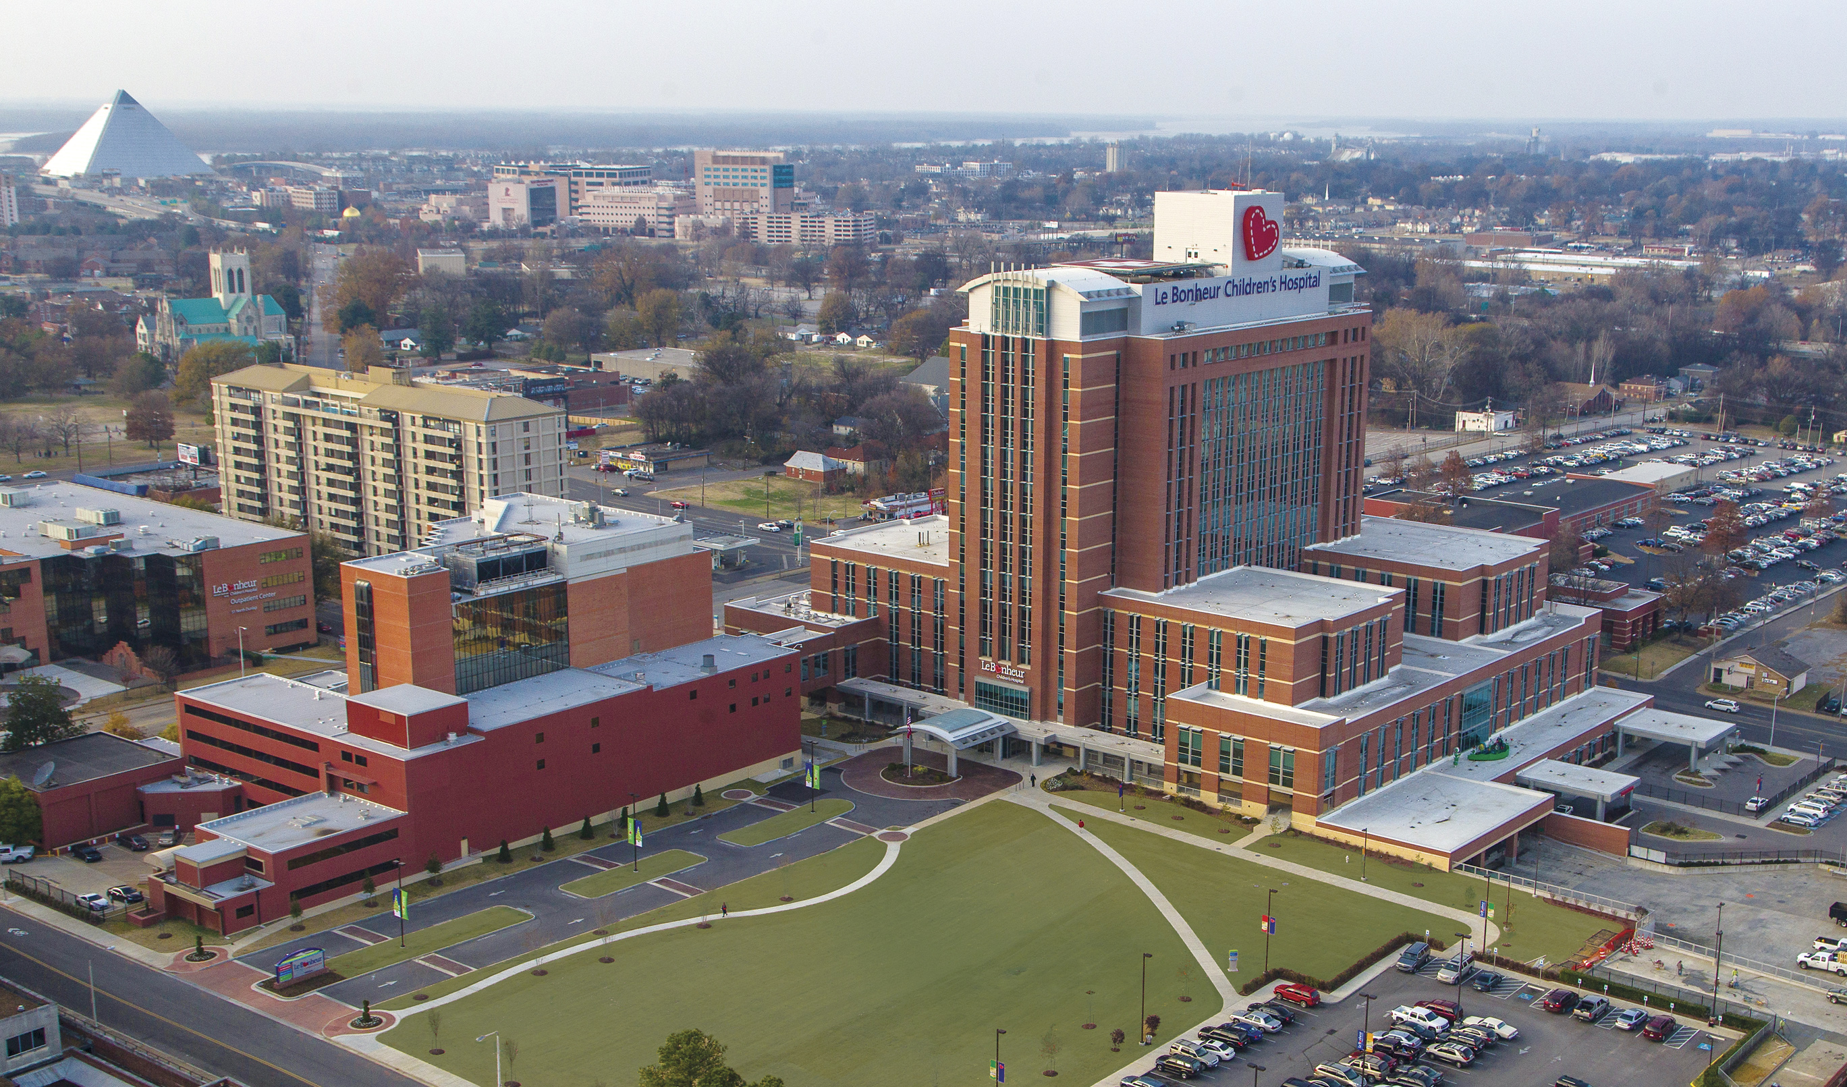
CAMPUS DISTINCTIONS
Le Bonheur Children’s Hospital: Nationally Ranked

Slide 10
CAMPUS DISTINCTIONS
UTHSC: Top Memphis Workplace, 6th Consecutive Year

Slide 11
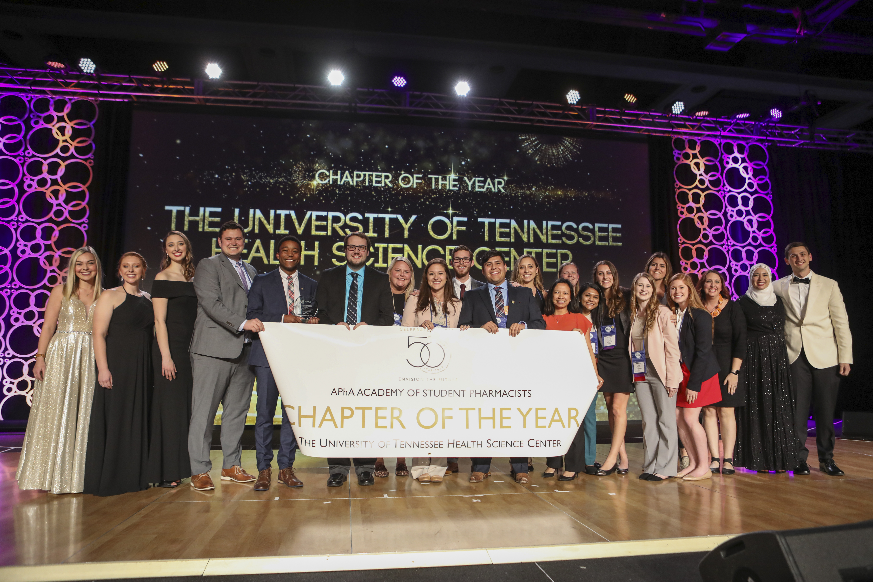
CAMPUS DISTINCTIONS
College of Pharmacy: Top 20 U.S. News & World Report

Slide 12
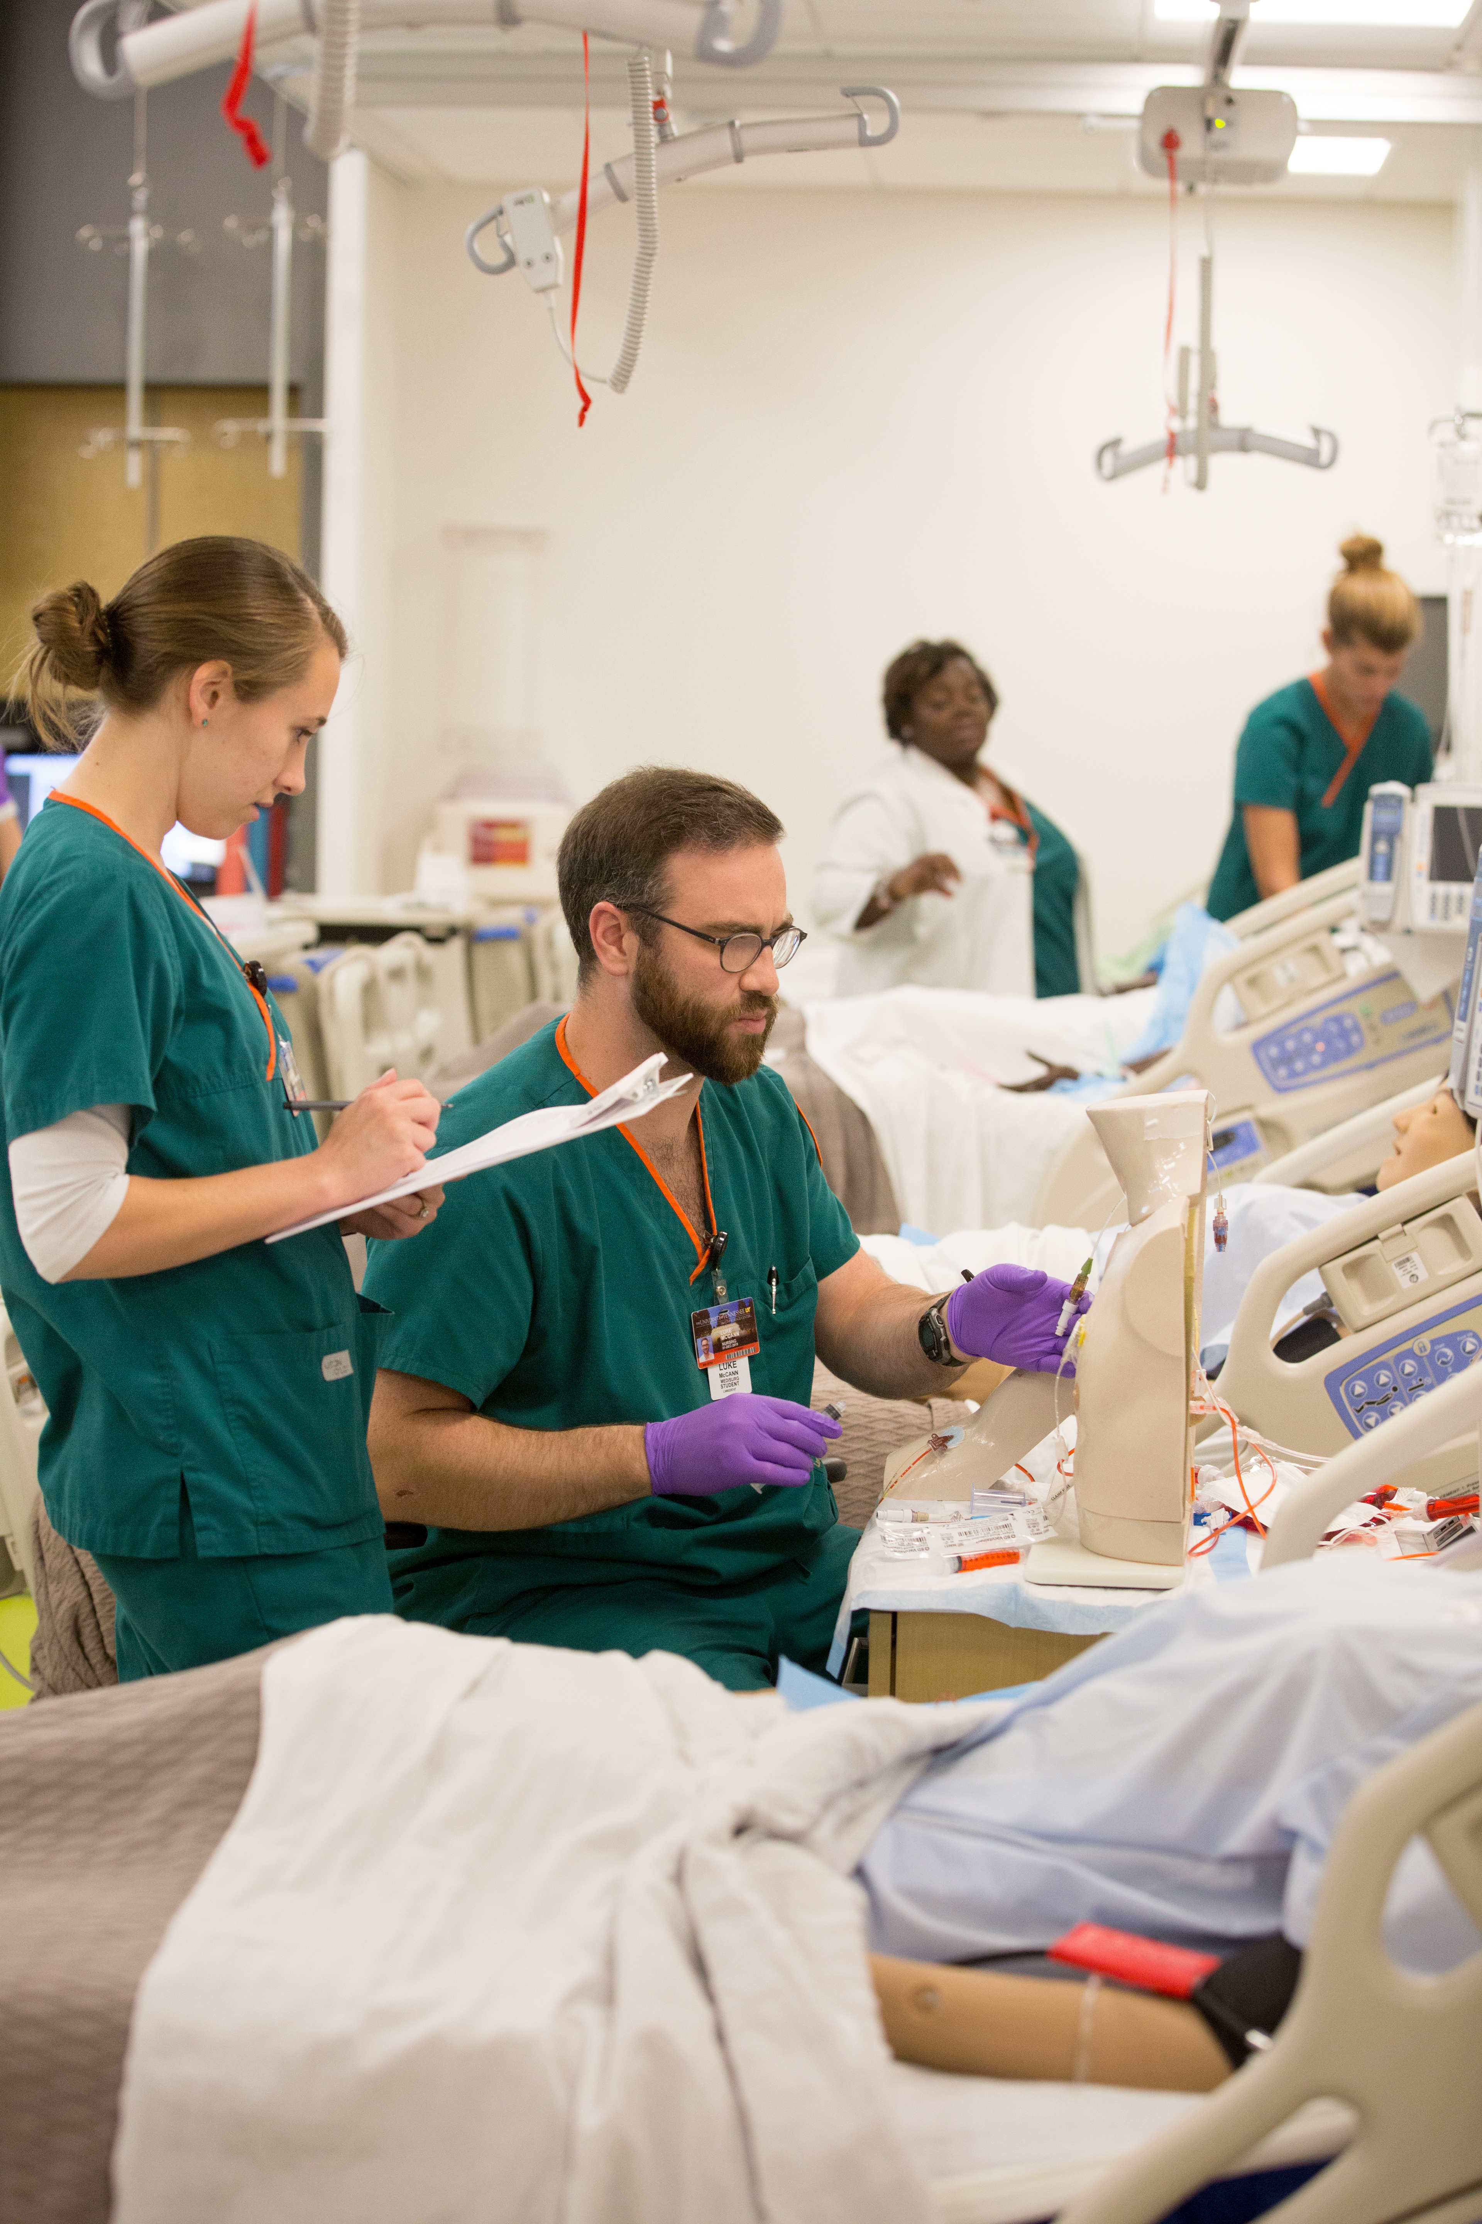
CAMPUS DISTINCTIONS
College of Nursing: Top 25 U.S. News & World Report

Slide 13
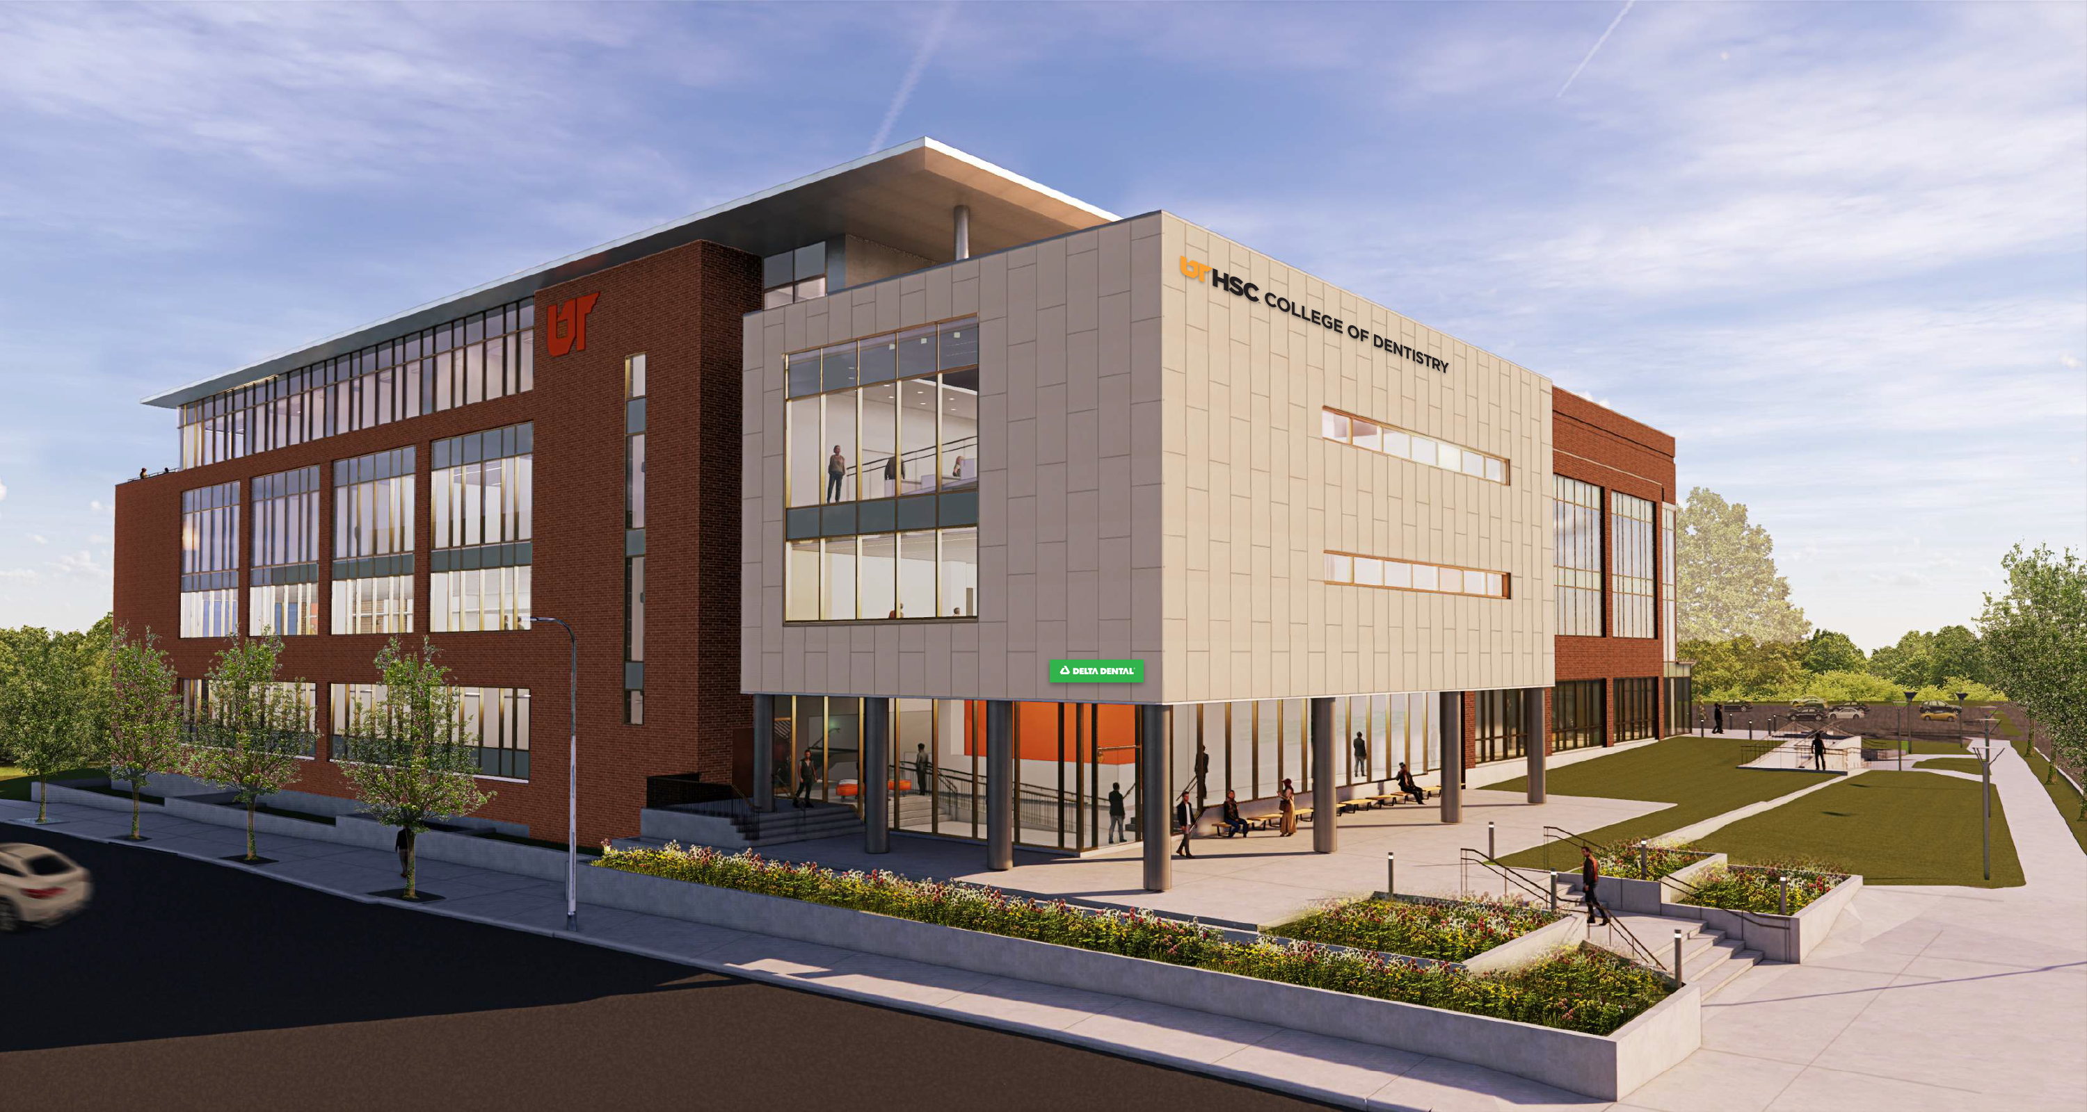
CAMPUS MASTER PLAN
College of Dentistry Building

Slide 14
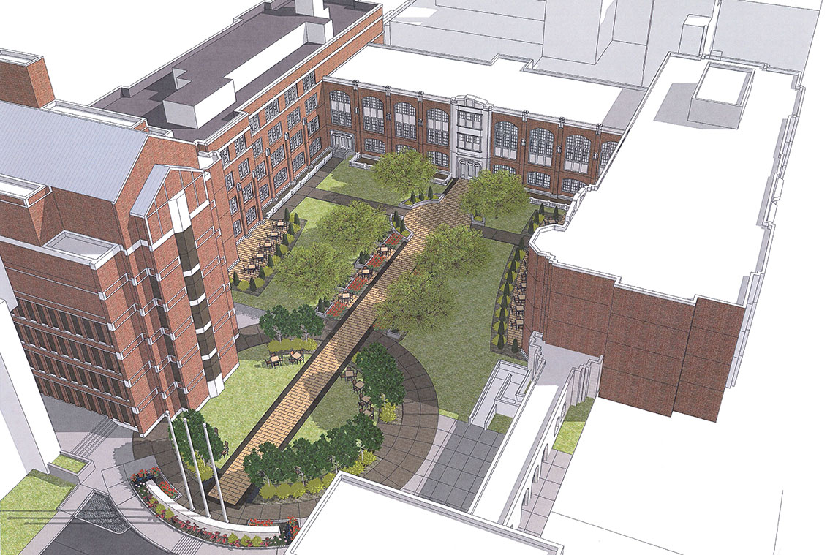
CAMPUS MASTER PLAN
Quadrangle Re-Build

Slide 15
NEXT YEAR

Slide 16
SUMMARY next year
• Education
- SACs reaccreditation site visit April 2020
- LCME site visit end of 2021

Slide 17
Challenges

Slide 18
Challenges next year
• State Budget
- Need Operational fund increases restored
Awaiting Governors Budget
-Tuition proposal
1. With operational funds minimal increase (Library cost coverage)
2. Without operational funds
3% Graduate degrees
2% undergrad degrees
College direct costs

Slide 19
Challenges next year
• UTHSC Legislative Agenda
1. Operational Funds
2. GME
3. Regenerative Medicine
4. Rural Dental Care

Slide 20
RESEARCH
Research Growth
• Grow clinical trials
- Capture credit for research UTHSC does – UTHSC faculty perform over $20 million (est) in clinical trials annually for hospital and private foundations with no credit to UTHSC
- Increase clinical trials on all campus locations
- Bind all 4 campuses together
• CTN2
- Operational
- Ten partners and growing

Slide 21
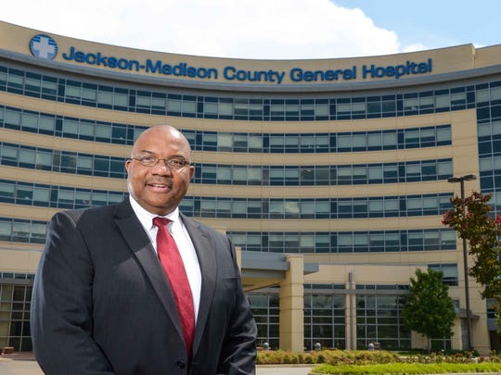
EDUCATION
West Tennessee Healthcare: Jackson-Madison County General Hospital

Slide 22
CLINICAL CARE
UTHSC Practices – Strategy of Alignment
• UT Medical Group 1974 – 2015
• UT Le Bonheur Pediatric Specialists 2011
• UT-West-Methodist Cancer Group 2012 – 2019
• UT Methodist Physicians 2013
• UT Regional One Physicians 2014
• University Clinical Health (UTMG) 2016
• UT Methodist Pathology 2018
• Erlanger (EMG-UT) 2019
• UT Surgical Associates (Chattanooga) 2020
• UT Jackson Family Medicine 2019 (first step)

Slide 24
NEXT YEAR
2019 – 2020 Goals
• Education
- Bring West Tennessee Healthcare into the core hospital consortium
- Expand St. Thomas partnership
- Complete SACS reaffirmation
• Clinical
- Create more nationally ranked Centers of Excellence
- Tighten relationship with partner core teaching hospitals
• Research
- Grow CTN2/ Launch MIRM
- UTHSC role in UT-ORNL Institute
- Seek more multi investigator center awards
- Expand relationship with the Memphis VA Medical Center

